Slide 1
Game Development Using HTML5 and JavaScript
Alok Mazumdar

Slide 2
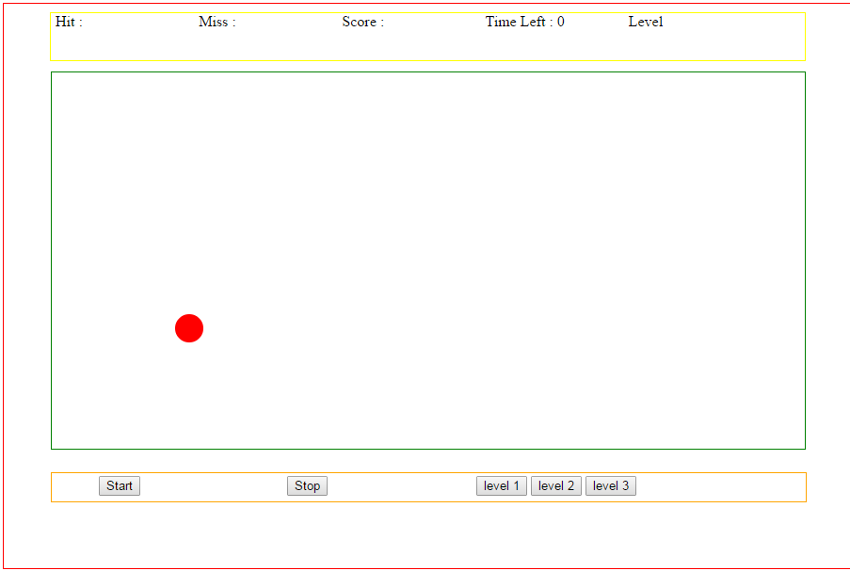
Game Development Using HTML5 and JavaScript
Prerequisites
1) JavaScript
2) Html
Game will look

Slide 3
Game Development Using HTML5 and JavaScript
What All Things Are Required to Develop Game
Learning Canvas in HTML5
1.1) How to draw shapes
1.2) How to animate shape using JavaScript
2) Working with event handling in JavaScript

Slide 4
Game Development Using HTML5 and JavaScript
Understanding Canvas in HTML5
1) Canvas is a Container or an area in webpage where we can draw shapes and animate them using JavaScript.
2) <canvas id="canvas" width="800px" height="400px"></canvas>
3)
<html>
<body>
<div class="wrapper">
<canvas id="canvas" width="400" height="300"></canvas>
</div>
</body>
</html>

Slide 5
Game Development Using HTML5 and JavaScript
How To Draw Shapes in Canvas
1) Getting the Canvas id
var canvas = document.getElementById("canvas");
2) Getting the 2D context of the Canvas
var ctx = canvas.getContext("2d");
3) Drawing shapes in Canvas
Drawing a line in Canvas
ctx.moveTo(0,0); // (x1,y1) ctx.lineTo(200,100);//(x2,y2) ctx.stroke();

Slide 6
Game Development Using HTML5 and JavaScript
How To Animate Shape in Canvas using JavaScript
Problem Statement: We will draw a ball and move it horizontally in the canvas
1) Drawing Ball in Canvas
We need to draw an arc to draw a ball
ctx.beginPath(); // to start drawing
ctx. arc(x, y, radius, startAngle, endAngle, counterClockwise); // arc
ctx.fillStyle = "#0095DD"; // giving color
ctx.fill(); // filling the color
ctx.closePath(); // closing the path , when the path begin

Slide 7
Game Development Using HTML5 and JavaScript
How To Animate Shape in Canvas using JavaScript
Problem Statement: We will draw a ball and move it horizontally in the canvas
2) Moving the ball horizontally in Canvas
To Move the ball we need to change the X , Y co-ordinates
Then we have to re-draw the ball every time with new co-ordinates which makes it to move horizontally
We will have a function call setTimeout we need to draw shape with new co-ordinates

Slide 8
Game Development Using HTML5 and JavaScript
How To Animate Shape in Canvas using JavaScript
Problem Statement: We will draw a ball and move it horizontally in the canvas
function drawBall(x,y) {
ctx.save(); // it saves the previous context
ctx.clearRect(x,y,canvaswidth,canvasheight); // clear aways the old shape
//drawing new shape
ctx.beginPath();
ctx.arc(x, y, 10, 0, Math.PI*2);
x=x+1; // increasing x co-ordinate by 1
ctx.fillStyle = "#0095DD";
ctx.fill();
ctx.restore(); // it restores the new shape draw
loopdraw=setTimeout('drawBall('+x+','+y+')',20); // recursive call to the function
}

Slide 9
Game Development Using HTML5 and JavaScript

