Slide 1
Introduction To JavaScript
ALOK MAZUMDAR

Slide 2
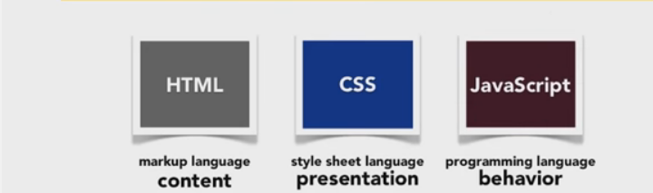
The Three Important Language Of Web
HTML : Its markup language which describes the content of webpage. How many paragraphs or div tags it has what are the contents of them etc
CSS : Its style sheet language which describes the presentation or layout of webpage. What is color of text, width of div tag,background color of div or body tag etc
JavaScript : Its programming language which describes the behaviour of webpage. What will happen when submit button is clicked, or a page is load or unload .

Slide 3
Why we need to learn javascript
Its most easiest language to start which does not requires any environment
2. Its one of the most highest paying programming langauge with avg salary of 91000$ per year
3. Its one of the most popular langauge ranking 7 in 2016 in Tiobe
4. Javascript is heart of web and all web applications
5. Javascript has got huge learning resources like w3schools,codeacademy
6 . If not any of the above , atleast to become rich one should learn javascript

Slide 4
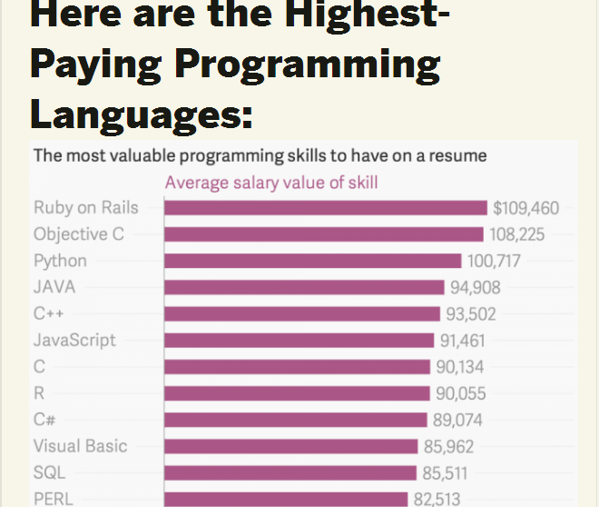
Highest Paying Programming Language

Slide 5
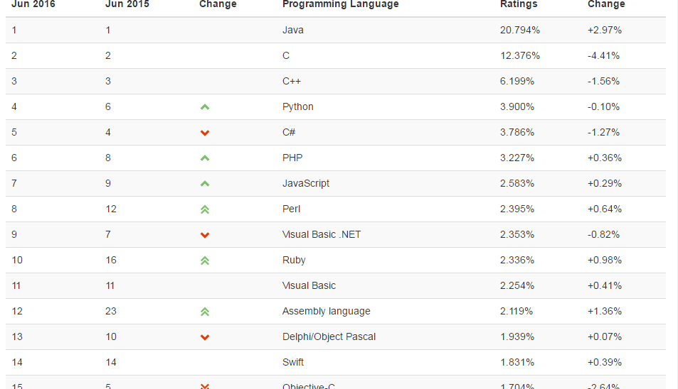
Most Popular Programming language 2016

Slide 6
What Is Javascript? What Does it Do?
What Is JavaScript By Defination?
It is a programming langauge. Also known as scripting langauge
2. It is client side scripting langauge that runs on different application that is the browser
What Is Client Side Scripting Language?
Web Browser
User Computer
Web Server
Web Pages
Web Browser
JavaScript
HTML
CSS
JAVASCRIPT

Slide 7
What Is Javascript? What Does it Do?
What JavaScript Do?
1 It makes webpage interactive
1 Form validation where user can give input
2 All events like onclick(for button),mouseover(for mouse event) etc
2. It is meant to manipulate webpages.
3 It makes exchange of data faster between client and server

Slide 8
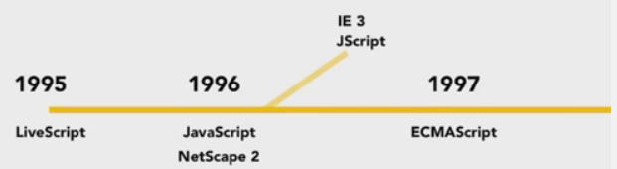
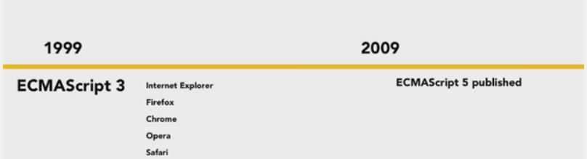
History Of JavaScript

Slide 9
Limitations Of Javascript
Cannot access database: It cannot access database directly without any server side script
2. Cannot write to files on server: It cannot write to file system directly without making any ajax call to server
3. Browser dependency: Different browser interprets javascript differently as they have different jaavscript engines.
4. Option to disable javascript: User can disable javascript in their browser which does not allow javascript to run

Slide 10
TOPICS TO BE COVERED
WHERE TO WRITE JAVASCRIPT
HOW TO START JAVASCRIPT
BASICS OF JAVASCRIPT
  VARIABLES, SCOPE , DECLARATION
  DATA TYPES
    UNDEFINED
    NULL TYPE
    BOOLEAN TYPE
    NUMBER TYPE
    STRING TYPE
    OBJECT TYPE
  OPERATION ON JAVASCRIPT
  CONDITION STATEMENT
  FUNCTIONS,DECLARATION,RULES,ARGUMENTS
  ARRAYS , JSON , DECLARATION
  OBJECT DECLARATION ,TYPES
DOM ,BOM ,JS FORM VALAIDATIONS

Slide 11
WHERE TO WRITE JAVASCRIPT
1 In the head section of the html page
2 In the body section of the html page
HOW TO START JAVASCRIPT
1 It has opening tag “<script>” and closing tag as “</script>” which marks javascript code.

Slide 12
BASICS OF JAVASCRIPT
  VARIABLES, SCOPE , DECLARATION
1.1 Variables are placeholders that holds value
1.2 Variables in ECMAScript can hold any kind of value , hence variables are loosely typed
1.3 Variables in ECMAScript by default that means when not initialized holds value “undefined”
1.4 Variables are declared as -> var x; and initialized as x=5;
1.5 Variables defined inside function with “var” keywords (var x=5) has scope only within function and cannot be used outside the function. If “var” is removed the variable acts as global variable

Slide 13
BASICS OF JAVASCRIPT CONTD..
  DATA TYPES
  There are total five data types(primitive data types) in ECMAScript and the fifth one is user defined data type that is the object data type
2. The “typeof” operator is used to determine the data type of the variable.
    1. UNDEFINED TYPE
1.1 Variable have undefined data type when variable is declared and not initialized.
1.2 Variable have undefined data type also when variable itself is not defined

Slide 14
BASICS OF JAVASCRIPT CONTD..
    2. NULL TYPE
2.1 It has got special value called “null”. Null is an empty object.
2.2 var x=null; (typeof x) will return an object
2.3 if(x==null) returns true if the value of x is null
2.4 As per as ECMAScript undefined is derivative of null hence , if(undefined==null) returns true
    3. BOOLEAN TYPE
3.1 It has got two value “true” or “false” and they are case sensitive
3.2 We can convert any value to its equivalent Boolean value by Boolean() function

Slide 15
BASICS OF JAVASCRIPT CONTD..
    3. BOOLEAN TYPE
Data type | Values converted to True | Values converted to False
Boolean | True | False
String | Non empty string | Empty string or “”
Number | Non zero number | 0,NAN
Object | Any object | Null
Undefined | n/a | n/a
3.3 var message=“hello js”;
var booleanMessage=Boolean(message); // now value is true

Slide 16
BASICS OF JAVASCRIPT CONTD..
    4. NUMBER TYPE
4.1 It has got mainly two literal format 1) integer 2) floating point
4.2 Integer can be represented as , var num=10;
4.3 Floating point can be represented as , var num=10.2;
4.4 Floating point takes twice as much memory as integer
4.5 Because of the above reason , ECMAScript does some automatic conversion to integer like , var num=10.0 is treated as 10 an integer value
4.6 Floating point can also be represented as e-notation for doing higher calculations .
4.7 var floatValue=3.725e7 is represented as 3.725 X 10(pow 7)

Slide 17
BASICS OF JAVASCRIPT CONTD..
    4. NUMBER TYPE
    NAN
4.8 A special numeric value which is known as “not a number”
4.9 Any operations involving NAN returns NAN
4.10 NAN is not equal to value including NAN , if(NAN==NAN) // returns false
4.11 ECMAScript provides a function called isNaN() which returns true if the value cannot be converted into a number else returns false
Operations | Output
isNaN(“10”) | False (can be converted to number)
isNaN(10) | False
isNaN(“true”) | True
isNaN(true) | False (can be converted to 1)

Slide 18
BASICS OF JAVASCRIPT CONTD..
    4. NUMBER TYPE
    NUMBER CONVERSIONS
4.12 There are three functions to convert non-numeric to numeric values
1) Number() : Number casting function , below is the conversion rules
Type of Operations | Output (Number())
When applied to Boolean | True and false get converted to 1 and 0 , Number(true) -> 1
When applied to Number | Number is simply returned ,Number(10) - > 10
When applied to Null | Returns 0 , Number(null) - > 0
When applied to undefined | Returns NAN
Case 1: When applied to string “1” ,”222”, “011” | Returns the numeric value ,Number(“222”) - > 222, Number(“011”) -> 11 (leading zeroes are ignored)
Case 2: When applied to floating point | Returns floating point value
Case 3: If string is empty | Returns 0

Slide 19
BASICS OF JAVASCRIPT CONTD..
    4. NUMBER TYPE
    NUMBER CONVERSIONS
2) parseInt()
2.1) This function is an better option when dealing with integers
2.2) It removes leading whitespaces during the conversions
2.3) It reads each occurrence and if found integer continues with the next else it stops and returns the integer value
2.4) parseInt(“1234alas”) // returns 1234 and ignores the rest
2.5) parseFloat() works in similar way

Slide 20
BASICS OF JAVASCRIPT CONTD..
    5. STRING TYPE
5.1 It consist series of characters , can be either single quote or double quote
5.2 Single quote must end with single quote and double with double
5.3 String index are zero based , starts with 0
5.4 Strings are immutable as per ECMAScript
    5.1 STRING CONVERSIONS
5.5 Every value can be converted to string using “toString()” method.
5.6 var intSalary=6000; var charSalary=intSalary.toString();

Slide 21
BASICS OF JAVASCRIPT CONTD..
    6. OBJECT TYPE
6.1 In ECMAScript objects are created using new operator and Objects are base from which all other objects are derived.
6.2 var o=new Object(); // creating object
6.3 Once the objects are created we can add properties and methods to them;
6.4 Adding properties to the object
o.name=“JS”;
o.country=“India” // {name,country} are called properties
6.5 Shorthand way of creating objects
var person={“name” : ”JS” , ”country” : “India”};
Each property are separated by comma and the final property end without comma

Slide 22
BASICS OF JAVASCRIPT CONTD..
  3. OPERATIONS ON JAVASCRIPT
3.1 In ECMAScript basic operations remain same as c language.
3.2 Unary operators like prefix and postfix operators
var age=26;
++age//prefix
age++//postfix
Prefix operator changes the value before the statement is read
Postfix changes the value after the statement is read.
3.3 Basic multiplicative operators(add,multiply,divide,modulus) are same , we wont be covering in this session.

Slide 23
BASICS OF JAVASCRIPT CONTD..
  4. CONDITION STATEMENT
4.1 In ECMAScript conditions flow remain same as c language.
4.2 If Statement.
if(condition)
statement
else
statement
Similarly if , else if condition flow remain same
4.3 for loop
for(initialization;condition;increment/decrement)
{
}
var i;
for(i=0;i<5;i++)
{
// statement
}

Slide 24
BASICS OF JAVASCRIPT CONTD..
  4. CONDITION STATEMENT
4.4 while loop // called entry control loop
while(condition)
{
// statement
// increment/decrement of condition
}
4.5 do while loop // called exit control loop
do
{
// statement
// increment/decrement of condition
} while(condition)

Slide 25
BASICS OF JAVASCRIPT CONTD..
  5. FUNCTIONS,DECLARATION,RULES,ARGUMENTS
5.1 Function is a block of code that does a specific job or task
5.2 function findSum(sum1,sum2)
{
return sum1+sum2;
}
5.3 Function is declared with keyword function(input parameters does not need any specific data type)
5.4 Another way of declaring function
var sumValue=function (sum1,sum2)
{
return sum1+sum2;
};
// how to invoke the above
sumValue(10,20);

Slide 26
BASICS OF JAVASCRIPT CONTD..
  5. FUNCTIONS,DECLARATION,RULES,ARGUMENTS
5.5 Functions are object which function names are simply pointers to function object
5.6 function sumValue(sum1,sum2)
{
return sum1+sum2;
}
1) sum(10,20) // 30
2) var anotherSum=sum;
3)anotherSum(10,20)// 30
4)sum=null;
5)anotherSum(10,20) // 30 it still shows because it was holding the reference
5.7 Function overloading is not allowed in ECMAScript , the last function replaces all before

Slide 27
BASICS OF JAVASCRIPT CONTD..
  5. FUNCTIONS,DECLARATION,RULES,ARGUMENTS
  FUNCTIONS DECLARATION VS FUNCTIONS INITIALIZATION
5.8 alert(sum(10,20));
function sum(sum1,sum2)
{
return sum1+sum2;
}
// above example will display 30 , as function declarations are read and added to the context before execution line(alert) begins running
5.9 alert(sum(10,20));
var sum=function (sum1,sum2)
{
return sum1+sum2;
}
// above will show error because function is being initialized and was not part of declaration

Slide 28
BASICS OF JAVASCRIPT CONTD..
  6. ARRAYS
6.1 Arrays are special variable that can store multiple values
6.2 Creating arrays using literals
var fruits=[“orange”, ”apple”, ”mango”]; // valid
var distinctSet=[“orange”, 1, 2, “lemon”]; // valid
6.3 In ECMAScript arrays can store different type of values such as position 1 can have string , position 2 can have numeric
6.4 Creating arrays using object notation
var fruits=new Array(“orange”, ”apple”, ”mango”); // creating array object using constructor
  6. 1 Property of arrays
6.5 Length is one of most important property that gives the size of the array and number of items it has or it can hold

Slide 29
BASICS OF JAVASCRIPT CONTD..
  6. ARRAYS
  6. 1 Property of Arrays
6.6 var animals=[“cat”,”dog”,”lion”]; // animals.length= 3
var fruits={} // length 0
6.7 var colors=[“red”, ”orange”, “green”];
colors[2] // gives green with length 3
6.8 change the size of array using length property
colors.length=2;
colors[2] // it shows undefined
6.9 Similary you can add or remove the size using length property of array
  6. 2 Arrays as Stack and Queue
6.10 Stack is datastructure that stores data in LIFO order , eg piles of book

Slide 30
BASICS OF JAVASCRIPT CONTD..
  6. ARRAYS
  6. 2 Arrays as Stack
6.11 It has got two important function
1) Push : That inserts data
2) Pop : That removes data from top.
6.12 var colors=[“red” , “ green” , “blue”] // length 3
blue
green
red
black
blue
green
red
6.13 colors.push(“black”); // length 4
blue
green
red
6.14 colors.pop();

Slide 31
BASICS OF JAVASCRIPT CONTD..
  6. ARRAYS
  6.2 Arrays as Queue
6.15 It stores data in FIFO order , eg queue of people at ticket counter
6.16 It has got two important function
1) Push : That inserts data at rear end (ex people stands at rear)
2) Shift : That removes data from front. (ex people standing front gets ticket first)
6.17 var colors=[“red” , “ green” , “blue”] // length 3
6.18 colors.shift(); // removes red from front length 2
  6.3 Methods on Arrays
6.19 colors.reverse() // reverse the array
6.20 colors.sort() // sorts in case of string sorting is based on ASCII value

Slide 32
BASICS OF JAVASCRIPT CONTD..
  7. OBJECT DECLARATION ,TYPES
7.1 Almost everything in ECMAScript is an object , except primitive types.
7.2 Objects are heart of ECMAScript if you understand objects you understand ECMAScript. Hence also called as Object Based Programming Language
7.3 Objects in ECMAScript are named value pairs. There mainly three way to create objects in ECMAScript
7.4 Ways to create object
1) Using new keyword
2) Using object literals
3) Using different Object Creation pattern
3.1) Using Factory Pattern
3.2) Using Constructor Pattern
3.3) Using Prototype Pattern (* very Imp)

Slide 33
BASICS OF JAVASCRIPT CONTD..
  7. OBJECT DECLARATION ,TYPES
7.5) Create Object using new keyword
7.6) var person=new Object();
person.name='Mathews';
person.age='26' ;
person.salary='96000';
person.gender='male';
7.7) Downside of the above approach is creating multiple objects with same interface
7.8) Create Object using object literals
7.9) var person=
{
    'name':'Mathews',
    'age':'26',
    'salary':'96000' ,
    'gender':'male'
}; // key value pairs

Slide 34
BASICS OF JAVASCRIPT CONTD..
  7. OBJECT DECLARATION ,TYPES
7.10) Create Object using Factory Pattern
7.11) Its common design pattern that abstract away the process of creating object
7.12) function createPerson(age,name,salary,gender)
{
var person=new Object();
person.name=name;
person.age=age;
person.salary=salary;
person.gender=gender;
return person;
}// this function sole job is create object and return them
7.13) var person1=createPerson('26,'mathews','96000','male'); // call the function which return new object
7.14) In the above approach we are just passing values , we do not know how the objects are being created.

Slide 35
BASICS OF JAVASCRIPT CONTD..
  7. OBJECT DECLARATION ,TYPES
7.15) Create Object using Constructor Pattern
7.16) function Person(age,name,salary,gender)
{
this.name=name;
this.age=age;
this.salary=salary;
this.gender=gender;
}// this keywords represents current context
7.17) var person1=new Person('26,'mathews','96000','male'); // call the constructor
7.18) The difference between both the patterns are in factory each time we are creating object inside the function and returning the object which is not in constructor pattern

Slide 36
BASICS OF JAVASCRIPT CONTD..
  7. OBJECT DECLARATION ,TYPES
Problems with Constructor Design Pattern for Object Creation
7.20) function Person(age,name,gender)
{
this.name=name;
this.age=age;
this.gender=gender;
this.sayHello=function()
{
alert(“ Hello “ + name);
};
}// this keywords represents current context
7.21) var person1=new Person('26, 'mathews', 'male'); // call the constructor
7.22) var person2=new Person('23, 'flora',' female'); // call the constructor

Slide 37
BASICS OF JAVASCRIPT CONTD..
  7. OBJECT DECLARATION ,TYPES
Problems with Constructor Design Pattern for Object Creation
7.23) The problem is each instance of Person get its own copy of function to display name
person1
person2
name
age
gender
sayHello
name
age
gender
sayHello
7.24) Now it does not make sense to have two instance of function that does same work. Each object is duplicating the same function.

Slide 38
BASICS OF JAVASCRIPT CONTD..
  7. OBJECT DECLARATION ,TYPES
Solution for the problem of Constructor Design Pattern
7.25) Now the solution is make that function outside of the constructor. Each object will hold reference to that outside function .Hence we need to make change in one common that is the outside function.
person1
name
age
gender
sayHello
person2
name
age
gender
sayHello
sayHello
function object

Slide 39
BASICS OF JAVASCRIPT CONTD..
  7. OBJECT DECLARATION ,TYPES
Solution for the problem of Constructor Design Pattern
7.26) function Person(age,name,gender)
{
this.name=name;
this.age=age;
this.gender=gender;
this.sayHello=sayHello; // holds the reference of outer function
}
function sayHello()
{
alert(“ Hello “ + this.name);
}

Slide 40
BASICS OF JAVASCRIPT CONTD..
  7. OBJECT DECLARATION ,TYPES
7.27) Create Object using Prototype Pattern
7.28) Each object has some default properties and one of those properties is prototype.
7.29) Similarly each function in ECMAScript is just an object it also has prototype property
7.30) function Person()
{
}
Person.prototype.name=”Alok”; // this properties belong to prototype
Person.prototype.age=”26”;
Person.prototype.gender=”male”;
Person.prototype.sayHello=function()
{
alert(“ Hello “ + this.name);
};
7.31) var person1=new Person();
person1.sayHello(); // Hello Alok

Slide 41
BASICS OF JAVASCRIPT CONTD..
  7. OBJECT DECLARATION ,TYPES
How Prototype Works
Person
Person Prototype
name
age
gender
sayHello
second check
Person1
first check
7.32) person1=new Person();
person1.name;//Alok
How the search works first it will check Person object if the property is availabe or not , if yes fine , if not then search begins in its prototype.

Slide 42
STRING METHODS AND PROPERTIES
1) To find length of String, var name=”Brendan Eich”; // name.length 12
length is string property not method
2) To find a String inside other String
var newName=”Hello JS How are you”;
var find=”How”;
var indexPos=newName.indexOf(find); // 9 first occurence of the find
var searchValue=newName.search(find); // 9 is same as indexOf but used mainly in regular expressions
3) To Extract part of String from other String
1)slice(): which takes two parameters , start and end position , can also take negative index which means start from end of string
2)substring(): Similar to slice but cannot take negative index.
4) indexOf,search,slice are methods of string not properties

Slide 43
BASICS OF JAVASCRIPT CONTD..
  7. OBJECT DECLARATION ,TYPES
7.33) function Person()
{
}
Person.prototype.name=”Alok”; // this properties belong to prototype
Person.prototype.age=”26”;
Person.prototype.gender=”male”;
Person.prototype.sayHello=function()
{
alert(“ Hello “ + this.name);
};
7.34) var person1=new Person();
var person2=new Person(); // both of them are sharing comon prototype
7.35) alert(person2.name) // Alok
person1.name=”Charles”;
alert(person1.name)// Charles, it overrides the property of its prototype

Slide 44
DOCUMENT OBJECT MODEL(DOM)
1) When the page loads the browser creates DOM tree of that page
DOM
Windows
Core
Html
Xml
Location
Document
Navigator
History
Core DOM
Anchor tags
Forms
Links
Input fields
Radio buttons
Text area
Checkbox
Submit buttons

Slide 45
DOCUMENT OBJECT MODEL(DOM)
What DOM allows us to do
1 It allows to change elements and attibutes of web page
2 It allows to change and update css of the web page
3 It reacts to all HTML events
4 It can add and delete html elements which is know as manipulating web page
Document
<html>
<head>
<title>Welcome JS DOM</title>
</head>
<body>
<h3>hello header</h3>
<p id="para">hello world</p>
<div id="mydiv">first DIV</div>
</body>
</html>
Html
DOM
Html
Head
Body
title
h3
div
p

Slide 46

RESOURCES
BOOKS
1) Professional JavaScript for Web Developers
2) Beautiful Parts of JavaScript
3) Definite Guide to JavaScripts
ONLINE
1) http://www.w3schools.com/js/
2) http://javascriptissexy.com/
3) https://www.codecademy.com/learn/javascript

Slide 47
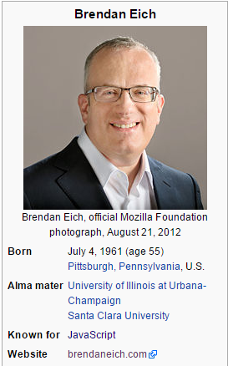
VOTE OF THANKS TO BRENDAN EICH
Brendan Eich (/ˈaɪk/; born 1961)[1] is an American technologist and creator of the JavaScript programming language. He co-founded the Mozilla project,[2] the Mozilla Foundation and the Mozilla Corporation, and served as the Mozilla Corporation's chief technical officer and briefly its chief executive officer.[3] He is the CEO of Brave Software.[4]

