Slide 1
Optimal Traffic Light Signaling Based on Genetic Algorithm Approach
By: Alok 58090001
Sajeerat 58090036
Tan Tianyu 58090002

Slide 2
Overview
Introduction
Revised approach
Data collection
Traffic simulation framework
Future work

Slide 3
Introduction
Genetic algorithms can be used to optimize traffic very efficiently.
However, the computational complexity of traffic simulation prevents this approach from being practical.

Slide 4
Revised approach
Use two genetic algorithms instead of one.
GA1 focuses on optimizing traffic over long period of time.
GA2 attempts to adapt current traffic to long term strategy devised by GA1.

Slide 5
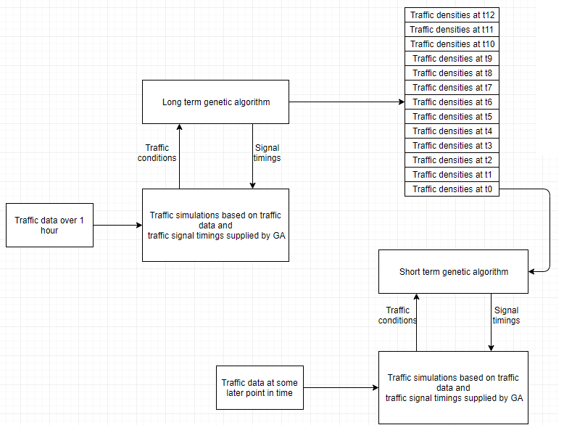

Slide 6
Data collection
Required information: traffic flow at intersections over time
Process:
Find average travel speed and density over time at roads connected to intersections
Calculate ratio of cars going to each road connected to an intersection

Slide 7
Traffic simulation Framework
TSF model extends NaSch model and makes possible simulation on a real city network.
Distinguishable cars with origin and destination
Differing behavior of cars and road conditions
Simulation rules also take into account crossroads, traffic lights and overtaking.

Slide 8
Experiments
Experiment parameters
Time step duration
Number of time steps
Fitness function of GA1
Area whose traffic signals are optimized
Area used to calculate fitness

Slide 9
Future work
Learn the API for using Traffic simulation framework.
Reselect region to be optimized in Warsaw.
Gather traffic data from Warsaw.
Implement genetic algorithms.

