Slide 1
Optimal Traffic Light Signaling Based on Genetic Algorithm Approach
By: Alok 58090001
Sajeerat 58090036
Tan Tianyu 58090002

Slide 2
Overview
Introduction
Literature review
Proposed method
Current progress
Future work

Slide 3
Introduction
Methods of traffic optimization:
Optimizing signal timings
Improving infrastructure
Guiding drivers to reduce congestion
Genetic algorithms can be used to optimize traffic very efficiently.

Slide 4
Literature review
[1] Chen, S.W., Yang, C.B., Peng, Y.H.: Algorithms for the Traffic Light Setting Problem on the Graph Model. In: Proc. of the 12th Conference on Artificial Intelligence and Applications, TAAI (2007)
[2] Gora P., “A genetic algorithm approach to optimization of vehicular traffic in cities by means of configuring traffic signals”, in “Emergent Intelligent Technologies in the Industry”, 2011, pp. 1-10, ISBN: 978-3-642-22731-8.
[3] P. Gora and P. W. Pardel, "Application of Genetic Algorithms and High-Performance Computing to the Traffic Signal Setting Problem", 2015.

Slide 5
Literature review
Research [1] tested the performance of different algorithms on traffic optimization. The results showed that genetic algorithms give best results when optimizing traffic.
Based on our discussions with a field expert (Pawel Gora), genetic algorithms are the best way of optimizing traffic.

Slide 6
Literature review
In research [2] genetic algorithm with 9 generations was used to optimize traffic signals over a period of 10 min
In research [3] genetic algorithm with 50 generations was used to optimize traffic signals in Warsaw over a period of 10 min

Slide 7
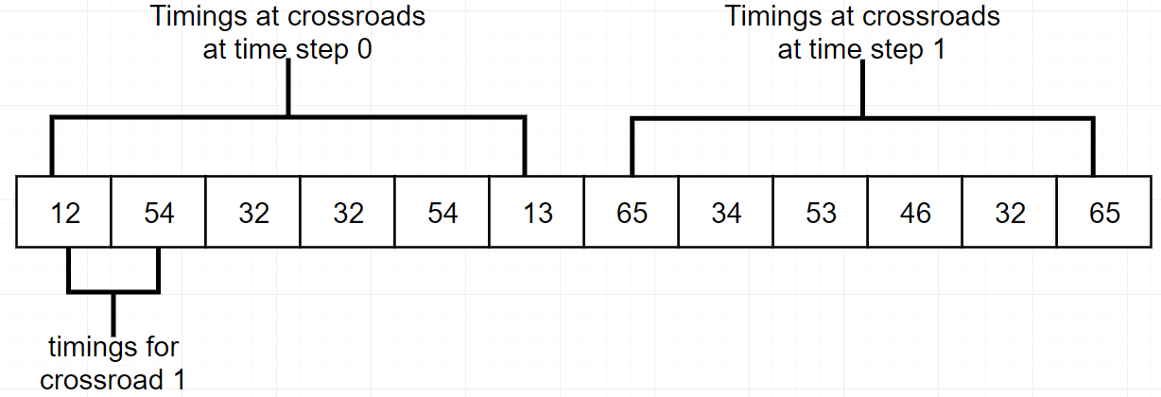
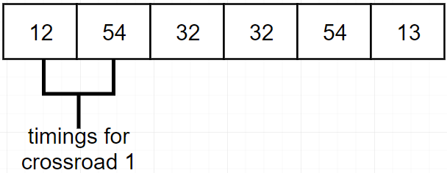
Proposed method
Optimize the sequence of traffic signals over a long period of time
Figure 1: sequence of timings for a 3
crossroad network in our proposed method
Figure 2: timings for a 3 crossroad
network in prior research

Slide 8
Proposed method
The problem with the proposal is the high computational complexity of numerous repeated simulations.
Due to this issue, prior research has yielded limited results.

Slide 9
Proposed method
We can get around this problem using the following modifications:
Optimize traffic over a long period of time and use the solution obtained to generate solutions for later periods of similar congestion
Optimize traffic over a long period of time and for later similar congestions, change the genetic algorithm to try to mimic the optimal density points at small intervals obtained from the first

Slide 10
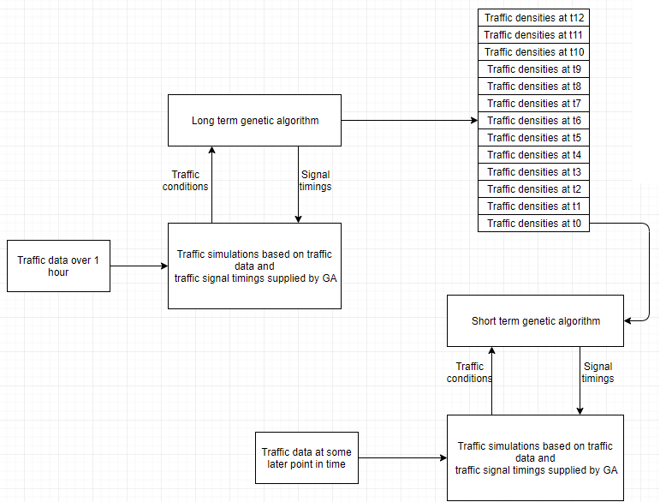

Slide 11
Current progress
Implemented scripts to gather traffic data from tomtom traffic API.
Implemented the genetic algorithms
Obtained Traffic Simulation Framework which was used in researches … and …
Parallelized the simulation requests to speed up computation

Slide 12
Future work
Implement a GUI to display the changing traffic conditions
Identify the degree by which traffic conditions vary to replicate it in the simulations
Alter the simulation based on traffic data, both for initialization and real time modifications.

