Slide 1
Don Bosco Institute of Technology
Department of Information Technology
Project:Irrigation System for Plants
Class:TE-IT
Group Members:
Alok Pandey 55
Nishant Nimbalkar 51
Pawankumar Maurya 43

Slide 2
Outline
Introduction
Problem Statement
Scope
Block Diagram
Circuit Diagram
Description
Hardware Requirement
Budget
Software Requirement
Conclusion

Slide 3
Introduction
According to the Researchers at the University of Georgia and University of Maine, plants need much less water than most people think.
Whenever we go out of town for few days, we worry about our plants as they need water on regular basis or have to rely on neighbours.

Slide 4
Problem Statement
While watering the plants people give inappropriate amount of water.
If a plant's soil has too much water, the roots can rot, and the plant can't get enough oxygen from the soil. If there is not enough water for a plant, the nutrients it needs cannot travel through the plant.

Slide 5
Scope
Temperature is important and potentially limiting factor. Air temperatures below 4 degree C causes tissue damage in most plants, and optimal photosynthesis is not possible for most plants below 15.5 degree C or above 32.2222 degrees F.
Temperature Sensor will be installed to water plants on thermal data.
Time Based System will be used to plant water on the initialized time by the user.

Slide 6
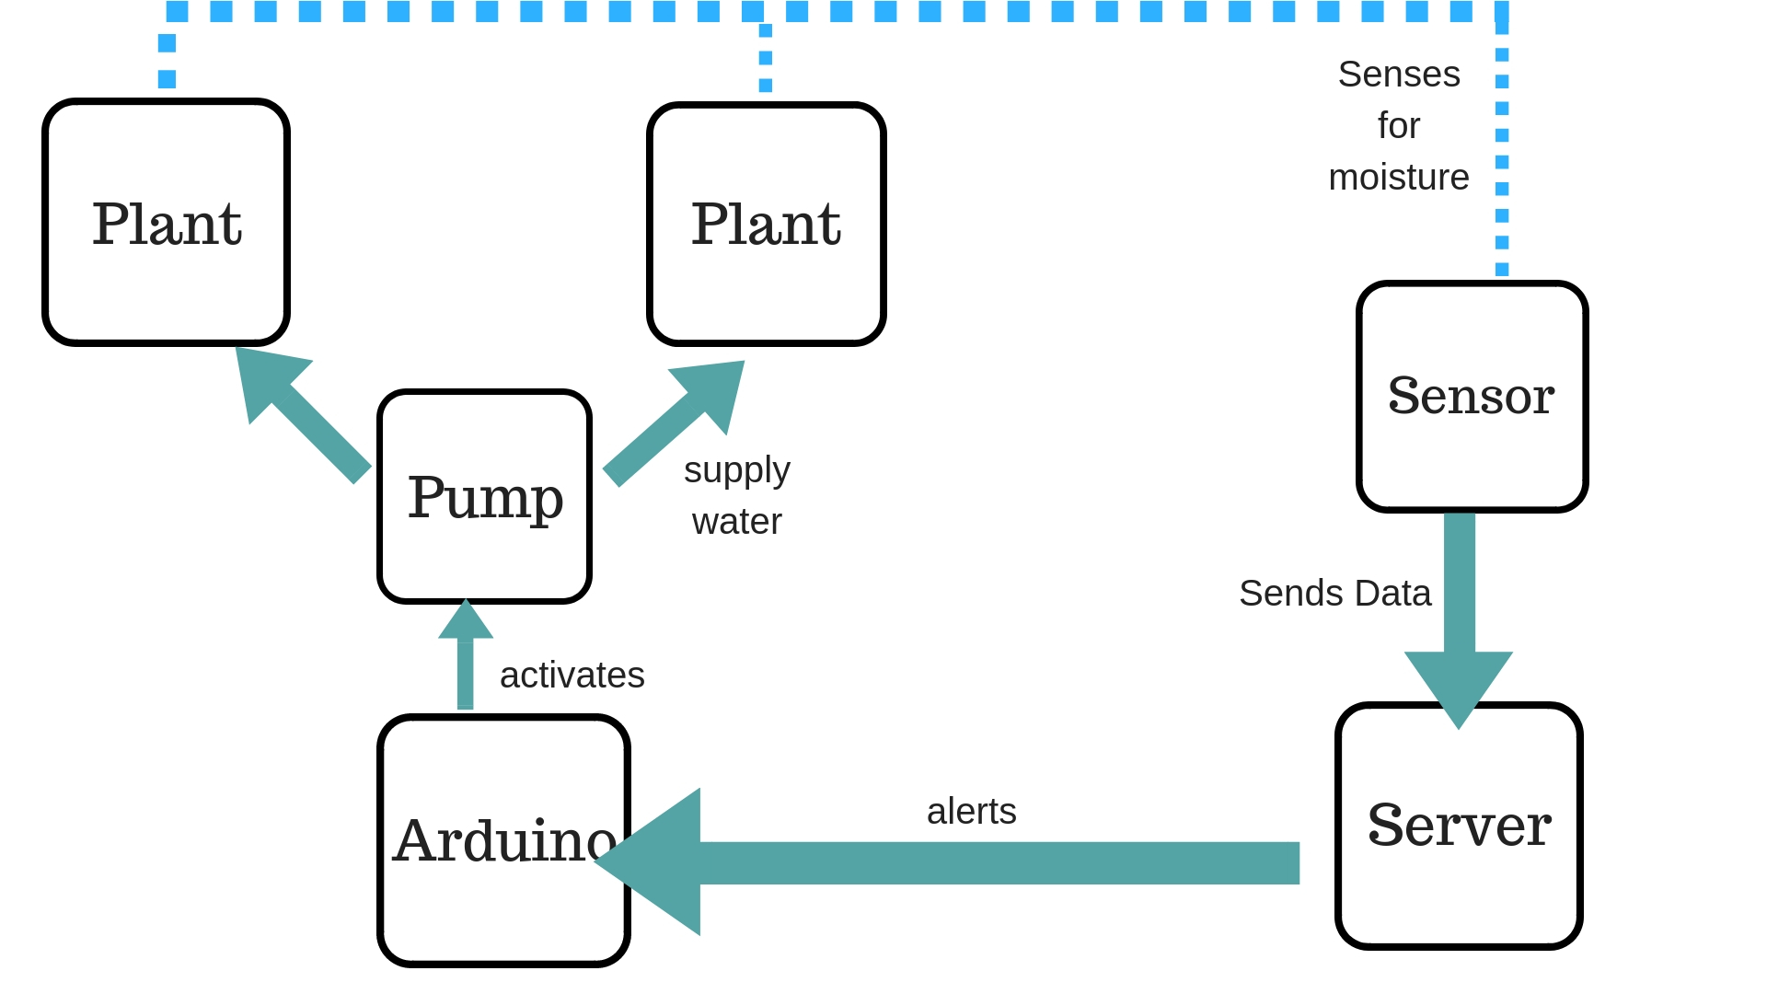
Block Diagram

Slide 7
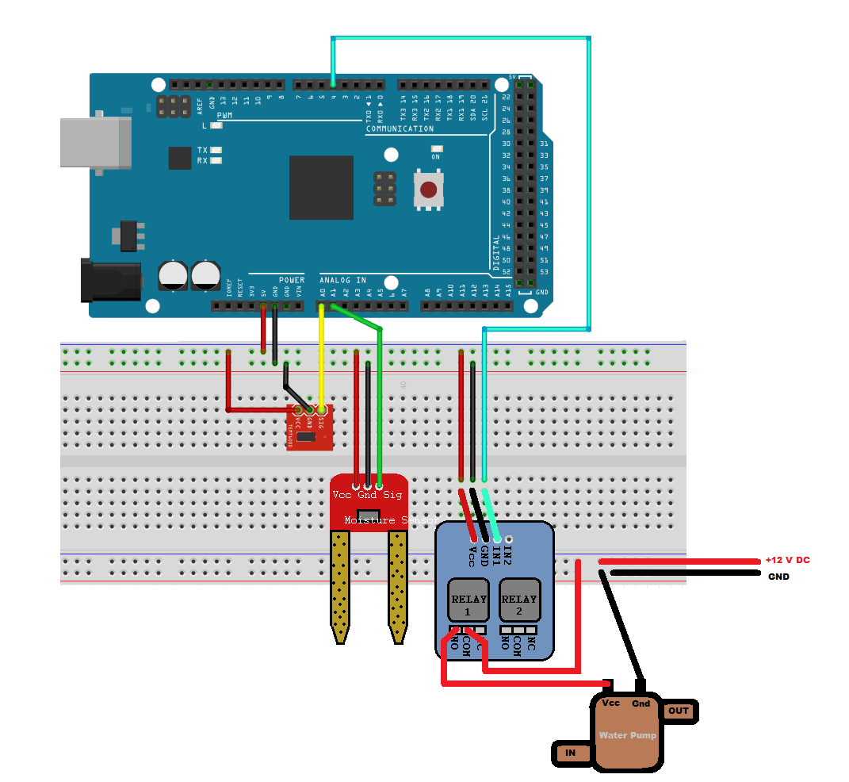
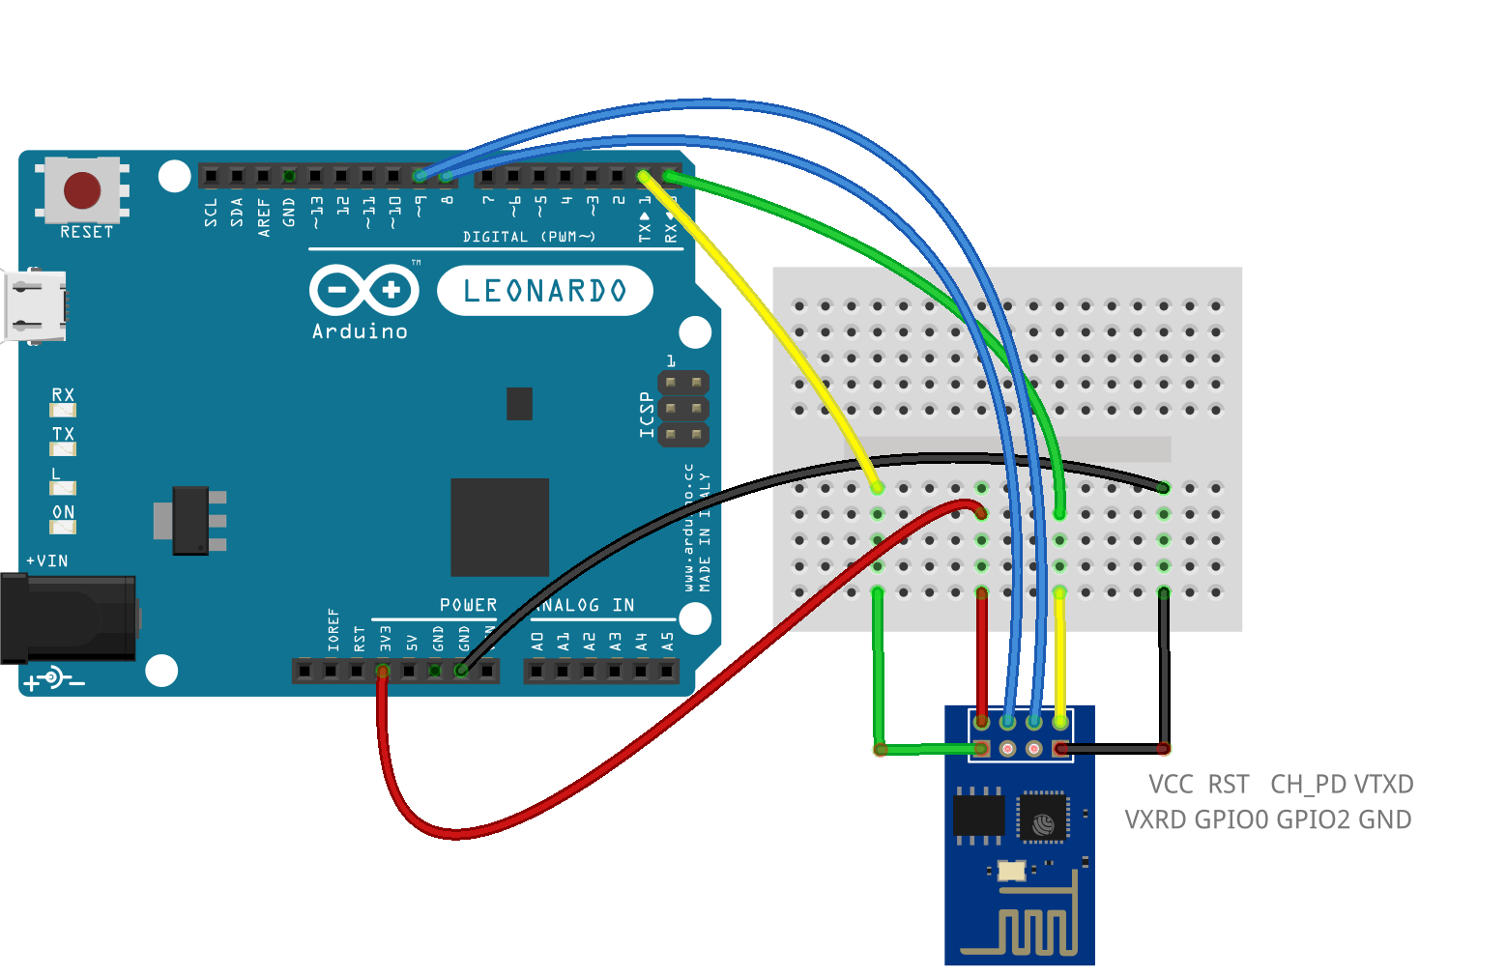
Circuit Diagram

Slide 8
Description
Soil Moisture Sensor checks moisture level in the soil & returns moisture value to the arduino.
If moisture level is low than the critical limit then water pump will get switched on.
Arduino receives request using ESP 8286 module.
Water Pump is switched on using Relay.
Water Pump pressure is controlled to water different plants using single water pump.

Slide 9
Hardware Requirements
BreadBoard
Arduino UNO R3
Soil Moisture Sensor
Relay
Jumper
Wifi Module (ESP 8266)
Water Pump
Water Container

Slide 10
Budget
Sr.No | Item Name | Price
1 | Arduino UNO | 300
2 | Soil Moisture Sensor | 120
3 | ESP 8266 (WiFi Module) | 200
4 | BreadBoard | 80
5 | Water Pump | 156
6 | Relay | 120
7 | Jumper | 70
8 | Water Tank | -
 | Total | 1046

Slide 11
Software requirements
Arduino IDE
Postman
Editor
Github
HTML,CSS .
Node.js

Slide 12
Conclusion
Irrigation System will help homeowners to take proper and healthy care of plants.
This can also be installed in farms to increase efficiency in farming and increase productivity.
Very helpful in drought conditions as it will help to use water in a optimized way

Slide 13
References
Google
http://www.circuitstoday.com/arduino-irrigation-plant-watering-using-soil-moisture-sensor

Slide 14
Thank You!
Feel Free to ask questions!

