Slide 1
Container Platform for OFS

Slide 2

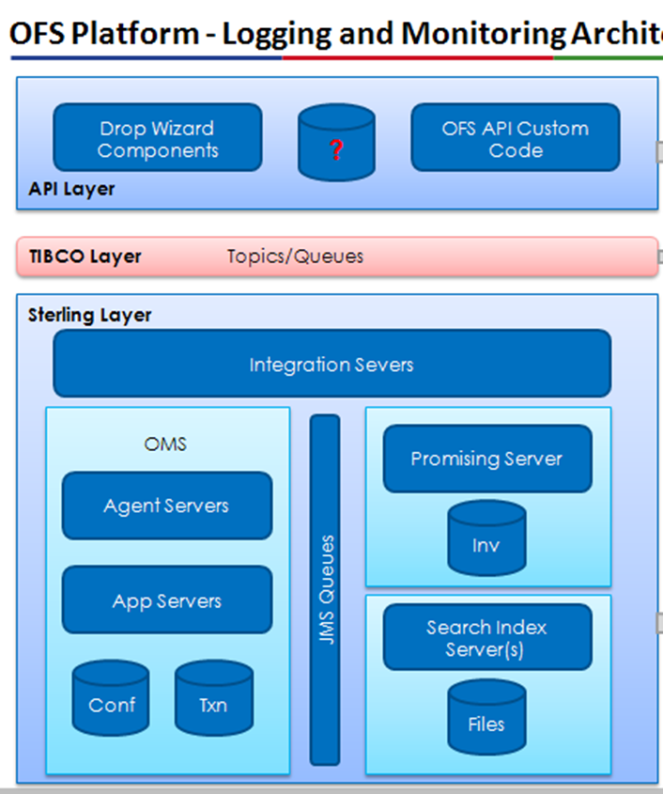

OFS Platform Architecture
CI -System
OFS Platform – Build Architecture
OFS Platform – Environment Architecture
Sterling Installed
Build Machine
API Layer
Build Machine
TIBCO
Build Machine
Conf DB
Txn DB
OFS Platform – DB Architecture

Slide 3
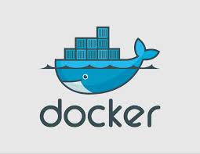
Container - Docker
An open source container for distributed applications.
Docker is a powerful tool that allows you to use Linux Containers in the most efficient way to -
Develop an app with any language and tool chain.
Ship the dockerized app with dependency anywhere.
Scale and move between datacenters/physical machine/private cloud with zero downtime and more.

Slide 4
Advantages of using docker containers -
Rapid application Development - We do not need a complete OS to run an application/service. Containers include the minimal runtime requirements of the application, reducing their size and allowing them to be deployed quickly.
Portability - The container can be run anywhere where docker is installed.
Multiple Services, Same machine - Run each service as a docker container. Multiple services with different configuration can be easily run on the same machine.
Easy Service Scheduling - Docker containers would be scheduled to run on particular machines depending on the criteria on the service unit files.
Easy Upgrades/Downgrades/Component reuse - Docker saves the delta between containers so upgrading or downgrading a container happens in seconds.
Complete Isolation - You run two apps with completely different environments and configuration in two containers in a single machine. As if they are running on two different machine.
Very lightweight - When compared to VMs you are running application in the lightest OS with only the binaries you need to run the app/service.
Scaling - The application can be easily scaled up and down depending on the load in seconds.

Slide 5
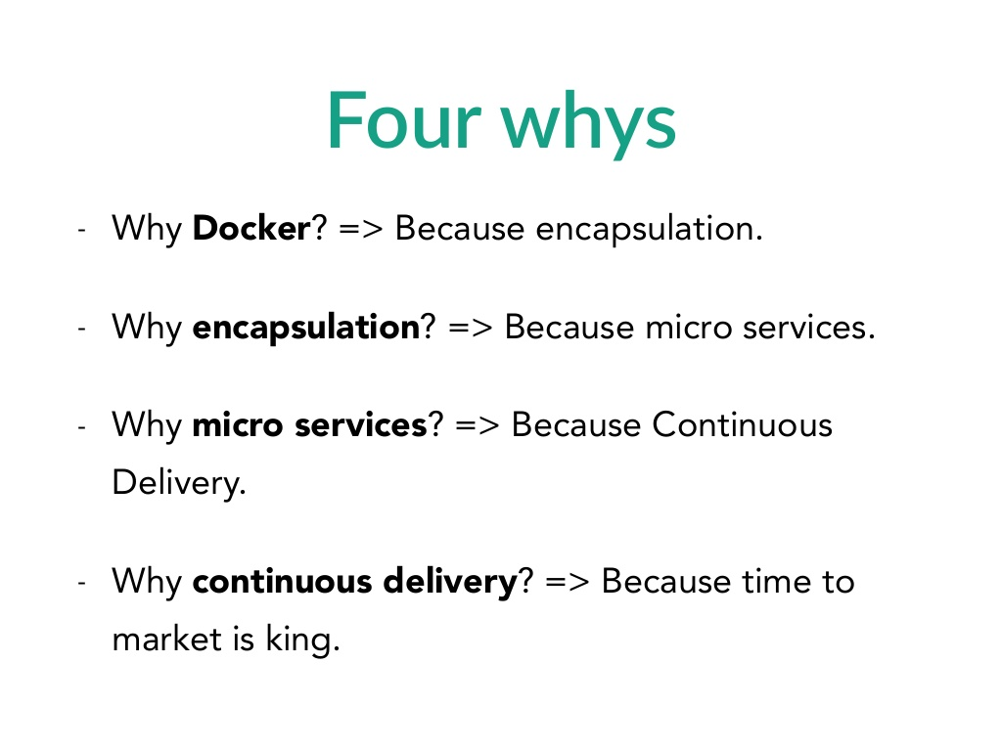
Long story short why docker ?

Slide 6
Containerize OFS
[root@ofsplatform01 ~]# docker images
REPOSITORY TAG IMAGE ID CREATED VIRTUAL SIZE
Tesco/env_sterling_app bld_ster2.2 c3e9e000438b 6 days ago 646.2 MB
Tesco/env_sterling_int bld_ster2.2 c3e9e000430b 6 days ago 536.2 MB
Tesco/env_sterling_jms bld_ster2.2 c3e9e000431b 6 days ago 546.2 MB
Tesco/env_api bld_api2.0 c3e9e000432b 6 days ago 746.2 MB
Tesco/env_tibco bld_tibco1.2 c3e9e000433b 6 days ago 446.2 MB
Tesco/build_sterling bld_ster2.2 c3e9e000232b 6 days ago 946.2 MB
Tesco/build_api bld_api2.0 c3e9e002232b 6 days ago 346.2 MB
centos centos7 34943832435d 8 weeks ago 224 MB
We will run each service as a docker container. This service being a docker container can be deployed and run anywhere from cloud to physical hardware to your laptop.
What do we solve by containerizing our application?
We decoupled our application from the environment it runs.
We can now upgrade/downgrade these running app containers easily in seconds.
We can now run multiple service in a single machine without worrying about maintaining the configuration for each service.
We broke down our complete application as individual services running in docker containers. We made our application scalable.
We can easily move between container platform solutions.

Slide 7
Container Platform
Containerizing the app was the first step.
But to build a end to end container solution we need a platform which delivers the solution to the below problems –
Service Discovery.
Service Management
Load Management and Scaling.
Release Management. (How will application upgrades be handled?)
Environment Management.
OS Upgrade.
Continuous Deployments.
Below are the most popular platforms which helps us solve the above problems:
Project Atomic by Redhat.
CoreOS by coreos.com.
Kubernetes by Google.
Mesos by Apache.
Docker Platform by Docker.
Openshift V3 by Redhat.
We are going with CoreOS (as of now) to achieve the solution to the
above problems. Each have their own + and -, we need to explore all to decide
on something.

Slide 8
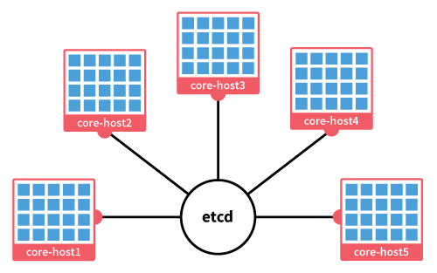
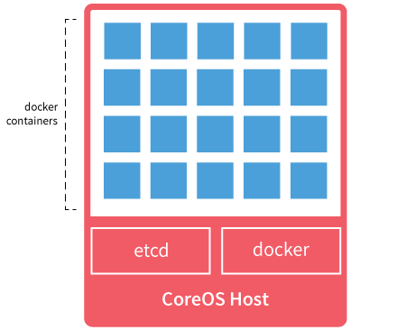
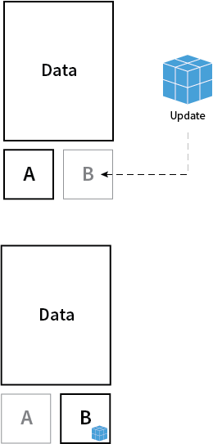
CoreOS
CoreOS: Minimal OS
Clustered by Default
Painless OS Update

Slide 9
Service Discovery – Problem Statement and proposed solution.
Problem: To build a fault tolerant system which auto-scales we need a component that does dynamic service discovery and registration.
In our current system, we have services and the machines tied up to each other. But to build a scalable system we need them independent. Our platform should have the capability to run a service on any machine it finds fit for running that particular service. To build such a solution, we need a globally available configuration store.
The service discovery would help us in other operational and development aspects also –
Load Balancing - It will help us reconfigure the load balancer depending on the current state of services which it reads from the service-discovery component.
Monitoring – It will make us setup a heartbeat mechanism for our services. When our service fail, this component pass on the information to the platform which would take actions to bring back the service up. (Fault tolerance)
App Communication - This can also be used by applications written in different languages to talk to each other.
Some consistent projects delivering this solution are Zookeeper, etcd, doozer…

Slide 10

Service Discovery - How CoreOS does it ?
CoreOS uses etcd for service discovery. It is a highly available distributed key-value store that provides a reliable way to store data across a cluster of machines.
Easily locate where services are being run within the cluster and be notified when something changes. Essential for a complex, highly dynamic cluster.
Containers can read and write data to etcd.
Any key/value change in etcd is read across all the nodes in cluster.
Watch a key for changes and react to the new values.
Backbone for cluster coordination and state management.
Enables Dynamic configuration of services.
Use Case: Store cluster level configurations
Store database connection details in etcd as key value pairs. These values can be watched, allowing your app to reconfigure itself when they change.
Use Case: Container communication
Etcd notifies container1 that it has to do work say w1. After container1 does the required work it modifies the state in etcd for the w1. Container2 seeing the state change for w1 in etcd starts its work.

Slide 11
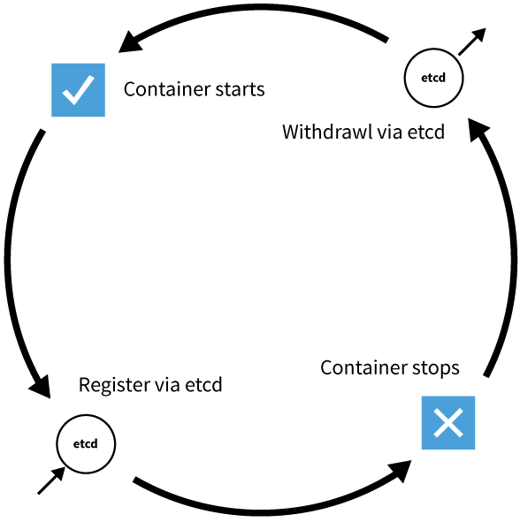
Service Discovery - How CoreOS does it ?
Use Case: Container Lifecycle
Containers when started registers themselves in etcd.
Containers when stopped unregisters themselves from etcd.
This way the whole cluster is always aware of the state of the service running
in the container. So when a service stops, the whole cluster knows about it and then the service is automatically brought up in another core-os host.

Slide 12
Service Management - How CoreOS does it ?
How do you define what the infrastructure look like?
How will you schedule services on the basis of user defined criteria's ?
How will you manage the containers across the clusters?
CoreOS uses fleet for the above tasks.
service unit files – for defining our services.
For example – Below is the service unit file for our application container.
omsapp.service
[Unit]
Description=Sterling Application Container
Requires=docker.service
[Service]
ExecStart=docker run –name omsapp Tesco/env_sterling_app
ExecStop=docker kill omsapp
[X-Fleet]
# Don't schedule on the same machine where a app container is already # running
X-Conflicts=omsapp.*.service

Slide 13
Service Management - How CoreOS does it ?
fleetctl utility – for scheduling and managing the services in a cluster.
$ fleetctl list-machines # Get the list of members in the cluster.
MACHINE IP METADATA
14ffe4c3... 10.132.249.212 -
1af37f7c... 10.132.249.206 -
9e389e93... 10.132.248.177 -
$ fleetctl submit omsapp.service # submit a service to the cluster.
$ fleetctl list-unit-files # to see the list of service unit files known to the cluster.
$ fleetctl cat omsapp.service # to see the contents of the service unit files.
$ fleetctl load omsapp.service # to load and schedule the submitted service.
Unit omsapp.service loaded on 14ffe4c3.../10.132.249.212
$ fleetctl start omsapp.service # to start a service.
$ fleetctl list-units # to show any running/scheduled service.
UNIT MACHINE ACTIVE SUB
omsapp.service 14ffe4c3.../10.132.249.212 active running
$ fleetctl stop omsapp.service # to stop the service.
$ fleetctl status omsapp.service # gives back the systemctl status of that service
# in that particular host.
$ fleetctl journal omsapp.service # gives the log for that service

Slide 14
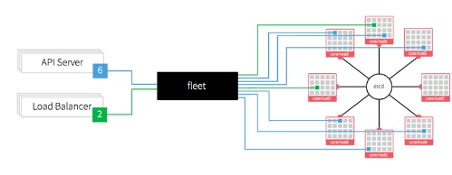
Service Management – How CoreOS does it?

Slide 15
Load Management and Scaling - Problem Statement and proposed solution.
Problem:
In our current scenario, to scale up the system we need to –
Manually setup the new machines for the application.
Manually add it to the cluster of machines.
Manually update the configuration of the load balancer and reload it.
The system never scales up automatically on the load it receives.
Solution:
We break down the application into scalable docker containers. Then use a container platform that solves the above problems.
It spins up the containers depending on the load.
It automatically reconfigures the load balancer depending on the container state and availability and then reload the load balancer gracefully without effecting the running containers.

Slide 16
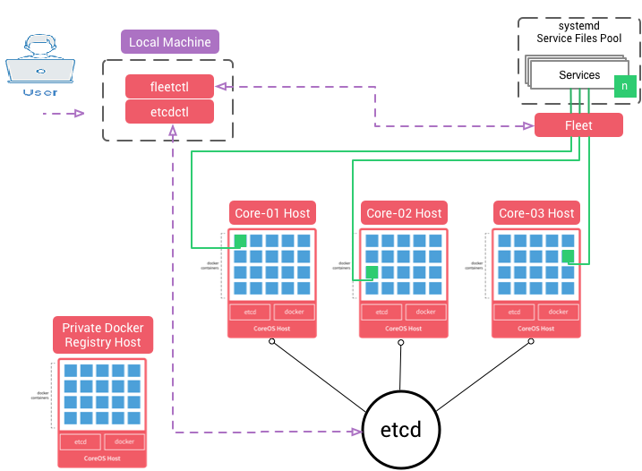
Load Management and Scaling
Environment Architecture

Slide 17
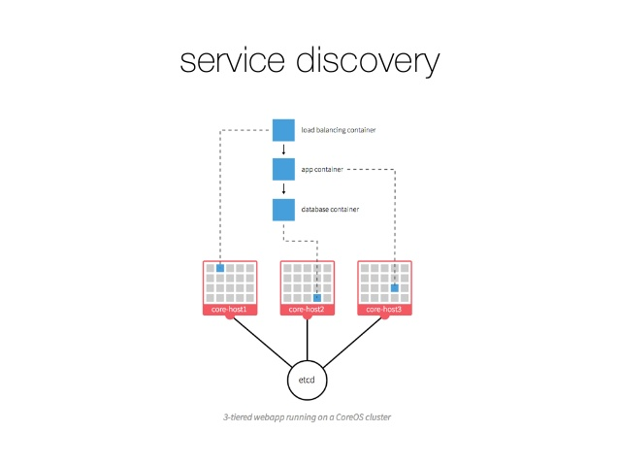
Service Discovery for Load Balancing and Scaling
App ip/port
App ip/port
etcd
HAPROXY
APP
XXX ip/port
Haproxy ip/port
etcd
TTL
WATCH
/services/app/app1
{
“ip”: “172.17.2.100”
“port”: “8080”
}
Sidekick service -
while true; do
etcdctl set /services/app/app1
“{xxx}” –ttl 60;
sleep 45;
done

Slide 18
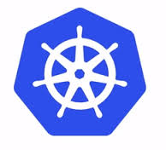
Kubernetes - Open source container management solution from google.
Google is handling more than 2 billions new containers a week.

Slide 19
Thank you.

