Slide 1
Pulse - Environment dashboard
#Golang
#HTML & JavaScript
#Web-sockets
#Bash and Perl

Slide 2
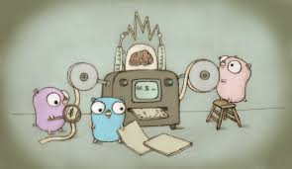

Design
Websocket Duplex Connection
Browser
Auto-Update Webpage (if found new local data )
Golang Server http://machine:8081
Continuously Poll for changes
Update local data with new change
Application 1
NEXUS
App status
Application 2
App status

Slide 3
Thank you

