Slide 1
“Text Editor for java”
Sr. No. | NAME | ROLL NO.
1) | Alok Agrawal | 32403
2) | Krishna Chidrawar | 32409
3) | Mohit Dulani | 32420
4) | Chinmay Gate | 32423
GUIDE
Mr. Bhakti Kadam
DEPARTMENT OF
ELECTRONICS AND TELECOMMUNICATION ENGINEERING
PUNE INSTITUTE OF COMPUTER TECHNOLOGY
PUNE – 43

Slide 2
Introduction
This application is a text editor in JAVA. This text editor is developed in a JAVA platform is a replica of the word editors we all are familiar with and which we use quite often on a daily basis. The only difference being that, this editor has been created using JAVA for the front-end interface and it is platform independent compile once and run everywhere with basic operations of the text editor cut ,copy ,paste ,file , edit operations and any new features can be easily coded. After opening text editor use can enter data using keyboard and edit existing document and open menu option to use save and save as options to save file. In order to save file we should select directory or it will show default directory. To make editing simple, we have provided a set of pop down menus in the interface, as well as support for shortcut keys to give commands . All the features are developed using java swings

Slide 3
Proposed System
Propose system is very good system compared to existing system. There are lot of more functionality will be added in latest system . That functionality are very useful for the user to work on it . This system saves the valuable time of the user by giving suggestions of the words to the user after writing some letters and give the user more controls to change user interface of the system . To work on this system is very easy because of advanced added functionality

Slide 4
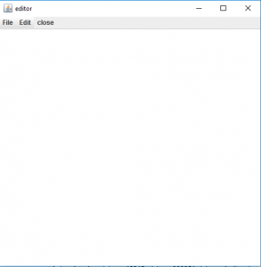
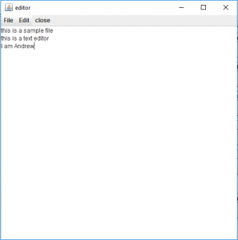
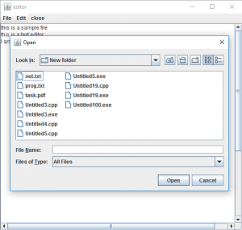
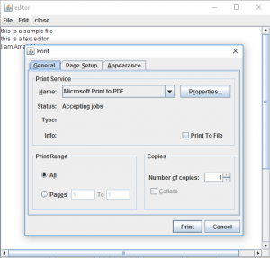
Animation of project

Slide 5
Algorithm
To create a simple text editor:
First, we will create a frame f titled “editor” and apply a metal look and feel and set an ocean theme in it.
We will add a text area and a menubar with three menu File, Edit, and Close.
The “File” option has 4 menu items new, open, save and print.
“Edit” has 3 menu items cut, copy and paste. We will add an action listener to all the menu items(using addActionListener() function) to detect any action.
We will add the menu items to the menu and menu to the menubar using add() function and we would add the menubar to the frame using addJMenuBar() function.
We will add the text area to the frame using add function set the size of the frame to 500,500 using setSize(500,500) function and then display the frame using show function.

Slide 6
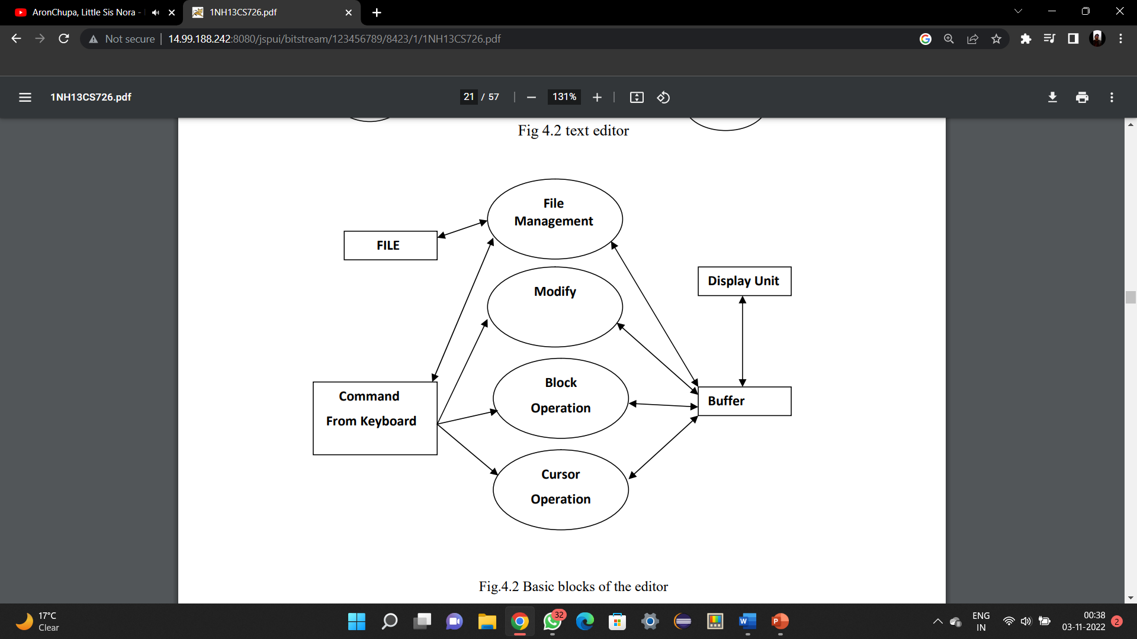
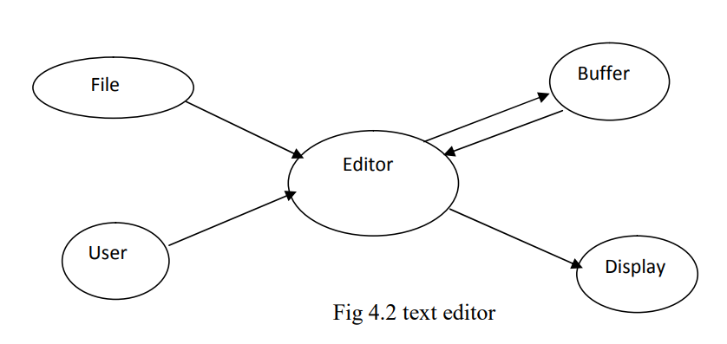
Flowchart

Slide 7
Source code explanation
Actionlistner:
Actionperformer:
Autocompletion:

Slide 8
Result:

Slide 9
Conclusion:

Slide 10
Future scope:
At the highest level, text editor scope covers the creation, editing, sharing , opening , collaborative editing, and creating webpage file ,PHP file and many more files.
The scope also covers the creation of Digital diary, Script writing , Webpage creating and project permission management . The scope of the editor itself is intended to cover relatively simple text file notation.
It can also be used in online work like sharing file over Gmail. This application is also time saving because in that multiple tab will be opened at same time this tab will open in the single window so user will easily take reference of another document.

Slide 11
References:
The referred books were :
Java 2-Complete reference (5th edition) by Herbert Schildt.
Thinking in Java by Bruce Eckel.
And the following websites were also used for reference :
http://en.wikipedia.org/wiki/Java_(programming_language)/
http://download.oracle.com/javase/tutorial/
http://www.developer.com/java/
http://java.sun.com/docs/books/tutorial
http://www.cafeaulait.org/course/
http://oopweb.com/Java/Documents/IntroToProgrammingUsingJava/VolumeFrames.ht ml
https://en.wikipedia.org/wiki/Design

Slide 12
THANK YOU!!

