Slide 1


Data pre-processing effect on the performance of machine learning algorithm
Netaji subhash engineering college
Presented By: CHIRASHREE KUNDU
CHANCHALA KUMARI
ALOK BHOWMIK
ANKESH KUMAR

Slide 2

Data pre processing effect on the performance of machine learning algorithms

Slide 3

Roadmap
Introduction
ML and data science
About data set
Data processing
Categorical values
Data visualization
Cross validation
Algorithm used
Experimental result
Future work
Conclusion
Reference

Slide 4

Introduction
To automate the loan eligibility process based on customer detail .
Machine learning and Data science are the technology to predict it in a faster rate.

Slide 5

Machine learning & Data science
Machine learning is the application of AI
It provides the system to automatically learn from the experience
Data science is the method to extract knowledge from the data.
It is the study where information comes from the data

Slide 6
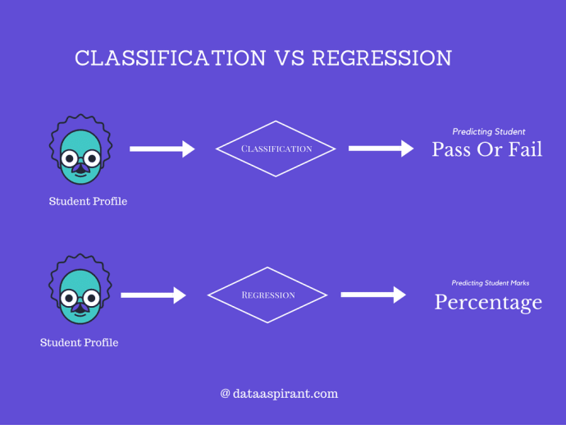
Regression
Classification

Slide 7
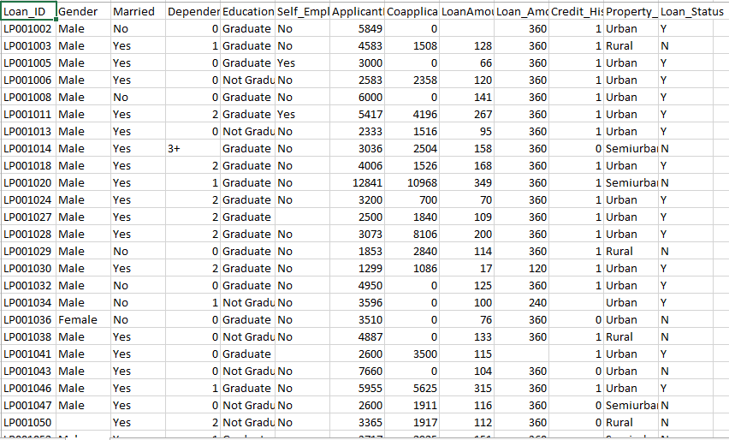
ABOUT OUR DATA SET
Source of the data set.
Content of the data set
Data Wrangling

Slide 8
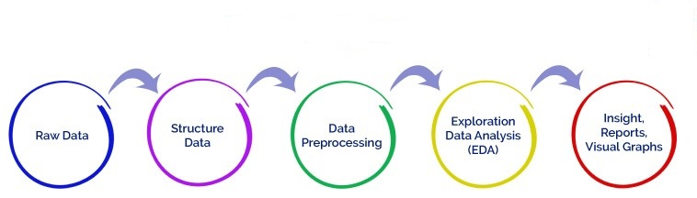
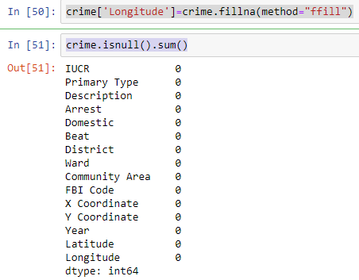
Data Processing
Refers to cleaning of data by doing away with missing values.
isnull( ).sum( )
Missing values are imputed by using fillna( ).

Slide 9
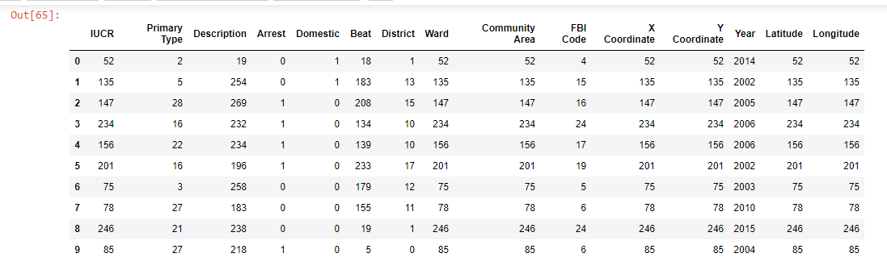
Conversion of Categorical Values
get_dummies( )- Converts categorical value to numeric and adds to columns
LabelEncoder- convert
categorical text data into model-understandable numerical data

Slide 10
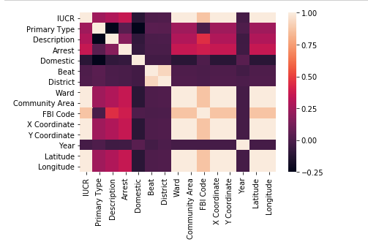
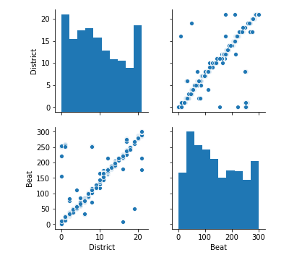
Data Visualization
It refers to understanding data by using charts, histograms and graphs.
Libraries used: seaborn, matplotlib

Slide 11
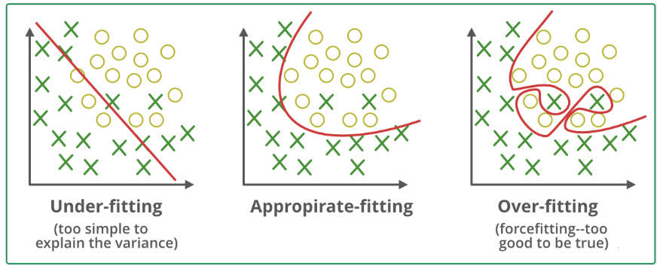
Model selection and Cross Validation

Slide 12
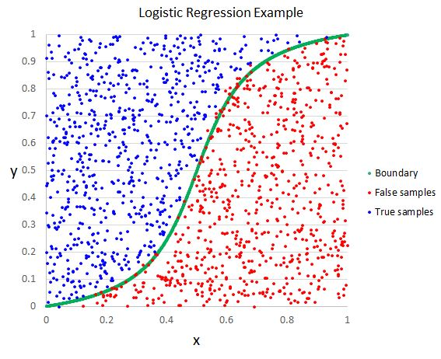
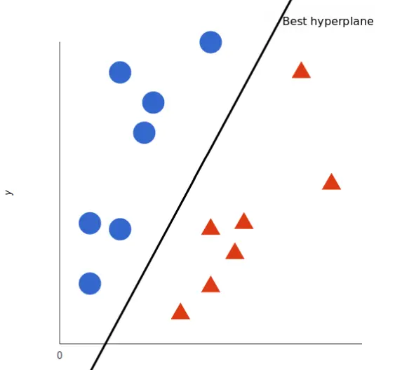
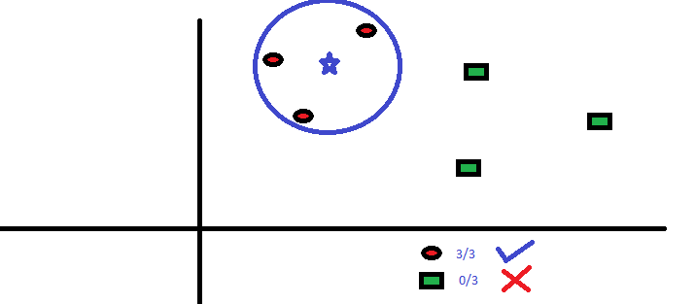
Proposed Algorithm
LOGISTIC REGR
RESSION
SVM
KNN

Slide 13
Experimental Result
Algorithm | Proceesed Data Model Accurecy | Without Proceesed Data Model Accurecy
Logistic Regression | 85% | 73.95%
SVM | 78% | 73%

Slide 14
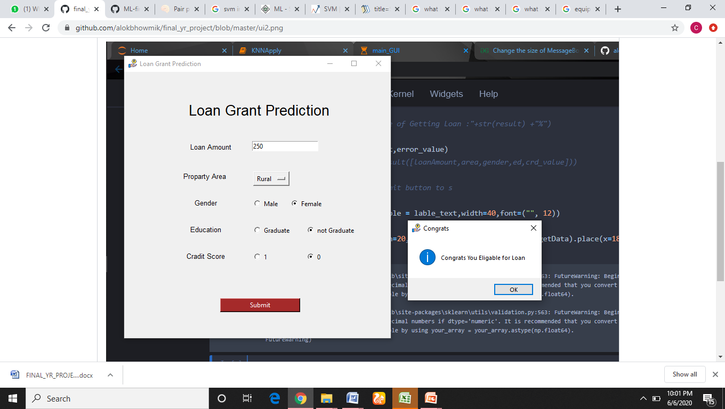
USER INTERFACE

Slide 15
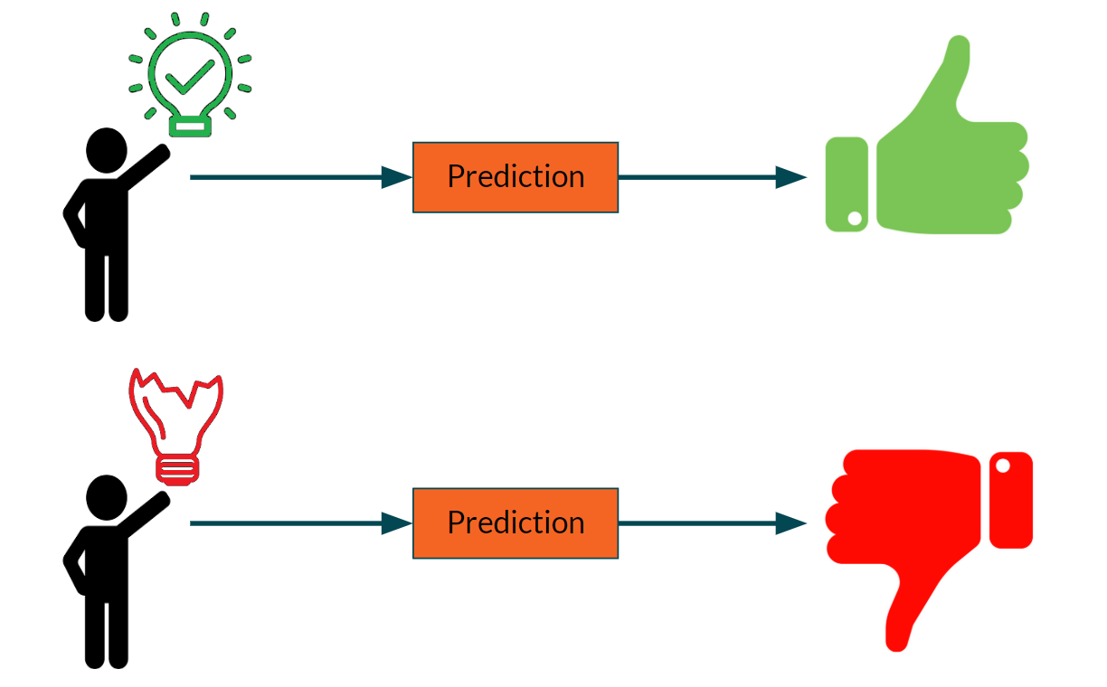
Conclusion

Slide 16
Human Brain can not be replaced by
MACHINES

Slide 17
References
https://www.analyticsvidhya.com/blog/2015/11/beginners-guide-onlogistic-regression-in-r/
)https://www.analyticsvidhya.com/blog/2015/11/improve-modelperformance-cross-validation-in-python-r/
https://en.wikipedia.org/wiki/K-nearest_neighbors_algorithm
https://en.m.wikipedia.org/wiki/Feature_selection
https://www.kaggle.com/altruistdelhite04/loan-prediction-problem-dataset
)https://www.analyticsvidhya.com/blog/2015/11/easy-methods-dealcategorical-variables-predictive-modeling/
Multivariate Data analysis book by Joseph, W/7th edition

Slide 18
Thank You

