Slide 1
Loan Management Analytics Platform
Presented by,
Alok Bhoye
Ashutosh Dubey
Mahesh Gore
K Swarna Kudva
Rajanya Chakraborty
February, 2026
Guided by,
Babjee Reddy

Slide 2
AGENDA
Business Scenario
Objectives
Technology Stack
Architecture Overview
ETL Process Overview
5.1. Data Sources
5.2. Transformations
Schema Design & Table Structure
IDMC Task flows
    7.1. Validation and Cleaning
    7.2. Star Schema Formation
Streamlit Dashboard
Cortex Search (RAG) and Cortex
9.1. Cortex Search
9.2. Cortex Analyst

Slide 3
1. Business Scenario
Financial institutions manage large volumes of:
_{- Loan master data}
_{- Borrower information}
_{- Branch operations}
_{- Daily loan transactions}
_{Manual reporting causes:}
_{- Delays in insights}
_{- Data inconsistency}
_{- Limited historical tracking}

Slide 4
2. Objectives
✔ Real-time ingestion of loan data
✔ Centralized analytics platform
✔ Historical tracking using SCD Type 2
✔ Interactive dashboards for KPIs
✔ AI-powered business querying & knowledge assistant

Slide 5




3. Technology Stack
AWS S3 (Cloud Data Storage)
Snowpipe – Automatically loads incoming CSV files into Snowflake in near real-time.
Snowflake (Central Data Warehouse)
Snowflake – Cloud-based data platform for scalable storage, processing, and analytics.
IDMC (Integration & Transformation)
CDI transformation for SCD2 and cleaning
Streamlit
Streamlit – Interactive web-based dashboard for real-time business insights.
Cortex Search – Enables semantic document search across policies, KPIs, and SOPs.

Slide 6
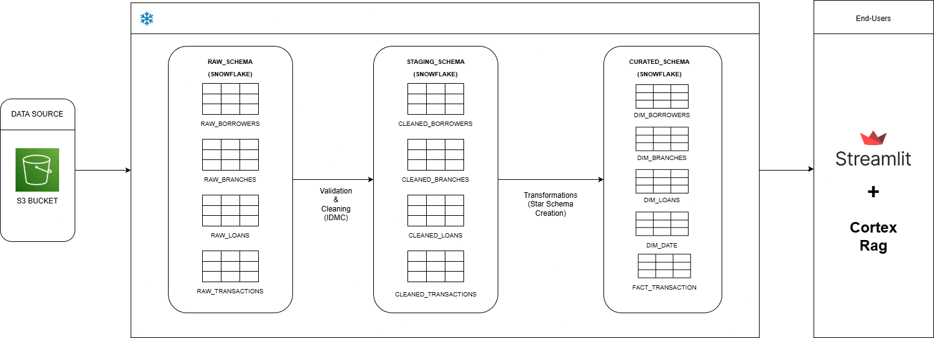
4. Architecture Overview

Slide 7
5. ETL Process Overview
5.1 Data Sources-
CSV Files:
Borrowers
Branches
Loans
Transactions

Slide 8
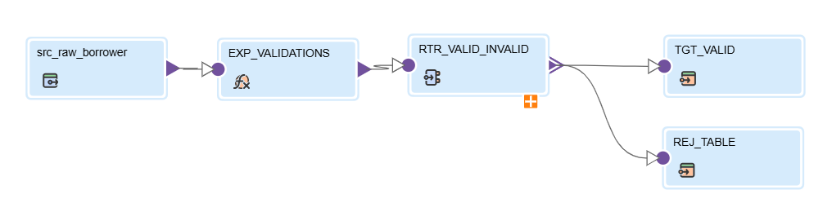
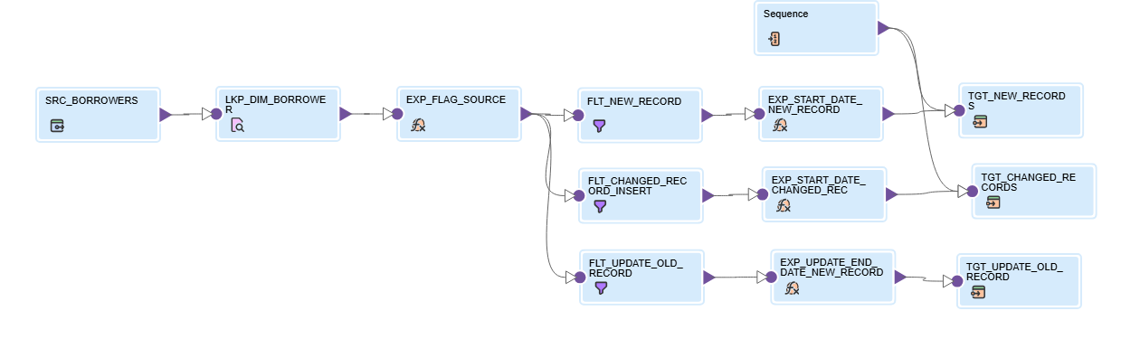
5.2 Transformations
Cleaning Mapping
SCD Type – 2 Mapping

Slide 9
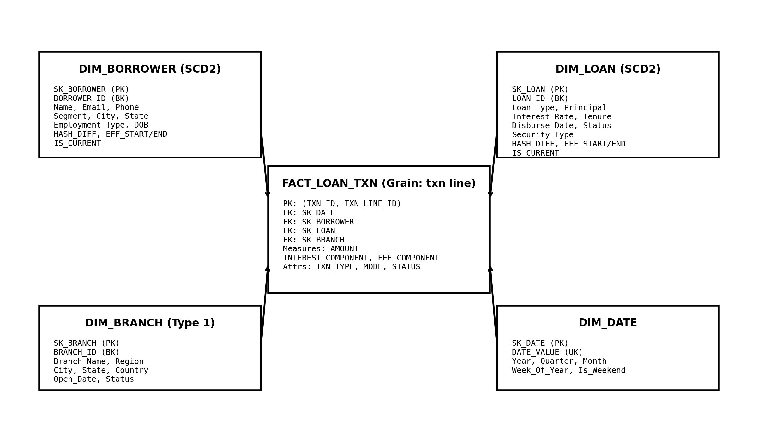
6. Schema Design and Table Structure
Benefits
Fast analytical queries
Simplified reporting
Historical tracking
Easy BI integration

Slide 10
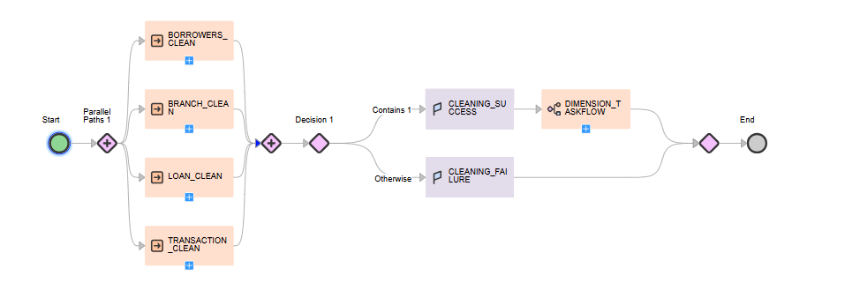
7. IDMC TASKFLOWS
7.1 Validation and Cleaning
!

Slide 11
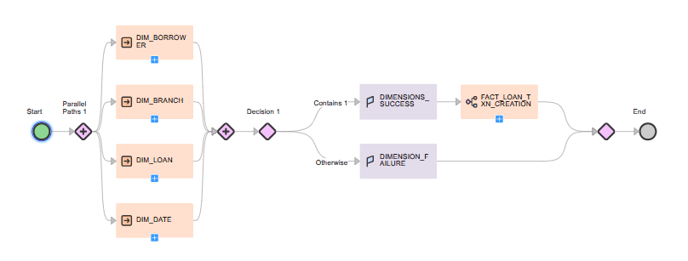
7.2 Star Schema Formation
!

Slide 12
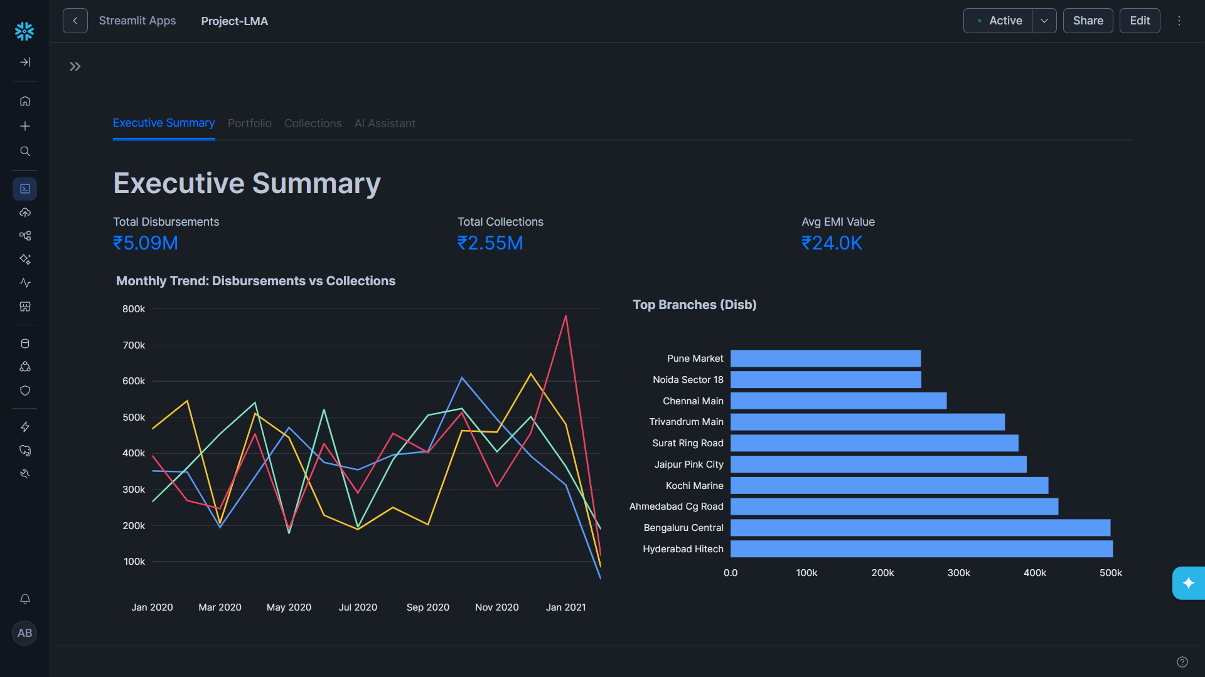
8. Streamlit Dashboard

Slide 13
9. Cortex Search (RAG) and Cortex Analyst
9.1 Cortex Search (RAG)
Retrieval Augmented Generation (RAG): Grounding AI responses in our private, secure documents to ensure zero hallucinations.
9.2 Cortex Analyst
Zero-Code Analytics: Turning plain English questions into optimized SQL queries instantly.
The AI Translator: Bridging the gap between business questions and database logic using semantic models.

Slide 14
THANK YOU

