Slide 1


Feature Selection: Spotlight on
Lasso Regression
Presented at :
In the presence of:
Dr. Deepa Kandpal
Dr. Manisha Pandya
Seminar by:
Alokchandra Jha
M.Sc. (Statistics)

Slide 2
Contents
The need for Lasso Regression
Lasso Regression
How does Lasso regression create sparsity?
Feature Selection using Lasso Regression
Evaluating the value of Hyperparameter

Slide 3
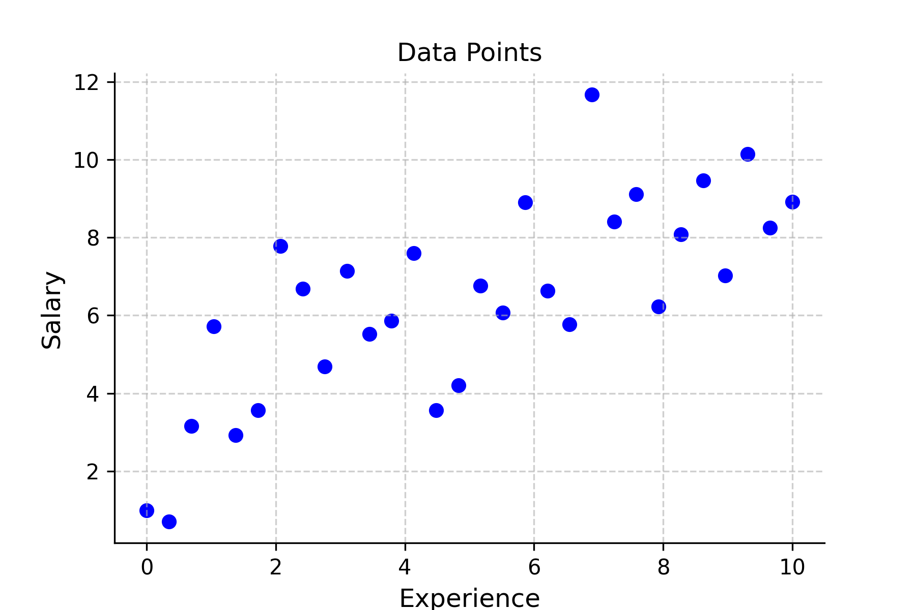
The need for Lasso Regression
To begin with, consider a hypothetical example dataset which shows the effect of experience on one’s salary. Let the data be visualised as this:
Here, we have experience on X axis and we have assumed that the salary depends upon the experience, and therefore on Y axis we have salary values.
One can observe that the data may looks linear but nothing can be said about the true relationship.

Slide 4
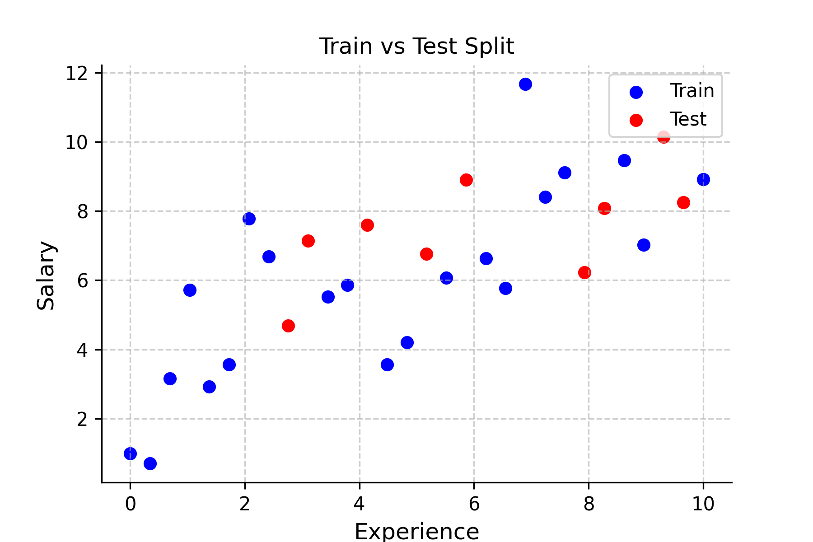
Next, we split our data into training data and test data in 70:30 ratio using Simple Random Split.

Slide 5
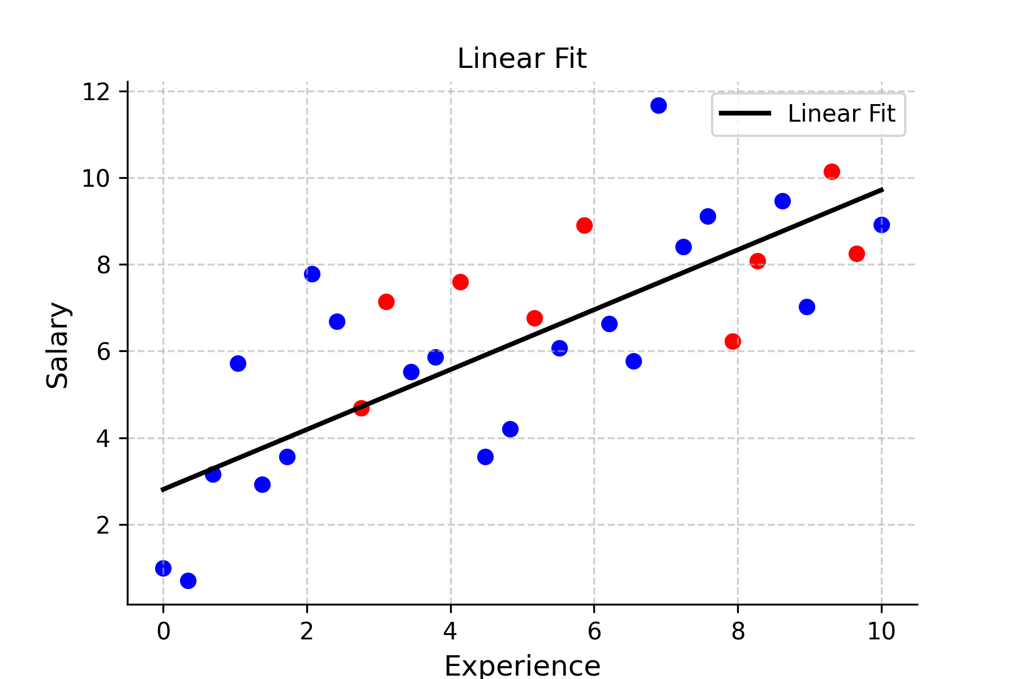
Then, we perform Simple Linear Regression and choose a line of best fit for the training data points. In this scenario, the line doesn’t capture the true nature of the relationship between the variables and we observe high bias.

Slide 6
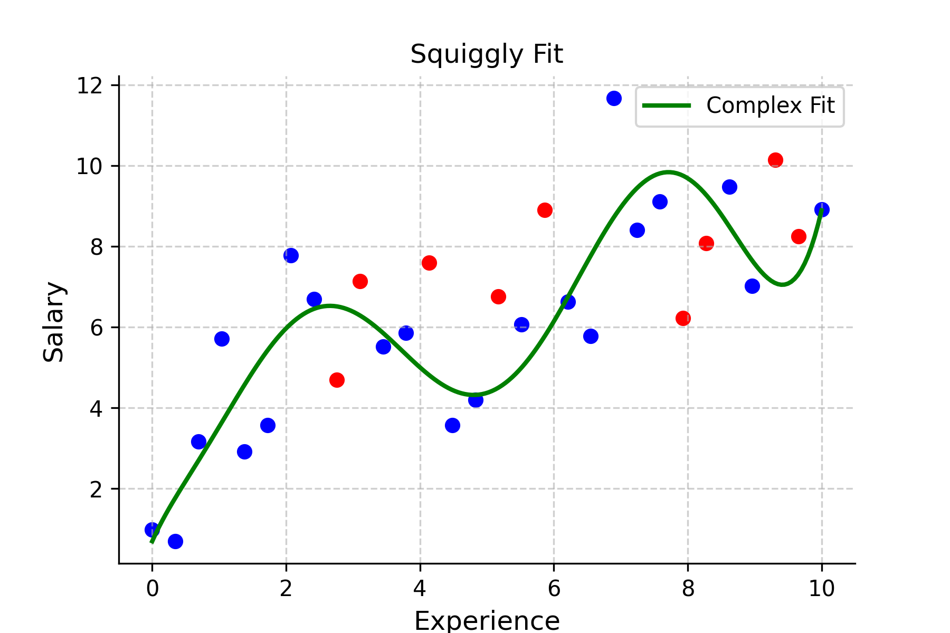
Another method by which we try to determine the underlying relationship is Polynomial Linear Regression. Here, we have applied on the training data set, a polynomial of degree 8. This includes more training data points and in turn the bias is low.

Slide 7
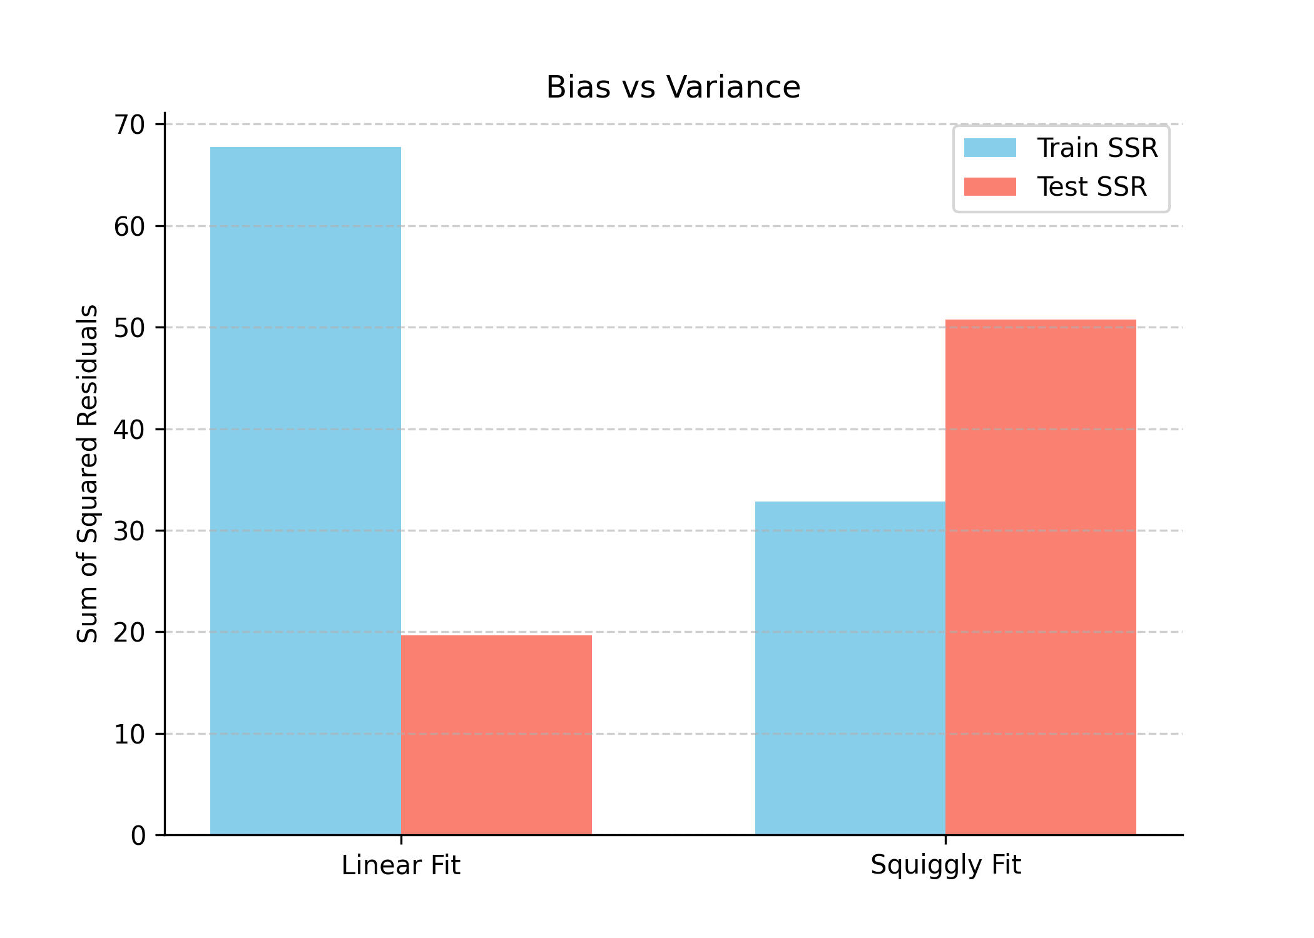
We then obtain the Residual Sum of Squares of train data and test data of both the methods. Simple Linear Regression which initially had higher sum of square (high bias) performed better than Polynomial Linear Regression on the test data.
Train Data
SSR (Linear fit): 67.75054334
SSR (Squiggly fit): 32.83292938
Test Data
SSR (Linear fit): 19.63014103
SSR (Squiggly fit): 50.75607191
Our goal is to obtain a Regression curve which has both low bias and low variance.

Slide 8
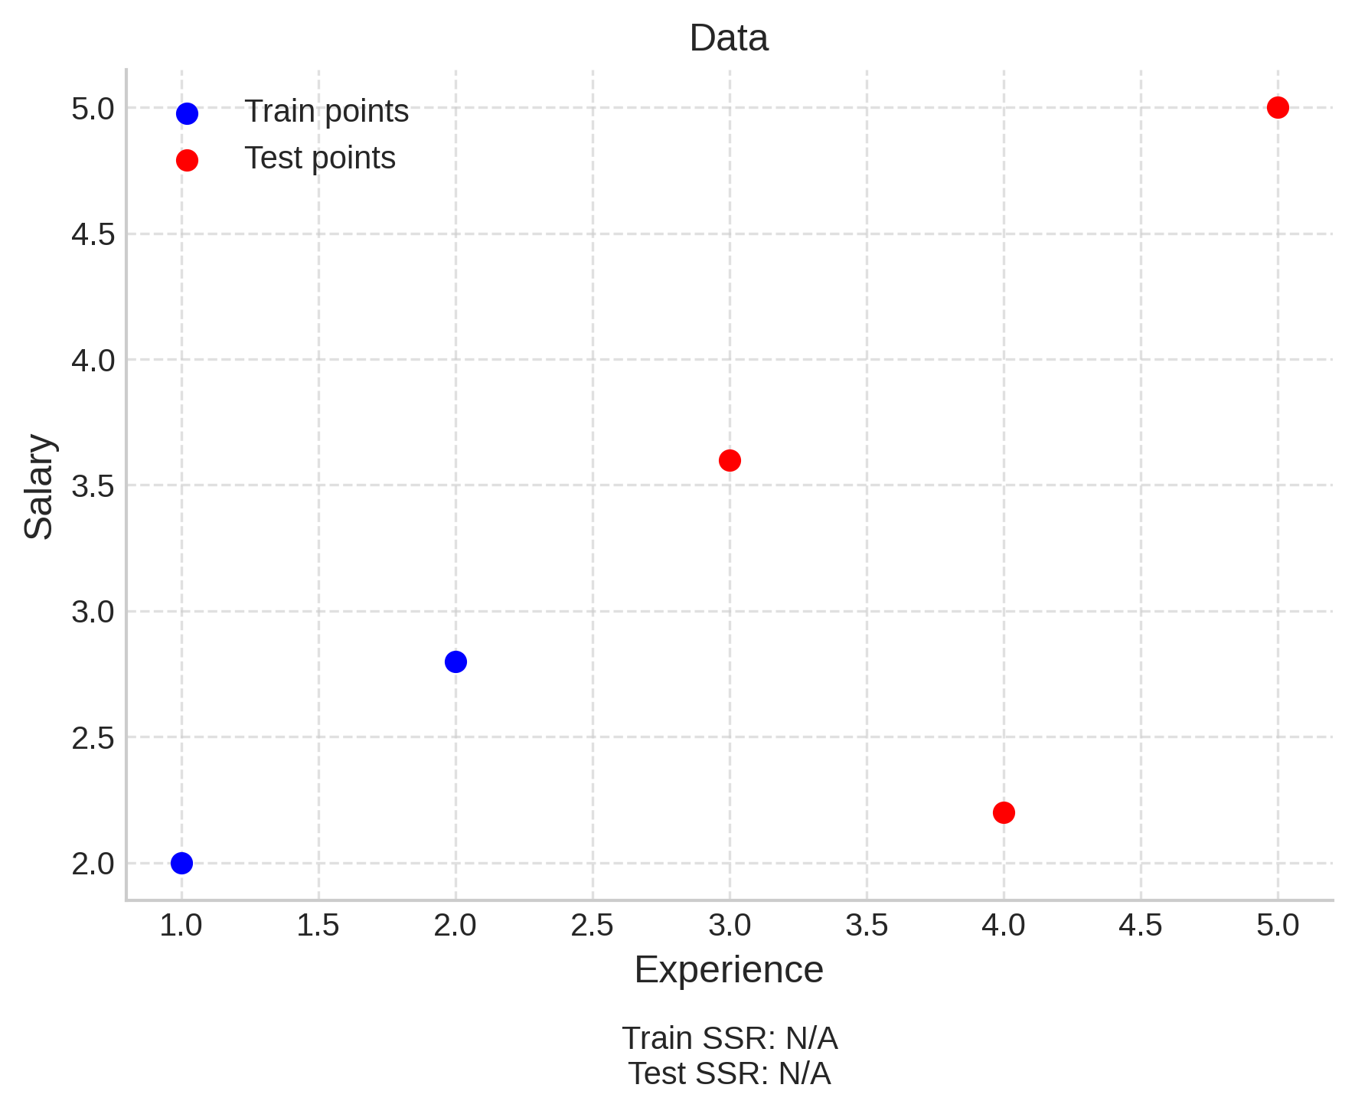
Lasso Regression
Here, we have another hypothetical dataset. For the sake of understanding, assume that the data has only two training data points.

Slide 9
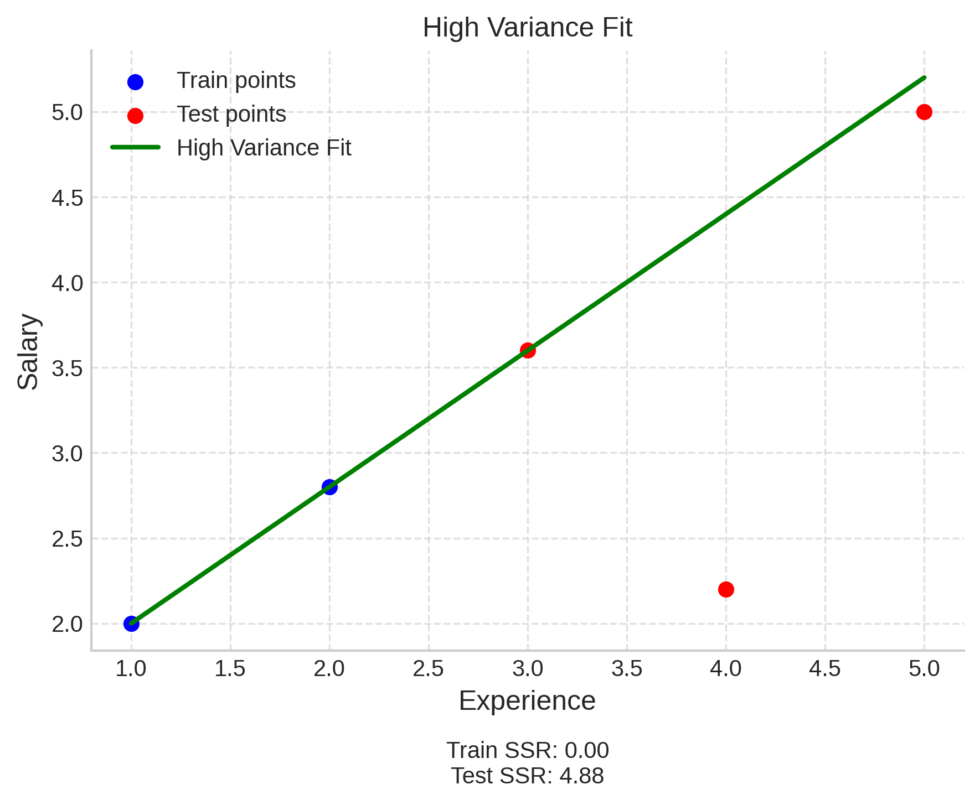
Then, the line of best fit will pass through both the data points and residual error would be 0.
This means that the bias is nil but the variance in this case would be high.
This is a case of Overfitting.

Slide 10
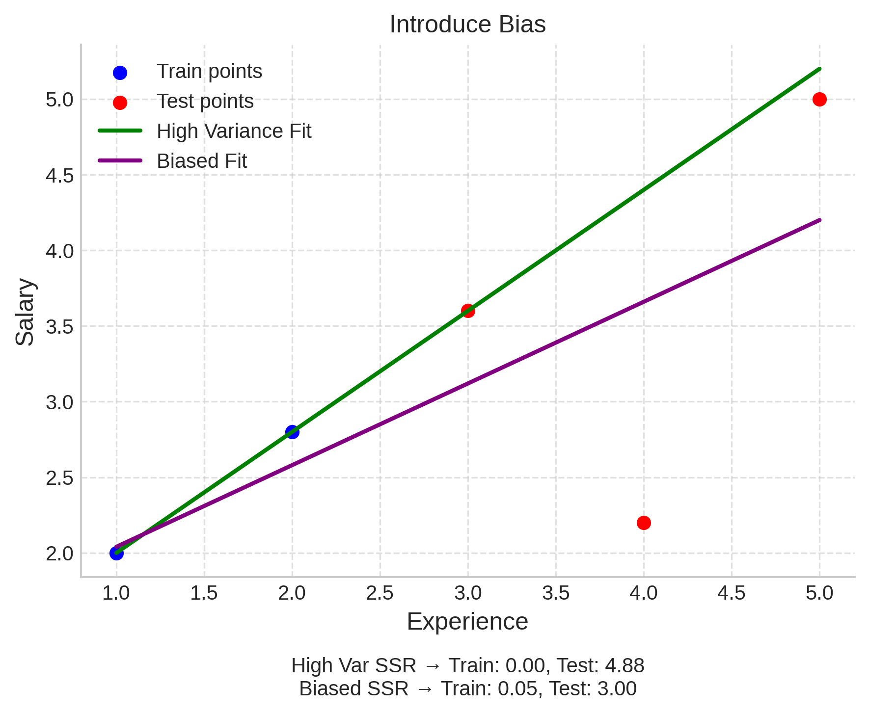
So what we do is introduce a little amount of bias.
And accounting to this bias, we see a significant drop in the variance.
This is essentially what Lasso Regression is.
We tend to reduce the slope and obtain decrease in the residual error.

Slide 11
What is Lasso?
Lasso stands for Least Absolute Shrinkage and Selection Operator (Tibshirani, 1996)
It is a regression method that shrinks coefficients and can even set some of them exactly to zero.
Why use it?
Helps when there are too many predictors (features).
Prevents overfitting by simplifying the model.
Unlike Ridge Regression (which only shrinks), Lasso also performs feature selection.
How does it work?
Lasso adds a penalty based on the absolute size of coefficients (L1 norm).
Big coefficients are reduced; unimportant ones can become zero.
This makes the model simpler, more stable, and easier to interpret.

Slide 12
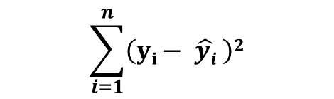
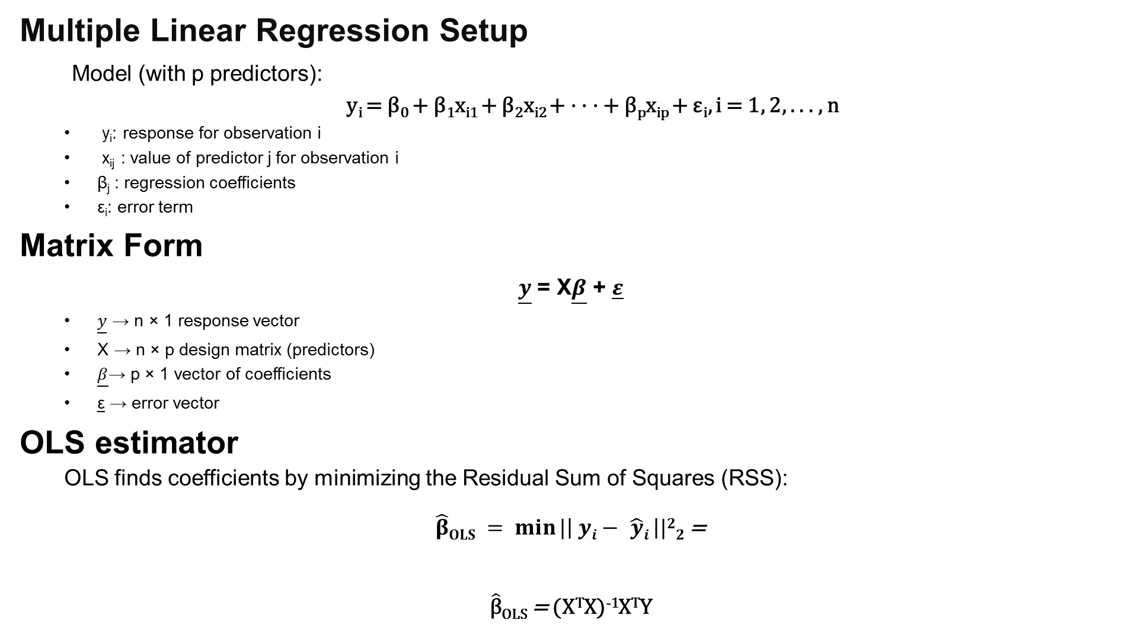


Multiple Linear Regression Setup
Model (with p predictors):
y_{i} = β₀ + β₁x_{i1} + β₂x_{i2} + · · · + β_{p}x_{ip} + ε_{i}, i = 1, 2, . . . , n
y_{i}: response for observation i
x_{ij} : value of predictor j for observation i
β_{j} : regression coefficients
ε_{i}: error term
Matrix Form
$\underline{y}$ = X$\underline{β}$ + $\underline{ε}$
$\underline{y}$ → n × 1 response vector
X → n × p design matrix (predictors)
$\underline{β}$→ p × 1 vector of coefficients
$\underline{\text{ε}}$ → error vector
OLS estimator
OLS finds coefficients by minimizing the Residual Sum of Squares (RSS):
$\hat{β}OLS = \min{|\left| yi− \hat{y}i \right||22}$=
$\hat{\text{β}}$_{OLS} = (X^{T}X)⁻¹X^{T}Y
$$\sum_{i=1}^{n}{\left(yi− \hat{yi} \right)2}$$
, where $\hat{ yi}$ = X_{T} β
$$β$$

Slide 13
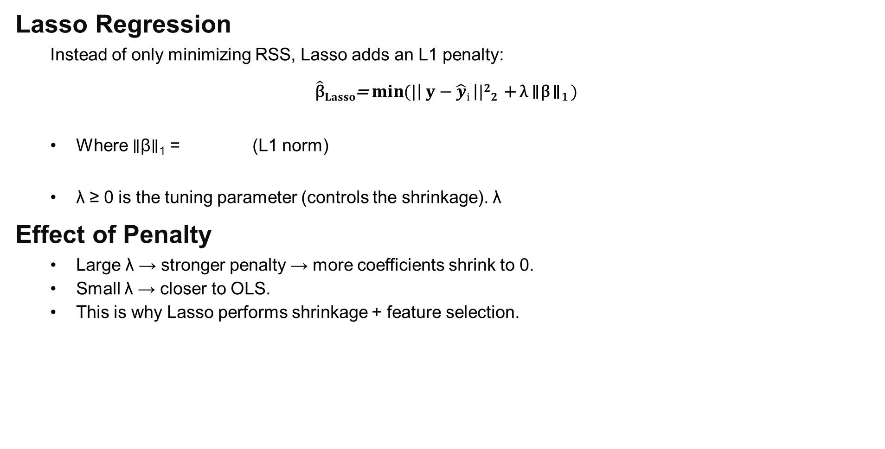

Lasso Regression
Instead of only minimizing RSS, Lasso adds an L1 penalty:
$\hat{\text{β}}Lasso$= $\min{(|\left| y−\hat{y}i \right||22}$ + λ ∥β ∥₁ )
Where ∥β∥₁ = (L1 norm)
λ ≥ 0 is the tuning parameter (controls the shrinkage). λ
Effect of Penalty
Large λ → stronger penalty → more coefficients shrink to 0.
Small λ → closer to OLS.
This is why Lasso performs shrinkage + feature selection.
$$β$$
$$\sum_{j=1}^{p}{\left|β_{j}\right|}$$

Slide 14
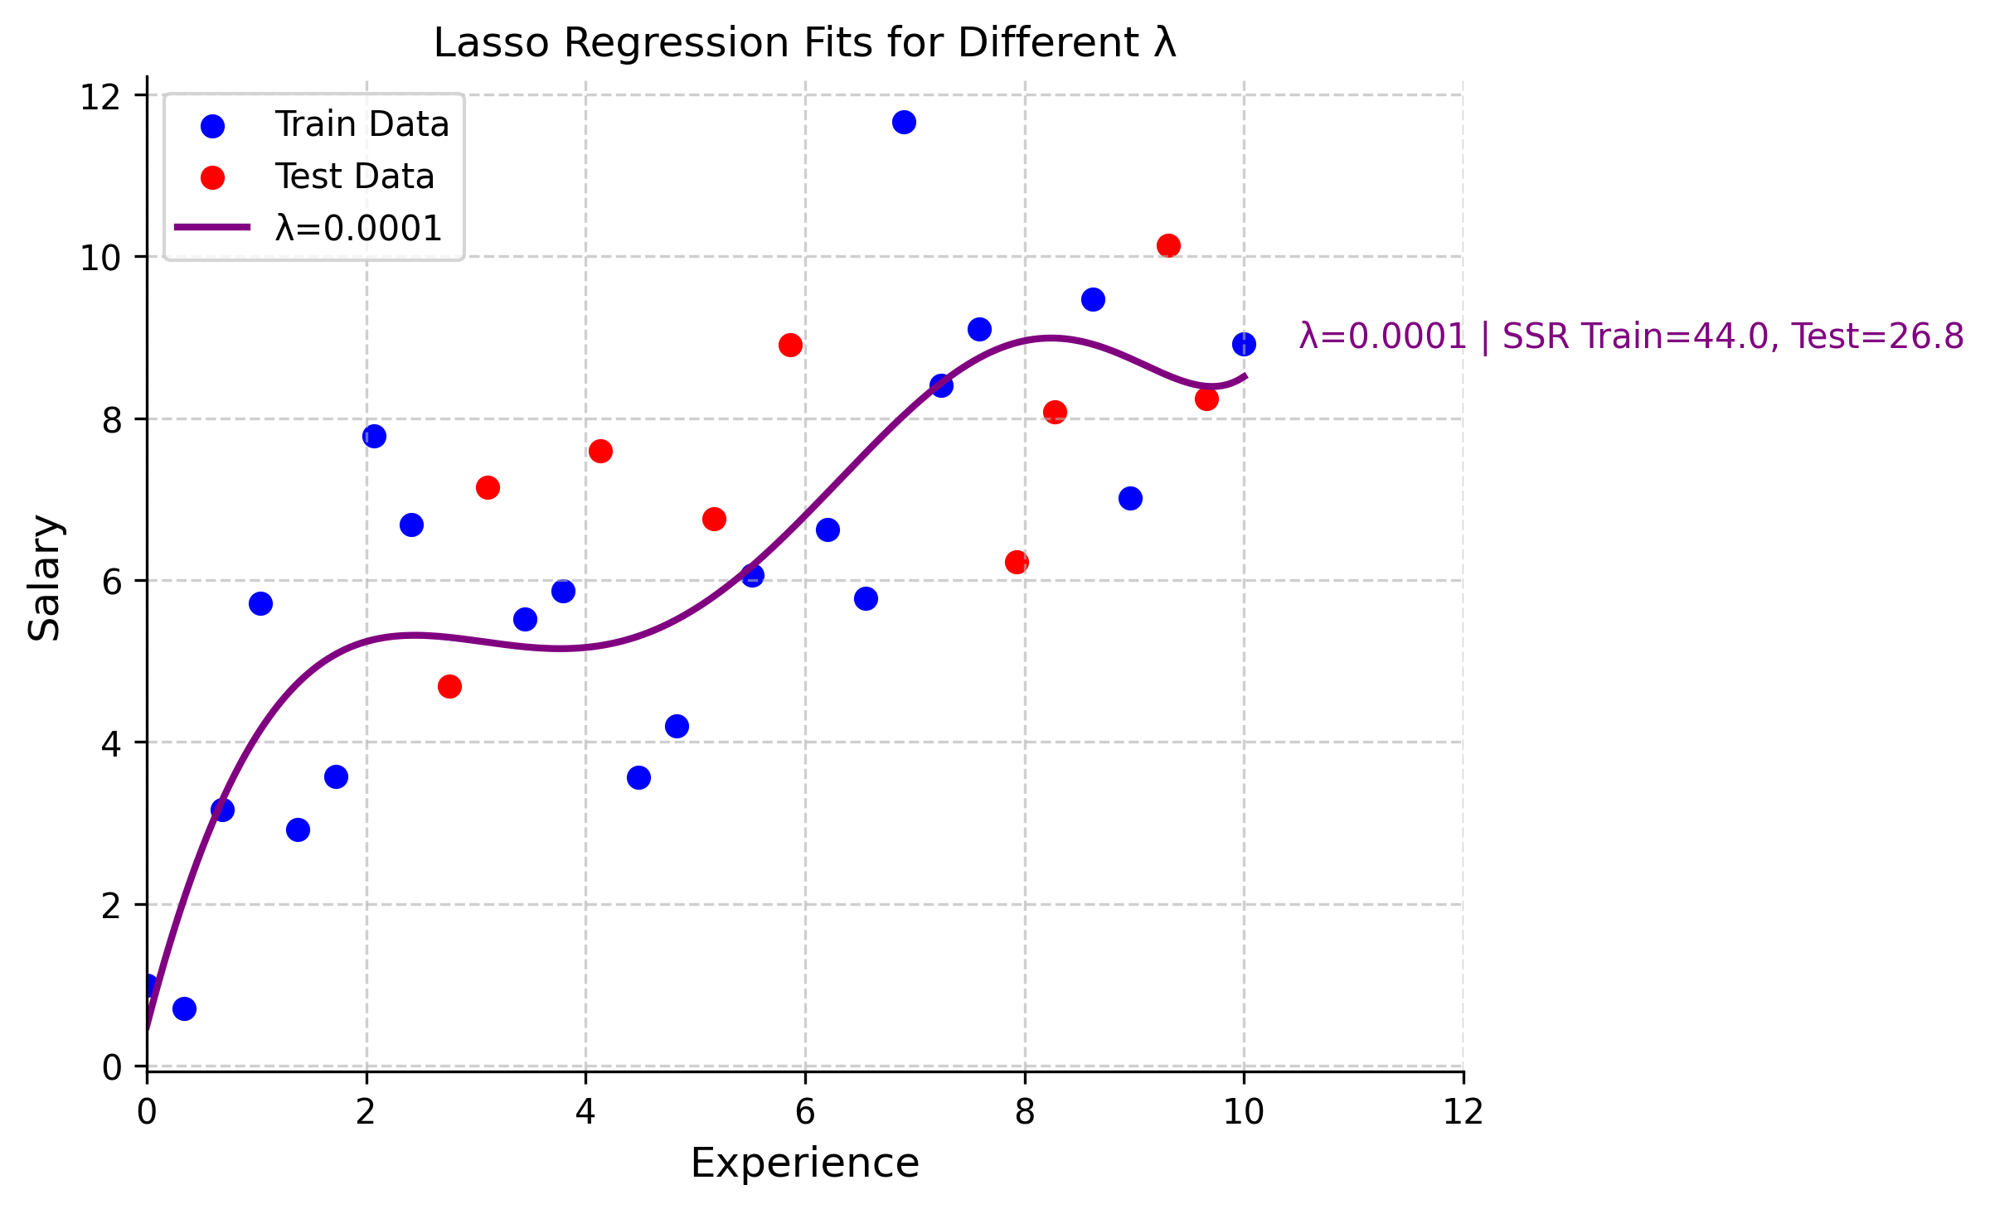
Moving further, we study the effect of regularisation on the earlier dataset.

Slide 15
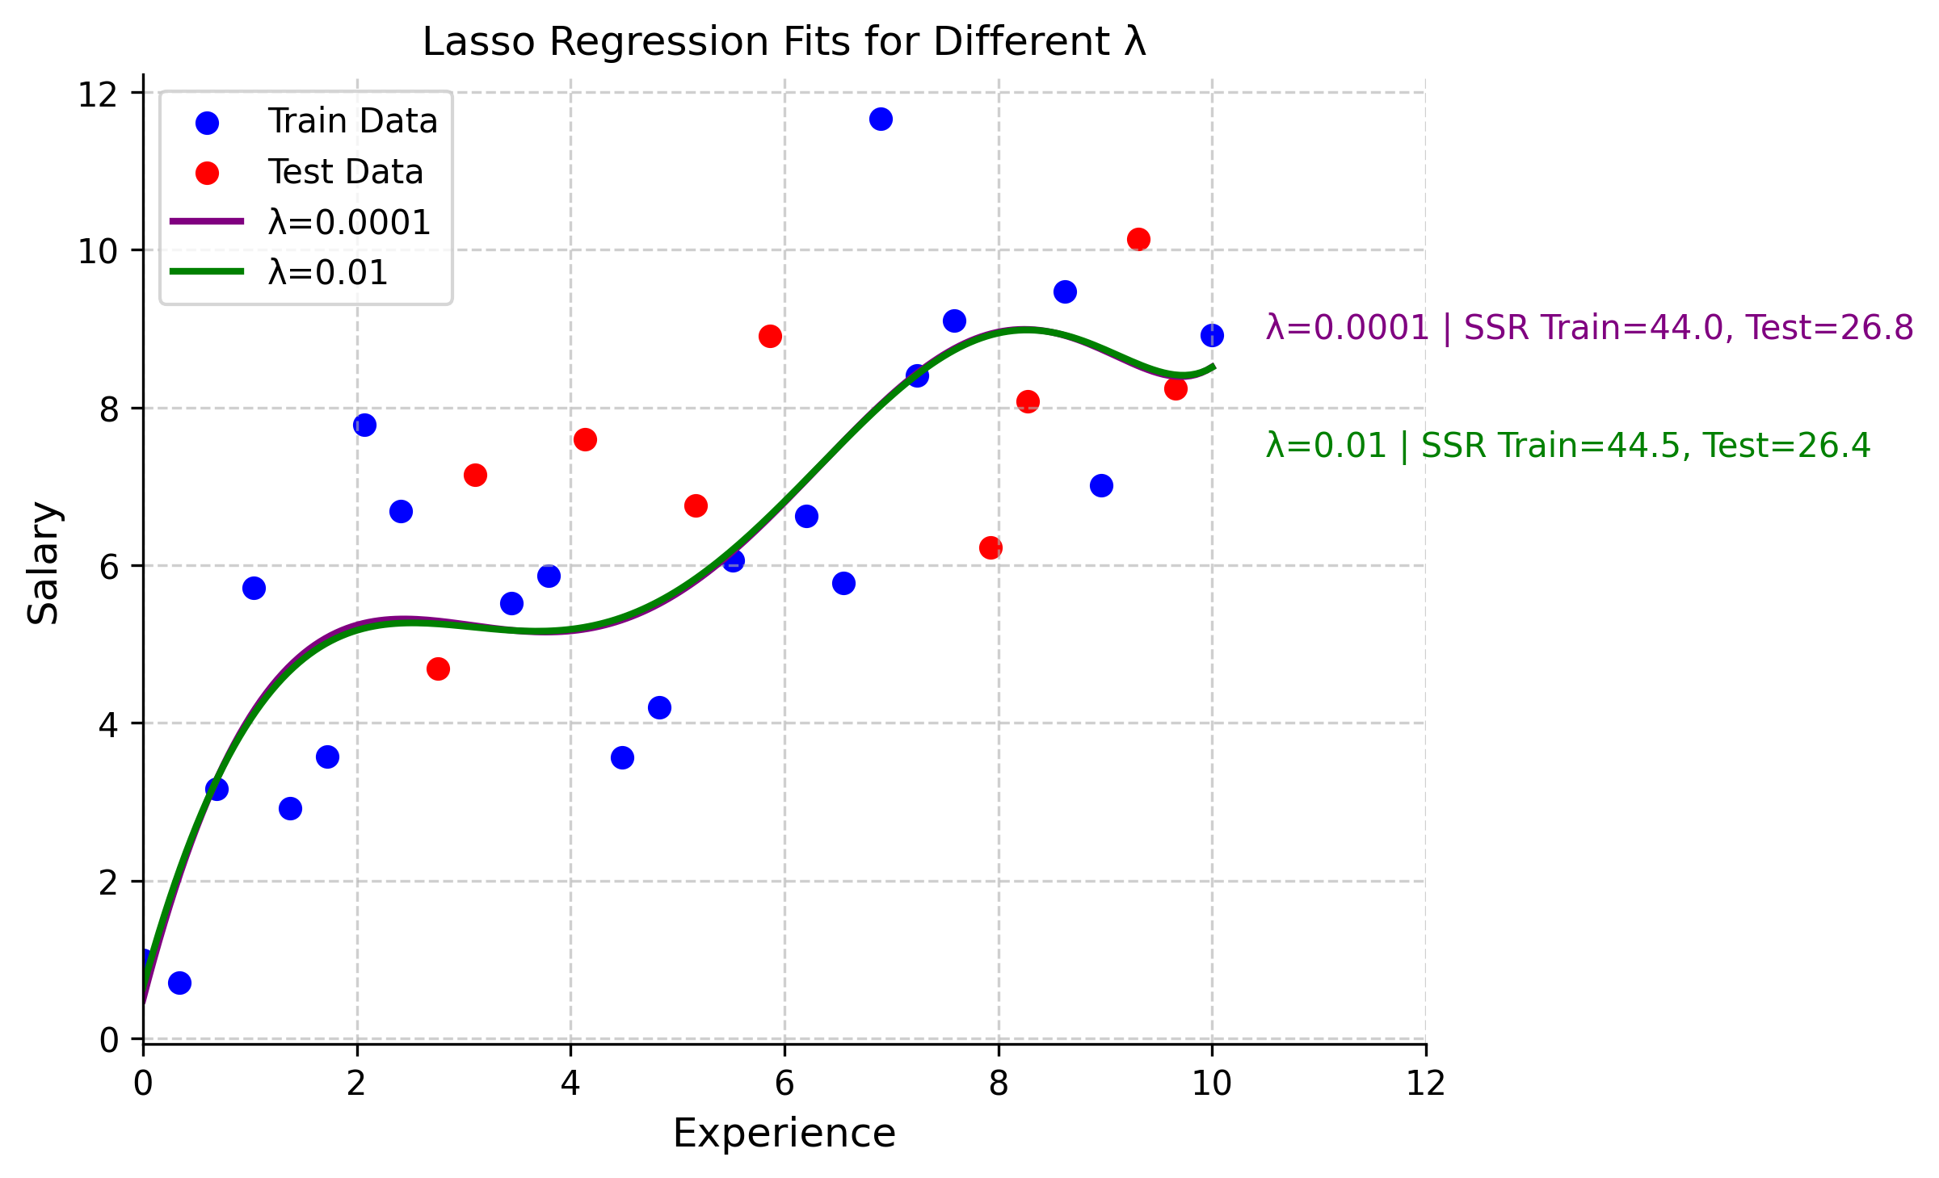

Slide 16
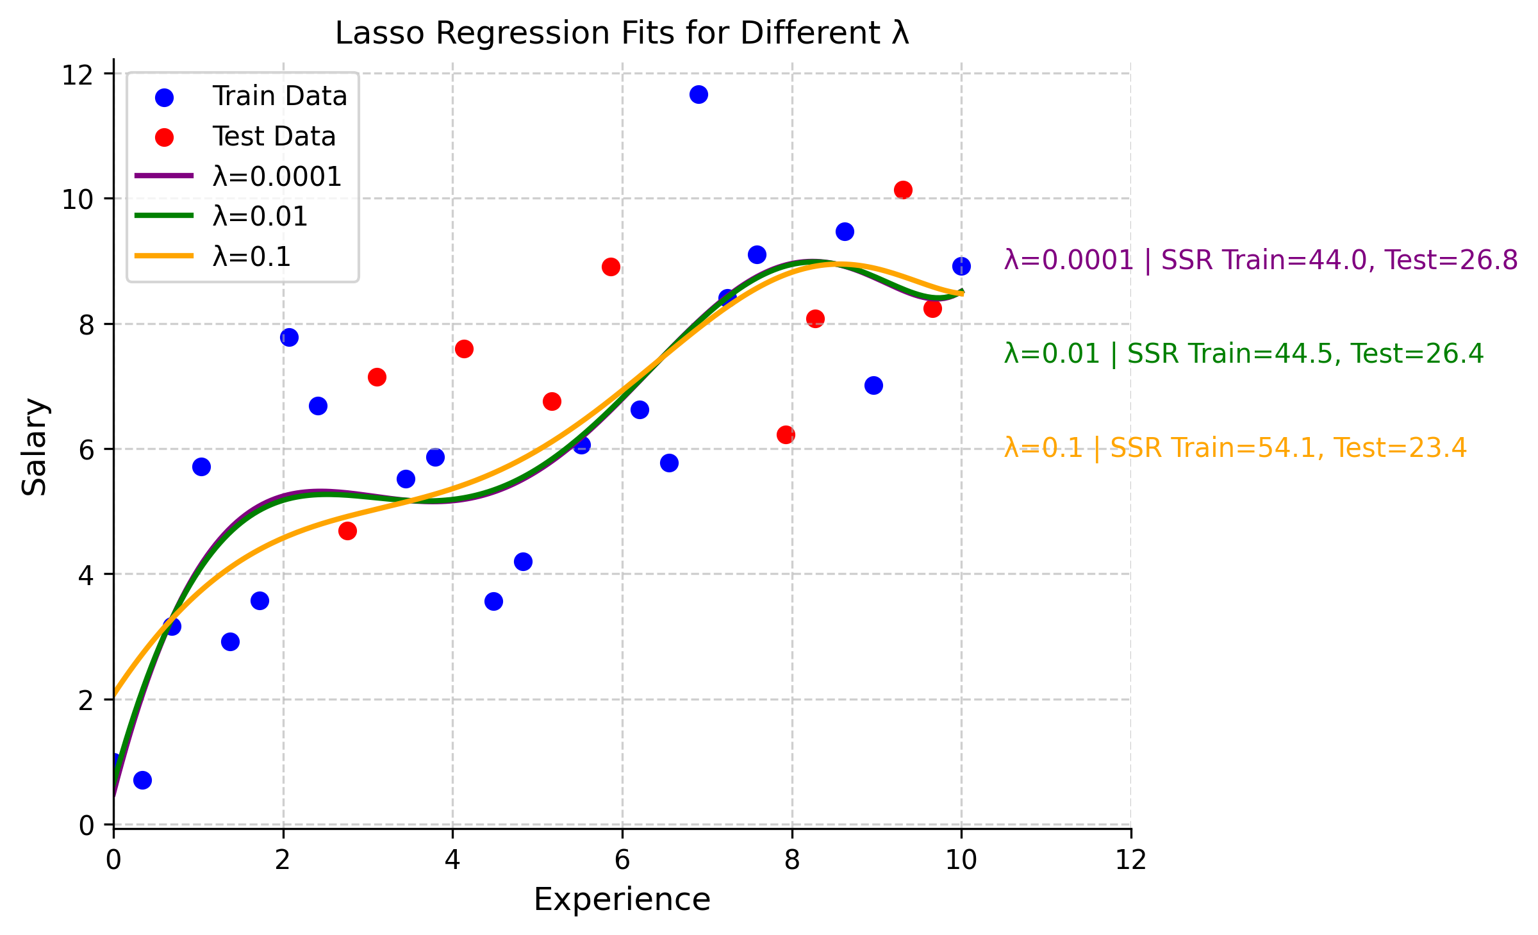

Slide 17
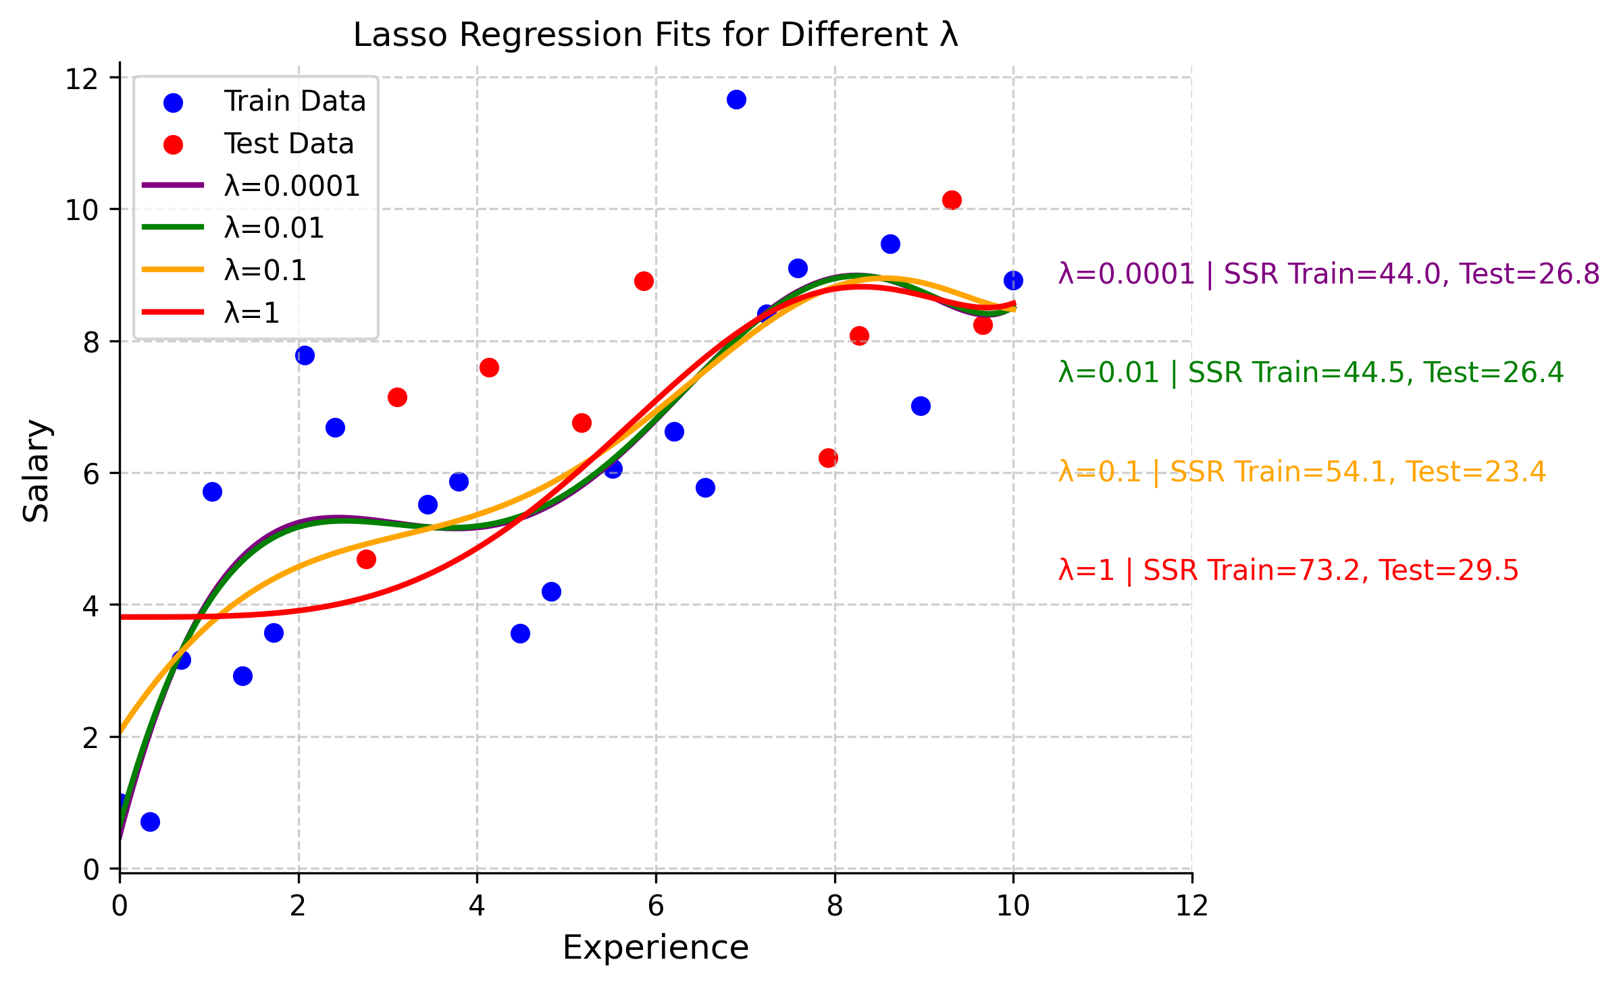

Slide 18
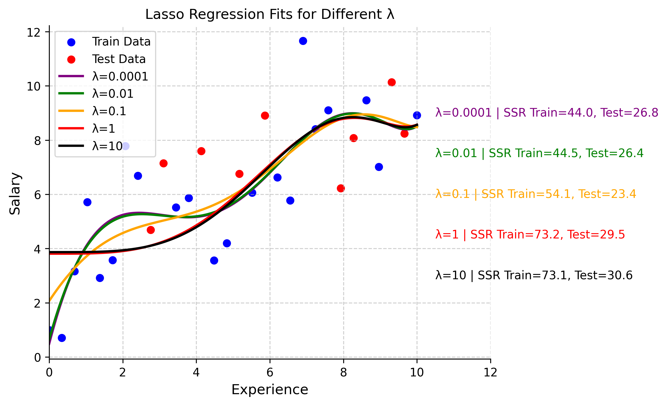

Slide 19
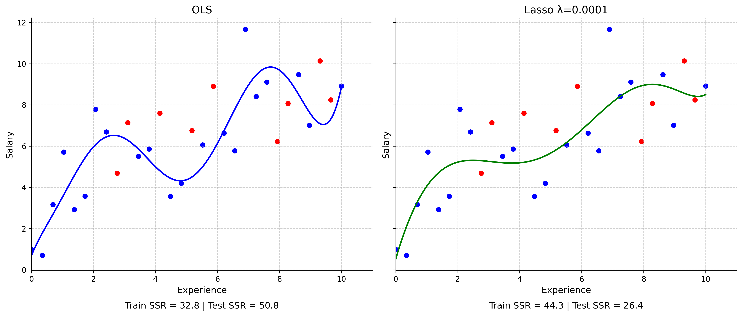

Slide 20
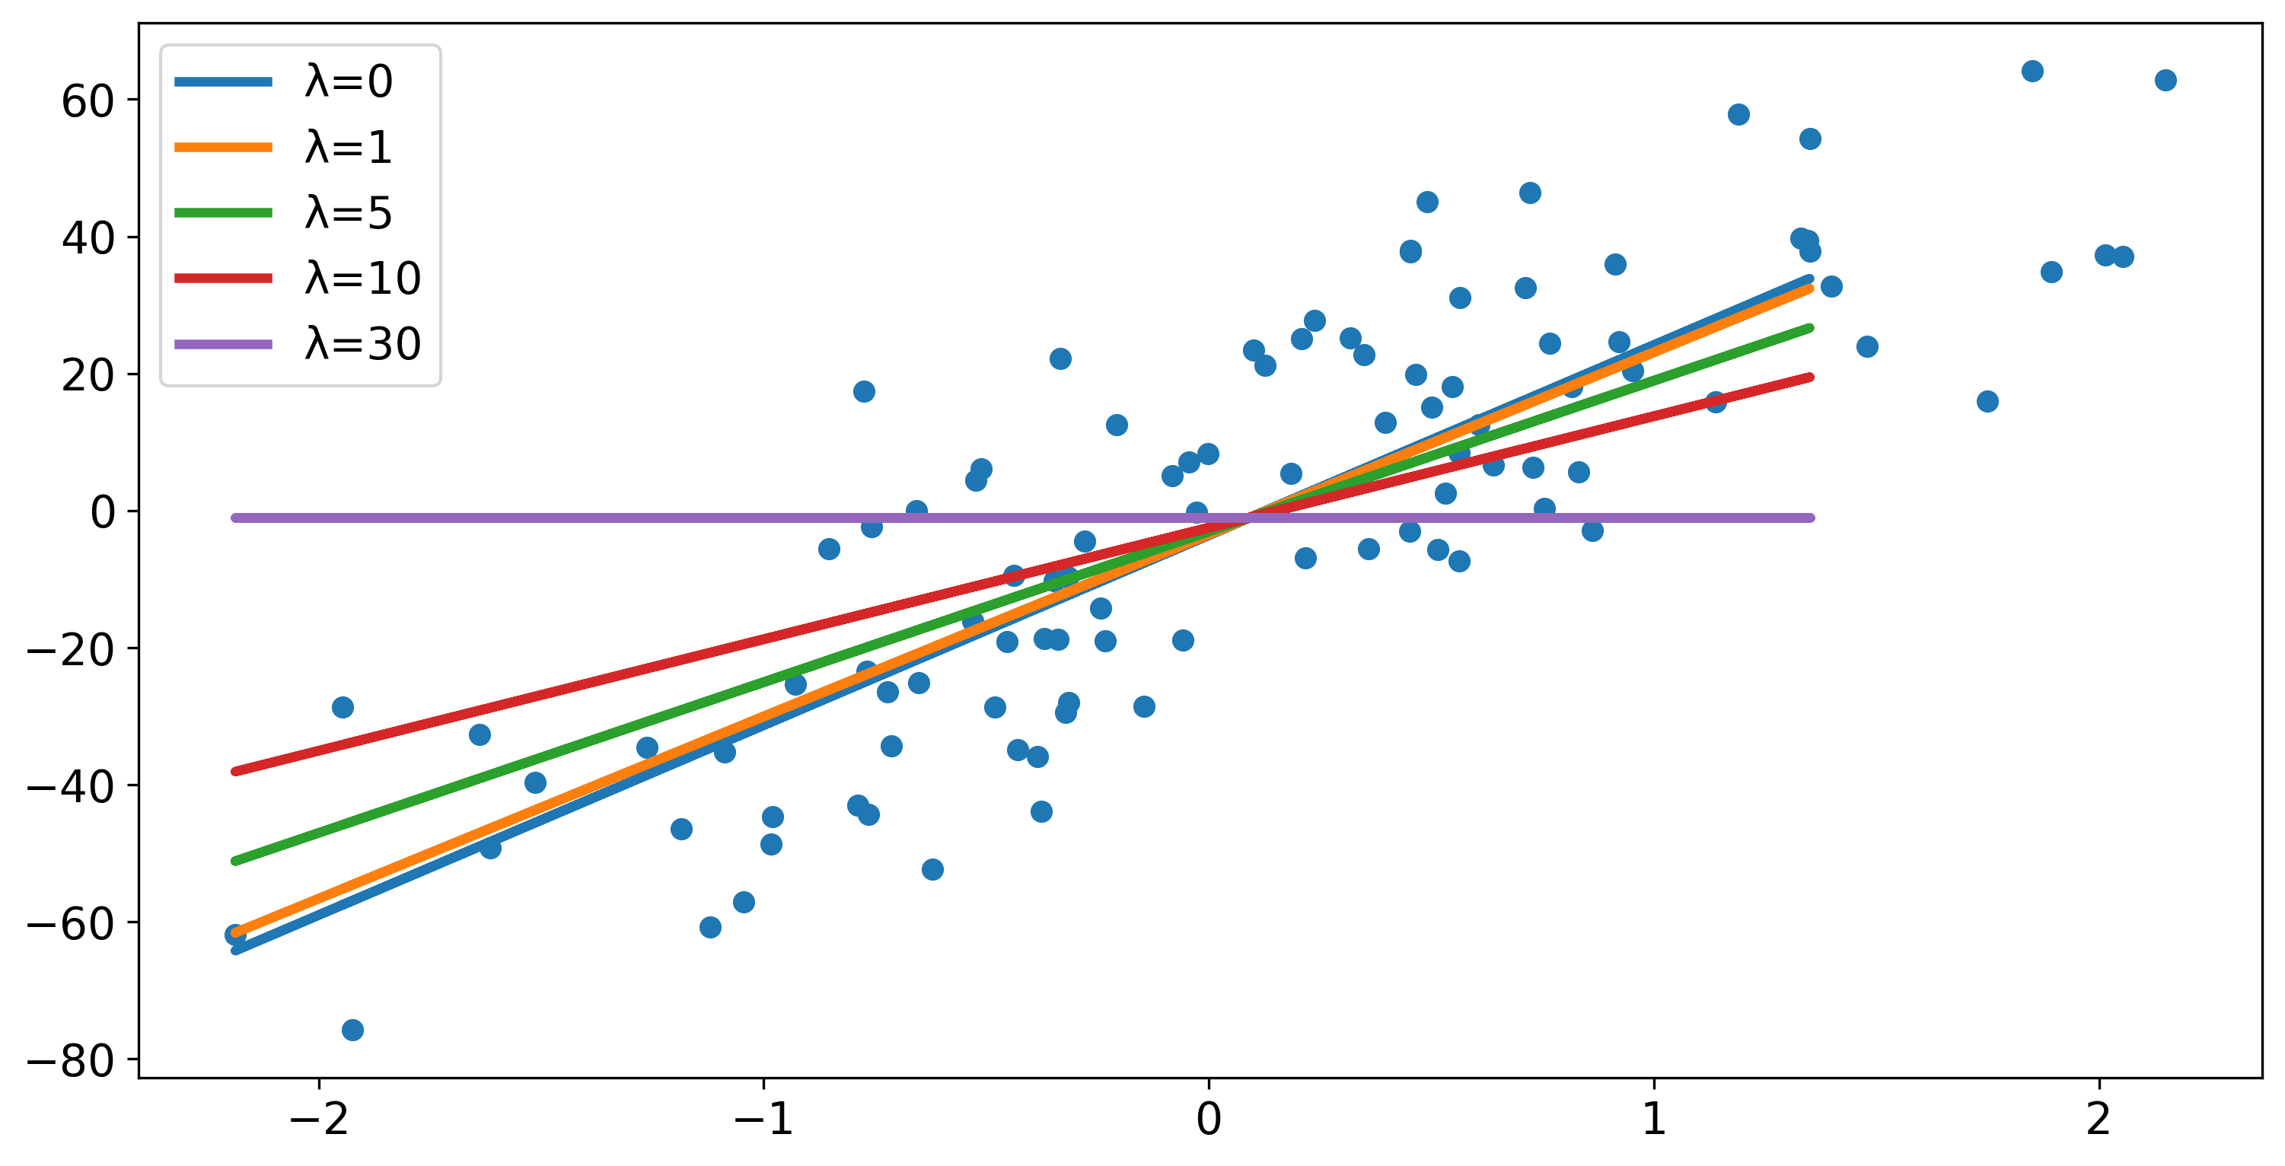
Feature Selection
Feature selection is a technique which is used to determine the explanatory variables(features) which have maximum effect on the response variable.
This is quite a necessary thing when you have a high dimensional data. You retain only the variables which actually affect the outcome and remove the uncorrelated variable while forming a model.
But how does Lasso Regression help in this? The simple answer would be - it can make the slope exactly 0.

Slide 21
To demonstrate an example of feature selection using the Lasso Regression, we take example of this Diabetes dataset. The data is of 442 diabetes patients. 15 of them are shown here. The predictor variables are standardised.
Source: North Carolina State University

Slide 22
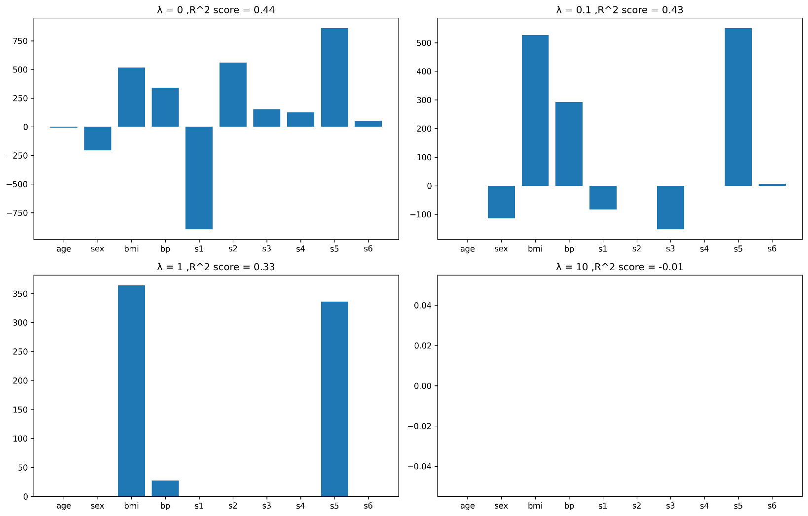
How are coefficients affected?

Slide 23
2. Higher coefficients are affected more.
lambda | age | sex | bmi | bp | s1 | s2 | s3 | s4 | s5 | s6
0 | 29.2540 | -261.7065 | 546.2997 | 388.3983 | -901.9597 | 506.7632 | 121.1543 | 288.0353 | 659.2689 | 41.3767
0.0001 | 29.2678 | -261.6044 | 546.4087 | 388.3010 | -895.5448 | 501.9258 | 118.1027 | 286.8003 | 656.8802 | 41.4161
0.001 | 29.3920 | -260.6857 | 547.3894 | 387.4250 | -837.8318 | 458.4046 | 90.6468 | 275.6888 | 635.3892 | 41.7704
0.01 | 28.2464 | -250.8192 | 556.2159 | 380.6595 | -468.7395 | 166.9934 | -60.2195 | 230.9163 | 492.6344 | 43.9693
0.1 | 0.0000 | -173.2711 | 558.9381 | 339.3537 | -58.7207 | 0.0000 | -274.1135 | 0.0000 | 372.8390 | 25.5868
1 | 0.0000 | 0.0000 | 443.7034 | 51.6011 | 0.0000 | 0.0000 | 0.0000 | 0.0000 | 201.9665 | 0.0000
10 | 0.0000 | 0.0000 | 0.0000 | 0.0000 | 0.0000 | 0.0000 | 0.0000 | 0.0000 | 0.0000 | 0.0000
100 | 0.0000 | 0.0000 | 0.0000 | 0.0000 | 0.0000 | 0.0000 | 0.0000 | 0.0000 | 0.0000 | 0.0000
1000 | 0.0000 | 0.0000 | 0.0000 | 0.0000 | 0.0000 | 0.0000 | 0.0000 | 0.0000 | 0.0000 | 0.0000
10000 | 0.0000 | 0.0000 | 0.0000 | 0.0000 | 0.0000 | 0.0000 | 0.0000 | 0.0000 | 0.0000 | 0.0000

Slide 24
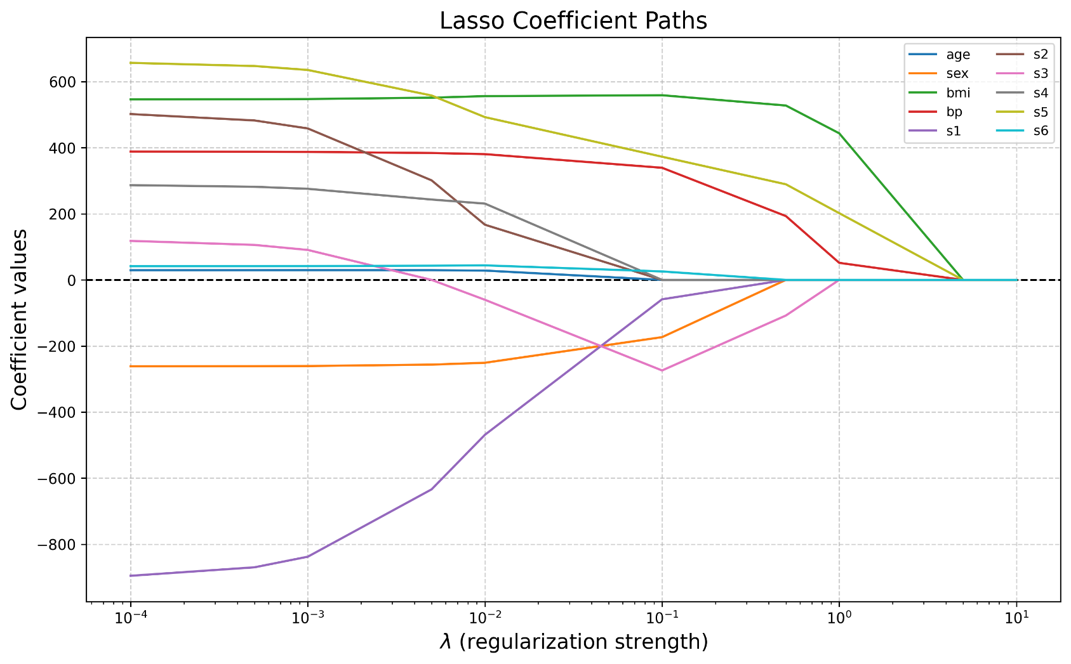
Here is the graph showcasing the drop in coefficients with increase in value of lambda. This is a clear indication that the parameter having higher magnitude of coefficients are penalised more when Lasso Regression is applied.

Slide 25
lambda | age | sex | bmi | bp | s1 | s2 | s3 | s4 | s5 | s6
0 | 29.2540 | -261.7065 | 546.2997 | 388.3983 | -901.9597 | 506.7632 | 121.1544 | 288.0353 | 659.2690 | 41.3767
0.0001 | 29.3697 | -261.5919 | 546.5051 | 388.2367 | -889.7714 | 497.2854 | 115.7430 | 286.2985 | 654.5041 | 41.5448
0.001 | 30.2800 | -260.6340 | 548.0371 | 386.9168 | -794.2892 | 423.1046 | 73.3631 | 272.6458 | 617.1613 | 42.9048
0.01 | 34.1673 | -254.0433 | 550.8449 | 379.1267 | -404.2533 | 123.0292 | -99.0417 | 215.0326 | 463.8426 | 50.3515
0.1 | 39.6635 | -213.8469 | 505.9143 | 341.7145 | -108.8063 | -70.5758 | -211.9066 | 160.1935 | 332.7735 | 77.6805
1 | 45.0542 | -71.9474 | 280.7163 | 195.2127 | -2.2293 | -17.5408 | -148.6889 | 120.4672 | 198.6144 | 106.9347
10 | 16.2309 | -2.9614 | 59.5242 | 43.4213 | 13.8751 | 10.8653 | -37.4958 | 38.7285 | 49.2247 | 34.7380
100 | 2.0728 | -0.0038 | 6.8999 | 5.0851 | 2.0697 | 1.7437 | -4.5089 | 4.9024 | 5.9265 | 4.3287
1000 | 0.2130 | 0.0036 | 0.7017 | 0.5177 | 0.2160 | 0.1831 | -0.4604 | 0.5035 | 0.6053 | 0.4437
10000 | 0.0214 | 0.0004 | 0.0703 | 0.0519 | 0.0217 | 0.0184 | -0.0461 | 0.0505 | 0.0607 | 0.0445
lambda | lasso_non_zero | ridge_non_zero
0 | 10 | 10
0.0001 | 10 | 10
0.001 | 10 | 10
0.01 | 10 | 10
0.1 | 7 | 10
1 | 3 | 10
10 | 0 | 10
100 | 0 | 10
1000 | 0 | 10
10000 | 0 | 10
lambda | age | sex | bmi | bp | s1 | s2 | s3 | s4 | s5 | s6
0 | 29.2540 | -261.7065 | 546.2997 | 388.3983 | -901.9597 | 506.7632 | 121.1543 | 288.0353 | 659.2689 | 41.3767
0.0001 | 29.2678 | -261.6044 | 546.4087 | 388.3010 | -895.5448 | 501.9258 | 118.1027 | 286.8003 | 656.8802 | 41.4161
0.001 | 29.3920 | -260.6857 | 547.3894 | 387.4250 | -837.8318 | 458.4046 | 90.6468 | 275.6888 | 635.3892 | 41.7704
0.01 | 28.2464 | -250.8192 | 556.2159 | 380.6595 | -468.7395 | 166.9934 | -60.2195 | 230.9163 | 492.6344 | 43.9693
0.1 | 0.0000 | -173.2711 | 558.9381 | 339.3537 | -58.7207 | 0.0000 | -274.1135 | 0.0000 | 372.8390 | 25.5868
1 | 0.0000 | 0.0000 | 443.7034 | 51.6011 | 0.0000 | 0.0000 | 0.0000 | 0.0000 | 201.9665 | 0.0000
10 | 0.0000 | 0.0000 | 0.0000 | 0.0000 | 0.0000 | 0.0000 | 0.0000 | 0.0000 | 0.0000 | 0.0000
100 | 0.0000 | 0.0000 | 0.0000 | 0.0000 | 0.0000 | 0.0000 | 0.0000 | 0.0000 | 0.0000 | 0.0000
1000 | 0.0000 | 0.0000 | 0.0000 | 0.0000 | 0.0000 | 0.0000 | 0.0000 | 0.0000 | 0.0000 | 0.0000
10000 | 0.0000 | 0.0000 | 0.0000 | 0.0000 | 0.0000 | 0.0000 | 0.0000 | 0.0000 | 0.0000 | 0.0000
BUT WHY?
Why is Lasso Regression is able to turn coefficients to 0 while Ridge regression cannot do that??

Slide 26
Methods for Optimal Lambda Selection in Lasso Regression
1. Cross-Validation (Gold Standard)
Method: K-fold CV to find lambda with minimum mean squared error
✓ Pros: Robust, statistically sound, widely accepted
✗ Cons: Computationally intensive for large datasets
2. Validation Set Approach
Method: Holdout validation set to test different lambdas
✓ Pros: Simple implementation, computationally efficient
✗ Cons: Wastes data, results depend on random split
3. Information Criteria (AIC/BIC)
Method: Uses theoretical criteria balancing fit and complexity
✓ Pros: No cross-validation needed, single training pass
✗ Cons: Can be conservative, may not optimize prediction error
4. Visualization (Regularization Path)
Method: Plot coefficient paths vs lambda values
✓ Pros: Provides intuitive understanding, shows feature importance
✗ Cons: Subjective, requires experience to interpret
Recommended Approach
Start with cross-validation → Validate with holdout set → Visualize paths
Balance: Statistical optimality + Model interpretability + Computational cost

Slide 27
Conclusion
Simple Reminder of the Problem
In regression, too many predictors → risk of overfitting.
We want models that are accurate and interpretable.
What Lasso Does
Adds a penalty on large coefficients (L1 penalty).
Shrinks some coefficients to exactly zero → performs feature selection.
Balances the bias-variance trade off → better prediction on new data.
Why It’s Useful
Works well when predictors are many or correlated.
Produces sparser models → easier to explain.
Widely applied in finance, genetics, image analysis, NLP, etc.
“Lasso is not just a shrinkage method like Ridge; it is also a tool for automatic feature selection, making it a bridge between simple regression and modern machine learning.”
“Lasso = Simpler models, Stronger predictions”

Slide 28
References
Regression Shrinkage and selection via the Lasso
Regression Shrinkage and shrinkage via the Lasso: a retrospective
Sparsity and smoothness via the fused Lasso
Lasso Regression and Forecasting Models, Jorge A. Chan Lau
Interview with Rob Tibshirani on Lasso
www.youtube.com/campusx
www.youtube.com/KrishNaik

