Slide 1
Data Science and Data Type
Created By : Alok Dadarya

Slide 2
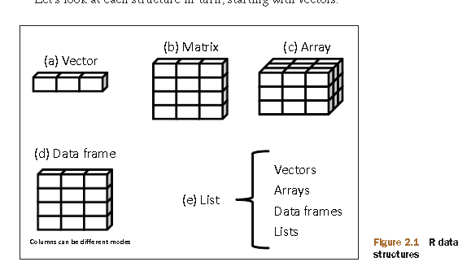
R Data Type

Slide 3
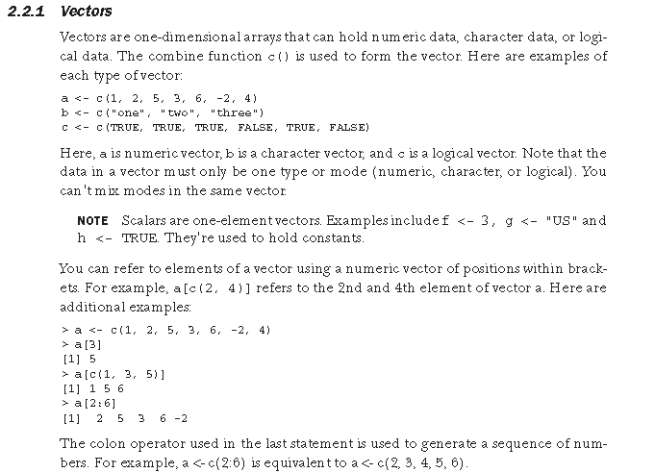
Vector

Slide 4
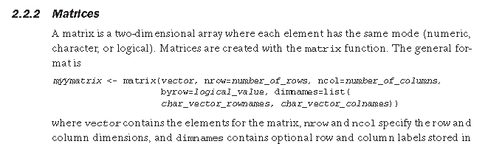
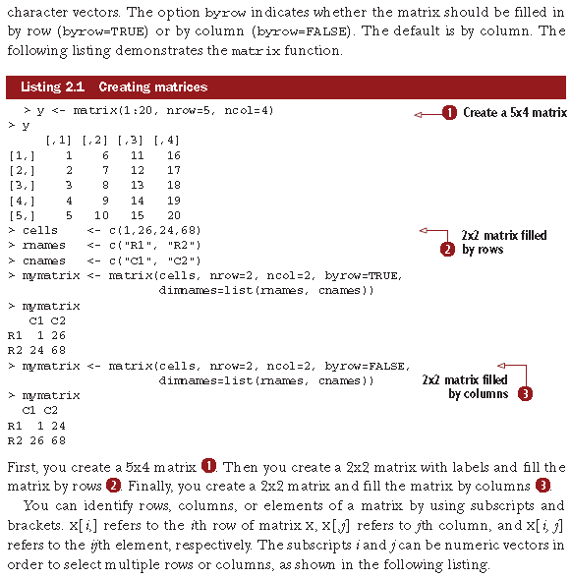
Matrices Refer R_in_action-2011

Slide 5
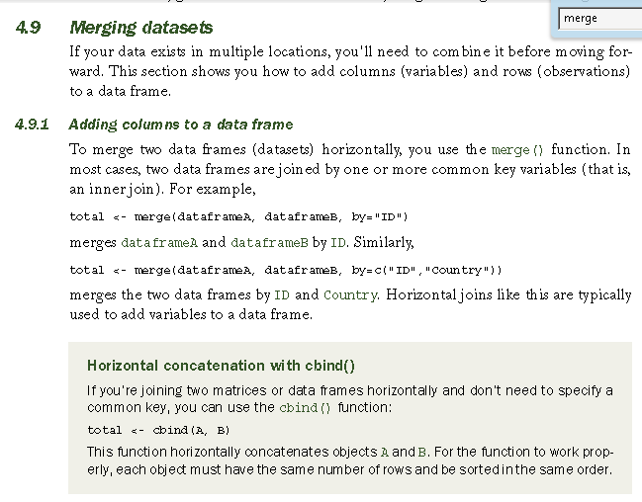
Merge

