Slide 1
Pathview

Slide 2
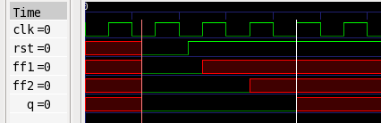
Testcase
module flop3(d, clk, rst, q);
input d, clk, rst;
output q;
wire ff1, ff2;
flop inst_ff1(.d(d), .clk(clk), .rst(rst), .q(ff1));
flop inst_ff2(.d(ff1), .clk(clk), .rst(rst), .q(ff2));
flop inst_ff3(.d(ff2), .clk(clk), .rst(rst), .q(q));
endmodule
module flop(d, clk, rst, q);
input d, clk, rst;
output reg q;
always @(posedge clk or negedge rst)
if (~rst)
q <= 1'b0;
else
q <= d;
endmodule
module tb;
reg d, clk, rst;
wire q;
wire ff1, ff2;
flop3 dut(.d(d), .clk(clk), .rst(rst), .q(q));
initial begin
clk = 1'b0;
forever begin
#5 clk = ~clk;
end
end
initial begin
#12 rst = 1'b0;
#10 rst = 1'b1;
#100 $finish;
end
endmodule
12
22
35
45
25

Slide 3
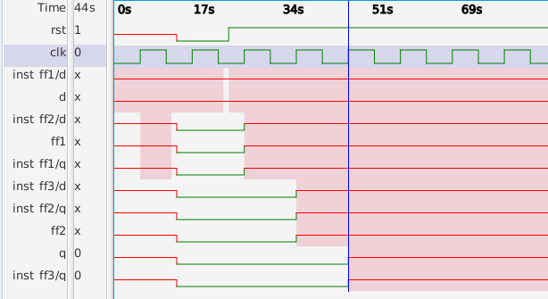
Assertion and Waveform
TEST2: assert iflow (d when (rst occurred) =/=> q);

Slide 4

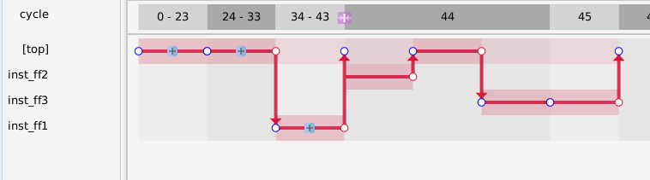


Pathview
2. The simulation event is ‘ff1 -> inst_ff2/q’ happening at 35
Should be shown as timestamp (ns)
2
1
3
4
4. The simulation event is ‘ff2 -> q’ happening at 45. At this point the assertion is violated.
1. The simulation event is ‘d -> inst_ff1/q’ happening at 25
3. Same information as in ‘2’. Not clear why the downward arrow

Slide 5
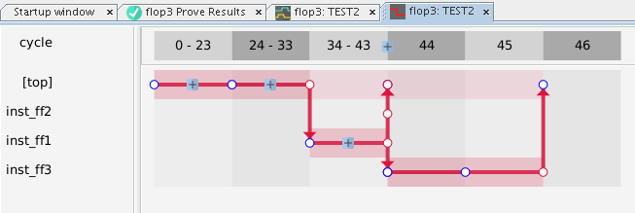
Pathview (collapsed view)
1
ff2 -> inst_ff3/d
There should not be any simulation event at 43/44
(1), (2) and (3) are unnecessary information to the user.
Showing two (2) time blocks (44 and 45) may not be necessary
2
inst_ff2/q -> ff2
3
inst_ff1/q -> ff1
4
inst_ff3/d -> inst_ff3/q

Slide 6
Suggestions
Pathview needs to be conveying ‘crisp’ (only necessary) information about why the path is established (described in time progession)
Better to report the events on the sequential devices as aligned with clock edges (desirable to show the clock edges, even if there are multiple clocks in the design)
Eliminate the instances in the display (e.g. ‘inst_ff1’, ‘inst_ff2’, etc.). Instead click on a node and see the transition in terms of the full hierarchical nodes (e.g. ‘top.A.B.C.sig1 -> top.B.sig2’)
Show ‘context-sensitive’ waveform localized to the dot in the display

Slide 7
My idea of the pathview for this test
Time
25
35
25
0
Source -> d
d -> ff1
ff1 -> ff2
ff2 -> q
Give option to show localized waveform
Give option to show localized waveform
Give option to show localized waveform

