Slide 1

Uyir Hackathon - 2025
Finals Presentation
Guardians of the Roads
“Accident Hotspot prediction and prevention system.”
UYIR - Hackathon2k25 ID: UH_STUD_0834
Category: Students
Team Name: Undefined Pair
Team Leader: Akanksha Priyadarshinee Rath
Team Members' Names: Alok Gupta

Slide 2
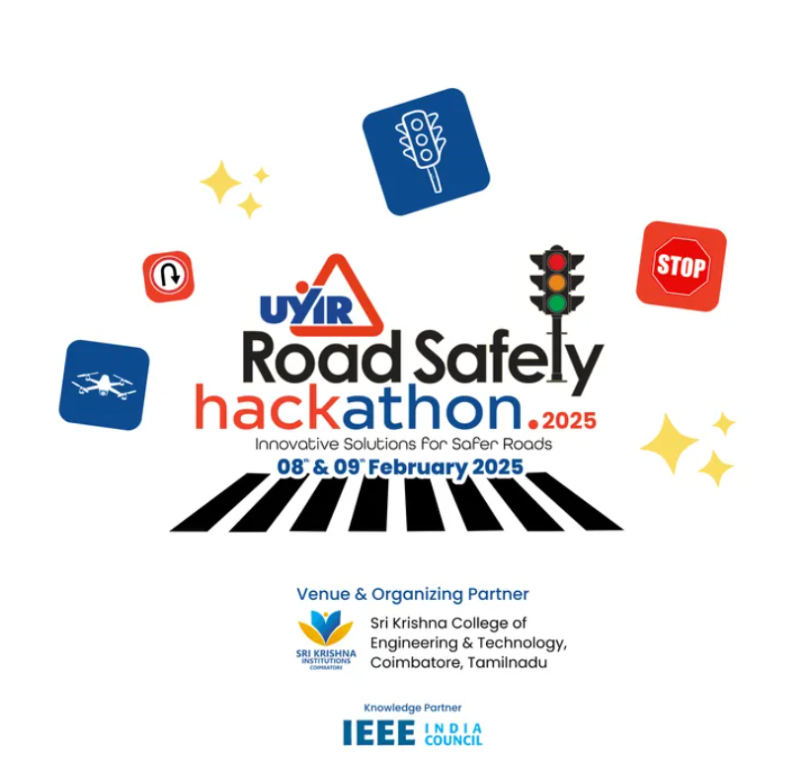

Slide 3
Problem Statement & Objective
Problem Statement:
Coimbatore is a rapidly growing urban hub, but this growth has brought challenges like frequent road accidents due to:
High Traffic Volume: Increased vehicular density on narrow roads.
Complex Intersections: Poorly designed junctions that lead to confusion and accidents.
Lack of Real-Time Monitoring: Limited data-driven solutions to anticipate risks.
Why It Matters:
Human Cost: Road accidents claim over 11 lives daily in Tamil Nadu alone (source: NCRB).
Economic Loss: Accidents cost 3-5% of India’s GDP annually due to healthcare expenses, productivity loss, and infrastructure damage.
Urban Mobility Challenges: Inefficient traffic management reduces the quality of life for citizens.
Objective:
To create a predictive and preventive road safety system that:
Identifies Accident Hotspots: Leverages AI and IoT for accurate and real-time predictions.
Prevents Accidents: Provides actionable insights to drivers and traffic authorities.
Engages Communities: Encourages public participation in road safety reporting and awareness campaigns.

Slide 4
Methodology
Data Collection:
Partner with Coimbatore Traffic Police and Tamil Nadu State Transport Corporation for historical accident and traffic data.
Deploy IoT devices like cameras and speed sensors in collaboration with Bosch India and Hikvision.
Prediction Model:
Develop ML models using algorithms like Gradient Boosting and Random Forest with support from IIT Madras and startups like Fractal Analytics.
Real-Time Monitoring:
Integrate IoT-enabled devices for speed, vehicle density, and environmental monitoring.
Use Google Maps APIs for live traffic analysis.
Prevention Systems:
Install smart traffic lights and adaptive warning systems with Schneider Electric.
Create a mobile app with MapmyIndia for driver alerts and hazard reports.
Community Reporting:
Launch a gamified citizen reporting feature integrated with popular apps like Ola and Uber.

Slide 5
Novelty /Contribution & Expected Outcome
Novelty /Contribution:
🚀 AI-Powered Predictions: Unlike static maps, our ML model updates accident hotspots every 5 minutes.
🚀 Real-Time Response: IoT-enabled sensors & edge computing ensure instant hazard detection.
🚀 Community-Driven Infrastructure: Citizen reports refine dynamic traffic management.
Expected Outcomes:
📉 30-40% reduction in accidents at major hotspots.
📲 40% more informed drivers via real-time alerts.
⏳ 50% faster incident response with live monitoring & AI-powered alerts.
🌍 Scalable model for nationwide adoption.
Expected Difficulties:
⚠️ Data Synchronization: Merging IoT data in real-time.
⚠️ Adoption Hurdles: Resistance to tech-driven traffic systems.

Slide 6

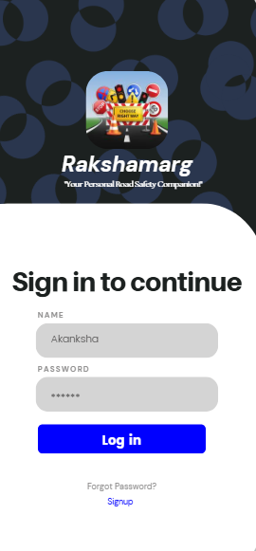
Architecture Diagram
Key Elements:
IoT Devices- Collection of real-time data (traffic density, speed, and environmental factors) via IoT & GPS devices.
Cloud Processing-High-volume data is transferred to the app and stored and analyzed on cloud platforms to extract actionable insights.
ML-Algorithm- Algorithms predict accident hotspots based on historical and real-time inputs like weather & road conditions, historical accident types and timings.
Dynamic Alert Systems- IoT-enabled warning boards and smart traffic lights provide real-time alerts to drivers.
Mobile App(RakshaMarg)- Sends location-specific safety notifications and updates to all users.
Government Dashboard- Offer heatmaps, traffic analytics, and recommendations for improving road safety through user feedback.
TRL (Technology Readiness Level):
Current Level (TRL 6): Prototype demonstrated in a simulated urban setting with real-time traffic scenarios.
Future Goal (TRL 9): Fully operational implementation across Coimbatore and other Indian cities with scalability for nationwide adoption.

Slide 7
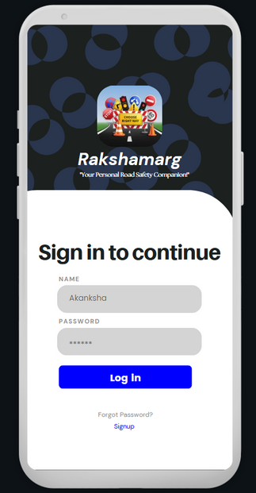
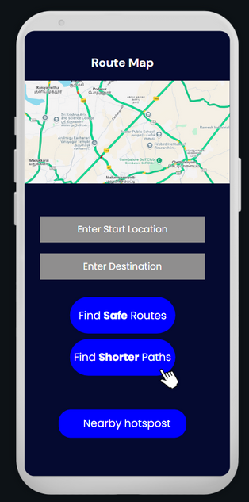
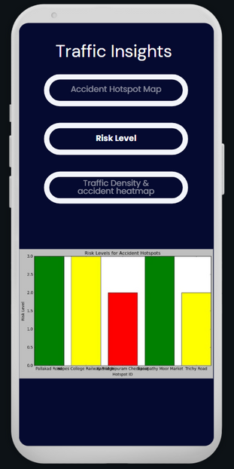

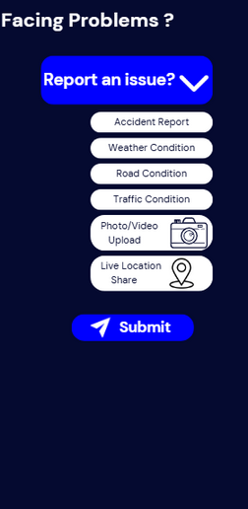
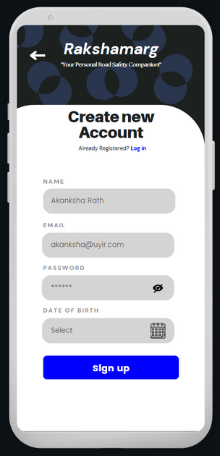
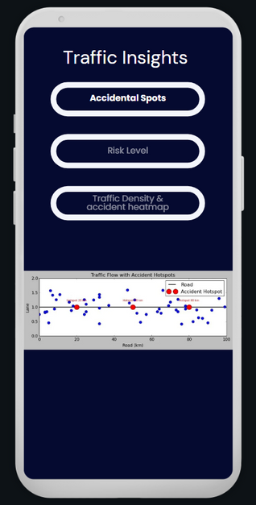
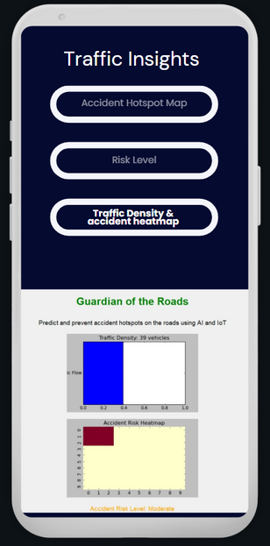
App Prototype
(https://shorturl.at/TTaSq)

Slide 8
Approximate Cost Estimate & Key Benefits
Approximate Cost Estimate:
IoT Devices and Sensors: ₹8,00,000 (via Bosch India, Hikvision).
AI Model Development: ₹4,00,000 (collaborate with IIT Madras).
Mobile App Development: ₹3,00,000
Tech Stack: Flutter or React Native will enable cost-effective, cross-platform app development.
Partnerships with local tech firms such as Zoho Corp (based in Tamil Nadu) to streamline development and maintenance.
Total: ₹17,00,000 (Cost-effective solution leveraging public-private partnerships and academic collaboration.)
Key Benefits:
Prevent Over 500 Fatalities Annually:
Targeting accident-prone hotspots with dynamic interventions to significantly reduce casualties.
Reduce Economic Losses by ₹10 Crore Per Year:
Avoid medical expenses, repair costs, and productivity losses associated with road accidents.
Improve Traffic Flow:
Enhancing road safety and optimizing traffic management will reduce idle emissions by over 15-20%, improving air quality.
Replicable and Scalable Model:
This initiative serves as a blueprint for other Indian cities aiming for smart and sustainable urban road safety solutions.

