Slide 2
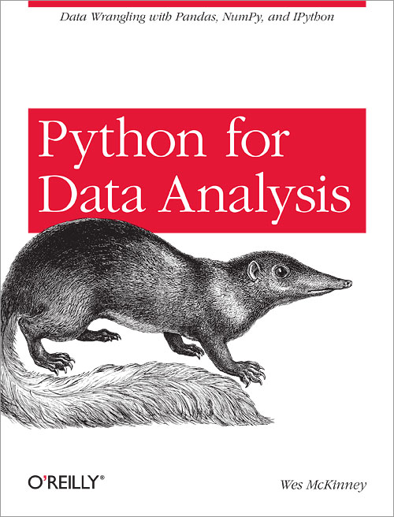


Slide 3
Computing Environment
Data
Code

Slide 4


Slide 5


