Slide 1
Capstone Project (Adventure Works Cycles)
Presented by: Alok Jha Roll No: P2527050
Program: PGDM (Finance)
Institute: Thakur Global Business School
Academic Year: 2025–2027

Slide 2
Project Background
Adventure Works Cycles is a multinational bicycle manufacturing company operating across North America, Europe, and Asia
The company expanded operations by acquiring a manufacturing plant in Mexico, responsible for producing key subcomponents
The business aims to:
Expand market share by targeting high-value customers
Enhance product availability through digital channels
Optimize production costs to improve profitability

Slide 3
Objective of the Project
To analyze overall sales performance and profitability
To identify key products, categories, and markets driving revenue
To understand customer behavior and purchasing patterns
To evaluate business risks such as product and market concentration
To build an interactive dashboard using Power BI for data-driven decision making

Slide 4
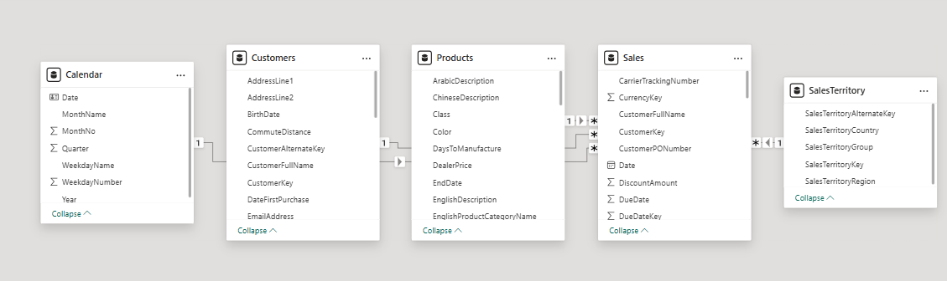
Data & Model Overview
The dataset consists of Sales, Customers, Products, Calendar, and Territory tables
A star schema model is used to organize the data efficiently
The Sales table acts as the central fact table, capturing transaction-level information
Customers, Products, Calendar, and Territory tables act as dimension tables
Relationships between tables enable cross-filtering and interactive analysis
Data modeling ensures accurate and efficient reporting in Power BI

Slide 5
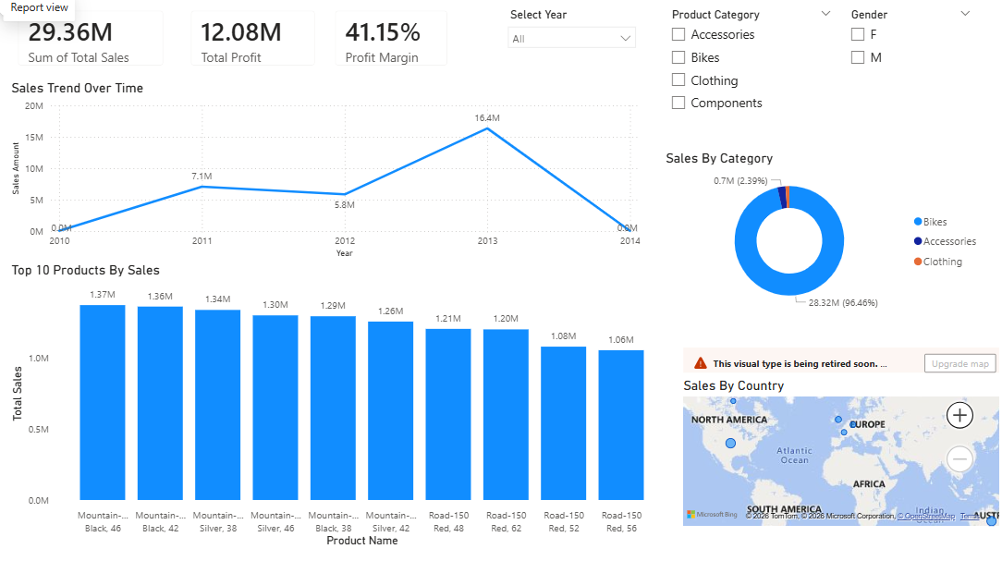
Sales Overview Dashboard
This dashboard provides an overview of sales performance, product trends, and geographic distribution.

Slide 6
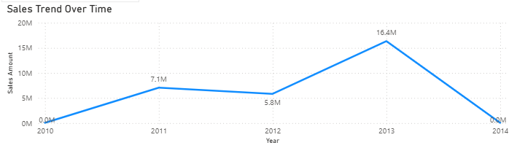
Key Sales Insights
Total sales reached 29.36M with a strong profit margin of 41%, indicating high profitability
Revenue is highly concentrated in the Bikes category (~96%), creating significant product dependency risk
Sales show a strong upward trend with a minor dip in 2012, followed by a peak in 2013 (16.4M)
The sharp decline observed in 2014 is likely due to incomplete data, not actual performance
Sales are primarily concentrated in North America and Europe, with additional presence in Australia, indicating limited geographic diversification

Slide 7
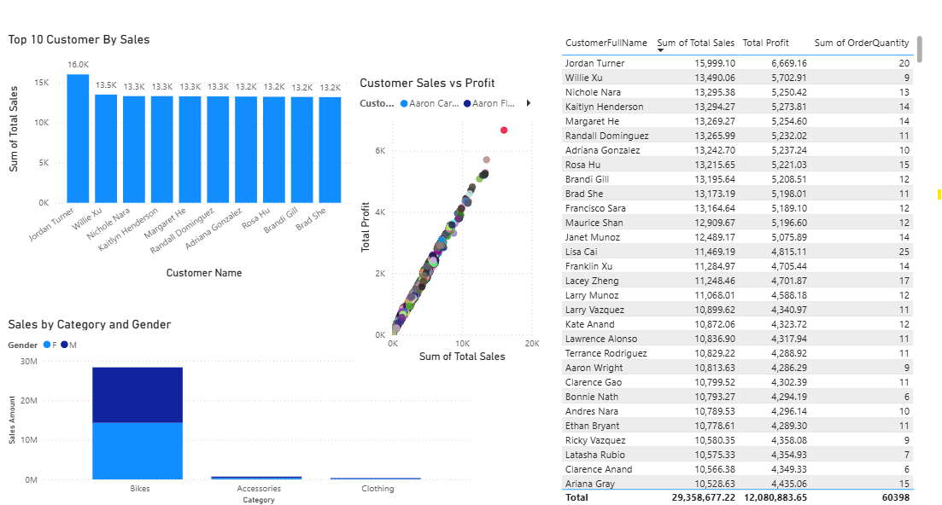
Customer Insights Dashboard
This dashboard provides insights into customer behavior, purchasing patterns, and profitability analysis.

Slide 8
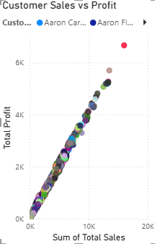
Key Customer Insights
Top customers generate sales in the range of 13K–16K, indicating a balanced revenue distribution
Profit ranges between 5K–7K, reflecting a consistent margin structure (~40%) across customers
Strong linear relationship between sales and profit indicates stable and predictable profitability
Bike sales are almost evenly distributed between male and female customers (14.3M vs 14.0M), indicating a balanced customer base
Absence of major outliers suggests uniform pricing and cost structure across customers

Slide 9
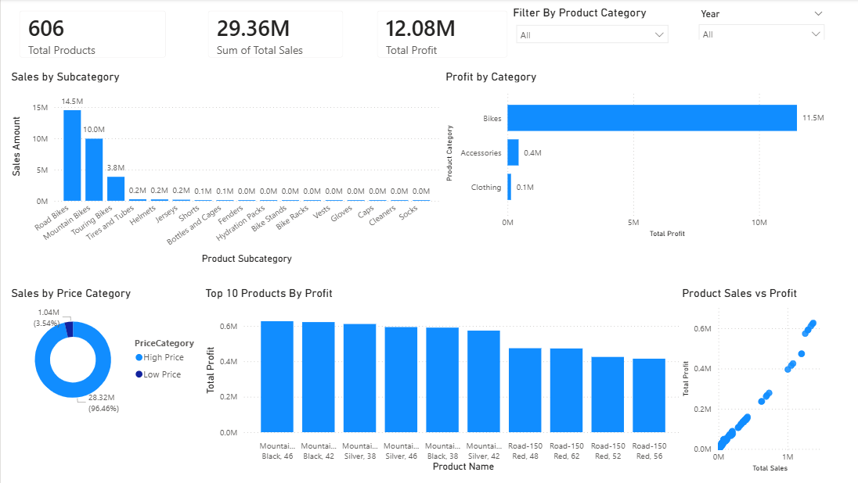
Product Insights Dashboard
This dashboard provides insights into product performance, pricing behavior, and profitability across categories and subcategories

Slide 10
Key Product Insights
Sales are driven primarily by specific subcategories, indicating uneven product contribution
Profitability varies across categories, highlighting differences in cost and pricing structure
High-price and low-price product segments both contribute to revenue, showing diverse pricing impact
Top products generate significantly higher profit, indicating key revenue drivers
Strong relationship between product sales and profit reflects consistent margin behavior

Slide 11
Strategic Insights & Recommendations
Revenue is highly concentrated in the Bikes category (~96%), creating significant product dependency risk
Product-level analysis shows that a few subcategories and products drive most sales and profit, indicating uneven contribution
Sales are concentrated in North America and Europe, with additional presence in Australia, limiting geographic diversification
Customer profitability remains stable (~40% margins) with a balanced gender contribution (14.3M vs 14.0M)
Growth opportunities exist through product diversification, expansion into new markets, and optimizing product mix and pricing strategies

Slide 12
Conclusion
The business demonstrates strong sales performance and high profitability (~41% margin)
Revenue is heavily concentrated in the Bikes category (~96%), creating product dependency risk
Product-level analysis shows that a limited number of subcategories and products drive most sales and profit
Customer base is well distributed with stable margins (~40%), indicating consistent operational performance
Sales are concentrated in developed markets, highlighting the need for geographic expansion
Future growth depends on diversification across products, markets, and optimization of product mix

Slide 13
THANK YOU

