Slide 1

Structural Gravity Model Estimation Using India-CPTPP Trade Data & Counterfactual Analysis
RESEARCH SYNOPSIS

Slide 2
CONTENTS
Introduction
International Trade and Trade Agreements
Research Gap & Literature Review
The Gravity Model in International Trade
Structural Gravity Model
Literature Review
Objective
Methodology
Data & Data Sources
Variable Description
Model Specification
Estimation Techniques
Hypothesis Testing & Counterfactual Analysis
Tentative Conclusion
References

Slide 3
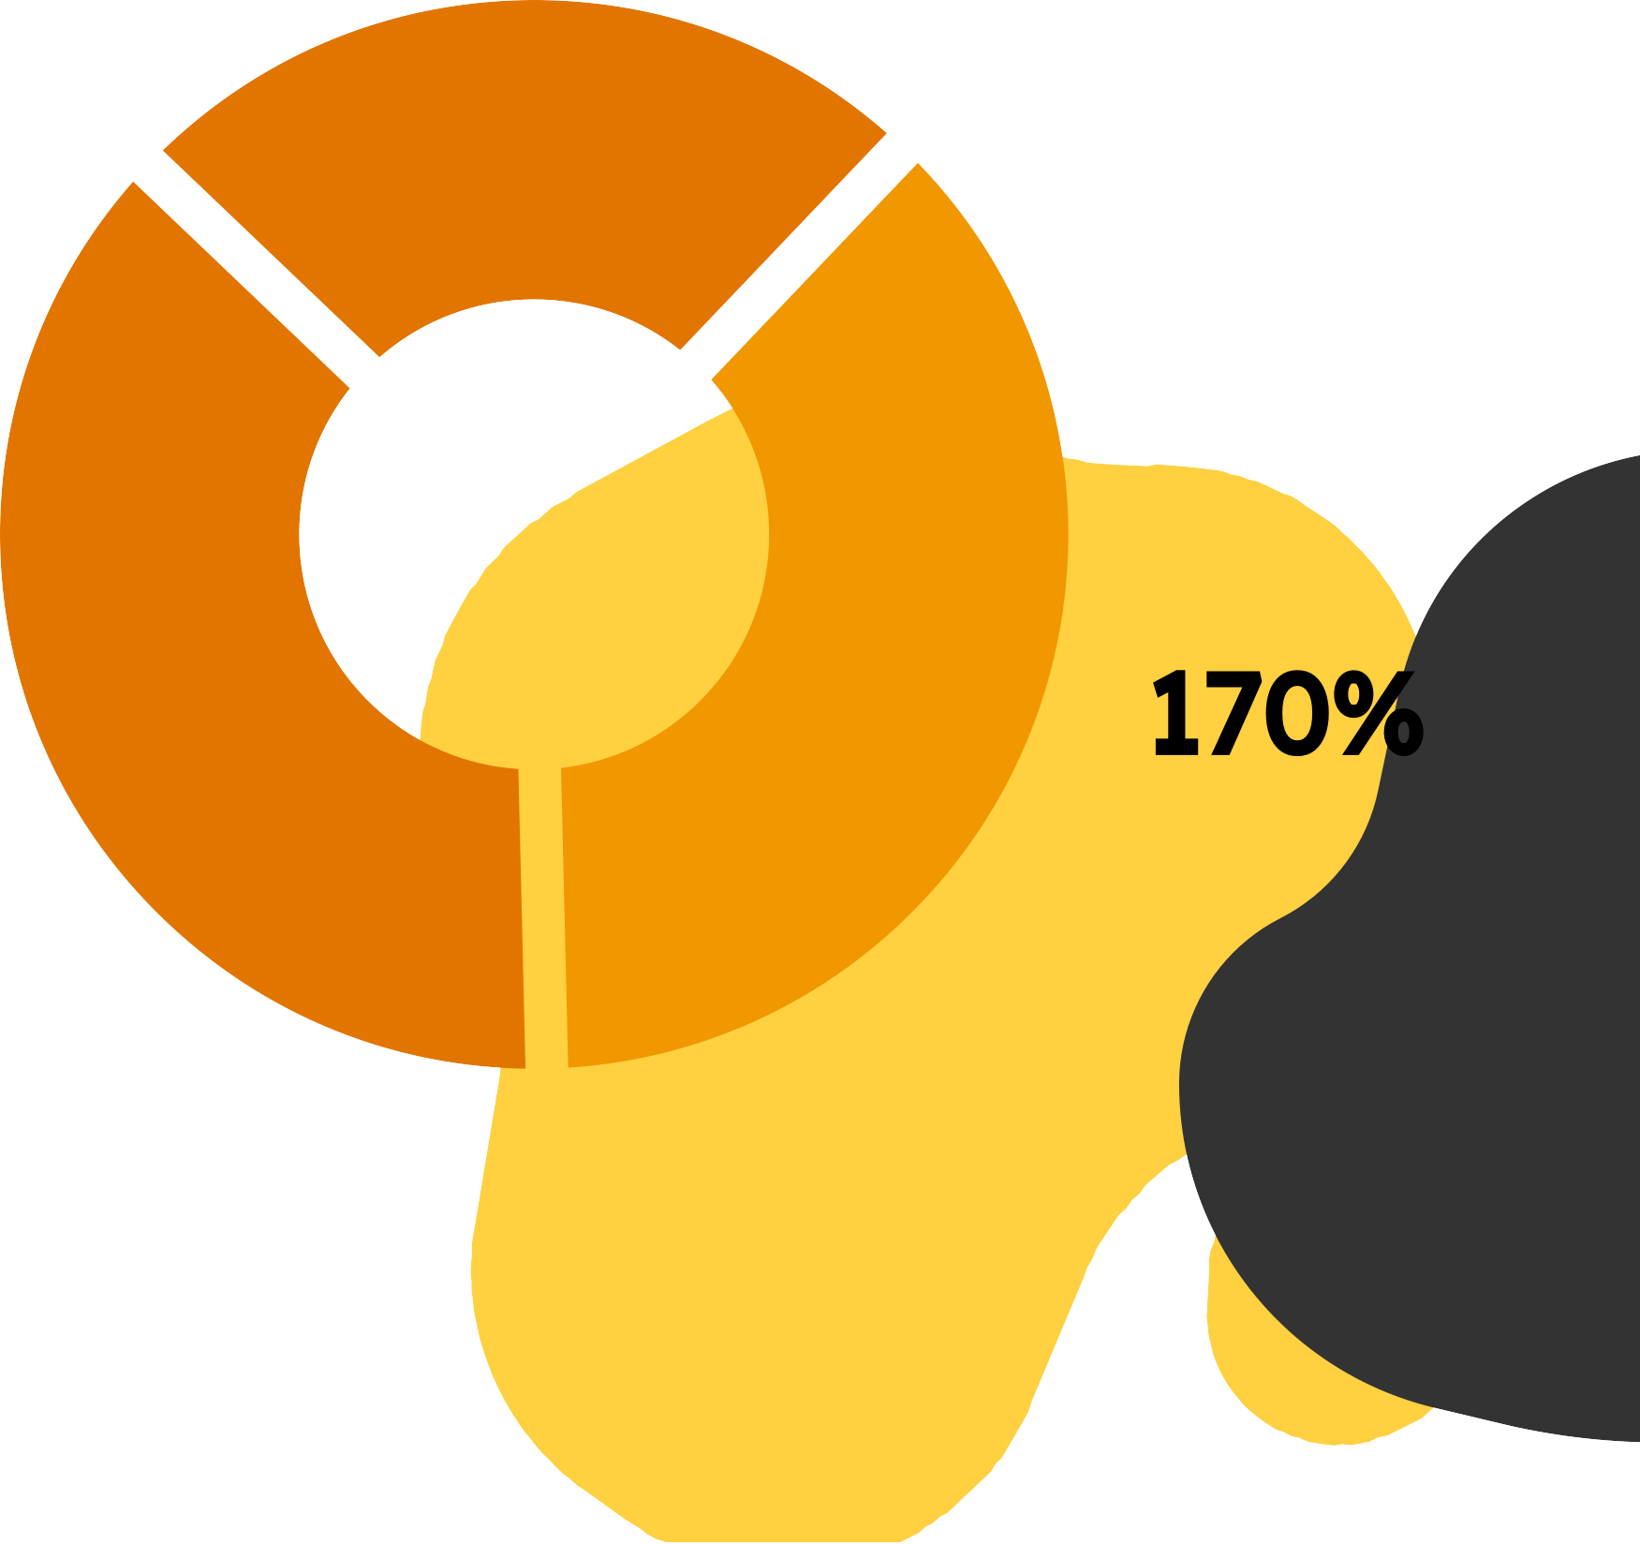
INTRODUCTION
INTERNATIONAL TRADE AND TRADE AGREEMENTS
International trade is pivotal in global economic prosperity, fostering specialisation, efficiency, and productivity. Trade agreements, like the Comprehensive and Progressive Agreement for Trans-Pacific Partnership (CPTPP), aim to facilitate trade by reducing tariffs and non-tariff barriers (NTBs) between member countries. These NTBs can include complex customs procedures, technical standards, and sanitary and phytosanitary (SPS) measures.

Slide 4
RESEARCH GAP AND LITERATURE REVIEW
The Gravity Model in International Trade:
The gravity model is a fundamental framework in international trade analysis. It posits that the trade value between two countries is positively correlated with their economic sizes (GDPs) and negatively correlated with the distance between them, representing trade costs. However, the basic gravity model has limitations:
Omission of Trade Agreements: It doesn't account for the impact of trade agreements on trade flows.
Neglect of Heterogeneity: It assumes similar trade policies across countries.

Slide 5
STRUCTURAL GRAVITY MODEL
To address those limitations, we employ a structural gravity model that incorporates additional variables:
Multilateral Trade Resistance (MTR): This captures the trade barriers a country faces due to its trading partners' policies with other countries. MTR terms are included as fixed effects for importers and exporters.
Trade Costs: Distance, tariff rates, and non-tariff barriers (represented by a prevalence score) are used to quantify trade costs.
CPTPP Dummy Variables: We introduce dummy variables to capture the trade creation and trade diversion effects of the CPTPP agreement.

Slide 6
LITERATURE REVIEW
Previous research has explored the impact of trade agreements using gravity models. For example, Anderson and Wincoop (2003) developed a structural gravity model that addresses the MTR issue. Baier and Bergstrand (2009) proposed an alternative approach to account for MTR. Studies by Eaton and Kortum (2002) and Chaney and Helpman (2008) explore more sophisticated models incorporating firm heterogeneity.

Slide 7
OBJECTIVE
Research Focus: This research analyses how a trade agreement, the Comprehensive and Progressive Agreement for Trans-Pacific Partnership (CPTPP), affects India's trade with member countries.
CPTPP Impact: CPTPP aims to reduce trade barriers (tariffs & non-tariff barriers) making trade cheaper and easier between members.
Analysis Method: A structural gravity model is used to assess how these changes, along with economic factors (GDP) and traditional trade costs (distance, existing tariffs & barriers), influence India's trade with CPTPP members.
Counterfactual Scenarios:
Scenario 1: No CPTPP: This predicts trade flows, assuming India is not part of the
agreement.
Scenario 2: India Joins CPTPP: This predicts trade flows if India becomes a member.

Slide 8
METHODOLOGY
DATA
We utilise trade data for five products between India and CPTPP member countries for the year 2018. The data source will be a reputable trade database, such as the World Trade Organization (WTO) Trade Map or the United Nations Comtrade database. The specific products will be chosen based on their economic significance and trade volume.
DATA SOURCES
VARIABLES | SOURCES
Importer’s GDP WDI | World Bank
Exporter’s GDP WDI | World Bank
DISTANCE | CEPII
Non-tariff barriers of importer | UNCTAD
Non-tariff barriers of Exporter | UNCTAD
Tariff Rate | WITS - TRAINS
Import value | WITS - TRAINS

Slide 9
VARIABLE DESCRIPTION
Dependent Variable:
Trade value (logged) between India and each CPTPP member country.
Independent Variables:
Economic Size: Logarithm of GDP for both India (Y_{i}) and each CPTPP member country (Y_{j}).
Trade Costs:
Distance (d_{ij}) between India and each CPTPP member country.
Tariffs (logged) applied by both India and CPTPP member countries on the chosen products.
Non-Tariff Barriers (NTBs): The NTB scores for both India (NTB_{i}) and each CPTPP member country (NTB_{j}) will be included (logged).
Common Border (dummy variable): This variable takes a value of 1 if India shares a land border with the CPTPP member country and 0 otherwise.
Landlocked Status (dummy variable): This variable takes a value of 1 if either India or the CPTPP member country is landlocked and 0 otherwise.
CPTPP Agreement:
CPTPP dummy (binary): 1 or 0.
Trade Diversion Dummies (binary): Two dummy variables (CPTPP_{TD1} and CPTPP_{TD2}) to capture potential trade diversion effects.
CPTPP_{TD1} 1 or 0, CPTPP_{TD2} 1 or 0

Slide 10
MODEL SPECIFICATION
The functional form of our model where the dependent variable is represented as a function of independent variables:-
𝑋_{ij} = 𝐹(𝑑_{ij} , 𝑌_{i} , 𝑌_{j} , 𝑁𝑇𝐵_{i} , 𝑁𝑇𝐵_{j} , 𝐶𝑃𝑇𝑃𝑃, 𝐼𝑀𝑃₁.... 𝐼𝑀𝑃₁₂ , 𝐸𝑋𝑃₁.... 𝐸𝑋𝑃₁₂ , 𝐶𝑃𝑇𝑃𝑃_{TD1}, 𝐶𝑃𝑇𝑃𝑃_{TD2} , 𝐶𝑂𝐵_{ij} , 𝐿𝐿_{ij}, 𝑡_{ij})
Where,
𝑋_{ij} : − 𝐼𝑚𝑝𝑜𝑟𝑡𝑠 𝑖𝑛 𝑐𝑜𝑢𝑛𝑡𝑟𝑦 𝑖 𝑓𝑟𝑜𝑚 𝑐𝑜𝑢𝑛𝑡𝑟𝑦 𝑗 𝑑_{ij} : − 𝑇ℎ𝑒 𝑏𝑖𝑙𝑎𝑡𝑒𝑟𝑎𝑙 𝑑𝑖𝑠𝑡𝑎𝑛𝑐𝑒 𝑏𝑒𝑡𝑤𝑒𝑒𝑛 𝑐𝑜𝑢𝑛𝑡𝑟𝑦 𝑖 𝑎𝑛𝑑 𝑗 𝐿𝐿_{ij}: − 𝑊ℎ𝑒𝑡ℎ𝑒𝑟 𝑜𝑛𝑒 𝑜𝑓 𝑡ℎ𝑒 𝑐𝑜𝑢𝑛𝑡𝑟𝑖𝑒𝑠 𝑖, 𝑗 𝑖𝑠 𝐿𝑎𝑛𝑑𝑙𝑜𝑐𝑘𝑒𝑑
𝐶𝑂𝐵_{ij}: − 𝑊ℎ𝑒𝑡ℎ𝑒𝑟 𝑡ℎ𝑒 𝑐𝑜𝑢𝑛𝑡𝑟𝑖𝑒𝑠 ℎ𝑎𝑣𝑒 𝑎 𝑐𝑜𝑚𝑚𝑜𝑛 𝑏𝑜𝑟𝑑𝑒𝑟 𝑡_{ij}: − 𝑇𝑎𝑟𝑖𝑓𝑓𝑠 𝑟𝑎𝑡𝑒
𝑁𝑇𝐵_{i} : − 𝑁𝑜𝑛 𝑇𝑎𝑟𝑖𝑓𝑓 𝑏𝑎𝑟𝑟𝑖𝑒𝑟 𝑜𝑓 𝑐𝑜𝑢𝑛𝑡𝑟𝑦 𝑖
𝑁𝑇𝐵_{j} : − 𝑁𝑜𝑛 𝑇𝑎𝑟𝑖𝑓𝑓 𝑏𝑎𝑟𝑟𝑖𝑒𝑟 𝑜𝑓 𝑐𝑜𝑢𝑛𝑡𝑟𝑦 𝑗 𝐼𝑀𝑃_{k} : − 𝐼𝑚𝑝𝑜𝑟𝑡𝑒𝑟 𝐷𝑢𝑚𝑚𝑦 𝑣𝑎𝑟𝑖𝑎𝑏𝑙𝑒
𝐸𝑋𝑃_{k} : − 𝐸𝑥𝑝𝑜𝑟𝑡𝑒𝑟 𝐷𝑢𝑚𝑚𝑦 𝑣𝑎𝑟𝑖𝑎𝑏𝑙𝑒
𝑌_{i} : − 𝐼𝑚𝑝𝑜𝑟𝑡𝑒𝑟𝑠 𝐺𝐷𝑃 𝑌_{j} : − 𝐸𝑥𝑝𝑜𝑟𝑡𝑒𝑟𝑠 𝐺𝐷𝑃 𝐶𝑃𝑇𝑃𝑃 : − 𝑇𝑟𝑎𝑑𝑒 𝐶𝑟𝑒𝑎𝑡𝑖𝑜𝑛 𝑑𝑢𝑚𝑚𝑦
𝐶𝑃𝑇𝑃𝑃_{TD1}: − 𝑇𝑟𝑎𝑑𝑒 𝐷𝑖𝑣𝑒𝑟𝑠𝑖𝑜𝑛 𝑑𝑢𝑚𝑚𝑦 𝐶𝑃𝑇𝑃𝑃_{TD2}: − 𝑇𝑟𝑎𝑑𝑒 𝐷𝑖𝑣𝑒𝑟𝑠𝑖𝑜𝑛 𝑑𝑢𝑚𝑚𝑦

Slide 11
ESTIMATION TECHNIQUES
Two-way Fixed Effects:
Controls for country-specific factors influencing trade flows, isolating the effects of independent variables (GDP, distance, tariffs, NTBs, and CPTPP membership).
𝑙𝑜𝑔 𝑋_{ij} = 𝐶 + α₁ 𝑙𝑜𝑔 𝑌_{i} + α₂ 𝑙𝑜𝑔𝑌_{j} + α₃ 𝑙𝑜𝑔𝑡_{ij} + α₄ 𝑙𝑜𝑔𝑑_{ij}+ α₅ 𝑙𝑜𝑔𝑁𝑇𝐵_{i} + α₆ 𝑙𝑜𝑔𝑁𝑇𝐵_{j} + α₇ 𝐶𝑃𝑇𝑃𝑃 + α₈ 𝐶𝑃𝑇𝑃𝑃_{TD1} + α₉ 𝐶𝑃𝑇𝑃𝑃_{TD2} + α₁₀ 𝐿𝐴𝑁𝐺_{ij} + α_{ij} 𝐶𝑂𝐵_{ij} + α₁₂ 𝐿𝐿_{ij} + 𝑎₁ 𝐼𝑀𝑃₁ + 𝑎₂ 𝐼𝑀𝑃₂ +....... + 𝑎₁₂ 𝐼𝑀𝑃₁₂ + 𝑏₁ 𝐸𝑋𝑃₁ + 𝑏₂ 𝐸𝑋𝑃₂ +....... + 𝑏₁₂ 𝐸𝑋𝑃₁₂ + ε_{ij}
Poisson Pseudo Maximum Likelihood (PPML):
Addresses count data nature of the dependent variable, providing more reliable estimates compared to traditional OLS methods.
𝑙𝑜𝑔 λ_{ij} = C+ α_{i} + αj+ β₁ t_{ij} + β₂ d_{ij} + β₃ NTB_{i} + β₄ NTB_{j} + β₅ CPTPP + β₆ CPTPP_{TD1} + β₇ CPTPP_{TD2} + β₈ COB_{ij} + β₉ LL_{ij} + β₁₀ LANG_{ij} + ε_{ij}

Slide 12
ESTIMATION TECHNIQUES
Baier and Bergstrand Bonus Vetus OLS:
Offers an alternative to address multilateral trade resistance without fixed effects, incorporating additional trade pattern information.
𝑙𝑜𝑔𝑋_{ijk} = 𝑙𝑜𝑔𝑌_{ik} + 𝑙𝑜𝑔𝐸_{jk} – 𝑙𝑜𝑔𝑌_{k} + (1 – σ_{k}) [𝑙𝑜𝑔 τ*_{ijk}]
NLS-GEPPML:
The analysis uses NLS-GEPPML (Herman's Method) for the general equilibrium gravity model, differing from the traditional GEPPML approach. Yotov et al.'s (2016) GEPPML procedure will assess trade impacts under various scenarios (counterfactuals). Below is the equation that we are considering:
𝑙𝑜𝑔 λ_{ij} = α_{i} + αj+ β₁ t_{ij} + β₂ d_{ij} + β₃ NTB_{i} + β₄ NTB_{j} + β₅ CPTPP + β₆ CPTPP_{TD1} + β₇CPTPP_{TD2} + β₈ COB_{ij} + β₉ LL_{ij} + β₁₀ LANG_{ij} + ε_{ij}

Slide 13
Results and Counterfactual Analysis
Building upon the estimated model parameters, we will conduct a counterfactual analysis to predict trade flows under two scenarios:
Scenario 1: No CPTPP
We will modify the model by setting the CPTPP dummy variable to zero for all country pairs. This allows us to estimate the trade flows that would have likely occurred in the absence of the CPTPP agreement.
Scenario 2: India Joins CPTPP
Here, we will modify the model by including India as a member country and adjust the relevant CPTPP dummy variables to reflect this change. This allows us to predict the potential impact of India's participation in CPTPP on its trade flows with member countries. By comparing the estimated trade flows under these scenarios, we can assess the trade creation and trade diversion effects associated with the CPTPP agreement for India.

Slide 14
Results and Counterfactual Analysis
When India Joins the CPTPP the following dominant parameters will be observed:
1. Factory Gate Prices changes
2. GDP Change
3. Welfare Statistic
4. OMR - Outward Multilateral Trade Resistance Term
5. IMR - Inward Multilateral Trade Resistance Term
6. Net Foreign Export & Net Foreign Import
Bilateral Trade Results:
Impact on India’s Export to the CPTPP and Non Member Countries
Impact on India’s Import from the CPTPP and Non Member Countries

Slide 15
Tentative Conclusion
We expect the analysis to reveal a positive impact of the CPTPP agreement on India's trade with member countries, with trade creation outweighing any potential trade diversion effects. However , the final conclusion will depend on the estimated coefficients of the model and the results of the counterfactual analysis.
References
1. Shepherd, Ben. 2016. “The Gravity Model of International Trade: A User Guide (An updated version).” United Nations publication.
2. Anderson, James, E., and Eric van Wincoop. 2003. "Gravity with Gravitas: A Solution to the Border Puzzle ." American Economic Review, 93 (1): 170-192.
3. “A Practical Guide to Trade Policy Analysis.” World Trade Organisation.
4. Yotov, Piermartini, Monteiro, Larch. “An Advanced Guide to Trade Policy Analysis: The Structural Gravity Model.” World Trade Organisation.

Slide 16

GROUP MEMBERS :
(210064) Aditya Patel
(210101) Alok Kumar
(210115) Amanpreet Kaur Rakhra
(210622) Mohd Siraj
(210752) Prassun Duggar

