Slide 1
An Unstructured Talk on Text Mining
Alok Kumar

Slide 2
An Unstructured Talk on Text Mining
Text Mining(TM) – Analyzing “The Matrix” of text data
Stories from the TM world (Each story has its own code)
  The golden rule : Let linguists make the rules!
  Good features can take you a long way (Tried and tested on FB)
  Program to an interface is a blessing
  Being unsupervised is scary, but the possibilities are endless!
  Know your library and “The Matrix”
  Being street smart always helps
  Journey from feature engineering to feature learning – Realm of “Deep learning”
Have you REALLY
  Watched “Friends”!
  Followed Billboard's top 100 songs!

Slide 3
An Unstructured Talk on Text Mining
Text Mining(TM) – Analyzing “The Matrix” of text data
Stories from the TM world (Each story has its own code)
  The golden rule : Let linguists make the rules!
  Good features can take you a long way (Tried and tested on FB)
  Program to an interface is a blessing
  Being unsupervised is scary, but the possibilities are endless!
  Know your library and “The Matrix”
  Being street smart always helps
  Journey from feature engineering to feature learning – Realm of “Deep learning”
Have you REALLY
  Watched “Friends”!
  Followed Billboard's top 100 songs!

Slide 4
Text Mining(TM) – Analyzing “The Matrix” of text data
Analysis of text data
  Sentiment Analysis, IR, Content Summarization, Spam Classifers
Wikipedia Link
  https://en.wikipedia.org/wiki/Text_mining

Slide 5
Text Mining(TM) – Analyzing “The Matrix” of text data
Show me “The Matrix”
  https://www.youtube.com/watch?v=yKN8a8jgIN8

Slide 6
Text Mining(TM) – Analyzing “The Matrix” of text data
Show me “The Matrix”
  NLP Parsing [POS Tagging, NEs, Parse Trees] etc
  Information Retrieval
  Rule based retrievals
  Hypothese based Features
  ML Techniques to findaly combine these features

Slide 7
The golden rule : Let linguists make the rules!
https://github.com/alokkumary2j/Applied-Text-Mining/blob/NLP-Rules/RespectTheLinguists.ipynb

Slide 8
  Good features can take you a long way “def f():print('~')f()”
https://github.com/alokkumary2j/Applied-Text-Mining/blob/Supervised-ML/FBPostClassification_NB.ipynb

Slide 9
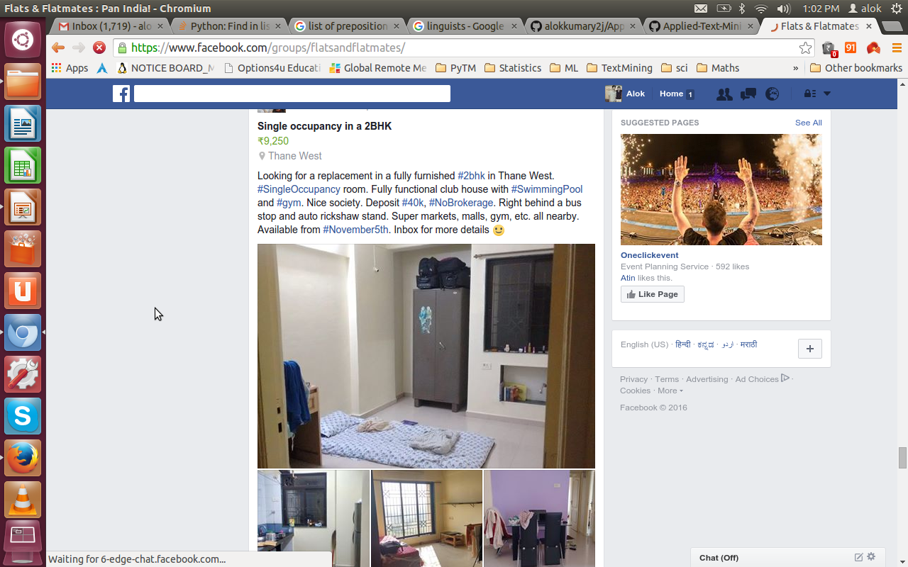
Good Feature can take you a long way~~

Slide 10
Program to an interface is blessing
https://github.com/alokkumary2j/Applied-Text-Mining/blob/Supervised-ML/FindGender-NB.ipynb
https://github.com/alokkumary2j/Applied-Text-Mining/blob/Supervised-ML/FindGender-MaxEnt.ipynb

Slide 11
Are you getting Bored!
Share of total words spoken in FRIENDS
  https://img.readitlater.com/i/datavisualised.com/wp-content/uploads/2016/07/share-of-total-words-spoken/RS/w704.png
  Who Spoke the most
Most characteristic words/phrases per person
  Joey How u doin
    https://www.youtube.com/watch?v=43wkqM27z2E
    https://img.readitlater.com/i/datavisualised.com/wp-content/uploads/2016/07/most-characteristic-words-spoken/RS/w704.png
How :
  http://datavisualised.com/text-mining-friends-rachel-talks-the-most-and-ross-talks-too-much-withabout-women/

Slide 12
  Being unsupervised is scary, but the possibilities are endless!
https://github.com/alokkumary2j/Applied-Text-Mining/blob/Unsupervised-Learning/RAKE.ipynb
RAKE is cool, but RAKE-PMI is the guy for us!
  Twiki Link
Even PageRank!

Slide 13
  Being unsupervised is scary, but the possibilities are endless!
https://github.com/alokkumary2j/Applied-Text-Mining/blob/Unsupervised-Learning/RAKE.ipynb
RAKE is cool, but RAKE-PMI is the guy for us!
  Twiki Link
Even PageRank!

Slide 14
  Know your library and “The Matrix”
Knowing your library
  https://github.com/alokkumary2j/Applied-Text-Mining/blob/Performance-Tuning/NumpyPerfBoost.ipynb
Knowing “The Matrix”
  https://github.com/alokkumary2j/Applied-Text-Mining/blob/Performance-Tuning/LinAlg_NumpyPerfBoost.ipynb

Slide 15
Being Street Smart Always Helps!
Custom Spell Corrector
Cool Abbreviation Learner

Slide 16
  Journey from feature engineering to feature learning – Realm of “Deep learning”
https://github.com/alokkumary2j/Applied-Text-Mining/blob/Deep-Learning/FastWordEmbedding.ipynb

