Slide 1
Inside the binary adder

Slide 2
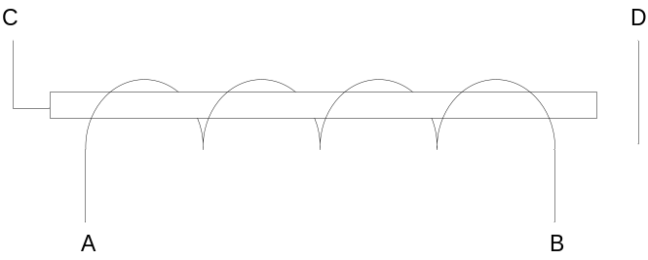
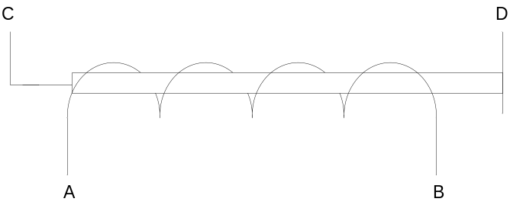
Electro-mechanical relay
A solid state relay is a switch that is controlled by a current. When current flows from A to B, the circuit C-D is closed:
The relay does not contain any transistors or other semi-conductor technology.
http://en.wikipedia.org/wiki/Relay
No current between A and B
Relay is open
Current between A and B
Relay is closed

Slide 3
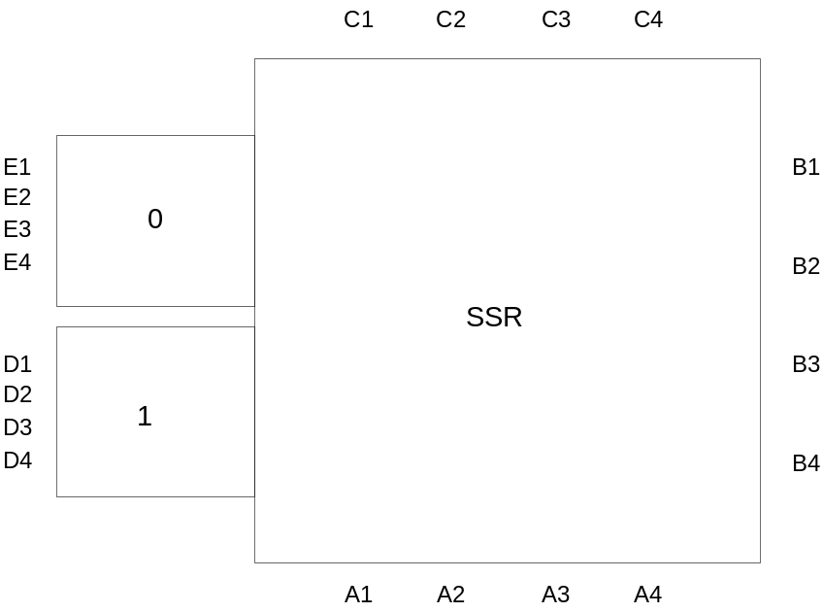
Electro-mechanical relay
The relays I used had 4 connections. If one of the 4 circuits A1-B1, A2-B2, A3-B3, A4-B4 is closed, the independant circuits C1-D1, C2-D2, C3-D3, C4-D4 will be closed.
When the circuit was open, independant circtuis C1-E1, C2-E2, C3-E3, C4-E4 were closed.
If you don’t have this type of relay, you can simply use 4x the number of required relays.

Slide 4
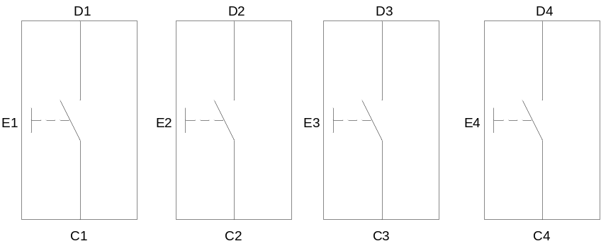
Switch
The switches I used for the project also had 4 independant connections. When the switch is off, the circuits C1-E1, C2-E2, C3-E3, C4-E4 are closed. When the switch is on, the circuits C1-D1, C2-D2, C3-D3, C4-D4 are closed.
If you don’t have this type of switch, you will need to add relays (or solder 4 switches together).

Slide 5
Circuit
The switches are used to input the binary number to the adder. My adder had 8 input switches (4 bits per number).
Relays are used to store the remainder (3 relay).
Leds are used to display the result (5 leds).
Binary addition table:
The table contains 8 possibilites. The various interconnections between the switches and relays will handle these 8 cases.
A B R → R’ L
0 0 0 → 0 0
0 0 1 → 0 1
0 1 0 → 0 1
0 1 1 → 1 0
1 0 0 → 0 1
1 0 1 → 1 0
1 1 0 → 1 0
1 1 1 → 1 1

Slide 6
Circuit
The following circuit illustrates a basic A+B+R block. Such a block needs to be created for each bit (4 in my case).
Given my component choice and DC current supply, I only needed resistors for the LEDs.
The relay I used required quit some current. I used a transformer from an old appliance.

Slide 7
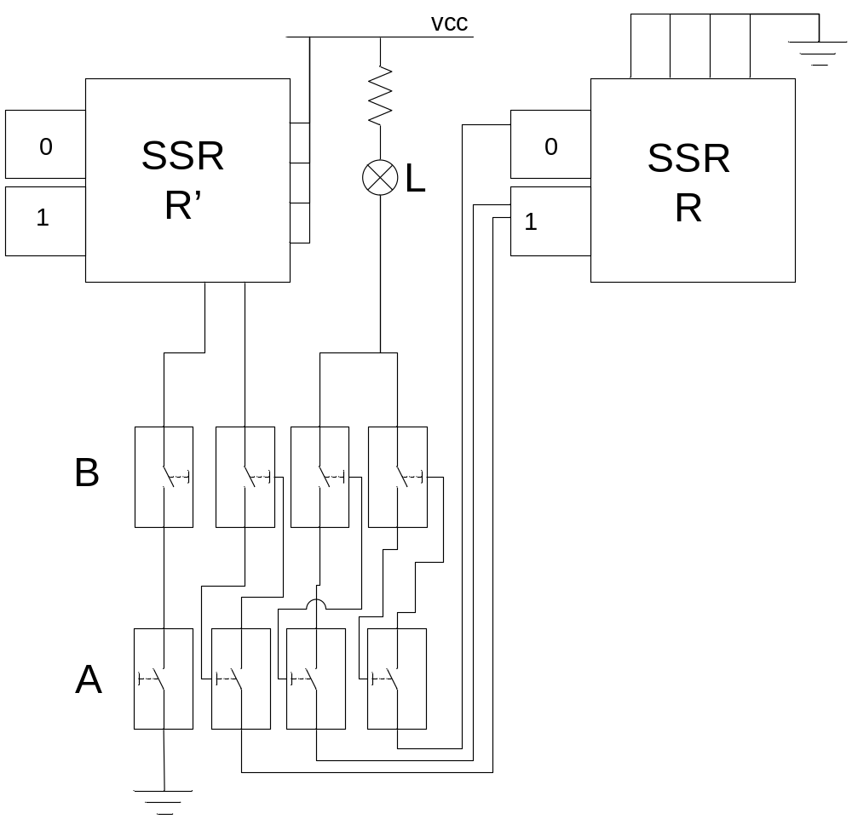
A B R → R’ L

