Slide 1
Car License Plate Recognition
18-793 Pattern Recognition Theory
Alexandre Alahi
Alok Menghrajani

Slide 2

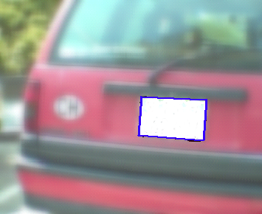









Overview
Plate
Localization
Mesh
Extrapolation
Plate Image
Raw Image
FR
Character
Extraction
Letter
Recognition
Digit / Letter
Separation
Spacial
Sort
162616
Digit
Recognition

Slide 3
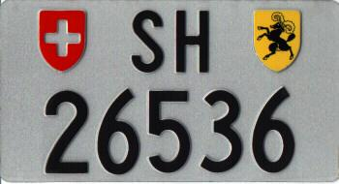

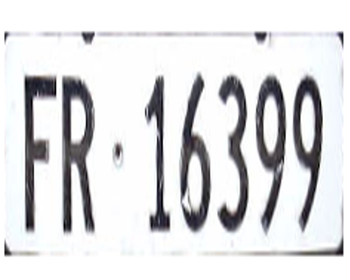
Letter / Digit Separation
Aspect ratio
Locating the dot
Locating the icons
Back Vertical
Back Horizontal
Front Horizontal

Slide 4




Character Extraction
Graph of projected points on x-axis for top part
Graph of projected points on x-axis for Bottom part
Black and white license plate
Graph of projected
points on y-axis

Slide 5




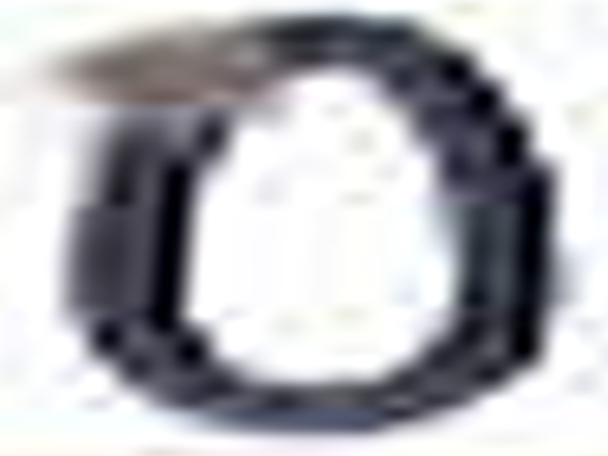











Digit Recognition
Binarize
Crop
Clustering
Correlation In
The Image Domain
Best Match
4
Image Preprocessing
Mean Of Pixel Values
Raw Training Data
Filters

Slide 6
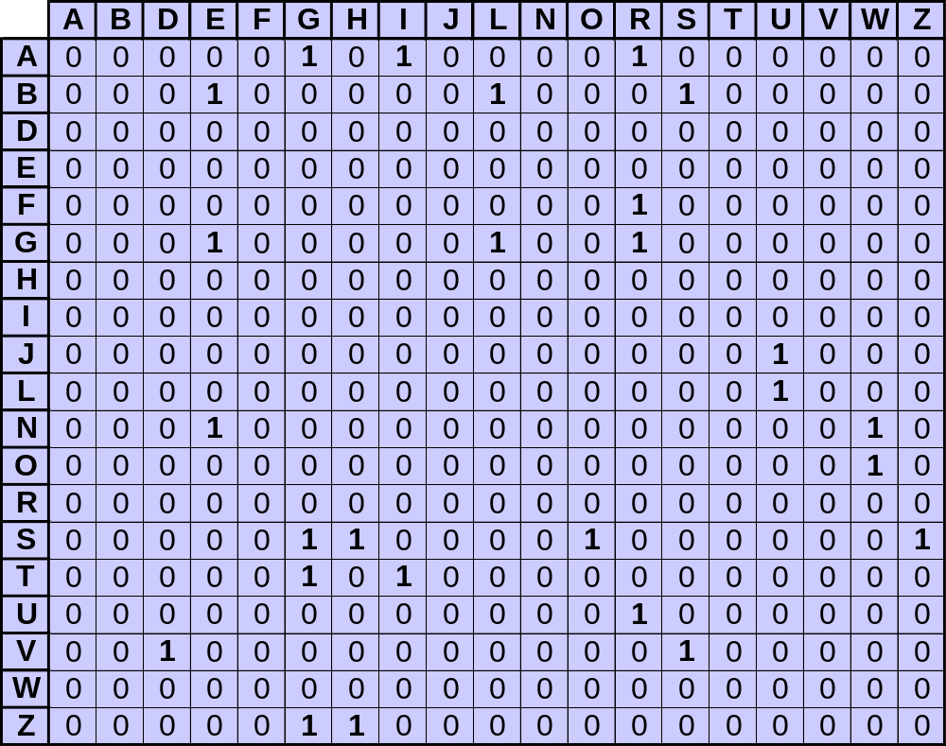
Letter Recognition
Second Letter
First Letter
We use a valid state code matrix in order to significantly improve our results.

Slide 7
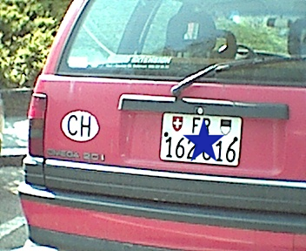
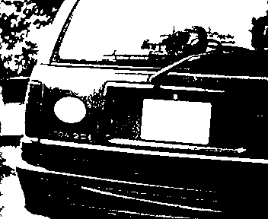

Plate Localization
Find Approx. Location
Remove Content Of Plate
Raw Image
Ladder
Algorithm
Mesh Extrapolation
Plate Image

Slide 8
Demo

