Slide 1
Terraform
Infrastructure as a Code
What is Terraform?
Terraform vs other tools
Terraform architecture and commands

Slide 2
Infrastructure as Code
Infrasructure as Code (IaC) is the practice of managing and provisioning infrastructure using code instead of manual process.
- Create 3 VM with:
2 CPU’s
4 GB RAM
Ubuntu OS
Connected to the same network
Terraform
Terraform

Slide 3

What is Terraform?
Terraform is an open source Infrasructure as Code (IaC) tool created by HashiCorp.
It allows you to define, provisioning and managing the infrastructure using a simple configuration language called HCL (HashiCorp Configuration Language)

Slide 4

Terraform vs CloudFormation: Terraform is cloud agnostic, while CloudFormation works only with AWS.
Terraform vs Ansible: Terraform provisions Infrastructure, whereas Ansible configures and manages software on existing machines.
Terraform vs Puppet/Chef: Terraform builds Infrastructure, whereas Puppet/Chef automate software deployment and system configurations.

Slide 5
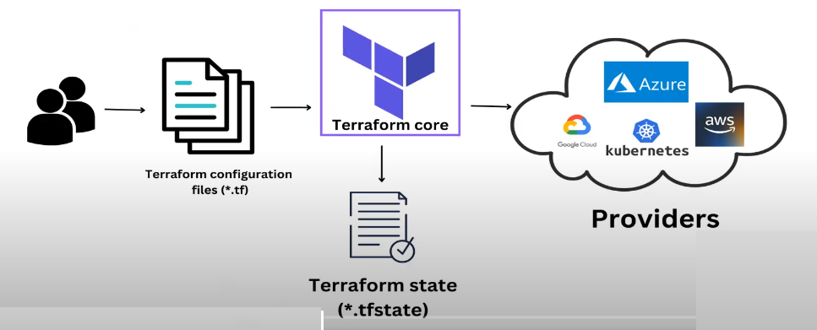
Terraform Architecture

Slide 6
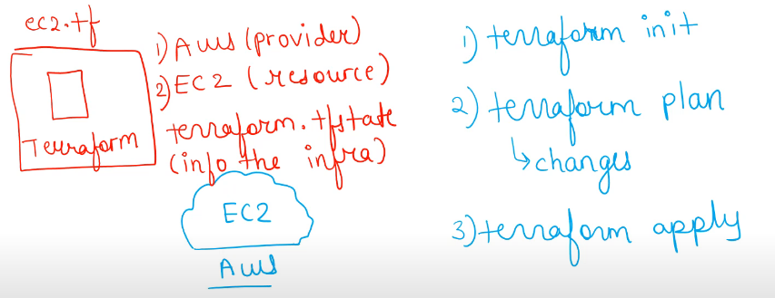
Terraform Architecture

Slide 7
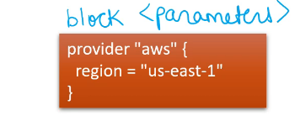
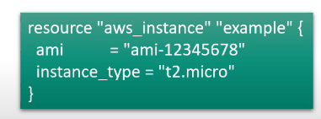
Terraform Architecture

Slide 8
Terraform Workflow
Terraform Configuration File
Terraform Working Directory
Checks the difference between the current infrastructure and the desired configuration
Executes the plan and applies the infrastructure changes.

Slide 9
Terraform Commands
Terraform init: Initializes the working directory and downloads provider plugins.
Terraform fmt: Formats .tf files to maintain code consistency.
Terraform validate: Validates the terraform configuration files
Terraform plan: Shows what changes will be made before applying them
Terraform apply: Applies the configuration to create/update infrastructure
Terraform destroy: Destroys all resources defined in the configuration
Terraform show: Displays the current state of resources.

