Slide 1
AWS

Slide 2
Topics
What is IAM?
How to set Billing Alarm Demo?
What is S3 bucket and how it works?
Create an S3 bucket Demo
Deploy the application using S3 bucket
S3 Pricing Tiers
S3 Versioning - Demo

Slide 3
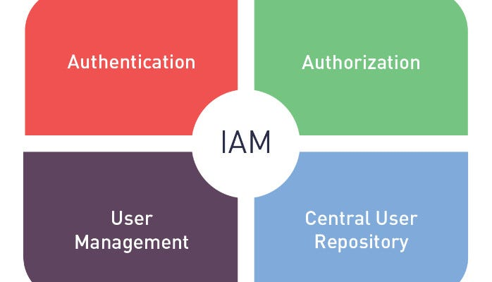
What is IAM?
AWS Identity and Access Management (IAM) is a web service that helps you securely control access to AWS resources.
With IAM, you can centrally manage permissions that control which AWS resources users can access. You use IAM to control who is authenticated (signed in) and authorized (has permissions) to use resources.

Slide 4
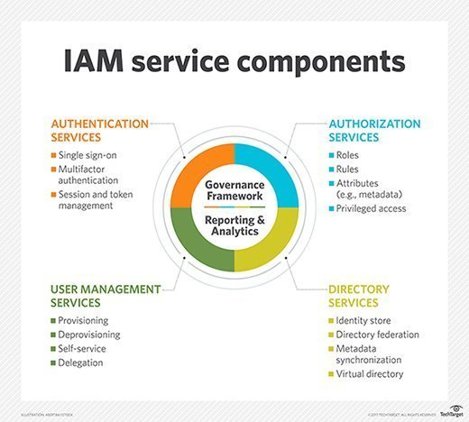

Slide 5
How to Set Billing Alarm Demo?
- CloudWatch is the solution of setting the billing alarm Steps:
Search cloudwatch service from AWS
Select the billing
Create a billing Alarm
Fill the desired settings
SNS(Simple Notification Service) will sent to provided email address for confirmation
After confirming, the subscription confirmed will appear
You will see the billing alarm in cloudwatch

Slide 6
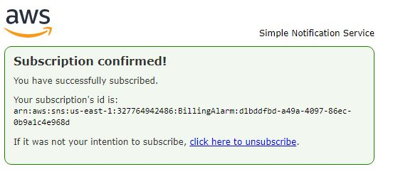

Slide 7
What is S3bucket?
S3 stands for Simple Storage Service
It is object-based storage, where data is stored inside S3 buckets in distinct units called objects instead of files.
The allows to upload files.
Files can be 0 bytes to 5TB
There is unlimited storage
Files are stored in buckets
Http 200 code on successful

Slide 8
How does data consistency work for S3?
Read after Write consistency for PUTS of new objects
In other words;
If you write a new file and read it immediately afterwards, you will be able to view that data.
Eventually consistency for overwrite PUTS and DELETES (can take some time to propagate)
In other words;
If you update An Existing File or delete a file and read it immediately, you my get an older version, or you may not. Basically changes to objects can take a little bit of time to propagate.

Slide 9
S3 features:
Tiered Storage Available
Lifecycle Management
Versioning
Encryption
MFA delete
Secure your data using Access Control List and Bucket Policies

Slide 10
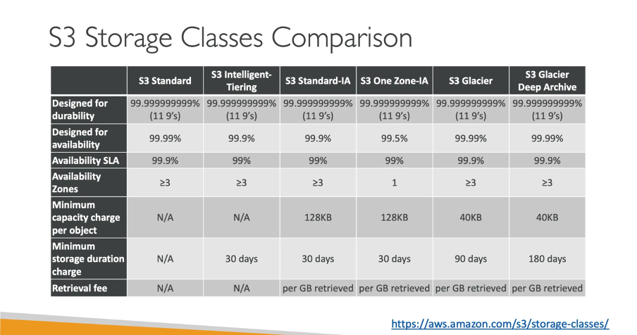
S3 Storage classes:

Slide 11
Charged in S3
Storage
Requests and Data Retrievals
Storage Management Pricing
Data Transfer Pricing
Transfer Acceleration
Cross Region Replication

Slide 12
Transfer Acceleration
Amazon S3 Transfer Acceleration enables fast, easy and secure transfer of files over long distances between your end users and an S3 bucket.
Transfer Acceleration takes advantage of Amazon CloudFront’s globally distributed edge locations. As the data arrives at an edge location. Data is routed to Amazon S3 over an optimized network path.

Slide 13
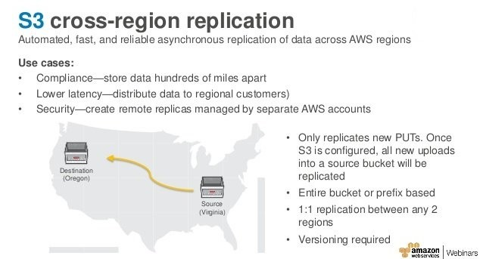
Cross Region Replication

Slide 14
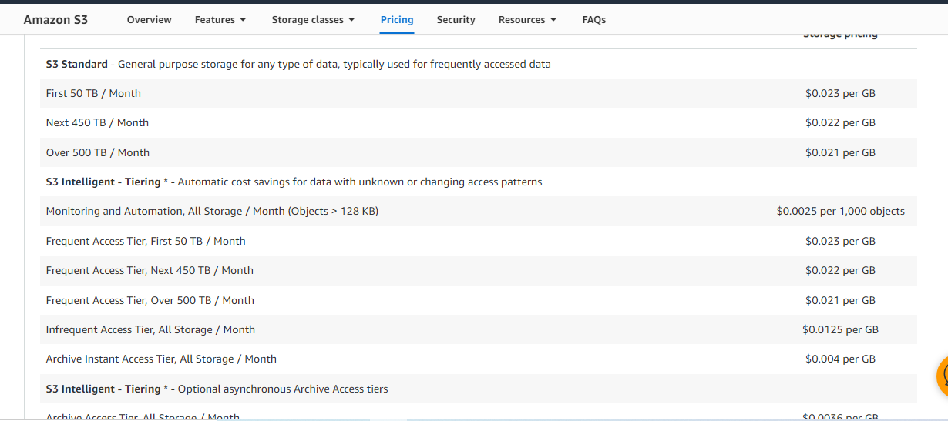
S3 Pricing Tiers:

Slide 15
