Slide 1
AWS Session-3

Slide 2
Topics
What is EC2 instance?
EC2 pricing
Security Groups
Security Groups - Demo
Connect EC2 with S3 – Demo
CloudFront - Demo
EBS
EBS Volumes and Snapshots – Demo

Slide 3
Instance Metadata – Demo
AMI Types (EBS vs. Instance Store)
Route53
Database Creation - Demo

Slide 4
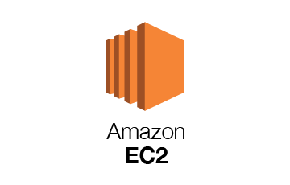
What is EC2?
✔ Amazon Elastic Compute Cloud (Amazon EC2) is a web service that provides secure, resizable compute capacity in the cloud.
✔ Access reliable, scalable infrastructure on demand. Scale capacity within minutes with SLA commitment of 99.99% availability.
✔ Provide secure compute for your applications. Security is built into the foundation of Amazon EC2 with the AWS Nitro System.
✔ Optimize performance and cost with flexible options like AWS Graviton-based instances, Amazon EC2 Spot instances, and AWS Savings Plans.

Slide 5
EC2 Types
General Purpose
Compute Optimized
Memory Optimized
Accelerated Computing
Storage Optimized
HPC Optimized
https://aws.amazon.com/ec2/instance-types/

Slide 6
EC2 Pricing?
https://aws.amazon.com/free/?all-free-tier.sort-by=item.additionalFields.SortRank&all-free-tier.sort-order=asc&awsf.Free%20Tier%20Types=tier%2312monthsfree&awsf.Free%20Tier%20Categories=*all

Slide 7
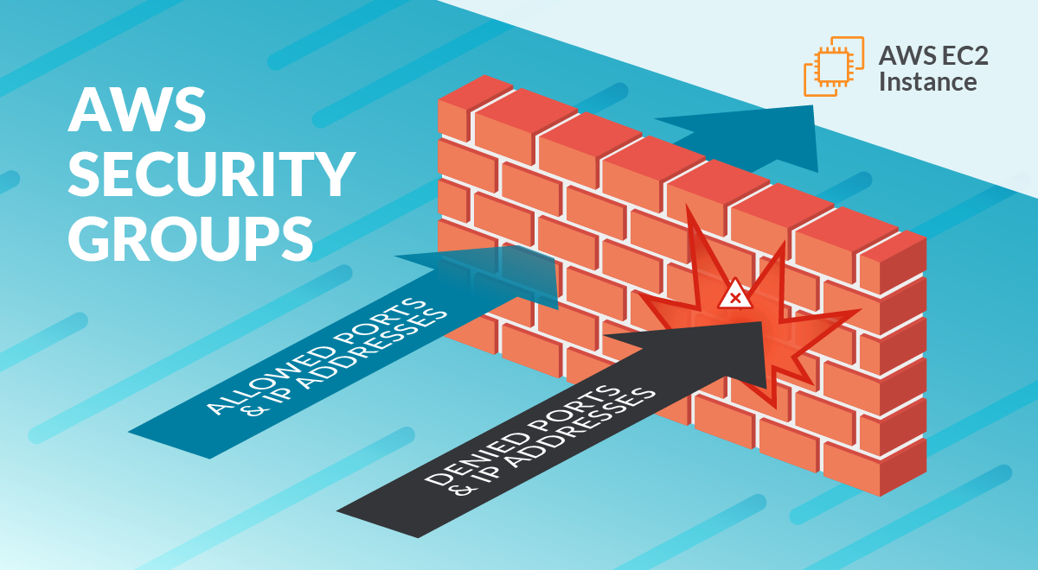
Security Groups
A security group controls the traffic that is allowed to reach and leave the resources that it is associated with. For example, after you associate a security group with an EC2 instance, it controls the inbound and outbound traffic for the instance.

Slide 8
CloudFront
Amazon CloudFront is a globally distributed network offered by AWS which securely delivers content to the end users with a high transfer speed and low latency
CloudFront delivers your content through a worldwide network of data centers called edge locations.
If the content is already in the edge location with the lowest latency, CloudFront delivers it immediately.
If the content is not in that edge location, CloudFront retrieves it from an origin that you've defined—such as an Amazon S3 bucket, a MediaPackage channel, or an HTTP server (for example, a web server) that you have identified as the source for the definitive version of your content.

Slide 9
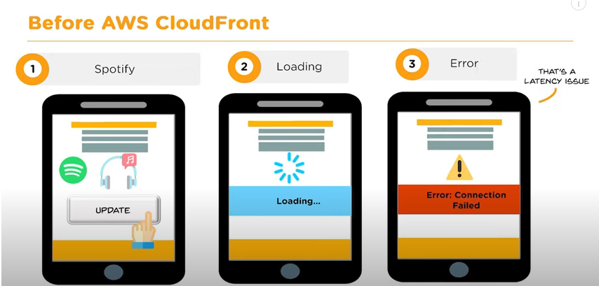

Slide 10
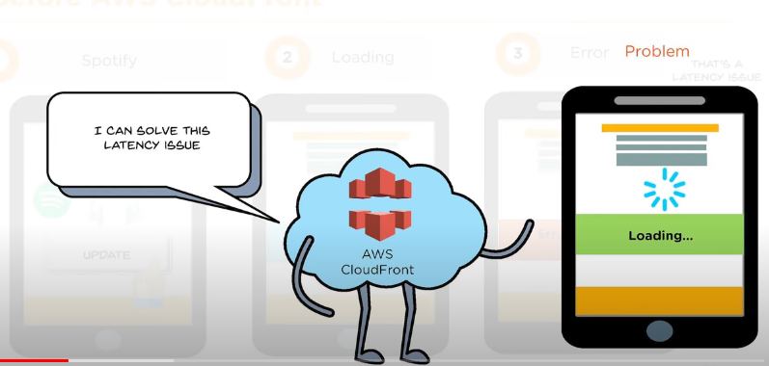

Slide 11
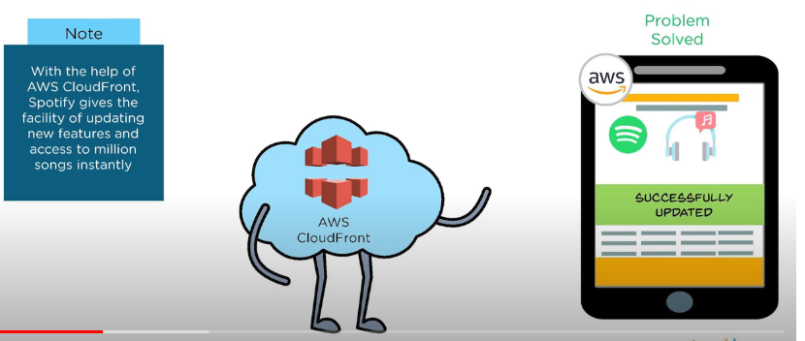

Slide 12





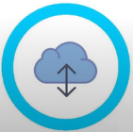
Benefits of CloudFront
Cost-effective
Time Saving
Content Privacy
Highly Programmable
Geo - targeting
Quick content delivery

Slide 13
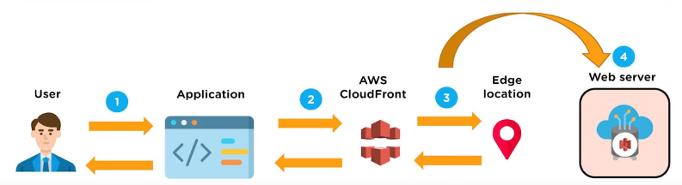
How AWS CloudFront delivers the content?

Slide 14
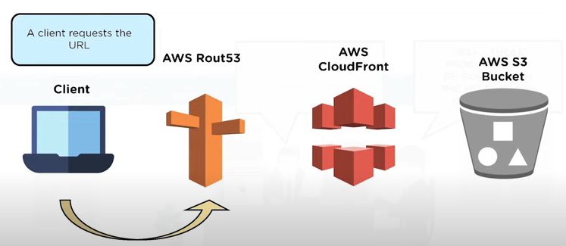

Slide 15
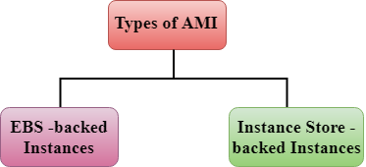
AMI(Amazon Machine Image)
An Amazon Machine Image (AMI) is a master image for the creation of virtual servers -- known as EC2 instances -- in the Amazon Web Services (AWS) environment.
AMI is divided into two categories

Slide 16
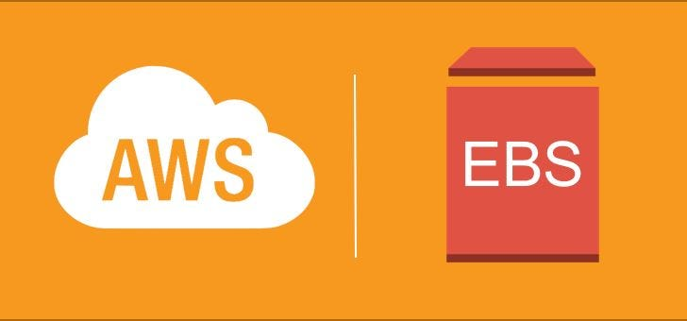
EBS
Amazon Elastic Block Store (Amazon EBS) provides block level storage volumes for use with EC2 instances.
EBS volumes behave like raw, unformatted block devices.

Slide 17
Route53
Amazon Route 53 is a highly available and scalable Domain Name System (DNS) web service.
Route 53 connects user requests to internet applications running on AWS or on-premises.
Performs global server load balancing by routing each request to the AWS region closest to the requester's location.

Slide 18
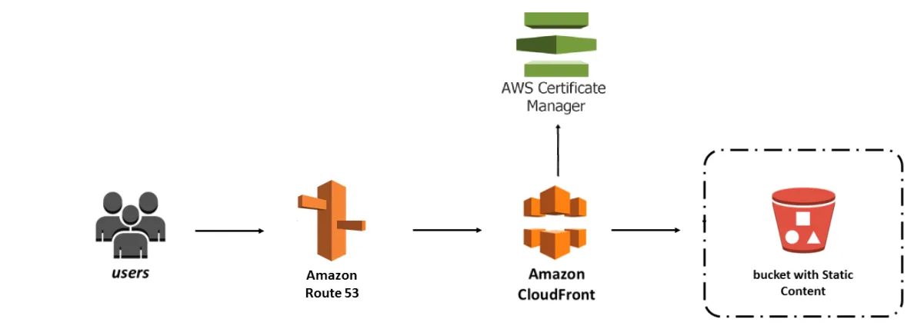

Slide 19
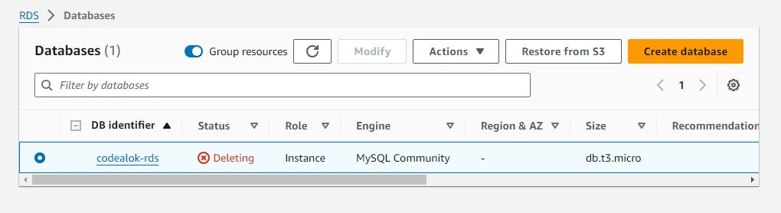
Database Creation - Demo
Relational Database creation - Demo

