Slide 1
AWS Session-5

Slide 2
Topics
Understanding CIDR
Security Group & NACL
VPC Creation Demo
EC2 Load balancing
EC2 AutoScaling

Slide 3
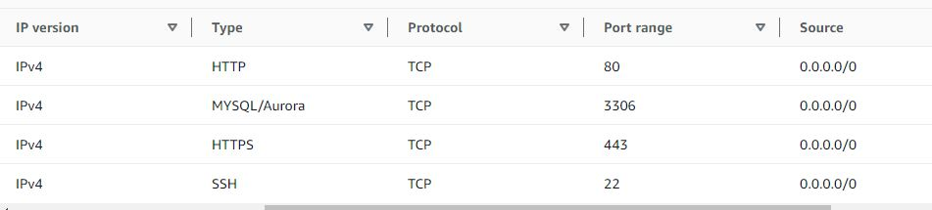
Understanding CIDR
Classless Inter-Domain Routing - a method of allocating IP addresses
Used in Security Groups rules and AWS networking in general
They help to define an IP address range:
We have seen WW.XX.YY.ZZ/32 => one IP
We have seen 0.0.0.0/0 => all Ips
But we can define : 192.168.0.0/26
=> 192.168.0.0 - 192.168.0.63 (64 IP addresses)

Slide 4
A CIDR consists of two components
Base IP
Represents an IP contained in the range (xx.xx.xx.xx)
Example: 10.0.0.0, 192.168.0.0, ….
Subnet Mask
Defines how many bits can change in the IP
Example: /0, /24, /32
Can take two forms:
/8 => 255.0.0.0
/16 => 255.255.0.0
/24 => 255.255.255.0
/32 => 255.255.255.255

Slide 5
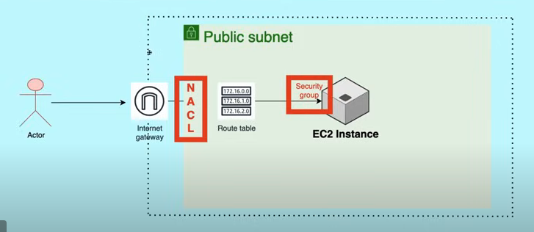
Security Group & NACL

Slide 6
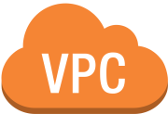





EC2 Load Balancer
Subnet
Internet Gateway
12.0.1.0/24
EC2
Subnet
12.0.3.0/24
EC2
Target Group
12.0.1.0/16

Slide 7

EC2 Auto Scaling
AutoScaling Group
Internet Gateway
Min: 1 Max: 3 Desired: 2
Launch Template
Subnet
12.0.3.0/24
EC2
EC2
EC2
Target Group
12.0.0.0/16

