Slide 1
AWS Session-5

Slide 2
Topics
Key Management Service
Elastic Transcoder
WAF
Elastic Container Service
Basic understanding of Docker
AWS Fargate
Lambda
AWS Shield

Slide 3
Key Management Service or AWS KMS
Allows to create and manage cryptographic keys that protect data across your AWS workloads
Access is governed by key policy which lets you control ,how and who can read your data.
Types
symmetric - a single encryption key used for both encrypt and decrypt the data
Asymmetric – A public and private key pair that can be used to encrypt/decrypt the data

Slide 4
Elastic Transcoder -- Demo
It is a media transcoding in the cloud. Designed to be highly scalable, easy to use and cost effective way for developers and business to convert media files from their source format into versions that will playback on devices

Slide 5
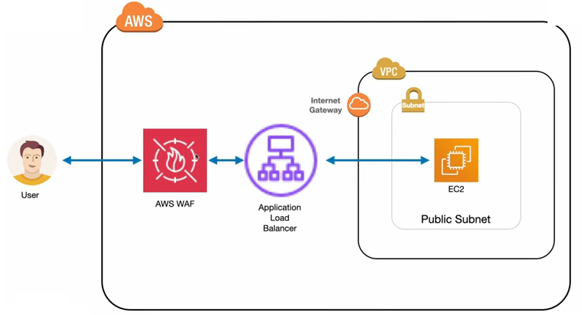
WAF (Web Application Firewall)

Slide 6
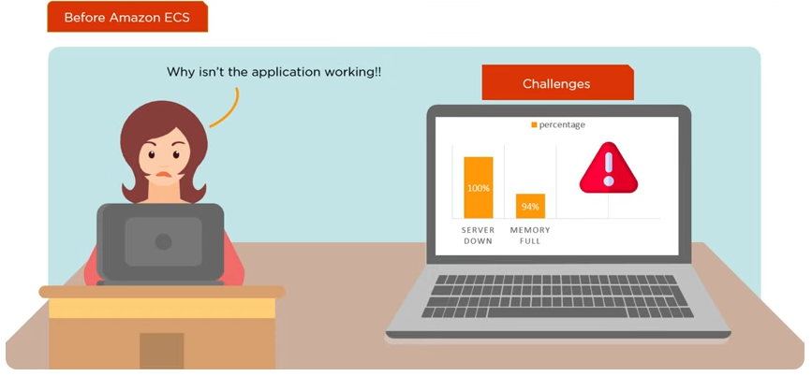
Elastic Container Service
It is a container management service which can quickly launch, exit and manage Docker containers on a cluster

Slide 7
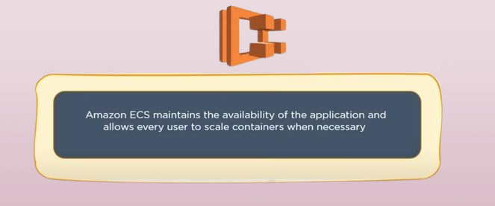
Why Amazon ECS

Slide 8
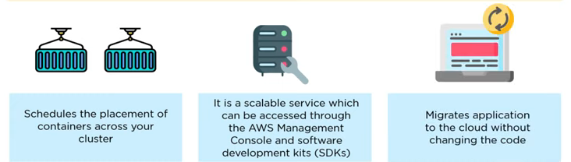

Slide 9
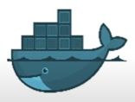
Docker
Docker is a tool to automate the deployment of an application as a lightweight container so that the application can work efficiently in different environments.

Slide 10

AWS Fargate
AWS Fargate is a serverless compute engine for containers that works with ECS & it allow you to run containers without having provision, configure and scaling
Eliminate the need of EC2 instance

Slide 11
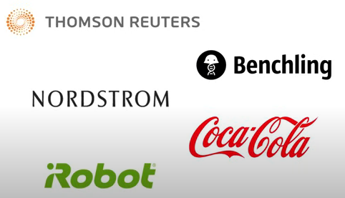
AWS Lambda
AWS Lambda allows to execute code for any type of application

Slide 12
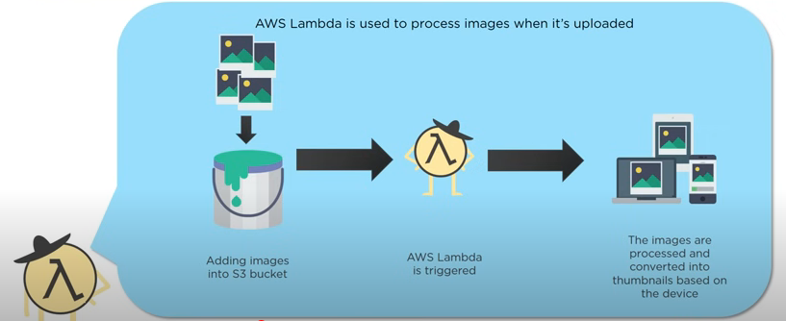
Where is Lambda used?

Slide 13
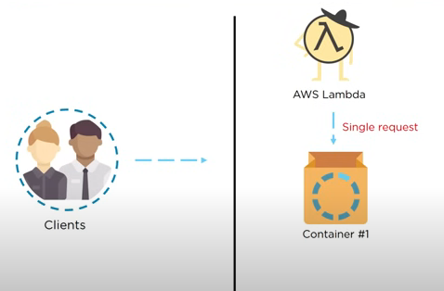
How does Lambda work?

Slide 14
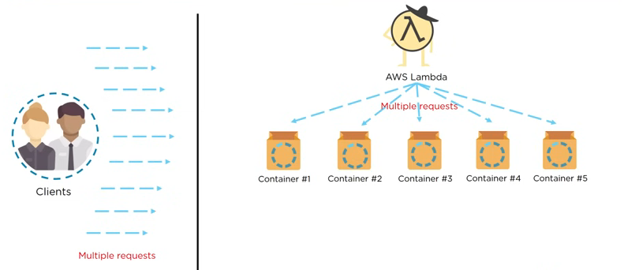
How does Lambda work?

