Slide 1
Cloud computing

Slide 2
Topics
What is Cloud?
What is AWS?
The Well-Architected Framework
AWS global infrastructure
AWS Platforms and Services
AWS Regions and Availability zones

Slide 3
What is Cloud?
"The cloud" refers to servers that are accessed over the Internet, and the software and databases that run on those servers. Cloud servers are located in data centers all over the world.

Slide 4
What is Cloud Computing?
Cloud computing is the on-demand delivery of IT resources over the Internet with pay-as-you-go pricing. Instead of buying, owning, and maintaining physical data centers and servers, you can access technology services, such as computing power, storage, and databases, on an as-needed basis from a cloud provider like Amazon Web Services (AWS).

Slide 5
Operations in Cloud computing
There are the following operations that we can do using cloud computing:
Developing new applications and services
Storage, back up, and recovery of data
Hosting blogs and websites
Delivery of software on demand
Analysis of data
Streaming videos and audios

Slide 6
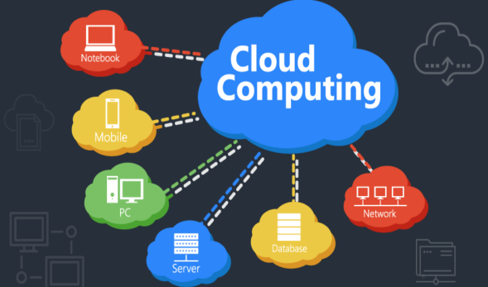

Slide 7
What is AWS?
Amazon Web Services is a subsidiary of Amazon that provides on-demand cloud computing platforms and APIs to individuals, companies, and governments, on a metered, pay-as-you-go basis. Clients will often use this in combination with autoscaling

Slide 8
Why should I learn AWS:
Increased Enterprise Cloud Migration to AWS
Expertise in Cloud Computing Is Inevitable for IT Professionals
AWS Is the Fastest Growing Public Cloud Service
Free-tier Access and Affordable Pricing
AWS Skills Demand Is high
The Abundance of AWS Learning Resources
Certification Validates Expertise and Credibility
Several Specialty Learning Paths

Slide 9
Characteristics of Cloud Computing:
The characteristics of cloud computing are given below:
Agility
The cloud works in a distributed computing environment. It shares resources among users and works very fast.
b) High availability and reliability
The availability of servers is high and more reliable because the chances of infrastructure failure are minimum.
c) High Scalability
Cloud offers "on-demand" provisioning of resources on a large scale, without having engineers for peak loads.

Slide 10
d) Multi-Sharing
With the help of cloud computing, multiple users and applications can work more efficiently with cost reductions by sharing common infrastructure.
e) Device and Location Independence
Cloud computing enables the users to access systems using a web browser regardless of their location or what device they use e.g. PC, mobile phone, etc. As infrastructure is off-site (typically provided by a third-party) and accessed via the Internet, users can connect from anywhere.

Slide 11
f) Maintenance
Maintenance of cloud computing applications is easier, since they do not need to be installed on each user's computer and can be accessed from different places. So, it reduces the cost also.
g) Low Cost
By using cloud computing, the cost will be reduced because to take the services of cloud computing, IT company need not to set its own infrastructure and pay-as-per usage of resources.
h) Services in the pay-per-use mode
Application Programming Interfaces (APIs) are provided to the users so that they can access services on the cloud by using these APIs and pay the charges as per the usage of services.

Slide 12
Exam Blueprint:
Download: AWS Certified Developer Associate

Slide 13
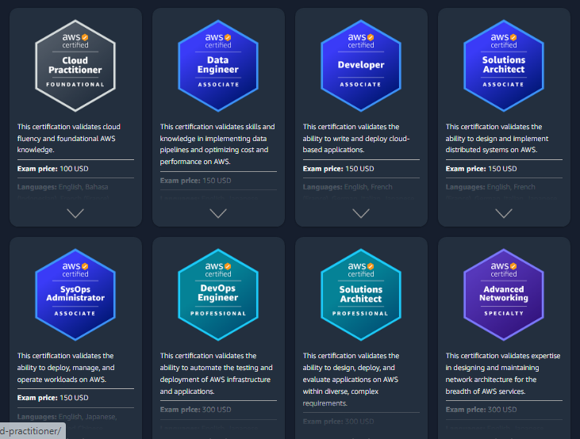
Supporting Courses

Slide 14
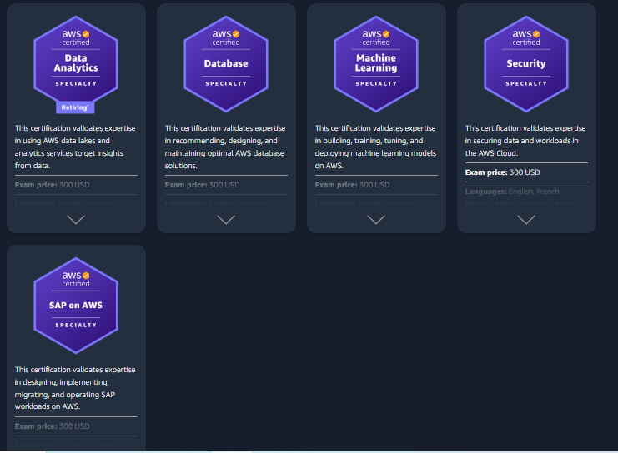

Slide 15
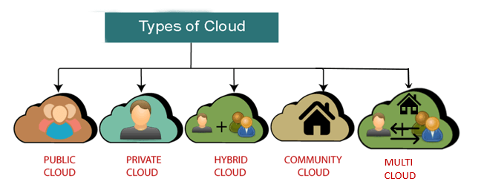
Types of Cloud

Slide 16
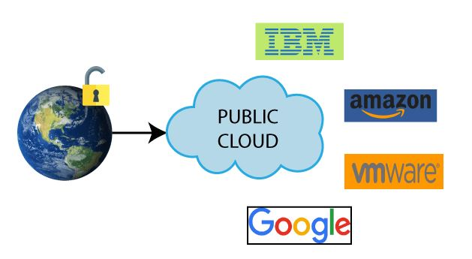
Public Cloud:
Public cloud is open to all to store and access information via the Internet using the pay-per-usage method
Computing resources are managed and operated by the Cloud Service Provider (CSP).
Open Architecture

Slide 17
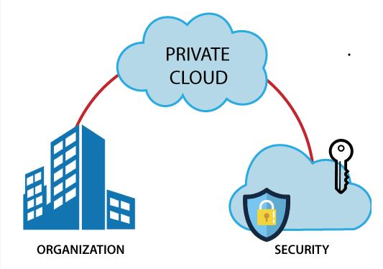
Private Cloud:
Private cloud is known as internal/corporate cloud.
Used by organizations to build and manage their own data centers internally or by the third party.
Examples: VMware vSphere,
OpenStack, Microsoft Azure Stack,
Oracle Cloud at Customer, and
IBM Cloud Private

Slide 18
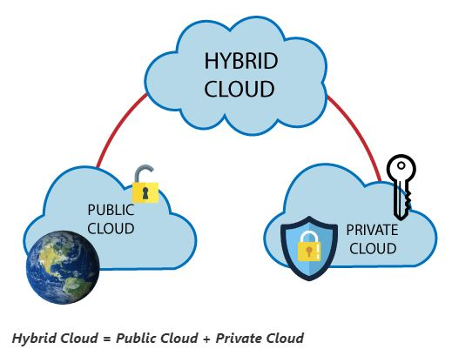
Hybrid Cloud:
Hybrid Cloud is a combination of the public cloud and the private cloud
Hybrid cloud is partially secure because the services which are running on the public cloud can be accessed by anyone, while the services which are running on a private cloud can be accessed only by the organization's users
Example: Google Application Suite (Gmail, Google Apps, and Google Drive)

Slide 19
IAAS:
IaaS is also known as Hardware as a Service (HaaS)
It is a computing infrastructure managed over the internet
it helps users to avoid the cost and complexity of purchasing and managing the physical servers
Example: DigitalOcean, Linode, Amazon Web Services (AWS), Microsoft Azure, Google Compute Engine (GCE), Rackspace, and Cisco Metacloud.

Slide 20
Characteristics of IAAS:
Resources are available as a service
Services are highly scalable
Dynamic and flexible
GUI and API-based access
Automated administrative tasks

Slide 21
PAAS:
PaaS cloud computing platform is created for the programmer to develop, test, run, and manage the applications.
Example: AWS Elastic Beanstalk, Windows Azure, Heroku, Force.com, Google App Engine, Apache Stratos, Magento Commerce Cloud, and OpenShift.

Slide 22
Characteristics of PAAS:
Accessible to various users via the same development application.
Integrates with web services and databases.
Builds on virtualization technology, so resources can easily be scaled up or down as per the organization's need.
Support multiple languages and frameworks.
Provides an ability to "Auto-scale".

Slide 23
SAAS:
SaaS is also known as "on-demand software“
It is a software in which the applications are hosted by a cloud service provider. Users can access these applications with the help of internet connection and web browser.
Example: BigCommerce, Google Apps, Salesforce, Dropbox, ZenDesk, Cisco WebEx, ZenDesk, Slack, and GoToMeeting.

Slide 24
Characteristics of SAAS:
Managed from a central location
Hosted on a remote server
Accessible over the internet
Users are not responsible for hardware and software updates. Updates are applied automatically.
The services are purchased on the pay-as-per-use basis.

Slide 25
Hybrid Cloud:
Hybrid Cloud is a combination of the public cloud and the private cloud
Hybrid cloud is partially secure because the services which are running on the public cloud can be accessed by anyone, while the services which are running on a private cloud can be accessed only by the organization's users
Example: Google Application Suite (Gmail, Google Apps, and Google Drive)

Slide 26
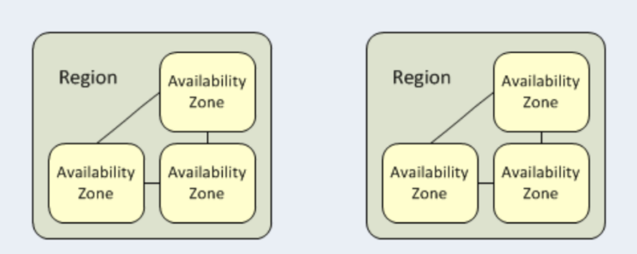
Regions :
A region is a specific geographical location where you can run your resources. Each region is subdivided into several zones.

Slide 27
Questions

