Slide 1
AWS Session-3

Slide 2
Topics
Security Groups
Security Groups – Demo
What is EC2 instance?
EC2 pricing
Connect EC2 with S3 – Demo
EBS
EBS Attach/detach to EC2 – Demo
CloudFront - Demo

Slide 3
Route53
Database Creation – Demo
DynamoDb

Slide 4
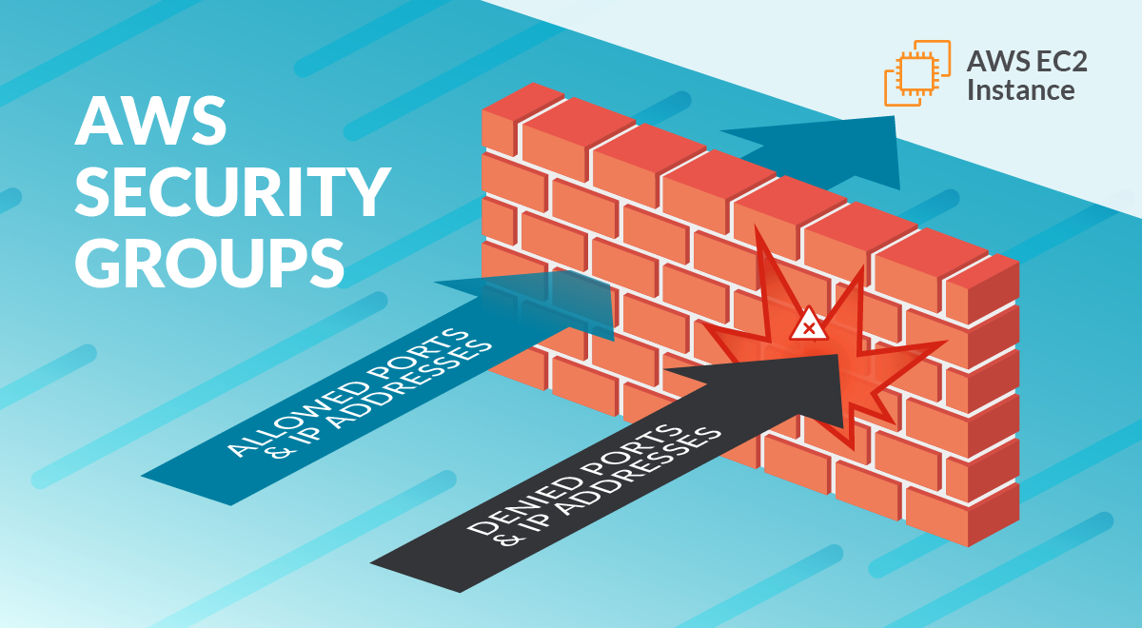
Security Groups
A security group controls the traffic that is allowed to reach and leave the resources that it is associated with. For example, after you associate a security group with an EC2 instance, it controls the inbound and outbound traffic for the instance.

Slide 5
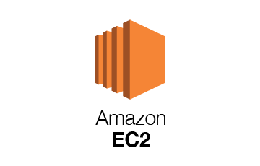
What is EC2?
✔ EC2 stands for Elastic Compute Cloud
✔ EC2 is most widely used service in AWS cloud
✔ Using EC2 we can launch Virtual Machines in AWS Cloud
✔ We can use EC2 instances under Free Tier
(1 year free, monthly 750 hours)

Slide 6
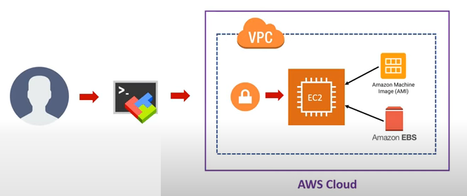
EC2 Instance Creation

Slide 7
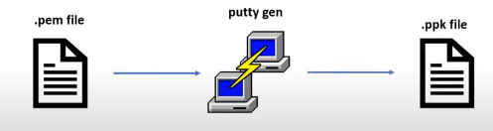
Convert .pem file to .ppk file
✔ PEM (Privacy Enhanced Mail) is a base64 container format for encoding keys and certificates
✔ PPK(Putty Private Key) is a Windows ssh client. We have to convert .pem to .ppk format using puTTy Gen.

Slide 8
EC2 Types
General Purpose
Compute Optimized
Memory Optimized
Accelerated Computing
Storage Optimized
HPC Optimized
https://aws.amazon.com/ec2/instance-types/

Slide 9
EC2 Pricing?
https://aws.amazon.com/free/?all-free-tier.sort-by=item.additionalFields.SortRank&all-free-tier.sort-order=asc&awsf.Free%20Tier%20Types=tier%2312monthsfree&awsf.Free%20Tier%20Categories=*all

Slide 10
EBS (Elastic Block Storage)
It is just like an hard dist or an SSD in our computer that stores operating system and other types of files
It offers storage volumes at block level for se with EC2 instances
We can attach as many volumes as we need and detach them when not in use

Slide 11
CloudFront
Amazon CloudFront is a globally distributed network offered by AWS which securely delivers content to the end users with a high transfer speed and low latency
CloudFront delivers your content through a worldwide network of data centers called edge locations.
If the content is already in the edge location with the lowest latency, CloudFront delivers it immediately.
If the content is not in that edge location, CloudFront retrieves it from an origin that you've defined—such as an Amazon S3 bucket, a MediaPackage channel, or an HTTP server (for example, a web server) that you have identified as the source for the definitive version of your content.

Slide 12
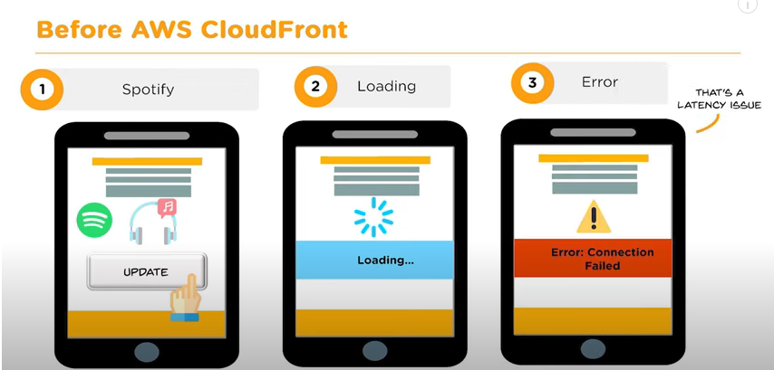

Slide 13
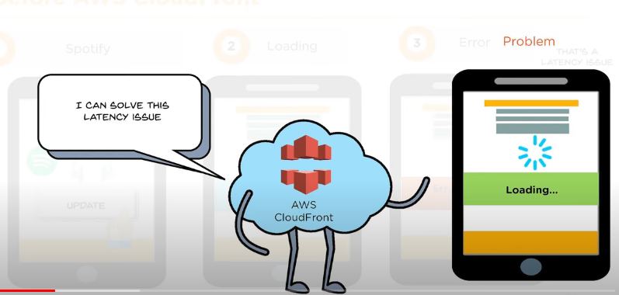

Slide 14
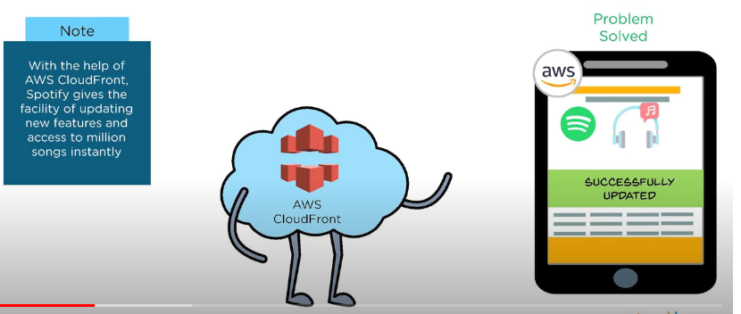

Slide 15





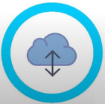
Benefits of CloudFront
Cost-effective
Time Saving
Content Privacy
Highly Programmable
Geo - targeting
Quick content delivery

Slide 16
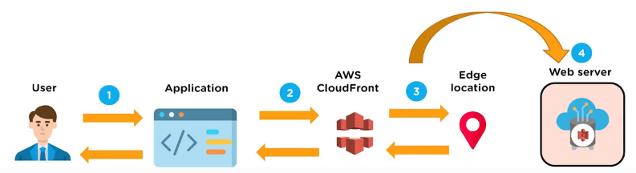
How AWS CloudFront delivers the content?

Slide 17
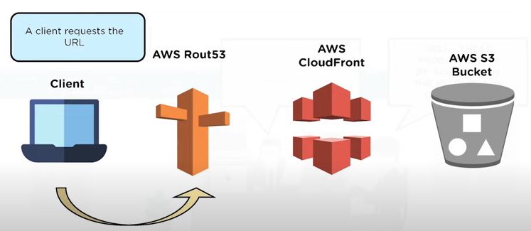

Slide 18
Route53
Amazon Route 53 is a highly available and scalable Domain Name System (DNS) web service.
Route 53 connects user requests to internet applications running on AWS or on-premises.
Performs global server load balancing by routing each request to the AWS region closest to the requester's location.

Slide 19
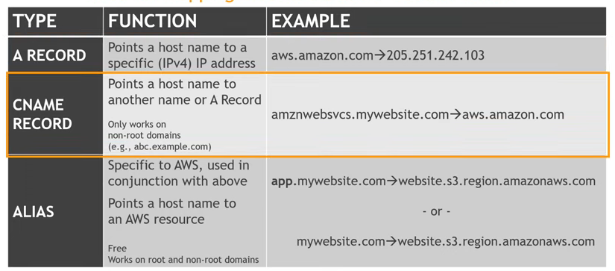

Slide 20
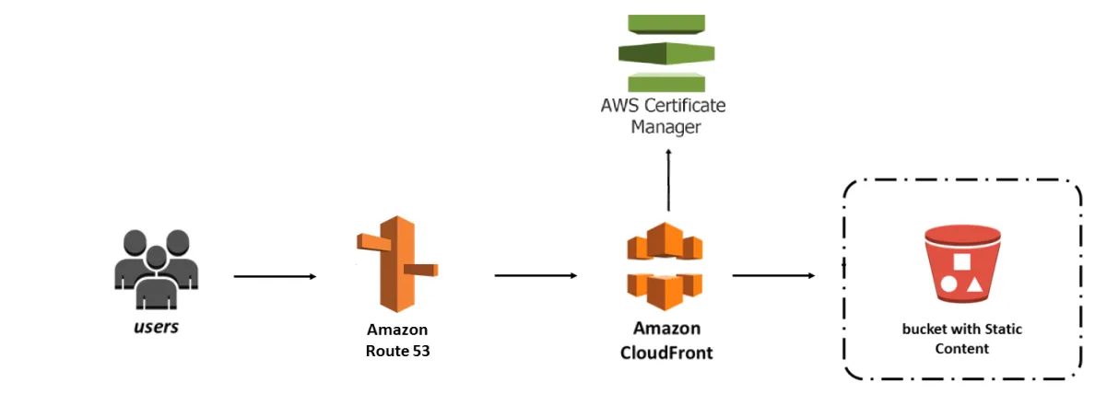

Slide 21
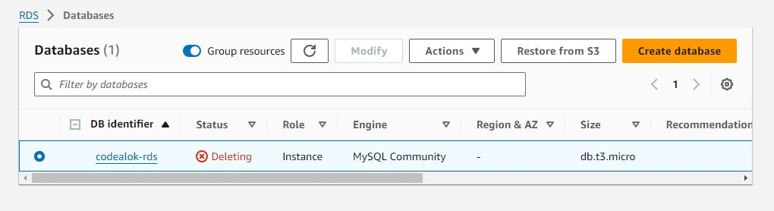
Database Creation - Demo
Relational Database creation - Demo

Slide 22
Types of Backups
Automated Backups
Database Snapshots

Slide 23
Read Replicas:
Can be Multi-AZ
Used to increase performance
Must have backups turned on
Can be in different regions
Can be Aurora or MySQL
Can be promoted to master, this will break the read replica
Multi AZ:
Used for DR(Disaster Recovery)
You can force a failover from one AZ to another by rebooting the RDS instance

Slide 24
Encryption at rest is supported for MySQL, Oracle, SQL Server, PostgreSQL, MariaDB and Aurora. Encryption is done using the AWS Key Management Service (KMS) service. Once your RDS instance is encrypted, the data stored at rest in the underlying storage is encrypted, as are its automated backups, read replicas and snapshots.

Slide 25
DynamoDb
Managed NoSQL Database optimized for performance at scale
High Availability and Durability
Access through API/ORMs and authorized through IAM
Integrated well with other AWS Services
Cost effective usage based payment model

