Slide 1
AWS Session-4

Slide 2
Topics
Amazon Redshift
Amazon Redshift – Demo

Slide 3

AWS RedShift
Amazon Redshift is a cloud-based service or a data warehouse service that is used for collecting and storing data. Also, it enables a user to analyze the data using BI tools and simplifies the process of handling large scale data sets.

Slide 4
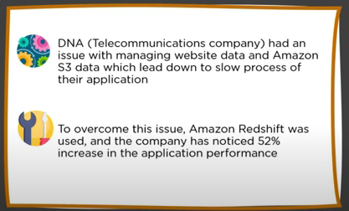
UseCase

Slide 5
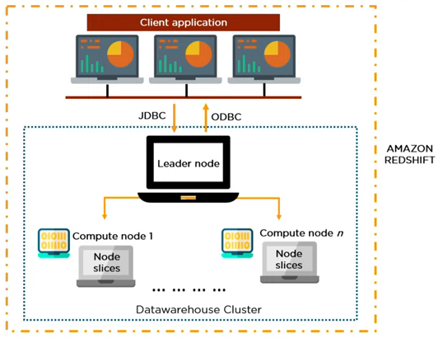
Architecture of Amazon Redshift

Slide 6
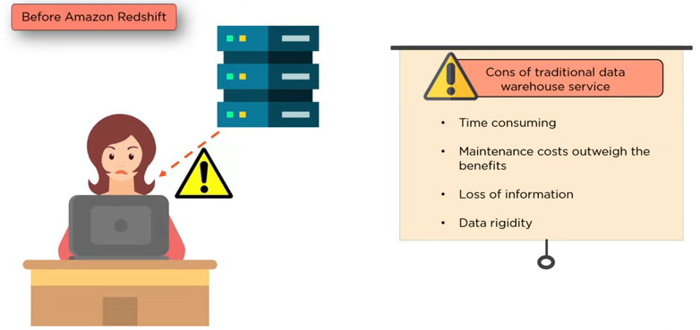
Why RedShift?

