Slide 1
Toxicity Detection in the Context of Social Media Discussions
Presented by:
Alokparna Bandyopadhyay
Jaydeb Sarker

Slide 2
Agenda
Introduction
Related Works
Dataset
Methodology
Experiments and Results
Conclusion

Slide 3
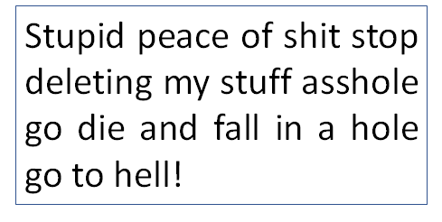


Introduction

Slide 4
Related Works
Kurita et al. (2020) propose Contextual Denoising Autoencoder
Salminen et al. (2020) develop online hate classifier
Vaidya et al. (2019) propose a multi-task learning model
Ollagnier et al. (2019) propose Classification and Event Identification Using Word Embedding

Slide 5

Dataset
Comments | toxic | severe_toxic | obscene | threat | insult | identity_hate
Would you both shut up | 1 | 0 | 0 | 0 | 1 | 0
Train: 159572
Test: 153165

Slide 6
Methodology

Slide 7
Results with Machine Learning Models
EMBEDDINGS | MODELS
 | SGD | LR | XGBoost
Word2Vec | train-auc: 0.77865 valid-auc: 0.90838 | train-auc: 0.77888 valid-auc: 0.90904 | train-auc: 0.96287 valid-auc: 0.84667
GloVe | train-auc: 0.77737 valid-auc: 0.90747 | train-auc: 0.77771 valid-auc: 0.90863 | train-auc: 0.95848 valid-auc: 0.84899
FastText | train-auc: 0.77897 valid-auc: 0.90712 | train-auc: 0.77929 valid-auc: 0.90848 | train-auc: 0.94710 valid-auc: 0.84969

Slide 8
Experiment with Deep Learning Models

Slide 9
Loss Calculation

Slide 10
Number of Toxic Comments

Slide 11
Future Work
Apply classification model to new domain of data
modify the preprocessing techniques according to the new dataset

Slide 12
Conclusion
Analysis of toxic comments in social media communication
Build classifier for detecting toxic comments
Pooled GRU model with FastText embedding gives the best result

Slide 13
Thank you

