Slide 1
Final Lesson
Decision Tree
Zane Lim

Slide 2
Learning Objectives
Explain how a decision tree functions and how to build one
Visually represent a decision tree
Determine when using a decision tree is an appropriate method

Slide 3
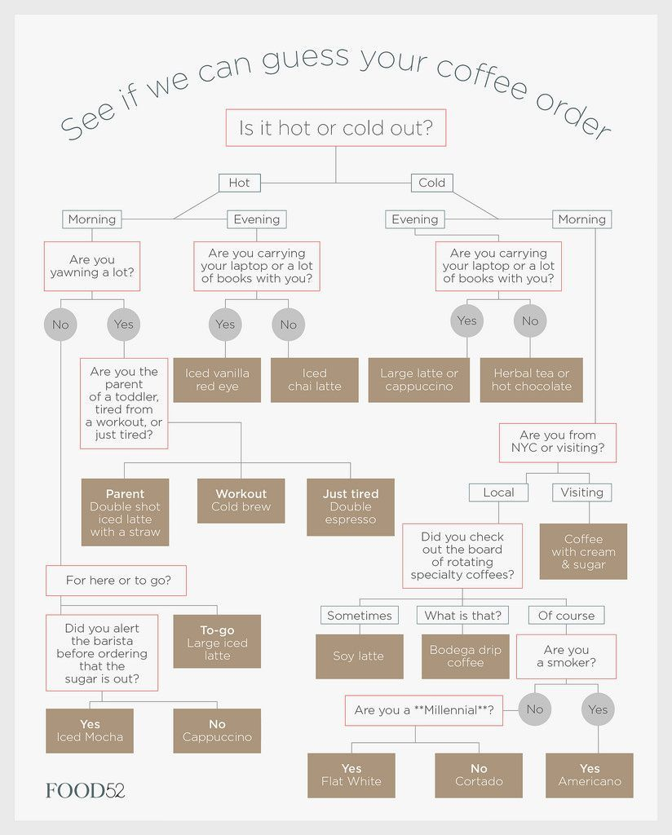
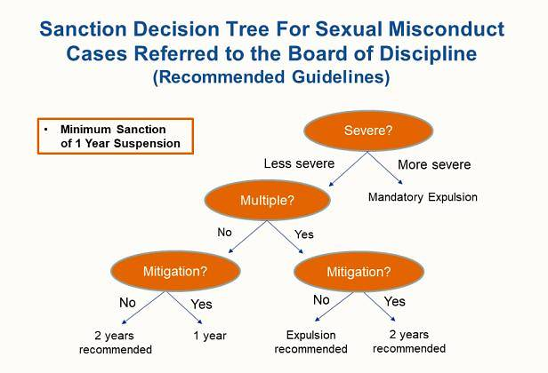
Decision Tree in Real Life
Decision support tool
model of decisions and corresponding consequences
Flow-chart or rules
Source
Source

Slide 4
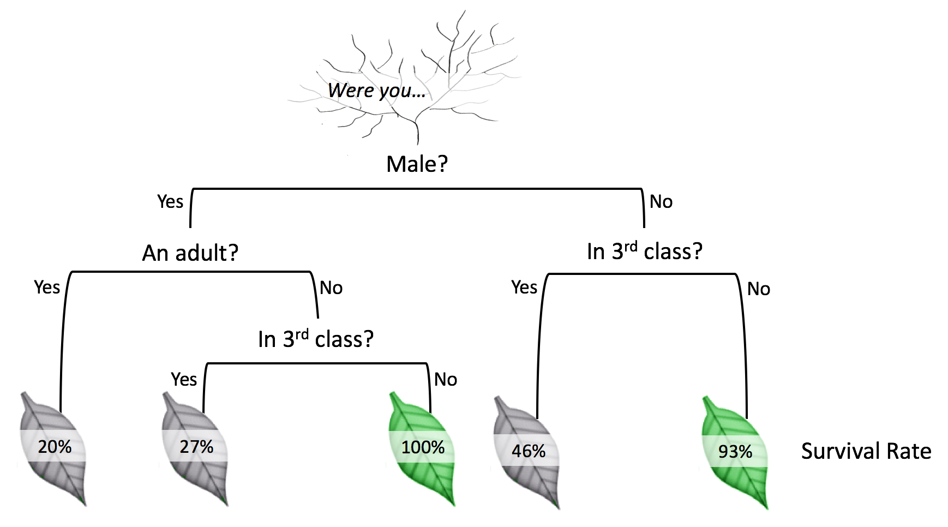
Decision Tree in Machine Learning
Fundamental supervised learning model
“Learnt” from data
Base model for more advanced methods- bagging, boosting
Algorithms
ID3
C4.5
CART (Classification And Regression Trees)
Notes:
ID3 (Iterative Dichotomiser 3) was developed in 1986 by Ross Quinlan. The algorithm creates a multiway tree, finding for each node (i.e. in a greedy manner) the categorical feature that will yield the largest information gain for categorical targets. Trees are grown to their maximum size and then a pruning step is usually applied to improve the ability of the tree to generalise to unseen data.
C4.5 is the successor to ID3 and removed the restriction that features must be categorical by dynamically defining a discrete attribute (based on numerical variables) that partitions the continuous attribute value into a discrete set of intervals. C4.5 converts the trained trees (i.e. the output of the ID3 algorithm) into sets of if-then rules. These accuracy of each rule is then evaluated to determine the order in which they should be applied. Pruning is done by removing a rule’s precondition if the accuracy of the rule improves without it.
C5.0 is Quinlan’s latest version release under a proprietary license. It uses less memory and builds smaller rulesets than C4.5 while being more accurate.
CART (Classification and Regression Trees) is very similar to C4.5, but it differs in that it supports numerical target variables (regression) and does not compute rule sets. CART constructs binary trees using the feature and threshold that yield the largest information gain at each node.

Slide 5
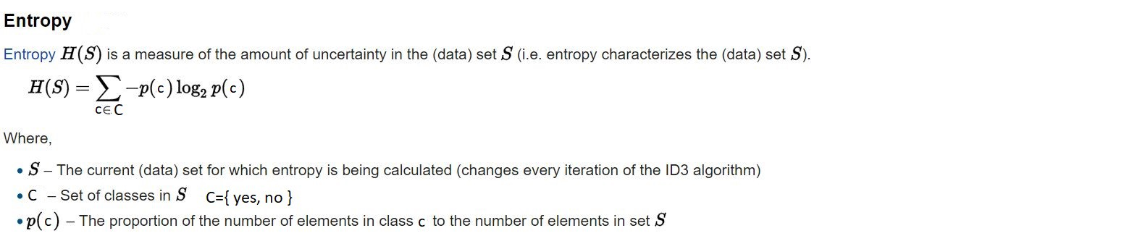
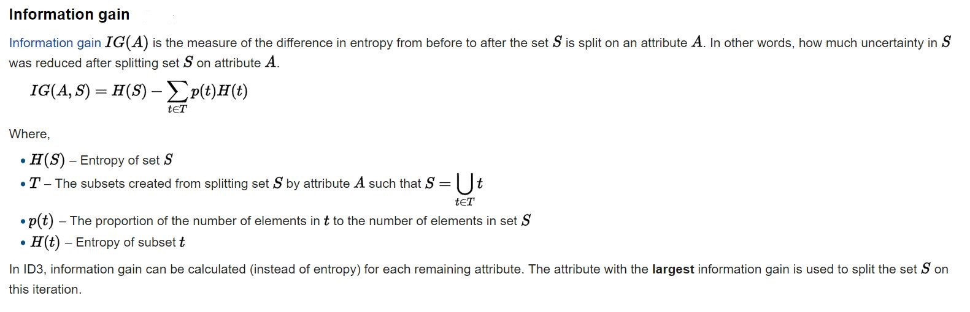
ID3 Algorithm Quality Criteria

Slide 6
ID3 Algorithm Walk-through
Compute the entropy for data-set
For every attribute/feature:
Calculate entropy for all categorical values
Take average information entropy for the current attribute
Calculate information gain for the current attribute
Pick the attribute with the highest information gain
Repeat until we get the tree we desired.

Slide 7
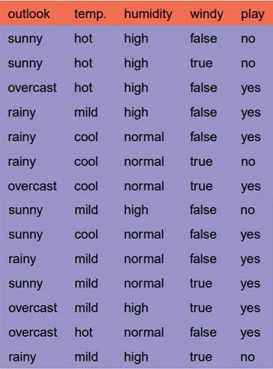
Practice
Famous weather dataset - shall we play an outdoor game?
Use the ID3 algorithm (steps) to calculate the information gain for each feature and select the first (root node) on which to split

Slide 8
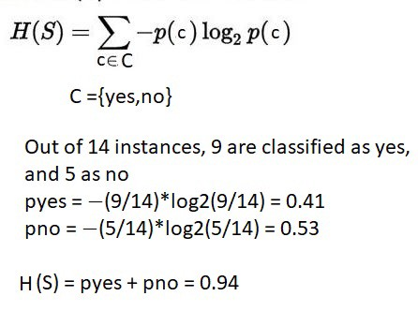
Answer
Calculate the entropy for dataset

Slide 9
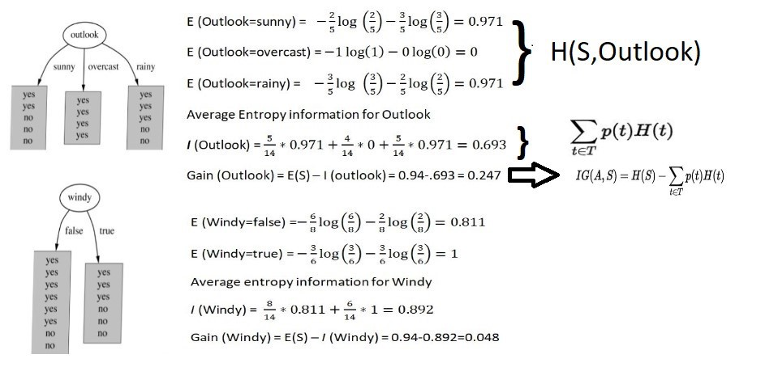
Answer
2. For every feature, calculate the entropy and information gain

Slide 10
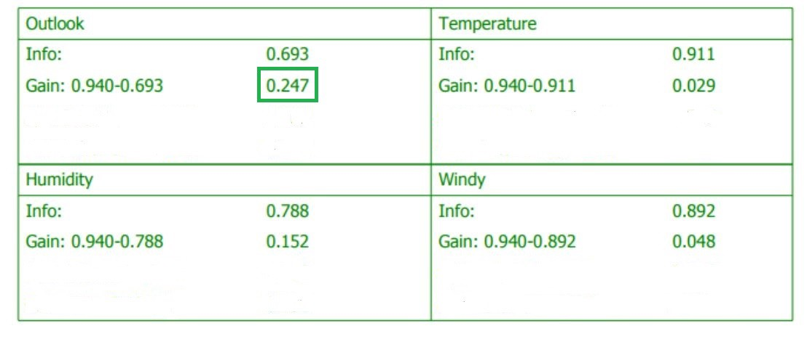
Answer
3. Pick the highest gain attribute - outlook

Slide 11
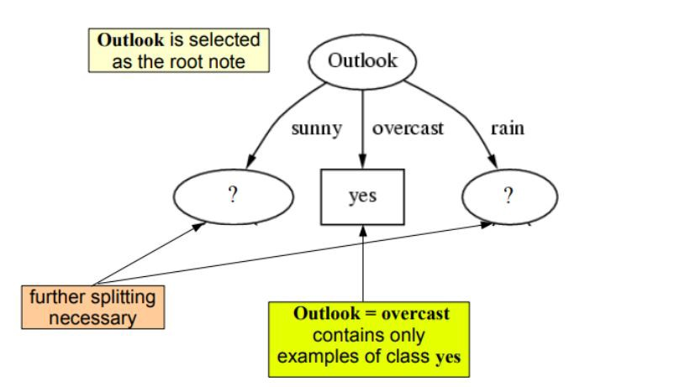
Answer
4. Repeat the same thing for sub-trees till we get the tree

Slide 12
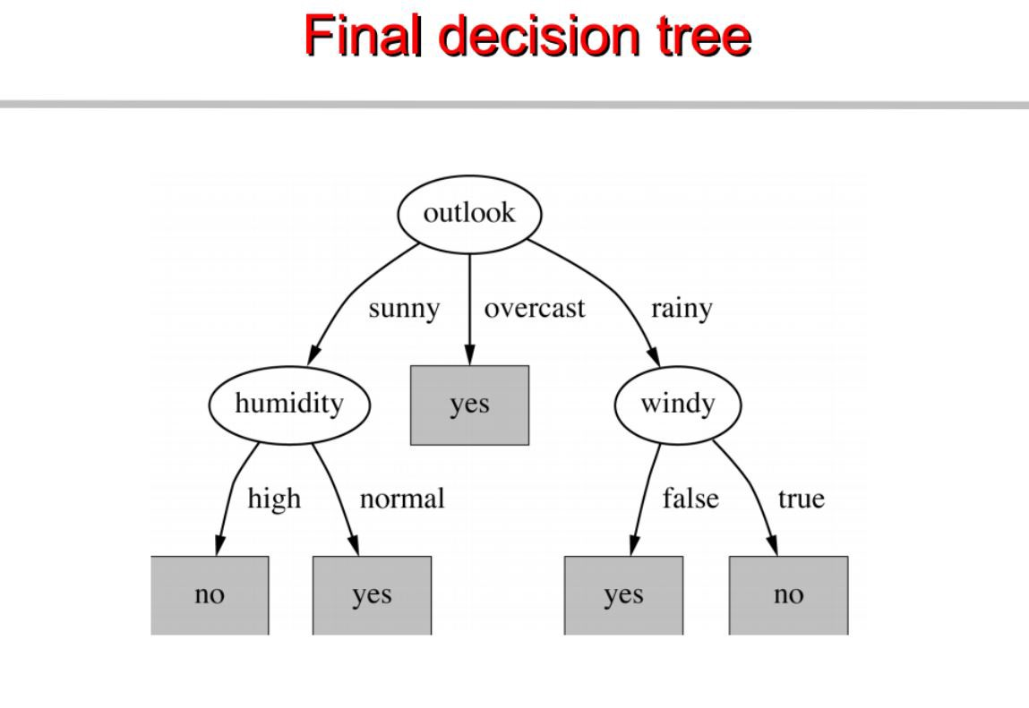
Answer
4. Repeat the same thing for sub-trees till we get the tree

Slide 13


Other Quality Criterias for Split
Gini impurity (uncertainty)
Misclassification error

Slide 14
Lab
Learning objectives
Train a decision tree for classification problem
Visualize the decision tree
Colaboratory (https://colab.research.google.com/drive/1l4y-81dB_TXucgb_UNVTY3OdBvTSH6IE)

Slide 15
Advantages & Disadvantages
Advantages
Simple to understand, interpret, visualize
Can handle both numerical and categorical data
Can handle non-linearity
Disadvantages
Easily overfit to data
High variance- small variation in data might result in different trees
Cannot guarantee to return globally optimal tree

Slide 16
When your values are clear to you, making decisions become easier.”
Roy E. Disney

Slide 17
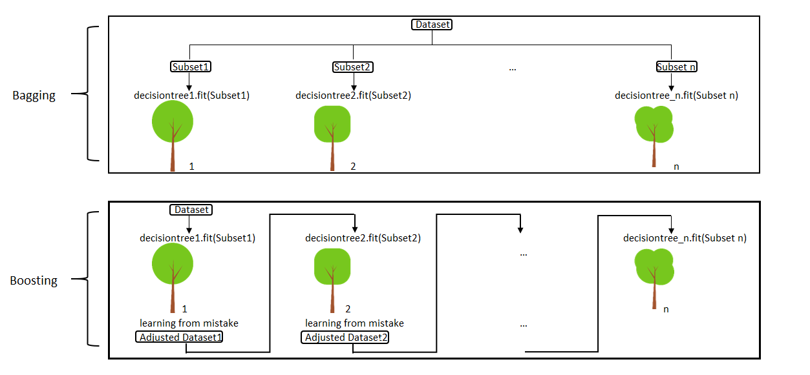
Bagging vs Boosting

Slide 18
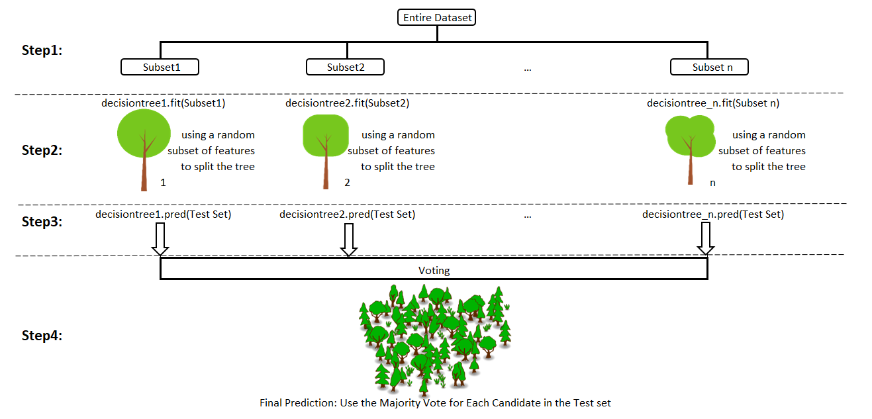
Bagging- Random Forest

Slide 19
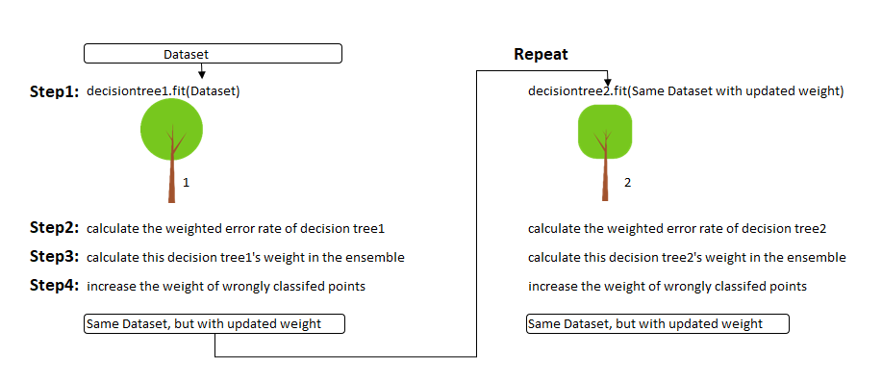
Boosting- AdaBoost

Slide 20
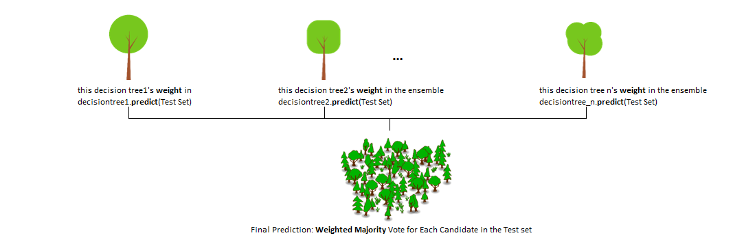
Boosting- AdaBoost Predict

Slide 21
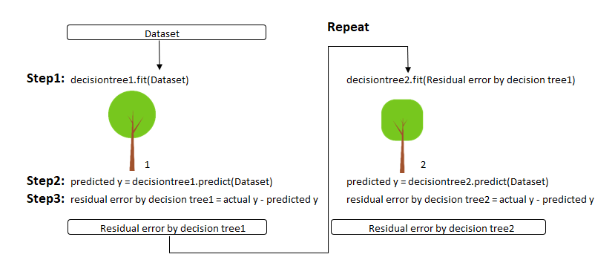
Boosting- Gradient Boosting

Slide 22
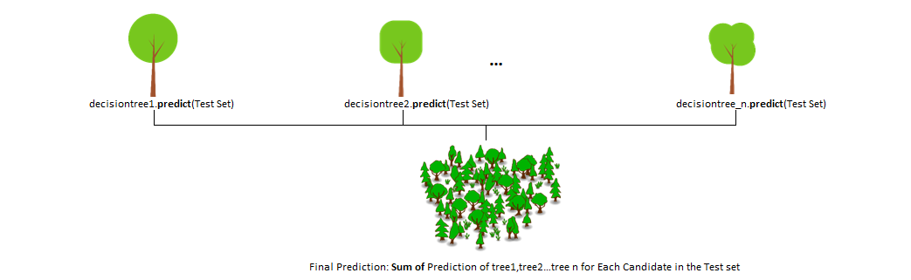
Boosting- Gradient Boosting Predict

