Slide 1
Project Meridian – Way Forward Plan

Slide 2
Agenda
Topic | Slide #
Project Meridian intro | 3
Supply Chain Assistant | 7
Our approach | 12
Roadmap & timelines | 18
Roles and Responsibilities | 21
Appendix | 23

Slide 3
Project Meridian Overview

Slide 4
Overview – Project Meridian
Business case
Project Meridian is an initiative which is targeting to embed automation in AI in the customer service lifecycle processes. With this initiative business have identified multiple operational efficiency and high value customer satisfaction initiative. Following are the high-level use cases:
Order Entry & Capture
Order Management & Visibility
Inventory & Stock Visibility
Credit Management
Pro-forma & Pre-Invoice Processing
Delivery Planning & Execution
Shipment & Logistics
Customer Delivery Invoicing
Claims & Credit Notes
Order Management & Visibility is the prioritized use case as per the data availability, architecture feasibility and requested across regions.

Slide 5
Implementation Phases
Business Use Case for Project Meridian
1
EDP Connect
2
SAP – (S4) Includes a portion of claims
3
Boundary systems, tracking information
4
Customer Access
700+
Hours saved in total
900+
Hours saved in total
1,200+
hours saved in total
3,300+
hours saved in total
~ 7600
Baseline Total Hours/year
(1 FTE / BU)
Times based on 1FTE per Business Unit (15 BU) Approx. 116 CS agents globally

Slide 6
Customer Service Assistant – Order Visibility
Order Visibility
The Sales team currently lacks real-time, self-service visibility into SAP order data, leading to over-reliance on manual lookups, delayed customer responses, and increased load on operations and IT teams. This provides an opportunity to provide a system that can provide single pane of data in new age of conversational AI
Current Pain Points
Sales reps depend on Operations or IT to pull order status from SAP, creating bottlenecks and delays
No self-service interface exists for real-time or near-real-time order tracking
Customer-facing queries on delivery ETAs and shipment tracking require manual effort
Lack of a unified view across the order lifecycle — from creation to fulfillment
Escalations and follow-ups consume significant non-value-added time for the sales team
Business Objectives
Enable Sales team self-service for order status queries via a conversational interface
Reduce average time-to-answer for order visibility queries from hours to seconds
Minimize dependency on IT/Operations for routine data lookups
Provide a scalable, governed, and secure chat interface aligned with the Azure data strategy
Deliver measurable ROI with rapid time-to-value

Slide 7
Supply Chain Assistant

Slide 8
Overview
Supply Chain Assistant
Primary Objective
To develop and deploy an AI-powered Supply Chain Assistant on Databricks Genie capable of answering 10 predefined, high-value business questions across order management, delivery, inventory, and service level performance.
Key Goals
Enable self-service analytics for business users (Customer Service, Supply Chain, Operations)
Provide real-time / near-real-time insights using enterprise data platform (EDP)
Reduce dependency on manual Power BI reports and SME interventions
Improve decision-making speed and accuracy across supply chain operations
Establish a scalable agent-based architecture for domain-specific queries

Slide 9
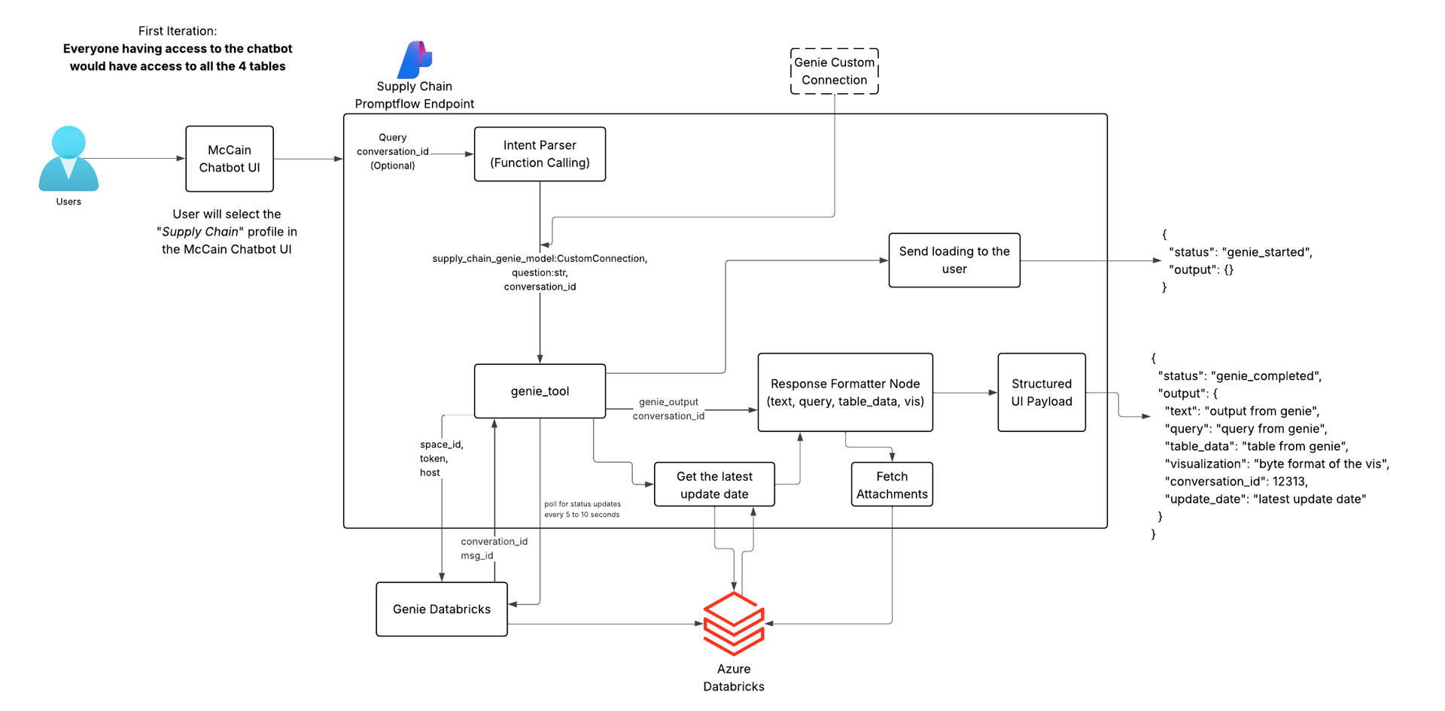
Architecture
Supply Chain Assistant

Slide 10
Retrospective…
Retro
1. Incorrect Business Logic from SMEs: Data was available within Prod tables, but the team was required to create a copy of these tables and work on the same. But while making the data copy, joins of the tables, and the tables themselves weren't correct, this caused the underlying data to be wrong.
Insight: The system was functioning correctly based on defined logic, but the logic itself was flawed
Plan: Get EDP consultant and business stakeholders validate the logic and data, not just the SQL queries
2. No Production Data Access: Development team, Did not have direct access to production data, Relied on assumptions / partial datasets. Could not validate, Real-world data scenarios, Data completeness or anomalies
Insight: Data used in Supply chain assistant was old and incomplete, hence the summarizations didn’t match in the final output with the
Plan: Create data tables after joining the relevant tables, and get the data validated by business stakeholders before agents are built.

Slide 11
Retrospective
Retro
3. No Standardized KPI Definitions: Metrics like Fill Rate, Delivery variance and Shortages were interpreted differently across systems
Insight: The metrics were supposed to be matched with the data coming in the Power BI reports, but the logic of creating these metrics was never shared with the team
Plan: Get logic of the dimensions and metrics created within Power BI, so that the same can be recreated within source tables
4. Ground truth comparison just looked into the SQL queries: While comparing the Ground Truth, only SQL queries were compared, and that showcased 97% match with the queries supplied by the operations team. No data output match was done to ensure that the queries are returning the expected data as well.
Insight: Output data has to be matched as well, not just the queries to ascertain accuracy
Plan: Get the output data matched along with the SQL queries, to establish the ground truth

Slide 12
Order Visibility – Our Approach

Slide 13
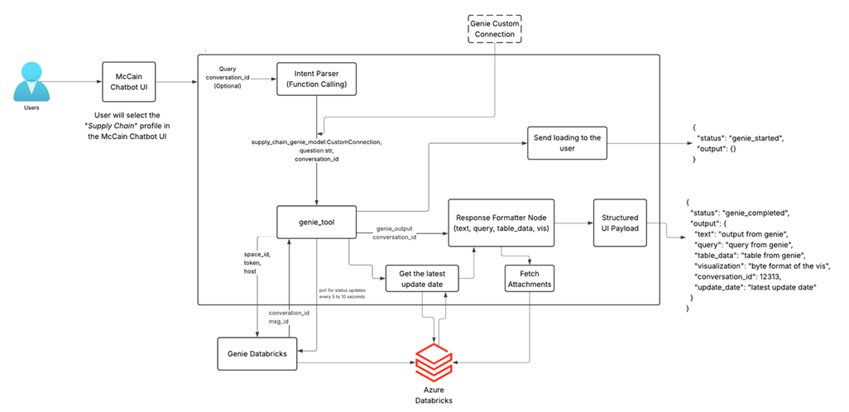
Architecture – 1 – Reutilization of Existing Infra/ Genie Capability
Supply Chain Assistant
Re-utilized Existing Architecture for Genie Space, databricks connectors, Request and response api, intent parser
As the issue was the business logic, so the logic SQL layer will be improved
Rather than silver layer which is a modiefied datamart, exact sap data from bronze layer will be used as a source of truth
Improve the Ground Truth layer
Create new agent on genie with source truth as bronze layer and update the logics

Slide 14
Architecture 2 - Building Semantic engineer from Scratch
Web app- Phase 1
Azure APIM
Next.js SSR / React
Gateway + auth
AGENT CORE
LangGraph agent — Azure Container Apps
Intent classifier
Data router
Query generator
Query Validator
Response synth
GPT-4o query type
EDP vs SAP vs both
Schema/MDL + LLM Model + Verified Query + Logics→ Query generated
Validates the query generator by checking the proper format
LLM Model → NL answer
Session checkpoint (Redis) — conv_id keyed graph state
DATA SOURCES
Databricks EDP — primary source
SAP systems — Phase 2
Salesforce System
Bronze layer Catalog
Salesforce Data
Connector/API
Unity Catalog
SAP API GW
SAP Data ( as is)
API/ Data Connector
Schema + ACLs
RFC / OData
AZURE SERVICES
Azure supporting services
App Service
Container Apps
Cosmos DB
Redis Cache
App Insights
Next.js SSR
LangGraph agent
Conversation history
Session + SQL cache
Traces + monitoring
SECURITY
Security perimeter
Azure Entra ID
Azure Key Vault
Front Door + WAF
SSO all channels
Tokens + secrets
DDoS, SSL, routing

Slide 15
Recommendation
Architecture
Option 1 – Utilize Architecture 1 -> This is something already present in production but provide incorrect result. One pathway forward is to utilize the application component deployed and genie integration and improve the logic layer with the help of data and sap team to fetch correct result
Option 2 – Build a Conversational text to query language chatbot from scratch -> Building the semantic layer that understand business logic better , can be connected to multiple

Slide 16
Risk Mitigation Strategy
Architecture
Logic signoff from SMEs
Groundtruth data to made available in dev and prod, which will not just compare the SQL queries, but also the data output
Day 1 SME/ Business involvement
Weekly Demo’s / Requirement Grooming
Our Accuracy strategy of calculation will be as per data points.
PowerBI data points can’t be source of truth until exact logic are shared with us.
We’ll show as is picture of data we are getting from EDP, no new dimension of metric to be introduced other than basic mathematical operations
Getting data directly from bronze Layer
We will be building the Semantic layer from scratch if we go ahead by approach 2. This will include provide business acumen, core SAP schema understanding and Agent to act as a SME specialist

Slide 17
Next Steps
Architecture
Aligning Resource
Alignment of Approach
Access Request and Resolution
Any specific logic clarification and data discovery
Ground Truth Establishment

Slide 18
Roadmap and timelines

Slide 19
Phased Delivery
roadmap
Sno | Phase | Description | Weeks
1 | Data validation and understanding | Understand the underlying data and what will be required to answer business questions | 1
2 | Foundation & Identity | Security set up, environment set up, build reference data within Azure environment | 2
3 | Orchestration and intelligent agent creation | Intent identification, information extraction, logic engine, create agents with specific Entra ID | 2
4 | SAP tooling | Develop fetch functionality | 2
5 | Frontend integration | Frontend development (React) & middleware creation | 2
6 | Integration with observability | Integrate with observability solution using metadata to create capability for the evaluation metrics | 2
7 | Admin panel utility | Prompt and logic management, business configuration, observability | 2
8 | Eval driven testing | Run historical queries to check for accuracy and hallucinations | 2
9 | UAT Testing | Testing with CS | 2
Total |  |  | 17

Slide 20
Project Timelines
roadmap
Phase | Description | Weeks | Wk 1 | WK 2 | Wk 3 | Wk 4 | Wk 5 | Wk 6 | Wk 7 | Wk 8 | Wk 9 | Wk 10 | Wk 11 | Wk 12 | Wk 13
Data validation and understanding | Understand the underlying data and what will be required to answer business questions | 2
Foundation & Identity | Security set up, environment set up, build reference data within Azure environment | 2
Orchestration and intelligent agent creation | Intent identification, information extraction, logic engine, create agents with specific Entra ID | 3
EDP tooling | Develop fetch functionality | 4
Frontend integration | Frontend development (React) & middleware creation | 3
Pipeline Testing | Test EDP pipeline | 2
Integration with observability | Integrate with observability tool using metadata to create observability capability for the evaluation metrics | 2
Admin panel utility | Prompt and logic management, business configuration, observability | 2
Eval driven testing | Run historical queries to check for accuracy and hallucinations | 2
Deploymentt | Deployment of the aplication on the Azure platform | 1
UAT Testing | Testing with CS | 2
Live Preparation | Soft Launch - Business Communication | 2

Slide 21
Roles & Responsibilities

Slide 22
Roles & responsibilities - Project vs Scrum Team
Role | Who | Description | Allocation (%)
Data Product Owner | Ankit Sharma | Owns the data product and provides deep data domain expertise | 20
Regional Business Partners | Abhishek Shama Melinda Veracion Georgina Peralta Annie Dumitrescu | Provide business context, collaborate on use case identification and supports on regional needs and expectations | 20
Product Owner | Graham Booth |  | 80
Region BA | Hana Mansouri | Translates regional requirements into actionable inputs and ensures alignment across markets | 20
Project Sponsors | Laure Largenton Richard Efting Diane Levin | Provide strategic direction, funding, and executive support; remove high-level blockers | 20
Business SMEs | Carmenza Ramirez Regional Lead (TBC) | Provides deep domain expertise, and validates business rules, processes, and outputs | 20
Scrum Team
Senior AI Engineer |  | Python, LangGraph, Prompt Engineering expert | 100
Forward Deployed Engineer | Kunal Mehta | Integration lead, to ensure the application functionalities talk to each other end to end | 100
Full stack engineer |  | React, Node.js, Tailwind, creating security roles and access, to create front end for the application and admin panel | 100
Integration Developer |  | EDP and application development and integration | 100
Data Engineer |  | Azure and Databricks AI engineer | 100
DevSecOps Engineer |  | Terraform, Security Center | 100
Testing Engineer/QA |  | Tests and validates the application functionalities | 100
Scrum Master | Joseph Hopkins | Help keeping high velocity and volume | 35

Slide 23
Appendix

Slide 24

Process flow
LLM (Azure OpenAI / Gemini)
Detailed Process Flow
Question
Retrieval
Prompt
Home
Output Processsing
Ask
Schema Metadata & Semantics
Vector Database
Index Processing
Modeling
Create data model
Connect
Data Source
Core
Metastore
Connect
Data Source Connectors
Read Metadata
SAP / EDP

