Slide 1
Order Status Enquiry Assistant — Monthly Progress
McCain · July 2026 · Alok Ranjan — Forward Deployed Engineer, StatusNeo
Delivered the complete design, evaluation & data foundation for Use Case 1 (Order Status) — ready to build.
8
22
22
11
Order states covered
Evaluation conversations
Security / corner cases
Sprint 1 work items
Design & Evaluation Foundation
Data, Platform & Delivery
1
Scenarios created
5
New catalog & data planning
8 order states + 22 end-to-end conversation scenarios
Bronze catalog: data + metadata + governance tables
2
Golden datasets
6
ER diagram
Q1 reference spec: inputs, answer logic, follow-ups
Silver ER overseen; Bronze modelling is next
3
RBAC & corner cases
7
Genie setup (in progress)
22 scenarios: role/field access, jailbreak, injection
Text-to-SQL with Shivansh & Madhavan
4
Follow-up rules
8
Sprint 1 plan & features
Multi-turn: ship date, blocks, invoice, which delivery
2-week Use Case 1 plan · 11 items · owners
Notes:
Overview: impact, key numbers, and the eight workstreams grouped into Design & Evaluation Foundation and Data, Platform & Delivery.

Slide 2
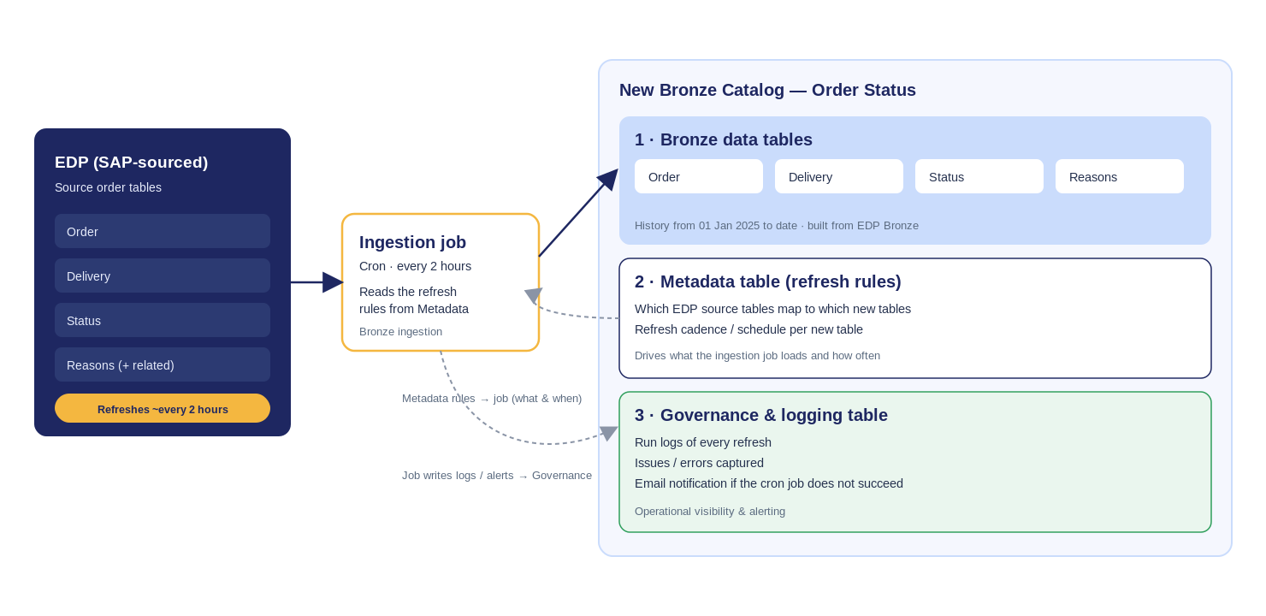
New catalog & data planning · what's next
The new catalog
Data tables — Order · Delivery · Status · Reasons
Metadata — refresh rules (source → target, cadence)
Governance — logs, issues, email alert on failure
From EDP Bronze · ~2h refresh · since 01 Jan 2025
What's next
Finish the Genie setup & tuning
ER diagram on the new Bronze tables
Stand up the catalog + 2-hour refresh & governance
Build Use Case 1 in the sprint (all scenarios & corner cases)
Toward the week-6 stakeholder demo
EDP Bronze → new catalog (data tables) · Metadata drives the ~2-hour refresh · Governance captures logs & email alerts.
Notes:
New catalog design and the roadmap to the week-6 demo.

