Slide 1
AGENTIC ORDER STATUS ENQUIRY ASSISTANT
Design, Architecture, Timeline & Status
Prepared for Manoj — CTO, McCain
Mccain Meridian Dev Team | 29 July 2026

Slide 2
AGENDA
What we'll cover
1
Solution scope
19 questions across 6 real CS-agent workflows
2
Architecture
A Databricks-native, defense-in-depth design
3
Request flow
How a question moves end-to-end — proven Promptflow + Genie pattern
4
Delivery timeline
6 sprints, 3 months — 29 Jul to 20 Oct
5
Current status
Day 1 of Sprint 1, today
McCain · Agentic Order Status
2

Slide 3
SOLUTION SCOPE
19 questions, 6 domains — sourced from real CS-agent workflows
2
5
4
Order Status & Lookup
Scheduling & Holds
Shortages & Fill-Rate
“What's the status of order 123?”
Past-due, credit/delivery blocks, loading dates
Confirmed vs. ordered/shipped quantity gaps
3
3
2
Inventory & Customer History
Packaging & Compliance
Billing & Invoicing
On-hand stock, what a customer's ordered before
Pallet, weight & UOM specs
Shipped-not-billed, billed-yesterday
McCain · Agentic Order Status
3

Slide 4
ARCHITECTURE
Azure
Databricks
SAP
Defense-in-depth, Databricks-native architecture
1
2
3
4
5
6
7
User &
Sign-in
→
API
Gateway
→
Prompt
Shield
→
Agent
→
Genie +
DB Shield
→
Governed
Data
→
Output
Guardrails
Entra ID SSO
Rate limits, WAF
Jailbreak defense
Model Serving
Read-only SQL
Unity Catalog
Cited, redacted
SECURITY
RESILIENCE
GOVERNANCE
OBSERVABILITY
SSO/SCIM · Private Link · read-only SQL
Autoscale · warm mins · graceful fallbacks
Row/column security · lineage · audit
MLflow tracing · 44-test eval gate
Applied to every request, in every environment — a failure at one layer is contained by the next.
Dev → QA → Prod
EDP on ADLS Gen2
Evaluation-gated
Isolated Unity Catalog catalogs, promoted via Databricks Asset Bundles
~2h refresh from SAP, read-only — SAP itself is never written to
22 functional + 22 security tests must pass before any release
McCain · Agentic Order Status
4

Slide 5
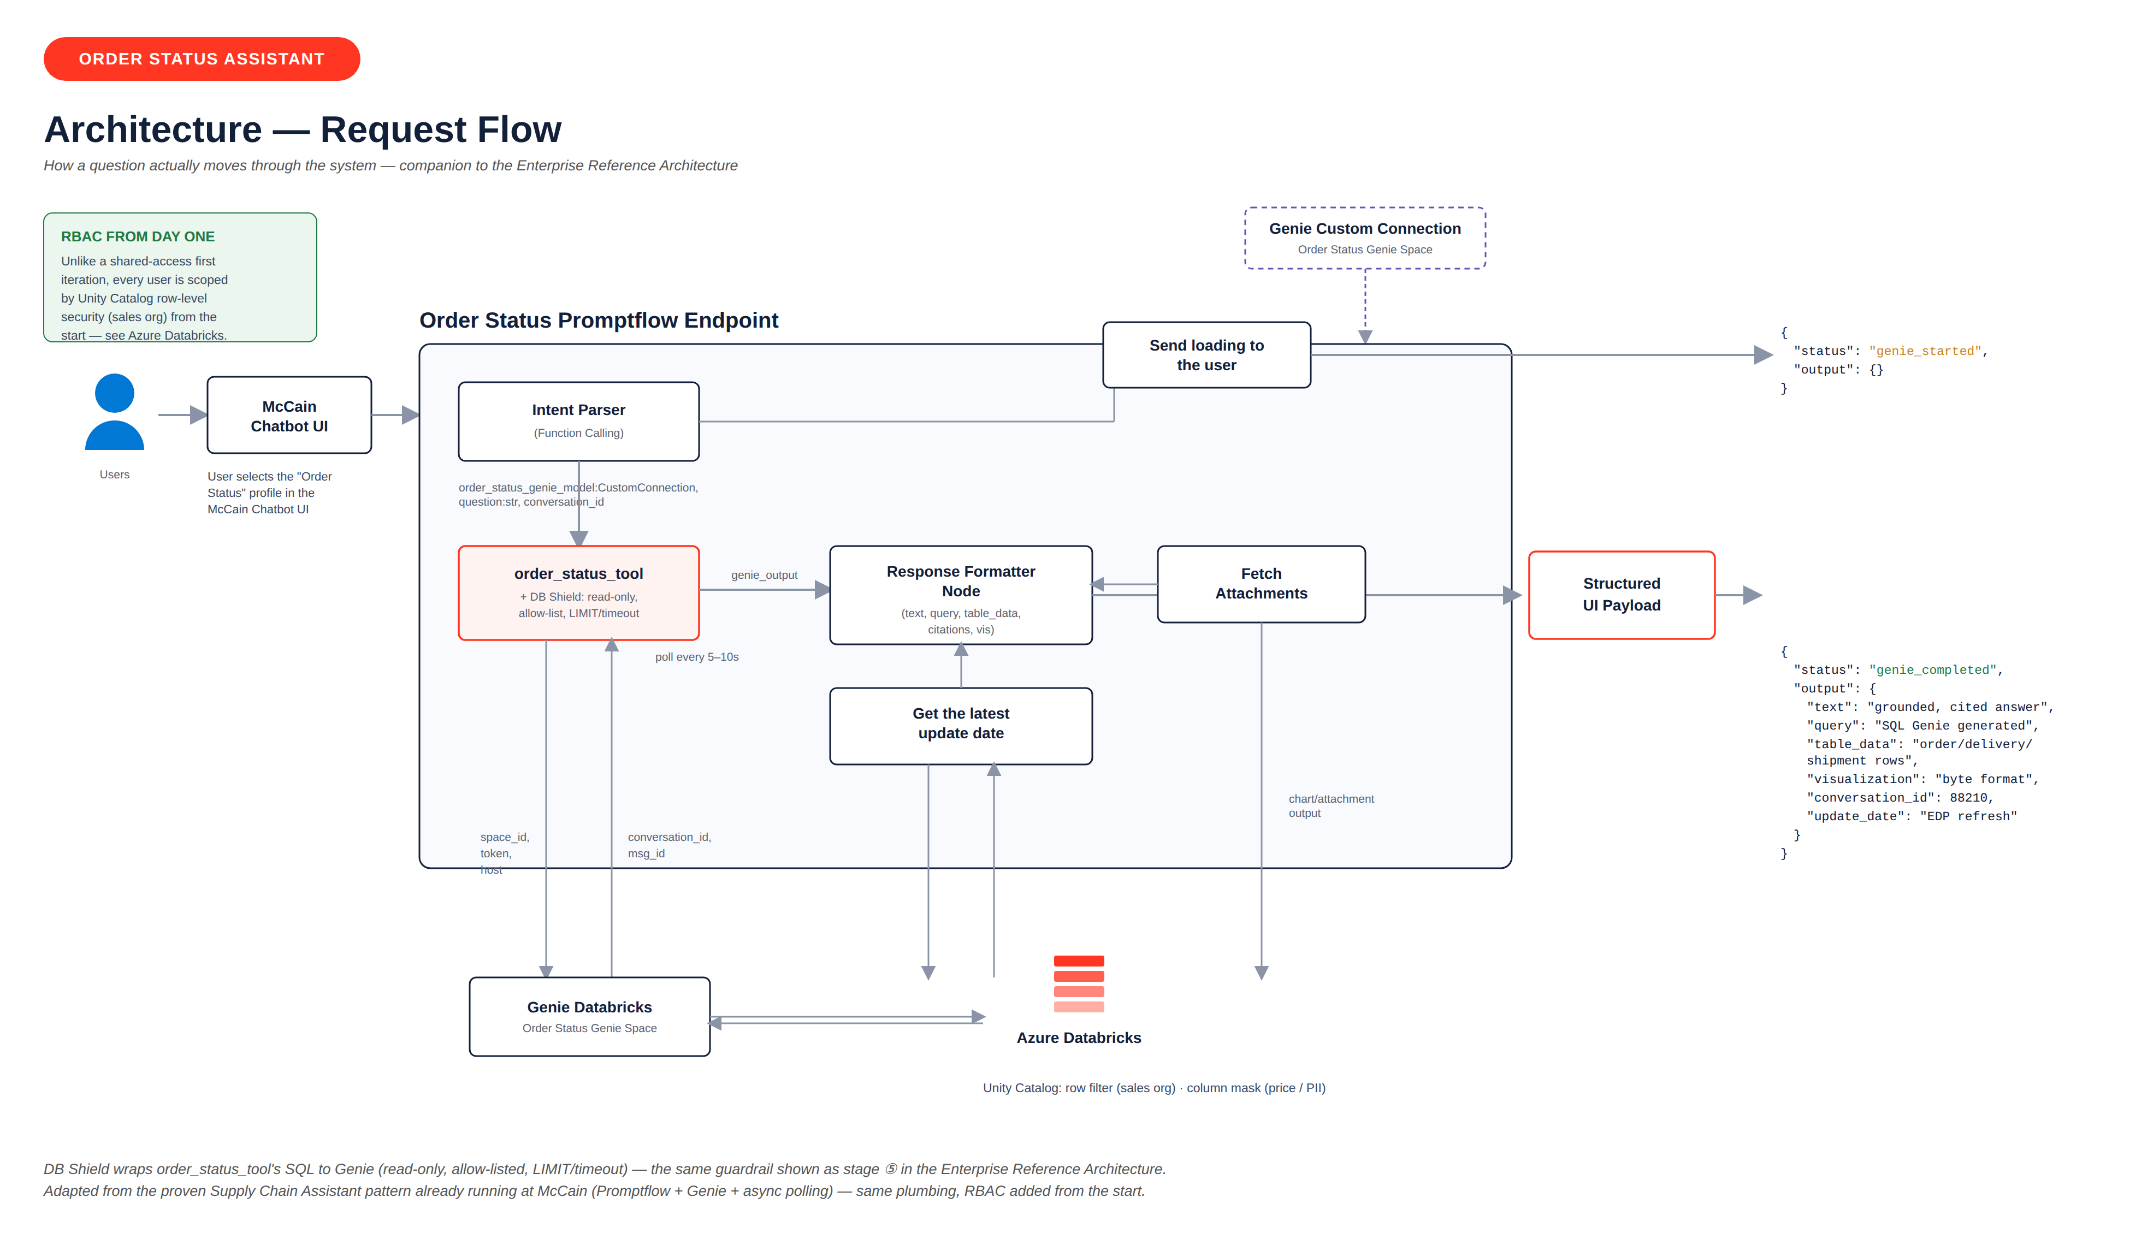
ARCHITECTURE — REQUEST FLOW
Proven at McCain today — adapted from the Supply Chain Assistant's Promptflow + Genie pattern, with RBAC scoped from day one.
McCain · Agentic Order Status
5

Slide 6
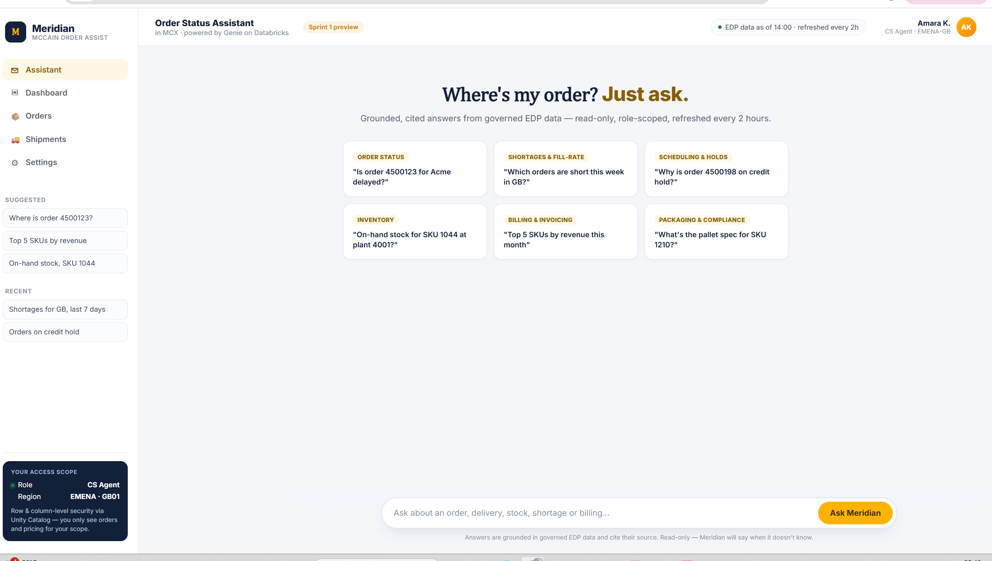
ARCHITECTURE — REQUEST FLOW
Proven at McCain today — adapted from the Supply Chain Assistant's Promptflow + Genie pattern, with RBAC scoped from day one.
McCain · Agentic Order Status
5

Slide 7
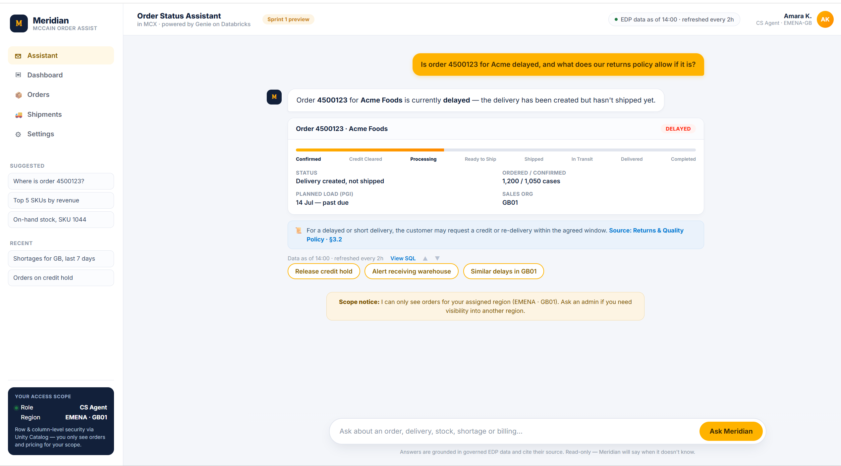

Slide 8
DESIGN PRINCIPLES
Built to be safe, governed, and observable by default
1
Guardrails at every hop
2
Governed data access
Prompt Shield, DB Shield (read-only SQL only) and output guardrails — a bypass at one layer is contained by the next.
Unity Catalog enforces row-level security by sales org and masks restricted fields (pricing, margin, PII) — never left to app logic.
3
Databricks-native
4
Evaluation-gated releases
Genie for NL→SQL, Model Serving for orchestration — no unnecessary third-party layers between the agent and governed data.
Every release is scored against a 44-test golden set (22 functional + 22 security) before it ships — no exceptions.
McCain · Agentic Order Status
6

Slide 9
DELIVERY TIMELINE
3-month delivery plan — 6 sprints, 29 Jul → 20 Oct 2026
TODAY
Sprint 1
Sprint 2
Sprint 3
Sprint 4
Sprint 5
Sprint 6
29 Jul – 11 Aug
12 – 25 Aug
26 Aug – 8 Sep
9 – 22 Sep
23 Sep – 6 Oct
7 – 20 Oct
Order Status flagship
Scheduling & holds
Shortages & fill-rate + demo
Inventory & customer history
Packaging & billing
Hardening & go-live
Sprint 1 starts today. Sprint 6 ends with all 19 questions live and evaluation-gated in Prod.
McCain · Agentic Order Status
7

Slide 10
CURRENT STATUS
Where we are today — Day 1 of Sprint 1
DONE
IN PROGRESS — SPRINT 1
Requirements & environment (Dev/QA/Prod) plan finalized
Order Status flagship build
RBAC & Unity Catalog scope · DB Shield · all 8 order states · disambiguation & follow-ups · guardrails · tracing & evaluation gate · UI prototype
Reference architecture defined — defense-in-depth, Databricks-native
Target: working demo + evaluation gate passed by 11 Aug
3-month, 6-sprint delivery plan finalized
UPCOMING
Sprint 1 backlog scoped in detail — 11 tasks, owners assigned
Scale/region decisions from McCain — gate Prod sizing
22 open questions identified for McCain & internal product team
QA environment stand-up — owned by McCain's platform team
McCain · Agentic Order Status
8

Slide 11
NEXT STEPS
What happens next
1
Finish Sprint 1
Complete the Order Status flagship build and pass the 44-test evaluation gate by 11 Aug.
2
Internal demo
Walk through the working Order Status assistant — all 8 order states, guardrails and citations.
3
Start Sprint 2
Scheduling & holds cluster begins 12 Aug, on the same 2-week cadence.
McCain · Agentic Order Status
9

Slide 12
Thank you
Questions & discussion
Mccain Meridian
Dev Team

