Slide 1
Custom Content Delivery for Stack Overflow
Alok Kucheria
Raman Preet Singh

Slide 2
WHAT ?
A system to deliver customized content from Stack Overflow
Customization is done as per user requirement
Content is delivered in-mail as requested by the user

Slide 3
WHY ?
Stack Overflow has a lot of information
Currently, it is just present and available to users when they need it
What if all this information could be utilized effectively by understanding user needs
Information can be converted to knowledge

Slide 4
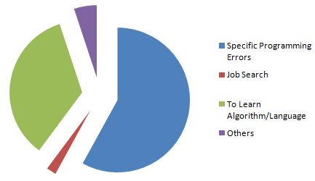
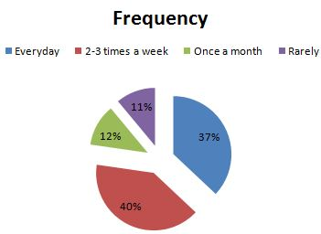
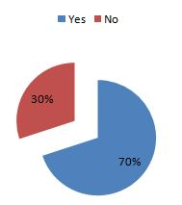
PROVE IT

Slide 5
WHO WILL BENEFIT FROM THIS
Any and everyone who uses StackOverflow
All those people who wanted a newsletter from StackOverflow
If you want to learn or just keep yourself with up to date.

Slide 6
HOW
Simple Filtering
Random Forest
N-gram

Slide 7
THE MODEL
SURVEY
(FRONT END)
PRE PROCESSED
DATA
ALGO
ENGINE
(CSV DATA FED)
(DATA CLEANED FROM DATASET)
(PLAINTEXT DATA)
PDF
CONVERSION
EMAIL

Slide 8
USING
Archival data from https://archive.org/details/stackexchange
Data provided by Stack Exchange for all its sites
Used subset of programmers.stackexchange.com

Slide 9
Simple Filtering
Based on user requirement, extract tags
Based on tags, sort posts by frequency of votes, comments etc

Slide 10
The Good and Bad - Simple Filtering
Advantages
Easy to implement, intuitive
Disadvantages
Difficult to measure results, uncertainty based on user requirement

Slide 11
Random Forest
Create multiple decision trees using content of tags and posts
Split data into training and testing sets.
Create feature vectors using tf-idf
Build model and sort on probabilities

Slide 12
The Good and Bad - Random Forest
Advantages
Accurate results, proven model based on probability
Disadvantages
Depends on size of data set

Slide 13
N-grams
Sequence of n-items from given text
Used bigrams (n=2) for balance between performance and accuracy
Uses content of posts rather than relying on tags

Slide 14
The Good and Bad - N-grams
Advantages
Quality of results is high
Disadvantages
High computational overhead

Slide 15
AND THE WINNER IS…
N-grams!
To the end-user, what matters is the quality of the content and not how difficult it was to extract it
Since delivery can be weekly, bi-weekly etc, content can be generated using adequate resources

Slide 16
STATISTICS
//CODE OWNERSHIP ISSUES

Slide 17
FUTURE WORKS
Extend to entire data set
Try web scraping instead of static data
Implement as Stack Overflow app using Oauth
Implementing a centralized database.

Slide 18
THANK YOU
Questions?

