Slide 1
CRUDE OIL CONSUMPTION FORECASTING
USING CLASSICAL
&
MACHINE LEARNING TECHNIQUES
SUBMITTED BY:
ALOK KUMAR (01114802715)
AYUSHI SAXENA(20314802715)
LAKSHITA BHARGAVA(20514802715)
Notes:
<number>

Slide 2
Content
Background
Significance of the project
Time series analysis
Forecasting system architecture
Proposed time series forecasting methods
Choice of Dataset
Framework and technology stack
Future scope of visualization
Notes:
<number>

Slide 3
BACKGROUND
In economies that are dependent on fossil fuel revenues there is a requirement of a fairly accurate estimation of the amount of consumption and its price fluctuations
Crude oil is a non renewable source of energy hence it makes the quantity of crude oil available for consumption fixed and limited.
But increase in consumption of crude oil in 20th century due to advancement of technology and increase in global human population there is a fast depletion in crude oil resources.

Slide 4
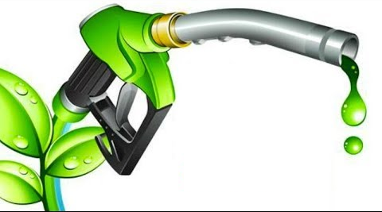
SIGNIFICANCE OF THE PROJECT
Keeping in mind, the current trend of excessive use of fossil fuels, particularly crude oil, it is essential to have a mechanism to predict its rate of consumption in the future and so that we start working in a sustainable manner and look out for alternatives before this precious resource runs out.
This project will predict consumption of crude oil in next few years which can be very useful for making proper strategies from today itself.

Slide 5
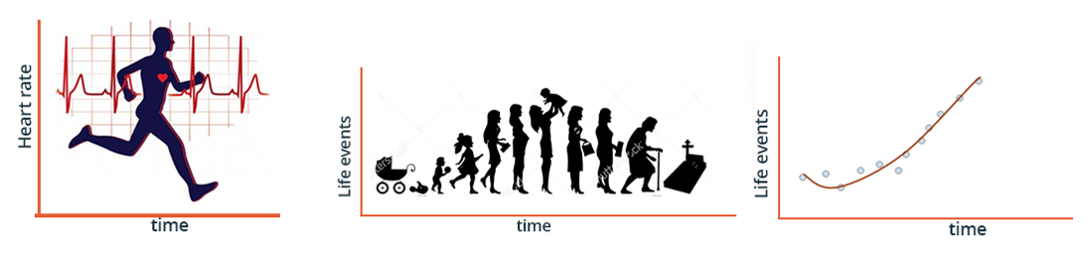
TIME-SERIES ANALYSIS
It is a notion of a real world event as an abstraction of a sequence of timely activities.
A time series has time (t) as an independent variable (in any unit you can think of) and a target dependent variable . The output of the model is the predicted value for y at time t .

Slide 6
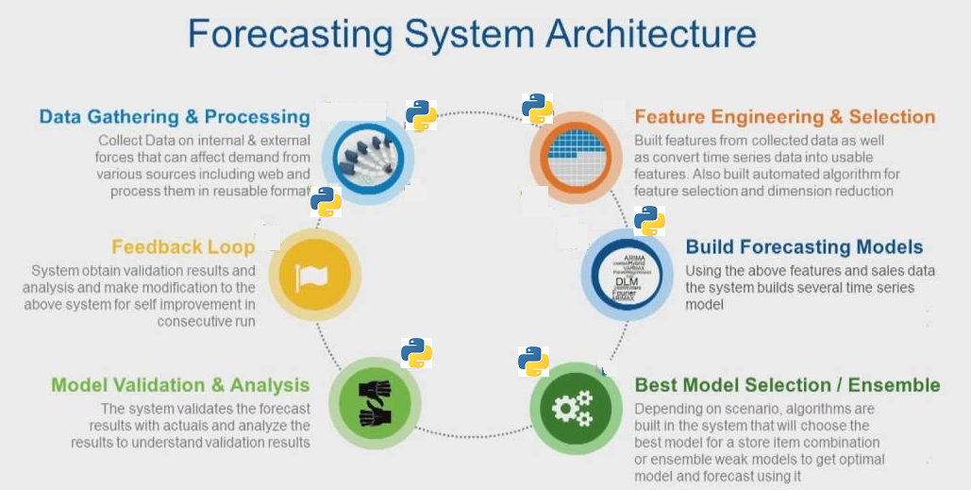

Slide 7
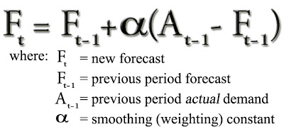
Proposed Time Series Forecasting methods
Classical Methods
Exponential Smoothing Method
Forecasts produced using exponential smoothing methods are weighted averages of past
observations, with the weights decaying exponentially as the observations get older.

Slide 8
2. ARIMA model
ARIMA model (AutoRegressive Integrated Moving Average) are combinations of
differencing,Autoregressive and Moving Average models. Briefly, they are:
AR: Autoregression. A model that uses the dependent relationship between an
observation and some number of lagged observations.
I: Integrated. The use of differencing of raw observations (e.g. subtracting an observation from an observation at the previous time step) in order to make the time series stationary.
MA: Moving Average. A model that uses the dependency between an observation and a residual error from a moving average model applied to lagged observations.

Slide 9
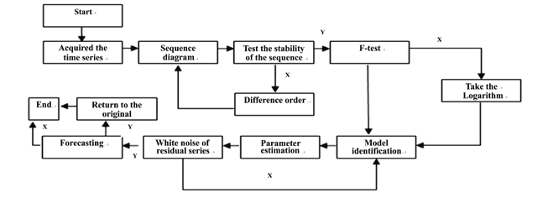
ARIMA Based Time Series Forecasting Model

Slide 10
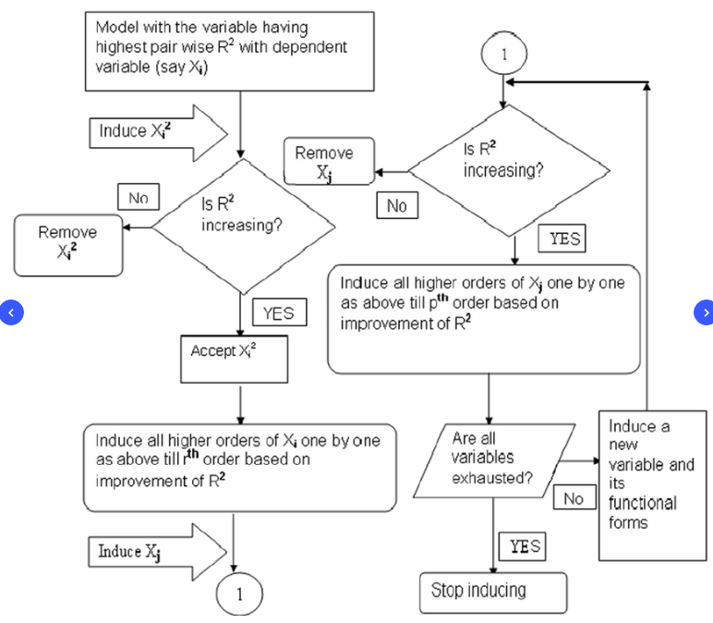
Machine learning methods
Linear Regression
Regression is the process of fitting models to data. Linear regression assumes that the relationship
between the dependent variable yi and the independent variable xi is linear: yi = a+ b xi.
Flow Diagram of Various Steps involved in linear regression

Slide 11
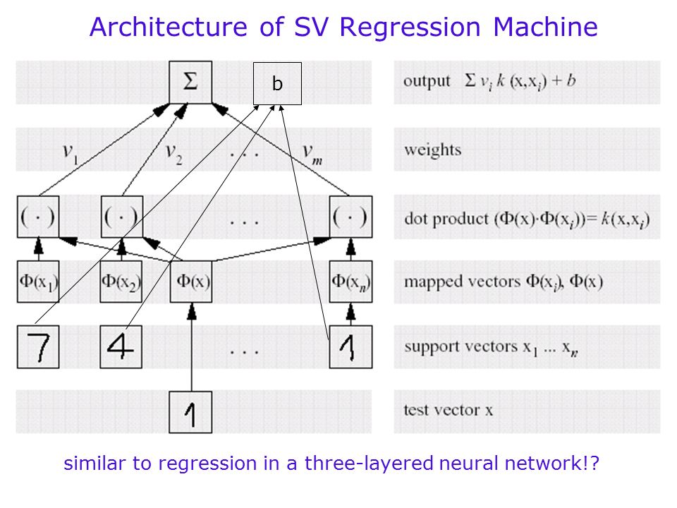
2. Support Vector Machine Regression
Support Vector Machine can also be used as a regression method, maintaining all the main features that characterize
the algorithm (maximal margin). The Support Vector Regression (SVR) uses the same principles as the SVM for
classification, with only a few minor differences.

Slide 12
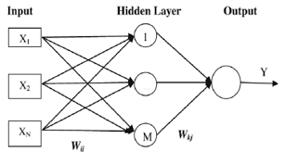
3. Neural Network
Artificial neural networks are forecasting methods that are based on simple mathematical models of the
brain. They allow complex nonlinear relationships between the response variable and its predictors.A
neural network can be thought of as a network of “neurons” which are organised in layers. The predictors
(or inputs) form the bottom layer, and the forecasts (or outputs) from the top layer. There may also be
intermediate layers containing “hidden neurons”.

Slide 13
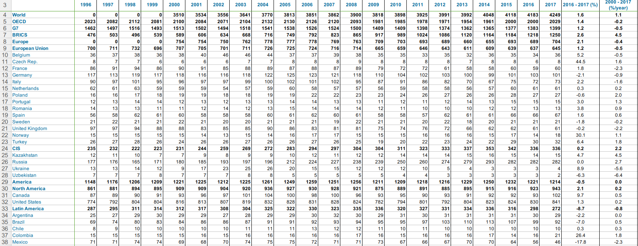
Choice of Dataset
For this project we are using dataset of global crude oil consumption from 1996-2017.
Reference:
yearbook.enerdata.net/crude-oil/world-production-statistics.html
Fig-Dataset Snippet

Slide 14
Framework and technology Stack
Python
NumPy
Pandas
Scikit-learn
Matplotlib
Jupyter notebook
TensorFlow

Slide 15
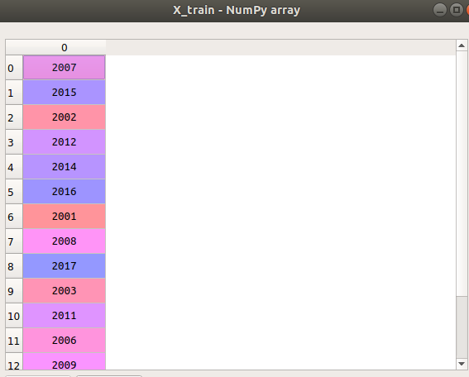
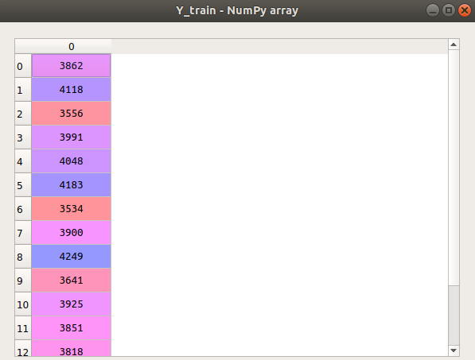
IMPLEMENTATION
For implementing this project we choose linear regression as our first model.
Steps involved in implementation of the model:
1.Preprocessing of dataset
2.Dividing entire data set into two sets(Training set and Test set) to avoid overfitting.
3.Implementing linear regression model on the Training set to train our model.
4.Checking the accuracy of our model on test data set.
5.Forecasting of consumption in next five year after getting a satisfactory result in testing phase.
Notes:
<number>

Slide 16
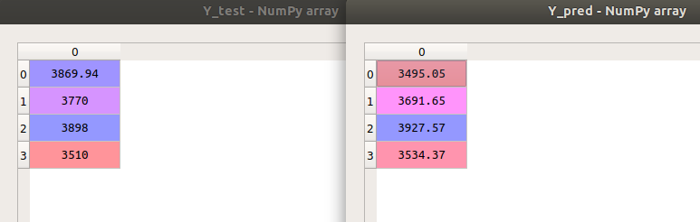
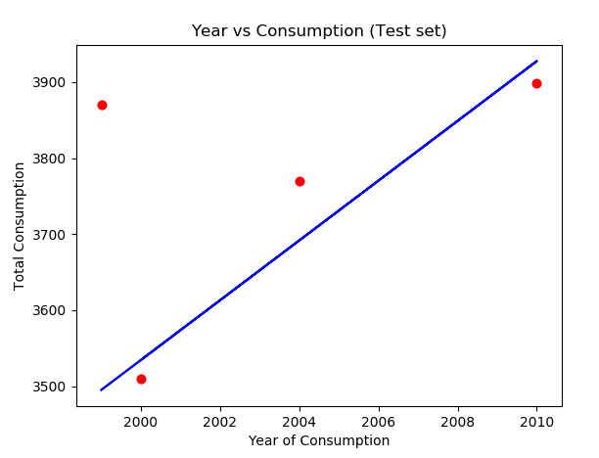
TESTING
After training our model on training data set.We tested it on test data set and it performed really well and gave satisfactory result.
Notes:
<number>

Slide 17
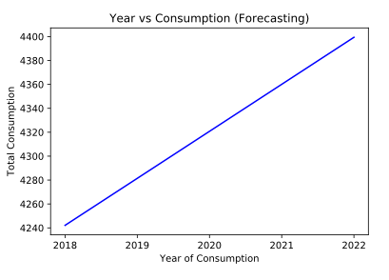
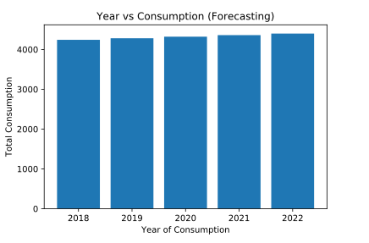
RESULT
After getting satisfactory results in testing we forecasted crude oil consumption for next 5 years using our trained model.Result of forecasting is shown in graphical form for better visualization.
Notes:
<number>

Slide 18
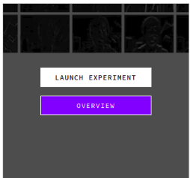
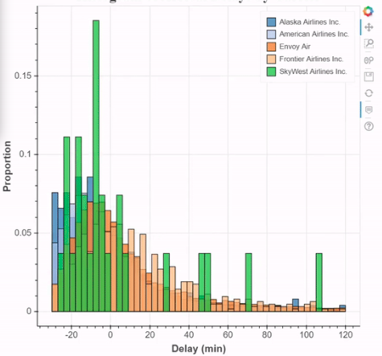
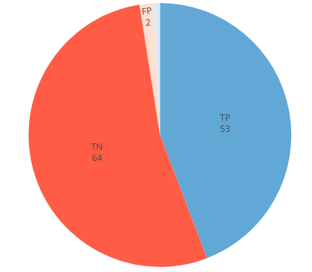
Future Scope for visualizations
This project can be extended further as major project where we will design a complete working user interface.This user interface will provide user with various set of controls using which user can select a particular year,country and can view predicted oil consumption results in various forms.Some sample images are given below.

Slide 19
THANK YOU
Notes:
<number>

