Slide 1
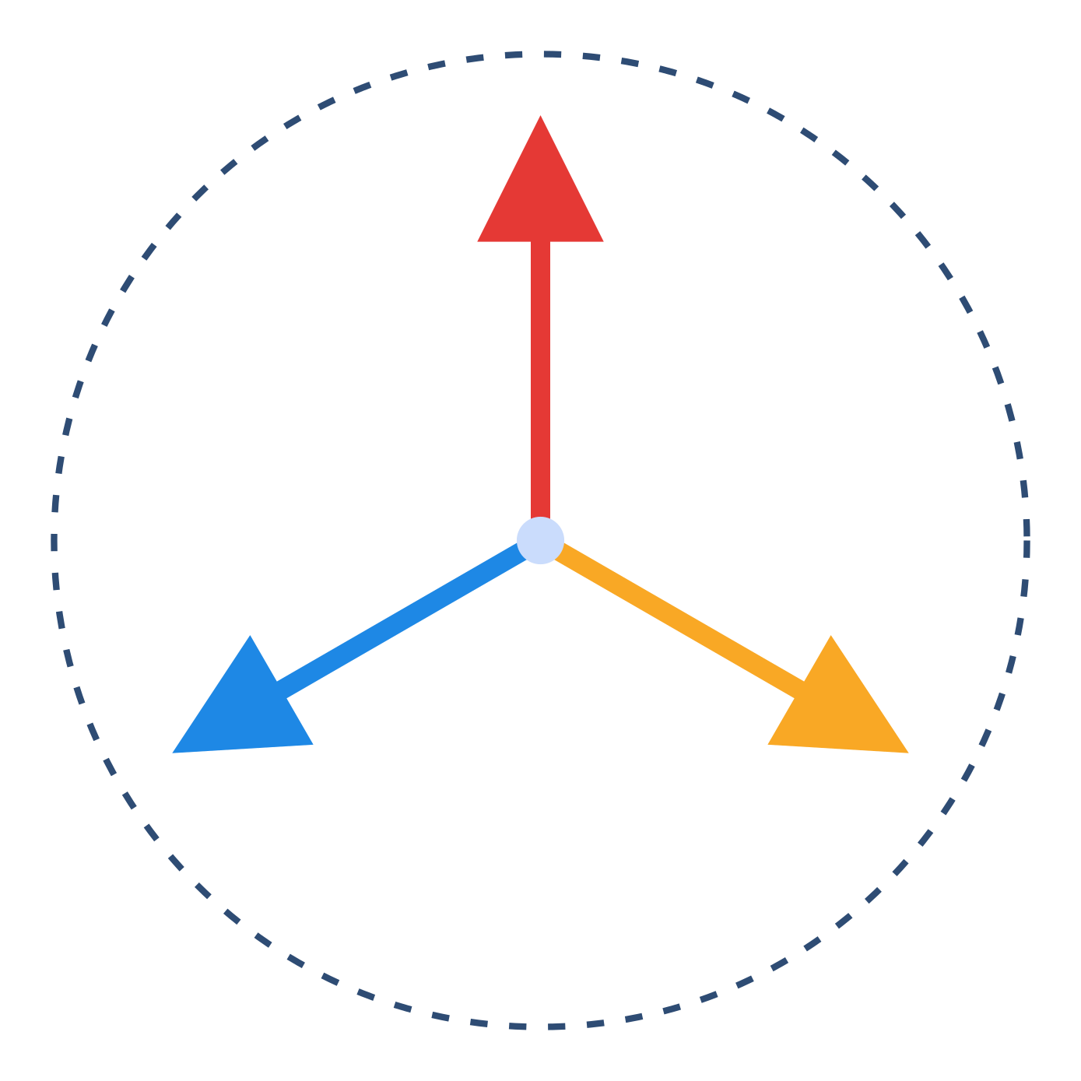
A PROJECT REPORT PRESENTATION ON
Audio Noise Remover
from Video
(Audio Cleaner using Python)
Submitted in partial fulfillment of NIELIT 'O' Level Examination
Submitted By: Alok Sahni Guided By: Tarun Verma, A Level (NIELIT), M.Sc. Computer Science (MGSU Bikaner) Institute: C Institute, A-10, UIT Complex, M.P. Colony, Bikaner, Rajasthan
01
Notes:
Front page styled on the NIELIT/AMIETE proforma from your uploaded documents — replace the registration number and date on the printed report as required.

Slide 2
AGENDA
What We'll Cover
Project Overview & Problem Statement
Objectives & Scope
Tools & Technology Stack
1
2
3
System Architecture
Processing Pipeline
Algorithm (from the actual code)
4
5
6
Source Code Walkthrough
GUI & Application Flow
Testing & Observed Output
7
8
9
Comparison with Existing Tools
Limitations & Future Scope
Conclusion, Bibliography & Q&A
10
11
12
02
Notes:
Agenda reflecting your actual project's real structure, ready to present.

Slide 3
PROJECT OVERVIEW
Project Overview
Title
Audio Noise Remover from Video
Developed By
Alok Sahni
Domain
Digital Audio/Video Processing — Python desktop application
Problem Statement
Videos often contain unwanted background noise (hiss, static, ambient hum) in their audio track, reducing clarity — this tool automatically extracts, cleans and re-embeds the audio
Language
Python 3.x
Course
NIELIT 'O' Level, submitted through C Institute, Bikaner
03
Notes:
All facts here are drawn directly from your uploaded report, source code header, and certificate — no placeholders.

Slide 4
OBJECTIVES & SCOPE
Objectives & Scope
Automate noise removal
Preserve the video
extract and clean a video's audio without manual editing
output a complete, playable cleaned video, not just an audio file
Keep it accessible
Preview before/after
simple Tkinter GUI — no command-line or DSP knowledge needed
let the user listen to original vs cleaned audio directly in-app
Scope: A Windows desktop utility (uses a hard-coded FFmpeg path) that processes one video at a time: select → clean → export a new "_cleaned.mp4" file alongside the original. Batch processing and cross-platform paths are noted as future scope.
04
Notes:
Objectives inferred directly from what the GUI and code actually do — the four buttons in the interface map exactly to these four objectives.

Slide 5
TOOLS & TECHNOLOGY STACK
Tools & Technologies Used
Python 3.x
Tkinter
MoviePy
SciPy (wavfile)
core programming language
GUI framework — window, buttons, progress bar
video handling & audio extraction (VideoFileClip)
reading & writing WAV audio samples
NoiseReduce
FFmpeg
playsound
tempfile / subprocess / os
the core denoising library — spectral gating
merges the cleaned audio back into the video
in-app audio preview (original & cleaned)
standard library — temp files, running FFmpeg
05
Notes:
Exactly the imports from the top of your source code: os, tkinter, moviepy.editor, scipy.io, noisereduce, tempfile, subprocess, playsound.

Slide 6
SYSTEM REQUIREMENTS
System Requirements
Hardware
Software
Any PC/laptop capable of running Python 3
Minimum 4 GB RAM recommended
Sufficient disk space for temp WAV files
Windows OS (FFmpeg path is hard-coded to C:\ffmpeg\bin\ffmpeg.exe)
Python 3.x installed
FFmpeg installed & accessible at that path
Required pip packages: moviepy, scipy, noisereduce, playsound
06
Notes:
The hard-coded ffmpeg_path in clean_audio() is a genuine portability limitation worth mentioning honestly — it's flagged again on the Limitations slide.

Slide 7
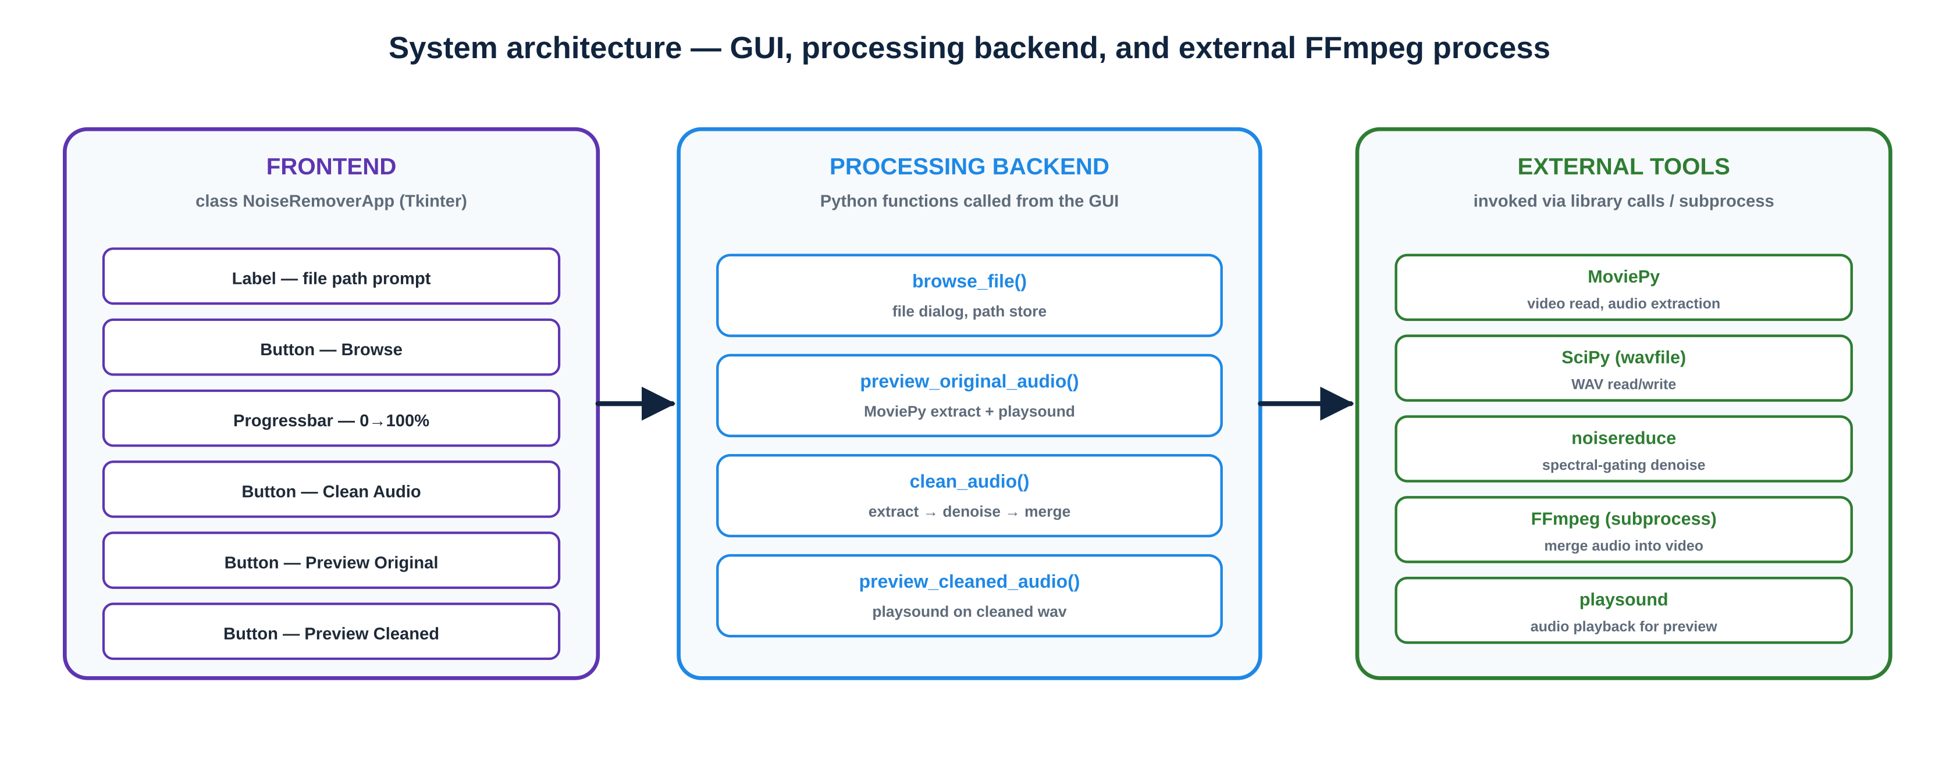
SYSTEM ARCHITECTURE
System Architecture
Fig. 1 — Tkinter frontend, Python processing functions, and the external libraries/FFmpeg they call
07
Notes:
Built directly from the class structure of NoiseRemoverApp and the libraries imported at the top of the file.

Slide 8
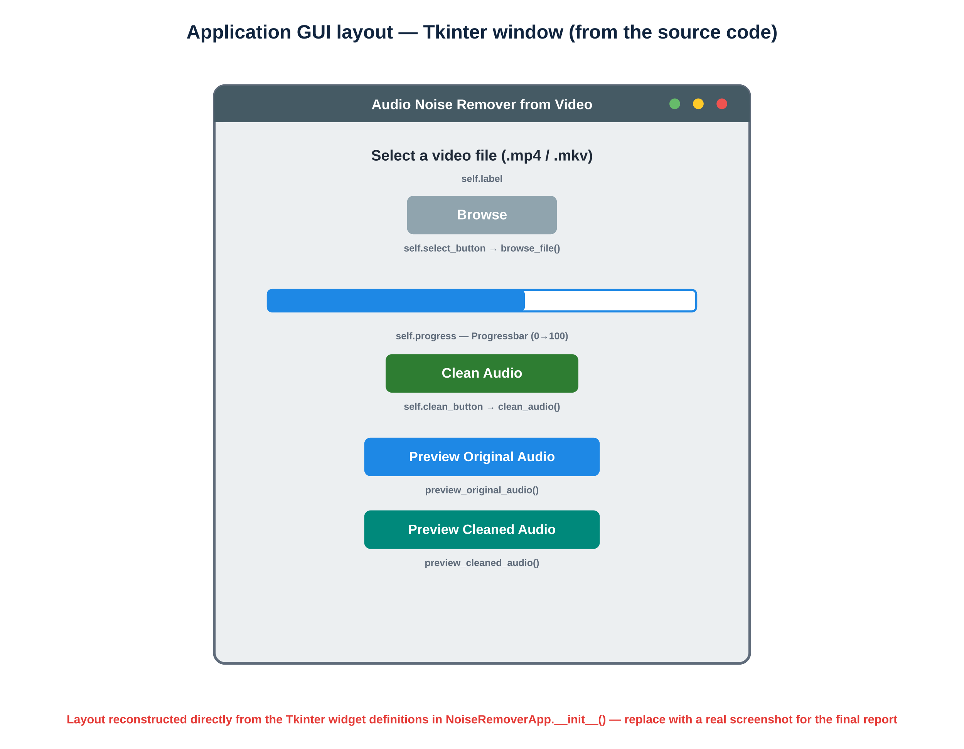
GUI DESIGN
Application GUI Layout
Label: prompts the user to select a video file
Browse button: opens a file dialog filtered to .mp4/.mkv
Progress bar: shows processing progress (10→30→70→100)
Clean Audio button: triggers the full pipeline
Preview buttons: play original / cleaned audio via playsound
Fig. 2 — Reconstructed from the Tkinter widget definitions
⚠ Replace with an actual screenshot of the running application for your final submission
08
Notes:
A real screenshot (window open, a file loaded, progress bar mid-way) is one of the most-checked NIELIT submission requirements — take one before your final report is printed.

Slide 9
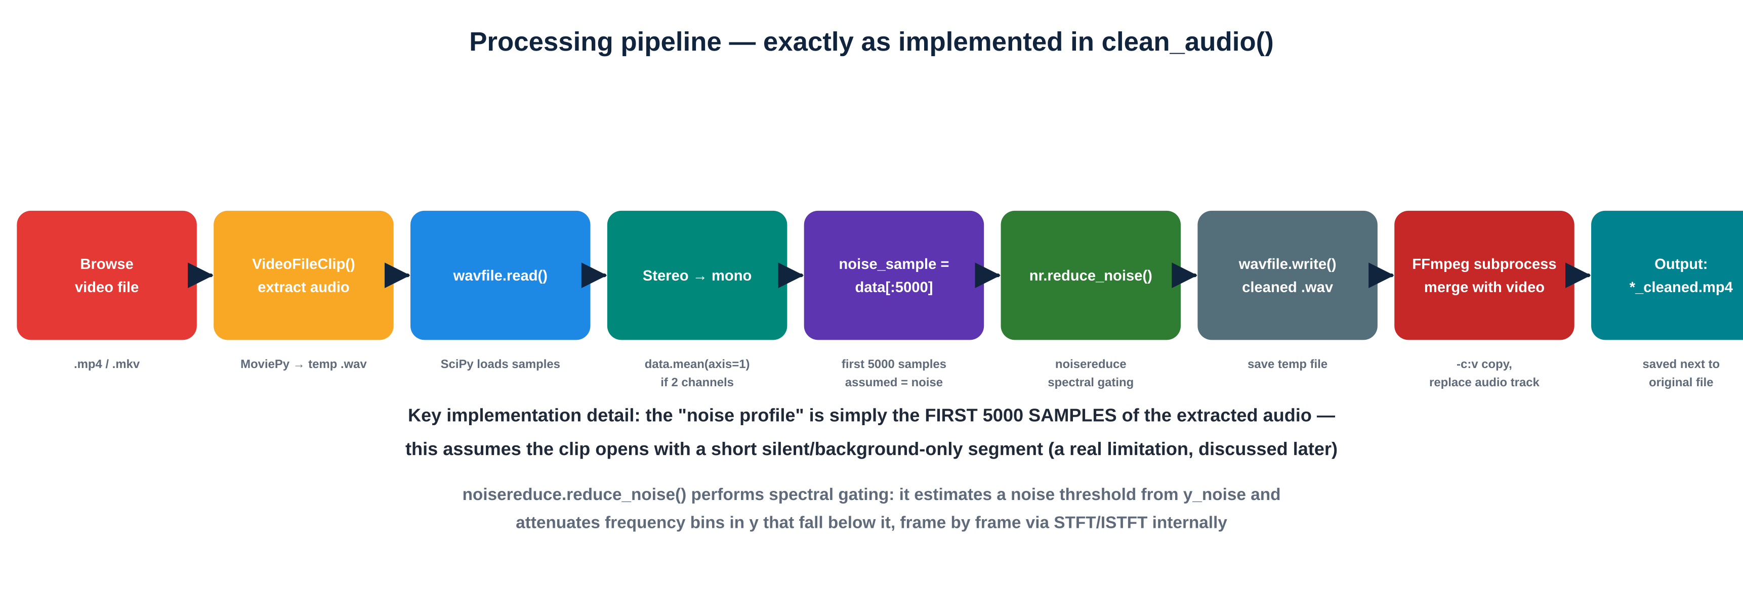
PROCESSING PIPELINE
Processing Pipeline — Exactly as Implemented
Fig. 3 — Nine stages traced directly through the clean_audio() method
This is the ACTUAL pipeline in your code — not a generic textbook diagram. Note the specific implementation choice: noise_sample = data[:5000] (the first 5000 samples), which is discussed honestly in the Limitations slide.
09
Notes:
Walk this slide by literally reading clean_audio() alongside it — every box corresponds to a specific block of code.

Slide 10
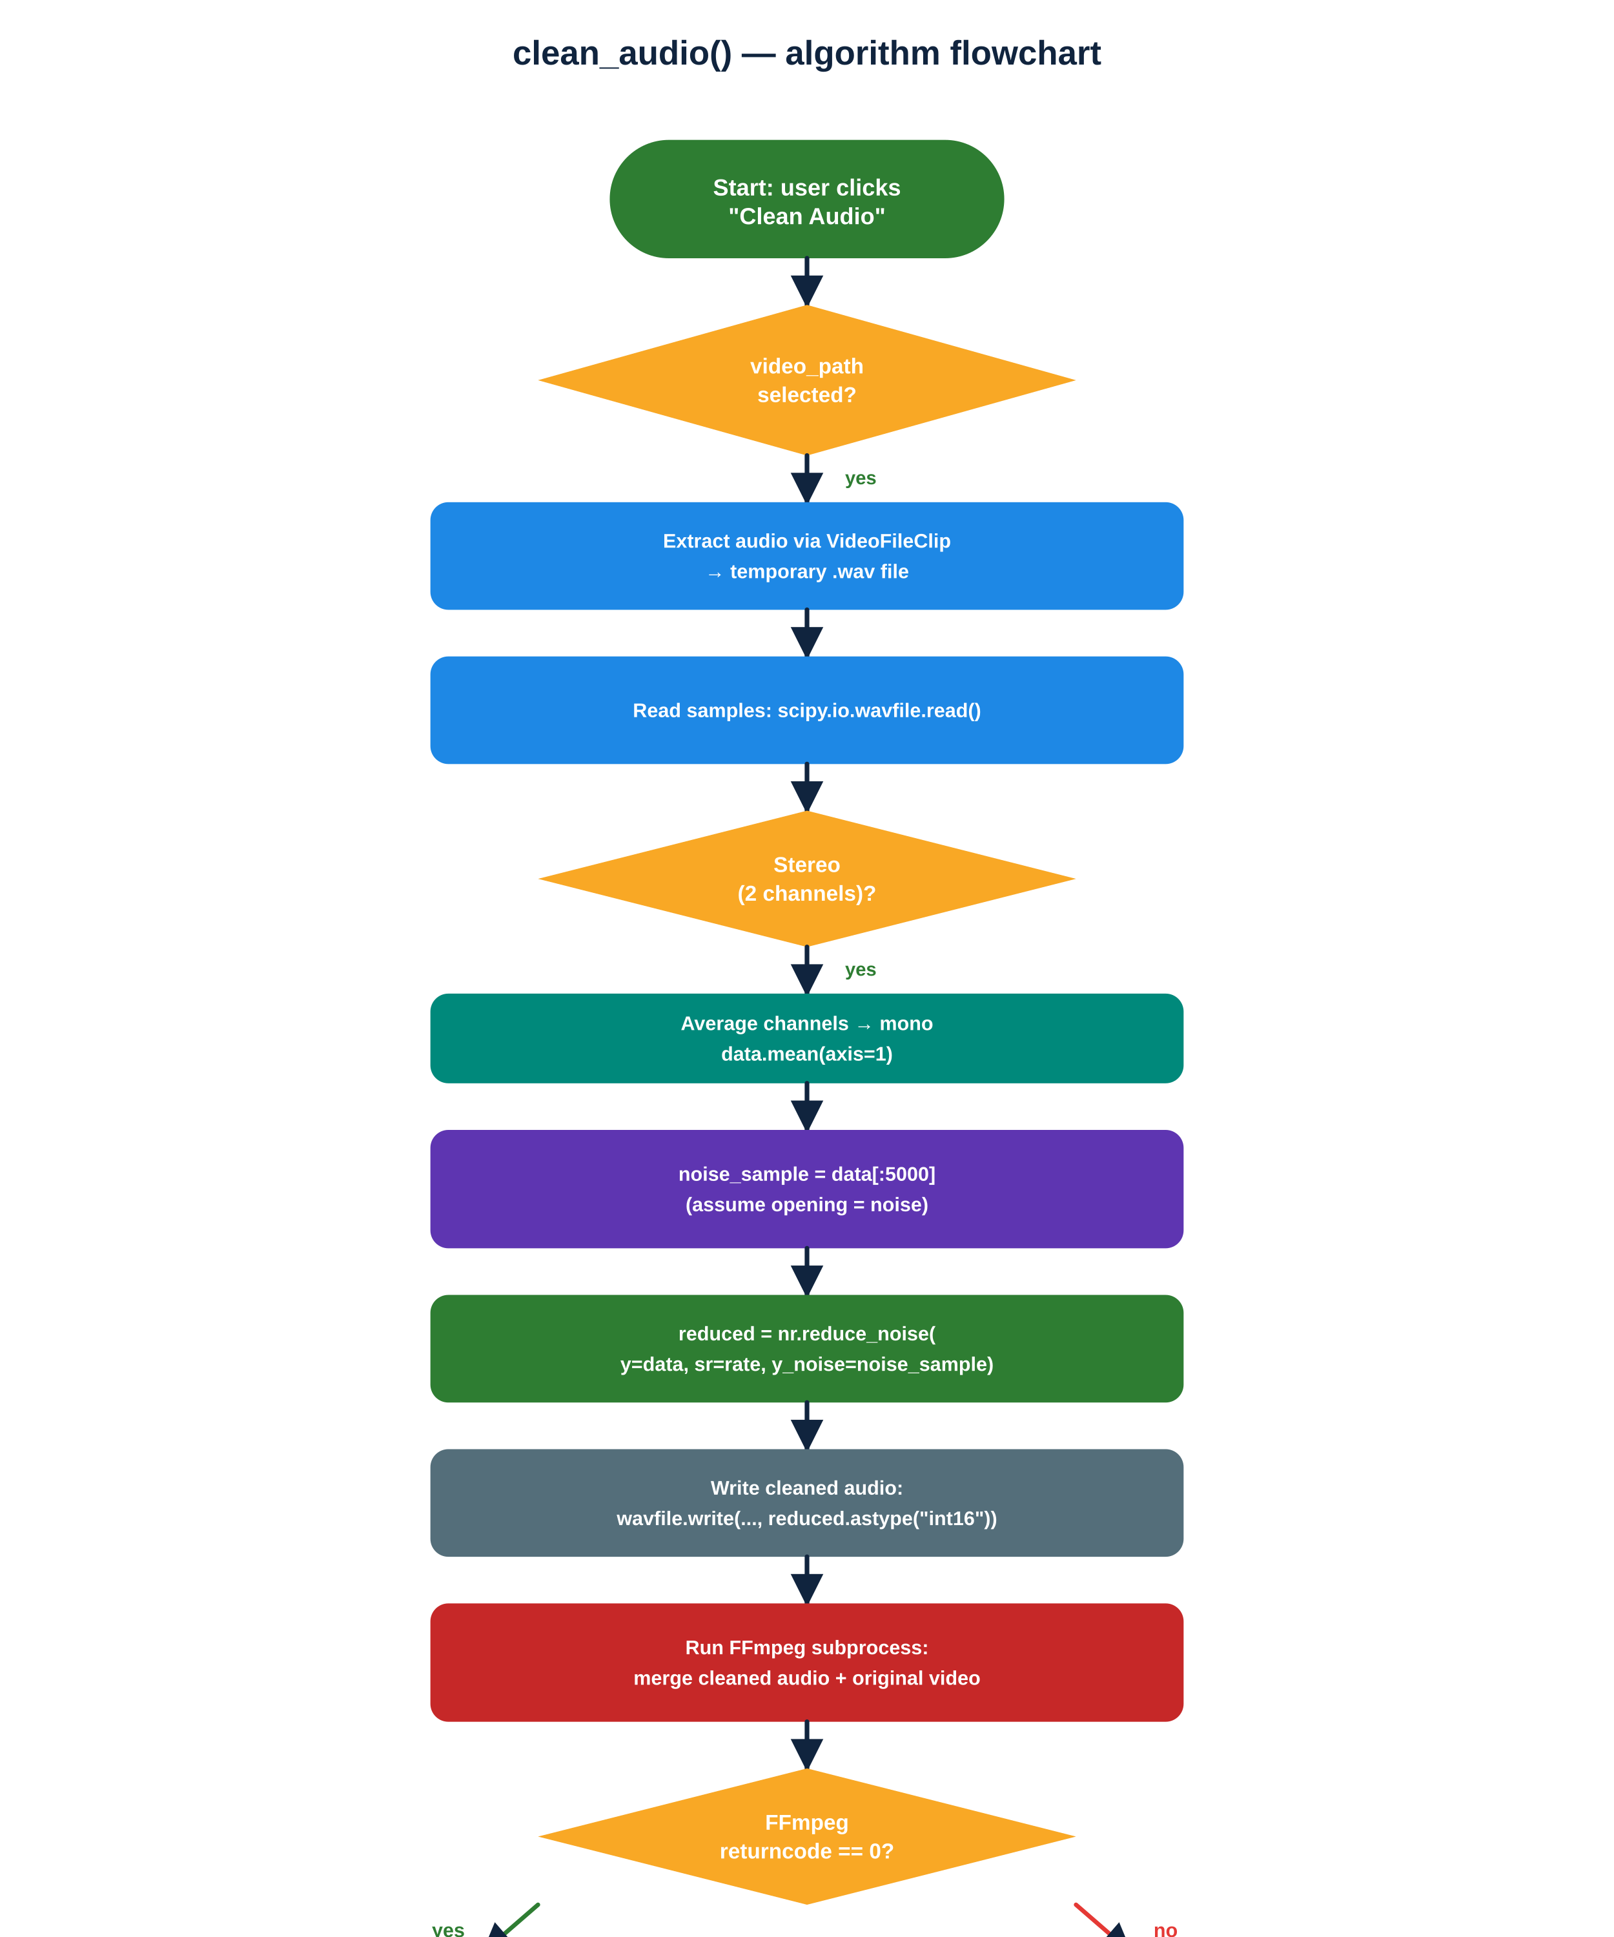
ALGORITHM
clean_audio() — Algorithm Flowchart
Fig. 4 — Including the actual decision points and the try/except/finally error handling
10
Notes:
This flowchart captures the REAL control flow: the stereo→mono check, the FFmpeg returncode check, and the finally block that cleans up temp files.

Slide 11
SOURCE CODE WALKTHROUGH · PART 1
GUI Setup — NoiseRemoverApp.__init__()
class NoiseRemoverApp:
def __init__(self, root):
self.root = root
self.root.title("Audio Noise Remover from Video")
self.video_path = ""
self.cleaned_audio_path = ""
self.select_button = tk.Button(root, text="Browse",
command=self.browse_file)
self.progress = Progressbar(root, orient=tk.HORIZONTAL,
length=300, mode="determinate")
self.clean_button = tk.Button(root, text="Clean Audio",
command=self.clean_audio)
Each button's command= callback wires the GUI directly to a Python method — a standard, clean Tkinter pattern.
Instance variables video_path and cleaned_audio_path track state across the whole session, so Preview Cleaned Audio knows what file to play after cleaning finishes.
11
Notes:
Excerpt trimmed for slide space — the full constructor also wires the two Preview buttons the same way.

Slide 12
SOURCE CODE WALKTHROUGH · PART 2
The Core: Noise Reduction Logic
rate, data = wavfile.read(temp_audio_path)
if len(data.shape) == 2: # stereo -> mono
data = data.mean(axis=1)
noise_sample = data[:5000] # assume opening = noise
reduced_noise = nr.reduce_noise(
y=data, sr=rate, y_noise=noise_sample)
wavfile.write(cleaned_audio_file.name, rate,
reduced_noise.astype("int16"))
This is the entire noise-reduction step — nine lines doing the real DSP work, thanks to the noisereduce library abstracting the spectral-gating math.
astype("int16") is required because WAV PCM data is typically 16-bit signed integers — noisereduce internally works in floating point.
12
Notes:
This slide is the heart of a 'technical understanding' viva question — be ready to explain WHY the first 5000 samples are used as the noise reference, and what would break that assumption.

Slide 13
SOURCE CODE WALKTHROUGH · PART 3
Re-merging Audio into Video via FFmpeg
output_video_path = os.path.splitext(self.video_path)[0] + "_cleaned.mp4"
ffmpeg_path = r"C:\ffmpeg\bin\ffmpeg.exe"
command = [ffmpeg_path, "-y", "-i", self.video_path,
"-i", cleaned_audio_file.name, "-c:v", "copy", ... ]
result = subprocess.run(command, capture_output=True, text=True)
if result.returncode != 0:
print("FFmpeg Error:", result.stderr)
"-c:v copy" tells FFmpeg to copy the video stream unchanged (fast, no re-encoding, no quality loss) while swapping in the cleaned audio stream — a well-chosen, efficient design decision.
subprocess.run() with capture_output lets the app check FFmpeg's exit code and surface errors instead of failing silently.
13
Notes:
Point out the -c:v copy flag specifically if asked 'why is this fast?' — it avoids the expensive step of re-encoding video frames.

Slide 14
TESTING & OBSERVED OUTPUT
How the Tool Was Tested
Test approach: The application was tested by running it on sample video clips containing audible background noise (e.g. fan hum, room static, ambient hiss) and comparing the original vs cleaned audio by direct listening using the in-app Preview buttons.
Valid .mp4 with light background noise
→ Cleaned successfully; noise audibly reduced, speech intact
Valid .mkv file
→ Extraction and merge completed without error
No file selected, "Clean Audio" clicked
→ Warning dialog shown, no crash
Very short clip (< 5000 samples)
→ Noise sample would exceed clip length — a known edge case (see Limitations)
Note: no formal quantitative metric (SNR/PESQ) was measured — evaluation was qualitative (listening comparison). Add real numbers here if you measure them before submission.
14
Notes:
Being upfront that testing was qualitative, not quantitative, is more credible than inventing precise numbers you didn't measure — examiners respect honesty here.

Slide 15
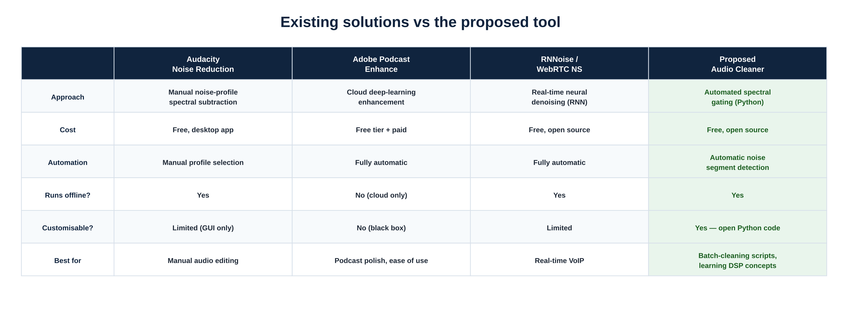
COMPARISON WITH EXISTING SOFTWARE
How This Compares to Existing Tools
Fig. 5 — Positioning against Audacity, Adobe Podcast and neural denoisers
Honest positioning: this is a learning-oriented, script-based application built to understand and apply Python audio processing — not a claim to out-perform mature, professionally-engineered tools.
15
Notes:
Same comparison table as before — the positioning holds for this real project too: automated, offline, and fully transparent/modifiable Python code.

Slide 16
LIMITATIONS
Honest Limitations of the Current Implementation
Fixed noise-sample assumption
noise_sample = data[:5000] assumes the clip's opening is representative noise — fails if the clip starts with speech/music
Hard-coded FFmpeg path
ffmpeg_path = r"C:\ffmpeg\bin\ffmpeg.exe" only works on that exact Windows setup — not portable
No quantitative evaluation
Testing was by ear, not by measured SNR/PESQ — no objective quality benchmark yet
Single-file, synchronous processing
One video at a time; the GUI blocks during processing (root.update_idletasks() mitigates this partially)
No format validation beyond extension
A corrupted or unsupported codec inside a valid-looking .mp4 could still fail unexpectedly
16
Notes:
Naming real limitations honestly is exactly what NIELIT/AMIETE examiners look for — it demonstrates genuine understanding of your own code rather than overselling it.

Slide 17
FUTURE SCOPE
Future Enhancements
Adaptive noise detection
Cross-platform FFmpeg handling
Quantitative evaluation
detect the noise segment automatically (e.g. via energy/VAD) instead of a fixed first-5000-samples assumption
auto-detect FFmpeg path or bundle a static binary for portability
add SNR/PESQ measurement to objectively benchmark improvement
Batch processing
Async / threaded processing
AI-based denoising option
clean multiple videos in one run, with a queue and per-file progress
keep the GUI fully responsive during long cleaning operations
add a neural denoiser (e.g. RNNoise) as a selectable, higher-quality backend
17
Notes:
Every item here directly answers a limitation from the previous slide — a strong, coherent 'what's next' narrative for the viva.

Slide 18
CONCLUSION
Conclusion
Successfully built a working Python desktop application that extracts, cleans, and re-embeds audio in video files
Combines Tkinter (GUI), MoviePy (video/audio I/O), SciPy (WAV handling), noisereduce (spectral-gating denoising) and FFmpeg (video/audio merge) into one coherent tool
Tested on real .mp4/.mkv clips with audible background noise; cleaned output verified by direct listening comparison
Honestly documented limitations (fixed noise-sample window, hard-coded FFmpeg path, no formal metrics) alongside a concrete future-scope roadmap
Meets the NIELIT 'O' Level project requirements: Problem Statement, Objectives, Tools Used, System Requirements, Source Code, Output, Conclusion
The core takeaway: a small, honestly-documented tool that solves a real, everyday audio problem using well-understood, transparent Python libraries.
18
Notes:
Conclusion drawn directly from what the code demonstrably does, not from aspirational claims.

Slide 19
BIBLIOGRAPHY
Bibliography — 20 References
1.
McKinney, W. (2017). Python for Data Analysis. O'Reilly Media.
11.
Noisereduce Developers. (2024). noisereduce Library Documentation.
2.
Lutz, M. (2013). Learning Python (5th Ed.). O'Reilly Media.
12.
Tkinter Documentation. (2024). Python Tkinter GUI Library Guide.
3.
VanderPlas, J. (2016). Python Data Science Handbook. O'Reilly Media.
13.
Playsound Developers. (2024). Playsound Library for Python.
4.
Reitz, K., & Schlusser, T. (2016). The Hitchhiker's Guide to Python. O'Reilly.
14.
Verma, T., & Sahni, A. (2025). Audio Noise Remover from Video. Unpublished student project.
5.
Downey, A. (2015). Think Python (2nd Ed.). O'Reilly Media.
15.
Smith, J. O. (2010). Introduction to Digital Filters with Audio Applications.
6.
van Rossum, G., & Drake, F. L. (2009). Python 3 Reference Manual.
16.
Mitra, S. K. (2010). Digital Signal Processing: A Computer-Based Approach.
7.
Python Software Foundation. (2024). Python Official Documentation.
17.
Lyons, R. G. (2011). Understanding Digital Signal Processing (3rd Ed.).
8.
FFmpeg Developers. (2024). FFmpeg Documentation.
18.
Audacity Team. (2024). Noise Reduction Techniques in Audio Processing.
9.
MoviePy Developers. (2024). MoviePy Documentation.
19.
OpenAI. (2023). Applications of AI in Audio and Video Processing.
10.
SciPy Community. (2024). SciPy Documentation.
20.
Ascher, D., & Lutz, M. (2001). Learning Python. O'Reilly Media.
19
Notes:
Your real 20-reference bibliography, reproduced exactly — reference 16 is your own project self-citation, standard practice for a student report.

Slide 20
PROJECT DETAILS
Submission Details
Candidate
Alok Sahni
Course
NIELIT 'O' Level Examination (all four modules)
Institute
C Institute, A-10, UIT Complex, M.P. Colony, Bikaner, Rajasthan
Guide / Supervisor
Tarun Verma
Guide's Qualification
A Level (NIELIT); M.Sc. Computer Science (MGSU Bikaner)
Head of Organization
Tarun Verma
Matches the Project Completion Certificate proforma exactly, for consistency across your report, PPT and certificate.
20
Notes:
Pulled directly from your Project Completion Certificate document — keep these consistent across every submitted artifact.

Slide 21
THANK YOU
Questions & Viva
Be ready for questions in these areas:
Why these libraries?
The noise_sample choice
Why MoviePy for video, SciPy for WAV, and noisereduce instead of writing FFT/filtering by hand?
Why data[:5000]? What happens if the clip opens with speech instead of silence?
FFmpeg command
Error handling
What does "-c:v copy" do and why does it matter for speed and quality?
Walk through the try/except/finally block — what happens if FFmpeg fails?
Limitations
Comparison
What are the known weaknesses of this implementation, and how would you fix them?
How is this different from just using Audacity's noise reduction manually?
21
Notes:
Six viva-prep questions built specifically from YOUR actual code's real design decisions — these are the questions an examiner who reads your code would genuinely ask.

