Slide 1

- Sandeep Kamble

Slide 2
Agenda
Single Page Applications (SPAs)
Introduction to Backbone
Why Backbone?
Backbone MVC
Model
View
Collections
Backbone Sync
Backbone Events
Sample web app “KinoEdu”

Slide 3
Single Page Applications
Only one web page
Resources are dynamically loaded and added to the page as necessary, usually in response to user actions
The page does not reload at any point in the process, nor does control transfer to another page
Use of JavaScript to generate content on the fly and quickly.
Examples are Gmail, Twitter…
Problems for developers
Large JS web apps became pretty messy really quick
More free-hanging and unrelated blocks of code
Lacks of structure it’s hard to maintain

Slide 4
Introduction to Backbone
JavaScript library that adds structure to your client-side code
MVC framework (MV*)
Models with key-value binding and custom events
Collections with a rich API of enumerable functions
Views with declarative event handling
Connects it all to your existing API over a RESTful JSON interface

Slide 5
Why Backbone?
A MVC pattern to keep code clean
A client side template to easily render view elements
A better way to manage events and callbacks
A way to preserve browser’s back button
Light weight
Code is more maintainable
Is a mature, popular library
Large development community

Slide 6
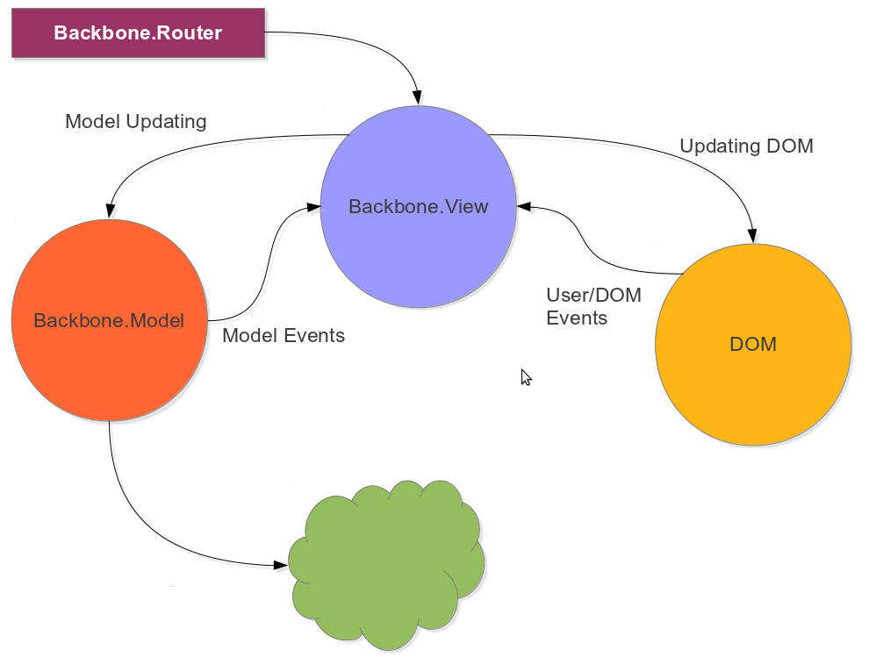
Backbone MVC
& Collection
RESTful API

Slide 7
Get started with Backbone
Backbone.js has dependency on underscoreJS and jQuery.
Add Backbone
<script src="../backbone-resources/libs/jquery/jquery-1.9.1.min.js"></script>
<script src="../backbone-resources/libs/underscore/underscore.js"></script>
<script src="../backbone-resources/libs/backbone/backbone0.9.10.js"></script>

Slide 8
Models
Represent your data
For simplification it can be considered as single record
Stores data in JSON format
Data can be created, validated, destroyed, and saved to the server
Any change in data triggers a “change” event

Slide 9
Define
var courseModel = Backbone.Model.extend({
// default – default attribute values for model.
defaults : {
icon: " C ",
name: "New Course Name",
description : "New Course Description"
}
});
var course = new courseModel({
name : "HTML5",
description : "HTML5 Fundamentals"
});

Slide 10
Methods
Set
Set multiple attributes
Get
toJSON
course.set(“name”, “Backbone MVC”);
course.set({“name”: “Backbone MVC” , “description”: “Backbone in details”});
course.get(“name”); // Backbone MVC
course.toJSON(); // {“name”: “Backbone MVC” , “description”: “Backbone in details”}

Slide 11
Views
It renders HTML [with the help of template as per need]
Can be used with any JavaScript templating library
Manages DOM events
Acts like a Controller
Connected to data in Model or Collection
Responds to change event of Model to update itself

Slide 12
Define
var AppView = Backbone.View.extend({
// el - stands for element. Every view has a element associate with it to render HTML content.
el: '#container', //id of existing Element in the DOM
// It's the first function called when this view it's instantiated.
initialize: function(){
this.render();
},
events: {
"click .clear":“clearData"
},
render: function(){
this.$el.html("Hello World <span class=‘clear’>clear</span>");
},
clearData: function(){
this.$el.html(“”);
}
});

Slide 13
Basic Properties
view.el
Reference a DOM at all times.
view.el get created from the tagName e.g. tagName:”span”/“li”
It is possible to assign className, id and attributes properties to view.el.
If none of these are specified, then this.el is an empty div since by default tagName is “div”.
view.$el
it’s a cached jQuery object of the view’s element (view.el).
Initialize/construtor
Here you have the option to pass parameters that will be attached to a model, collection or view.el.
render
In this function, you inject the markup into the elements.

Slide 14
Collections
Ordered sets of models
Can fetch data from a given URL
Triggers events like add/remove/reset
Can sort models if you define a comparator function

Slide 15
Define
var courseCollection = Backbone.Collection.extend({
model: courseModel,
//url - restFul API url to get courses
url: “/courses”,
//parse – success callback to fetch(), parse the JSON data and locate actual data array to be loaded in the collection
parse: function(data){
//data = {“total”:20, “courses”: [{..c1...},{…c2…}…]}
return data.courses;
}
});
var courses = new courseCollection;
courses.fetch(); //load data from → http://your-app .com/courses

Slide 16
Backbone Sync
Is the function that Backbone calls every time it attempts to read or save a model to the server
By default, it uses jQuery.ajax to make a RESTful JSON request
The default sync handler maps CRUD to REST like so:
create → POST /collection ------ {your-app.com/courses}
read → GET /collection[/id] ------ {your-app.com/courses[/2]}
update → PUT /collection/id ------ {your-app.com/courses/2}
delete → DELETE /collection/id ------ {your-app.com/course/2}

Slide 17
Backbone Events
Events is a module that can be mixed in to any object
Gives object the ability to bind and trigger custom named events
Events do not have to be declared before they are bound, and may take passed arguments.
var myObject = {};
_.extend( myObject, Backbone.Events);
myObject.on("alert", function(msg) {
alert("Triggered " + msg);
});
myObject.trigger("alert", "an event");

Slide 18
Sample web app “KinoEdu”
Create a sample web app “KinoEdu” using backboneJS, requireJS, underscroreJS and JQuery
Steps
Basic setup with RequireJS
Create Course Model and View
Course Collection and display all courses
Search functionality
Toggle Course View to display all courses as ‘Grid’ or as ‘List’
Create Course
Edit Course

Slide 19
References
http://backbonejs.org/
http://underscorejs.org/
http://backbonejs.org/examples/todos/
http://ricostacruz.com/backbone-patterns/

Slide 20
Questions ???

Slide 21
Thank You !!!

