Slide 1

Unit Testing Framework for JavaScript
Alok Guha

Slide 2


Slide 3
Why Unit Testing ?
Instant satisfaction
Code Against Your API While or Before it is Built
Leads to a Better Design
Understand How Your Code Works
Confidence in Your Code

Slide 4
Why UTs are more important with JavaScript
Because its weak-typed language
Works on client side.
Faster to test Unit Tests than to browse actual application.

Slide 5
Jasmine A BDD framework for JavaScript testing
a behavior-driven development framework for testing JavaScript code.
does not depend on any other JavaScript frameworks
does not require DOM.
Can be integrated with any CI tool.

Slide 6
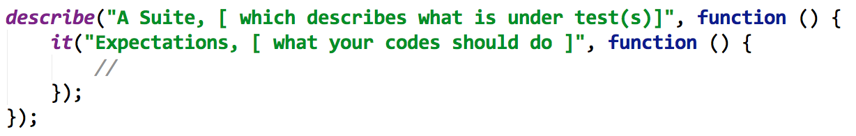
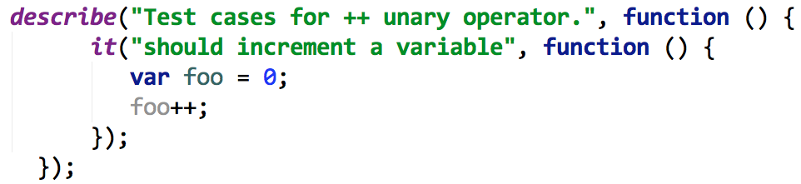
Suits & Spects

Slide 7
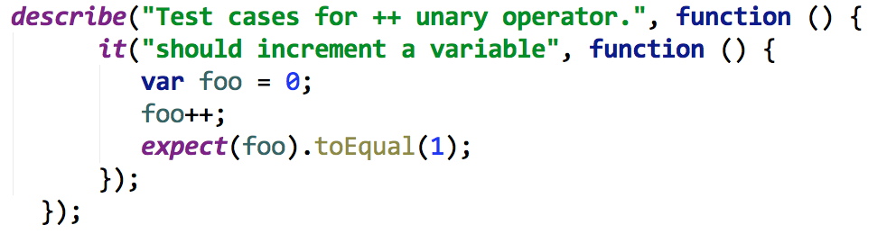
Expectations & Matchers
To express what you expect about behavior of your code.
Matcher implements a Boolean comparison between the actual value and the expected value

Slide 8
Frequently Used Matchers
The 'toBe' matcher compares with ===
The 'toEqual' matcher
The 'toMatch' matcher is for regular expressions
The 'toBeDefined' matcher compares against `undefined`
The `toBeUndefined` matcher compares against `undefined`
The 'toBeNull' matcher compares against null
The 'toBeTruthy' matcher is for boolean casting testing
The 'toBeFalsy' matcher is for boolean casting testing
The 'toContain' matcher is for finding an item in an Array
Every matcher’s criteria can be inverted by prepending .not

Slide 9
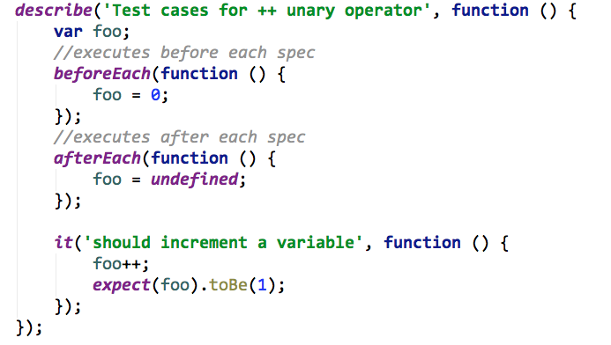
beforeEach & afterEach
Both takes a function which executes before and after execution of each spec.

Slide 10

Spy
These are mock or fake calls to method.
Spies should be created before expectations.
Spies can be checked if they were called or not, and what was calling arguments.

Slide 11

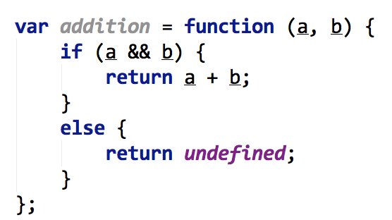
Think Tests ?

Slide 12
Possible Test cases
a & b should be defined always.
If a & b defined it should return sum of them.
if a or b is not defined, result should be undefined.
Result should be in same cast as input provided.

Slide 13
Lets welcome Jasmine
Live examples

Slide 14
references
http://pivotal.github.com/jasmine/
http://evanhahn.com/how-do-i-jasmine/
http://try-jasmine.heroku.com/
My own experiences.

Slide 15

