Slide 1
ChatCuisine (A conversational food ordering platform)
Alok Shandilya
CSM22010
Project Guide: Dr. Ringki Das (Assistant Professor)

Slide 2
Introduction
Goal: fundamentally alter how customers interact with online meal ordering/tracking process
Traditional online food ordering platforms often suffer from complex navigation and lack of personalized interaction
Problem Statement:
Despite rapid growth and popularity of online food ordering platforms, many users still face several issues that affect their overall experience. These issues include complex navigation, a multi-step ordering process, and a lack of personalized interaction, all of which can lead to user frustration and dissatisfaction.

Slide 3
Objectives
Primary aim is to transform the online food ordering experience through a conversational platform
Enhance user experience
Ensure data security and privacy
Achieve scalability and reliability
Facilitate Seamless Order Management
Support Multi-Platform accessiblity

Slide 4
FRONTEND Development
HTML, CSS, JavaScript
BootStrap getting-started
DialogFlow
Styled with BootStrap for uniformity with the application
a natural language understanding platform used to design and integrate a conversational user interface into mobile apps, web applications, devices, bots, interactive voice response systems and related uses.

Slide 5
BACKEND Development
FastAPI
FastAPI is a modern, high-performance web framework for building APIs with Python. It’s based on standard Python type hints and offers features like automatic documentation generation and validation.
SQLAlchemy
Python library for working with databases, offers a high-level SQL expression language and an Object-Relational Mapping (ORM) framework, allowing developers to interact with databases using Python objects
Pydantic
For data validation using type hints
Jinja2
Templating language for python
MySQL database
Hosted on Aiven

Slide 6
API development with FastAPI (API endpoints)
/
Redirects to /index for user and /admin for admin
/index
/admin
/create-food-item
/remove-food-item/{item-id}
/create-user
/webhook
/food-items
/logout
Also, FastAPI automatically generates interactive API documentation using Swagger UI and ReDoc at /docs and /redoc endpoints.

Slide 7
DialogFlow (core concepts)
Agent: handles conversation with end-users, is a module that processes Natural Language input from user and returns the corresponding result
Intents: represents purpose or goal of a user's input. Each intent contains:
Training phrases: examples of user inputs that help agent to recognize the intent
Responses: predefined messages that the agent sends back to the user
Parameters and Entities: extracted pieces of information from user input that are used to fulfill the intent
Entities: specific data elements that user mentions in input, eg. Food-item, quantitiy, address etc.
Contexts: used to mange flow of conversation by keeping track of context of current user input.
Fulfillment: enables the agent to call external APIs and webhooks to fetch real-time data and perform actions based on user inputs, allows chatbot to provide dynamic and personalized responses

Slide 8
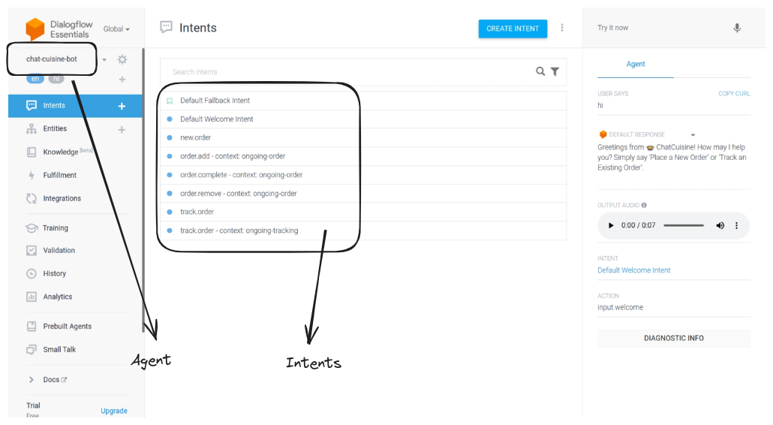

Slide 9
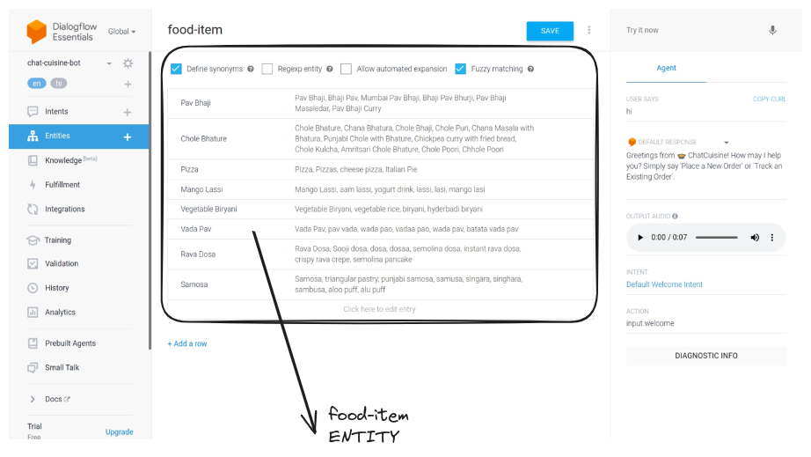

Slide 10
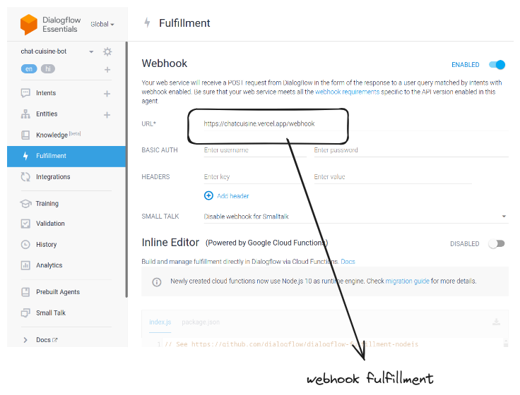

Slide 11
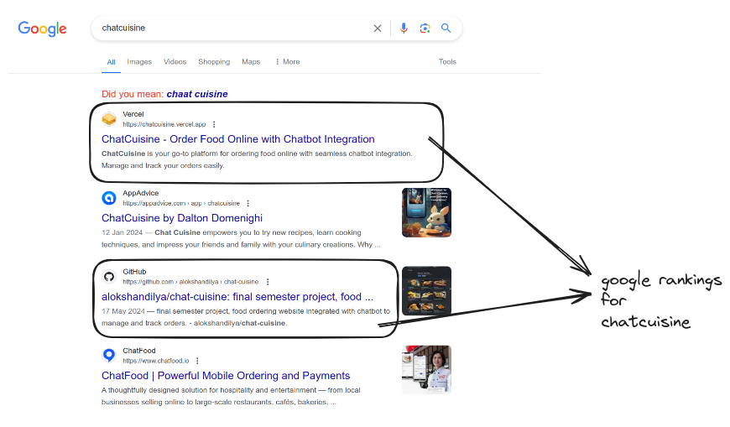

Slide 12
Let's go LIVE
ChatCuisine

Slide 13
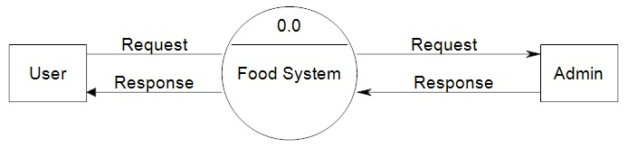
Data Flow Diagram
Level 0 (context level)

Slide 14
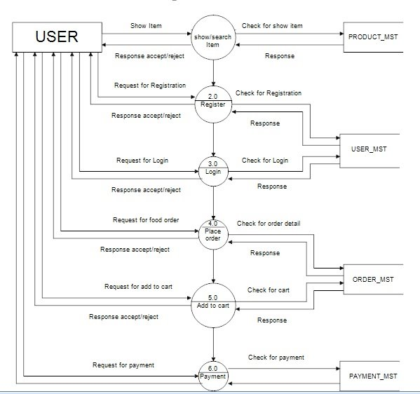
Level 1 DFD

Slide 15
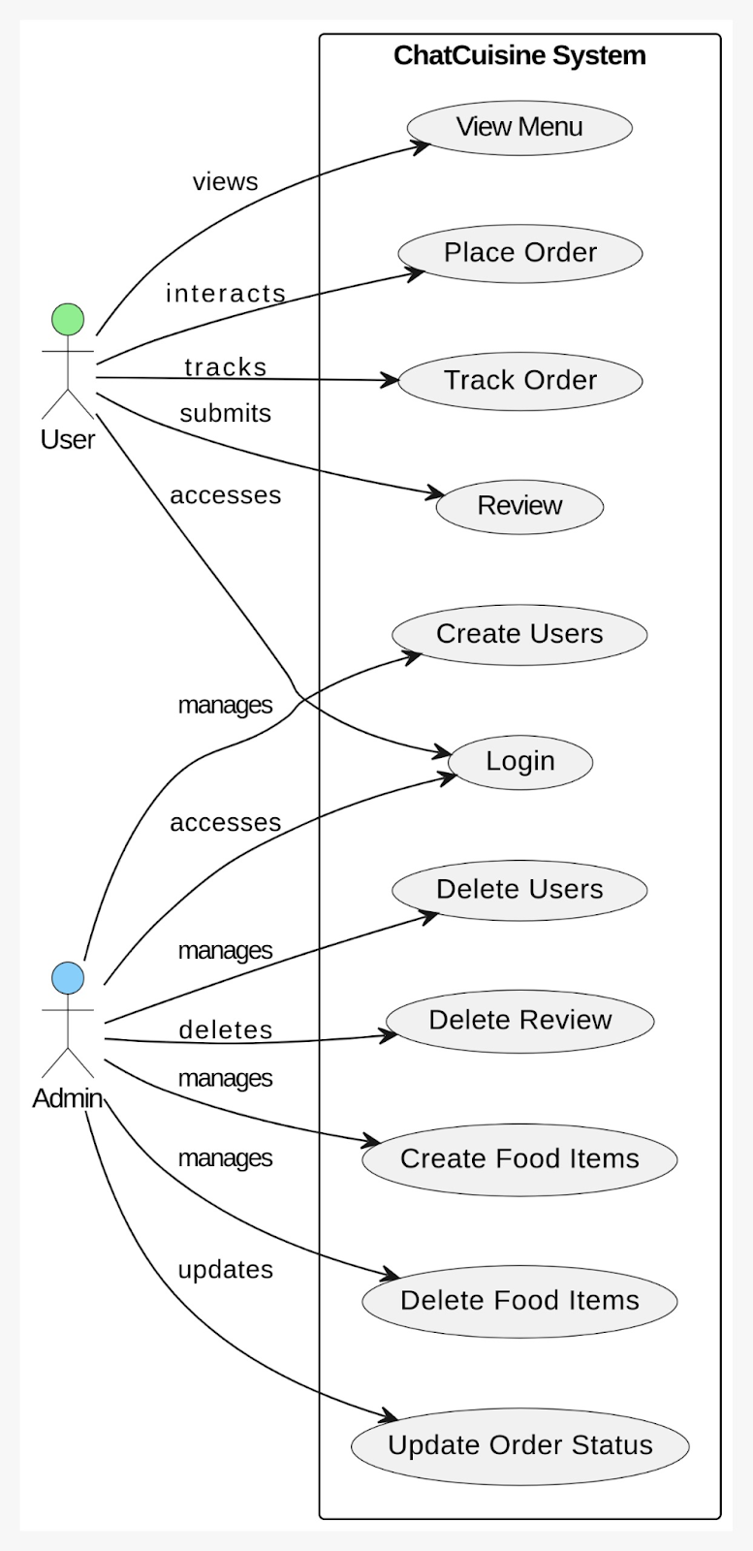
Use Case Diagram
Actors
User
Admin

Slide 16
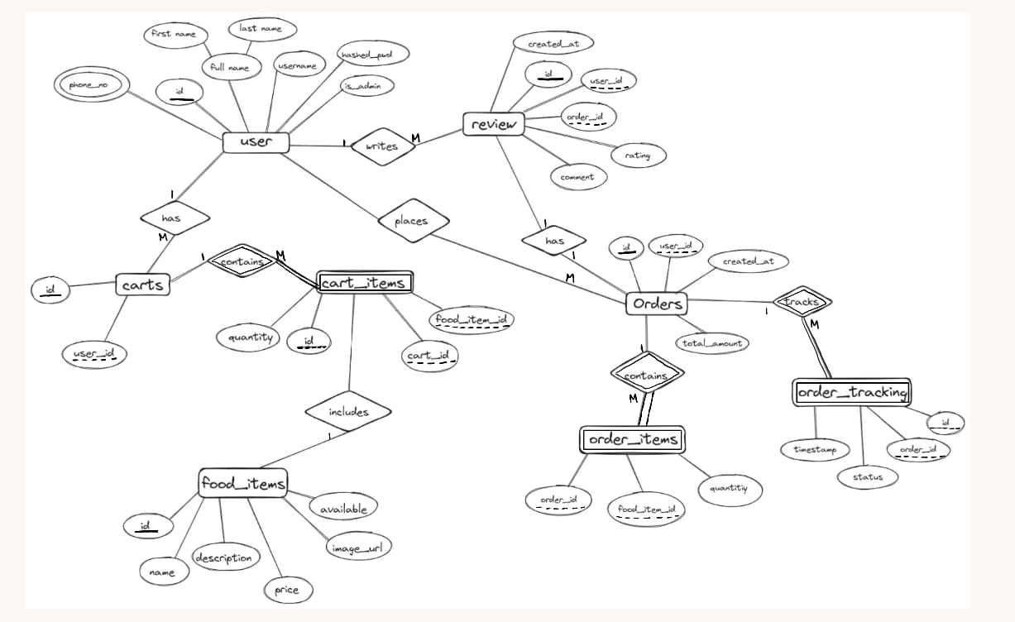

Slide 17
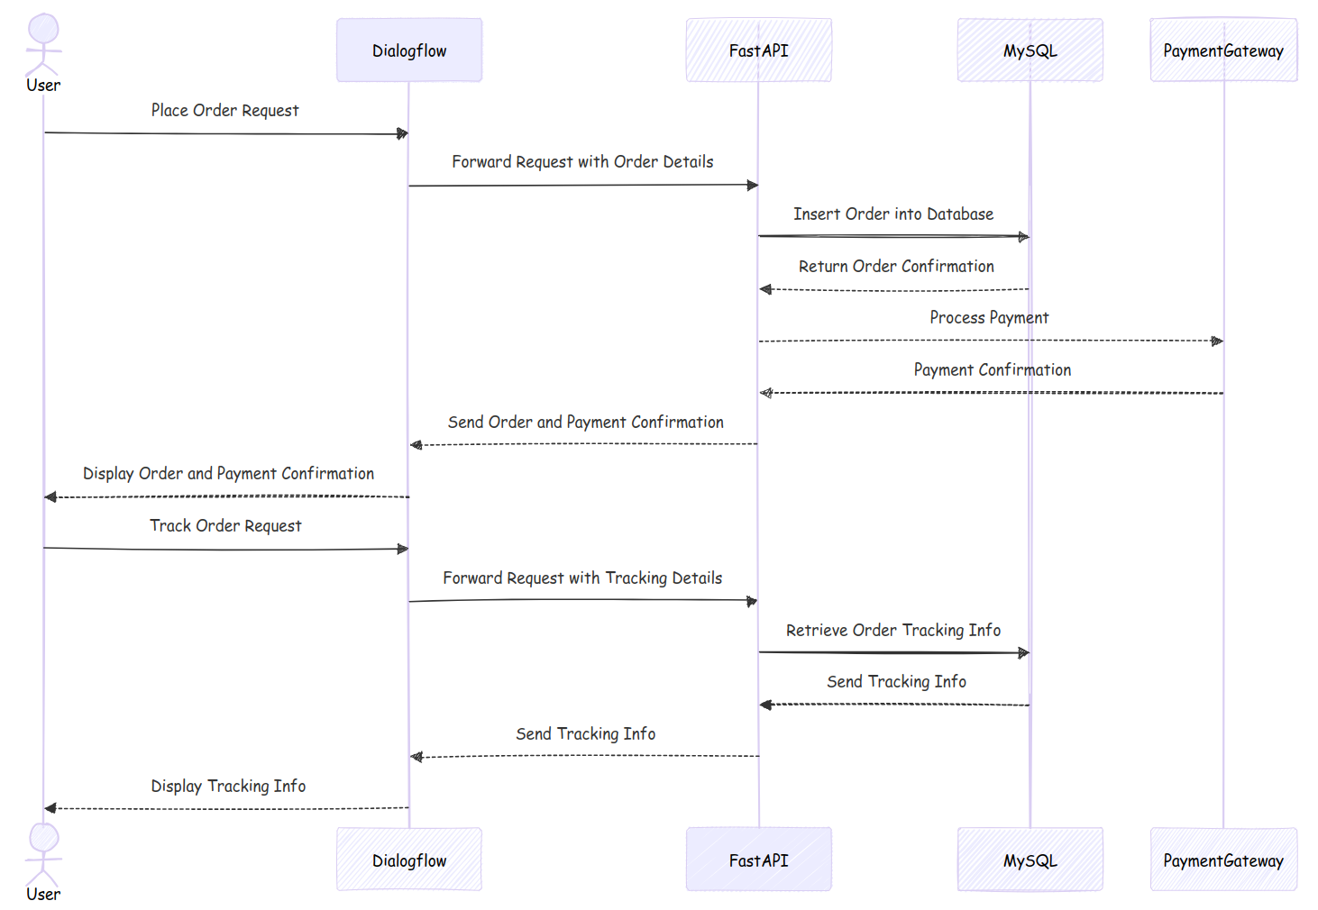

Slide 18
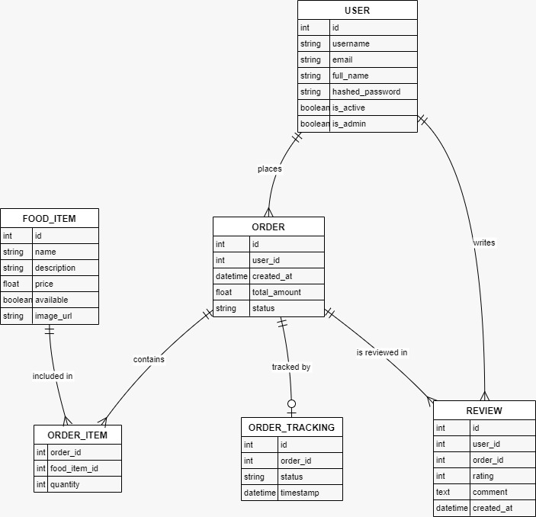
Class Diagram
USER
FOOD_ITEM
ORDER
ORDER_ITEM
ORDER_TRACKING
REVIEW

Slide 19
Future Enhancements
Mobile Application
Personalized Recommendations
Third-Party Integrations
Partner with local restaurants and delivery services to expand food options.

Slide 20
Thank You
Any questions/comments are welcomed.

