Slide 1


Watir
CSM22010
Alok Shandilya

Slide 2

What is Watir?
Web Application Testing In Ruby
Open Source library for browser-based automated testing
Test scripts written in Ruby programming language
pronounced like "Water"
At a low level, Watir works by interacting with a browser's HTML and JavaScript elements through the browser's automation interface. It leverages the browser's internal APIs to simulate user interactions and retrieve information from web pages.

Slide 3
What is Ruby?
Object oriented scripting language
interpreted rather than compiled
written in C
  will work on any platform that has a C compiler

Slide 4
Why use WATIR?
ideal for
  functional testing
  integration testing (with RSpec - testing DSL written in Ruby)
find bugs that unit tests miss
automates what is usually a manual tedious process

Slide 5
Installing and Setting Up Watir
Install Ruby
  Windows 🤢
    Download RubyInstaller (https://rubyinstaller.org/)
    add to PATH
  macOS 😅
  Linux 🤩
    use your package manager to install ruby
Install Watir gem
  gem install watir
Install Browser Drivers (add to PATH)
  chromedriver
  geckodriver
  msedgedriver
Verify Installation

Slide 6
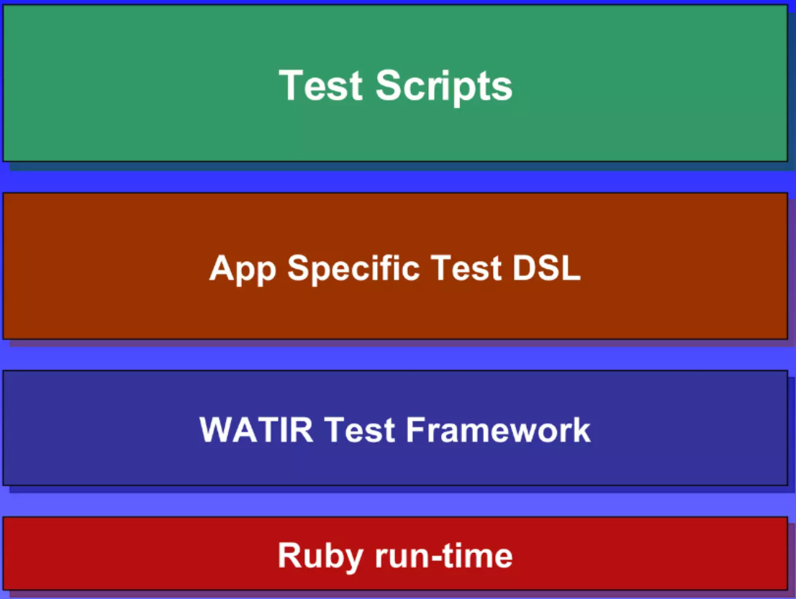
Test Framework

Slide 7
Watir Examples
browser.lin(:id, "lnk1").click
browser.button(:id, "btn1").click
browser.link(:name, "lnk1").exists?
browser.contains_text('Welcome')
wait_until {browser.contains_text "Edit"}
WATIR can find elements by id, name, text, link, XPATH etc…

Slide 8
let's go WATIR
LIVE

Slide 9

Alternatives
Selenium
  similar open source browser automation framework
  scripts are written in custom macro language
Cypress
  primarly uses JavaScript
  offers real-time reloads
PlayWright
  supports mobile browsers

