Slide 1
Workshop: Machine Learning Made Ridiculously Simple
Presented by:
Arsen Mamikonyan,
David Kellogg, Lydia Gu
Notes:
Introduce ourselves and what we’ll be talking about!

Slide 2

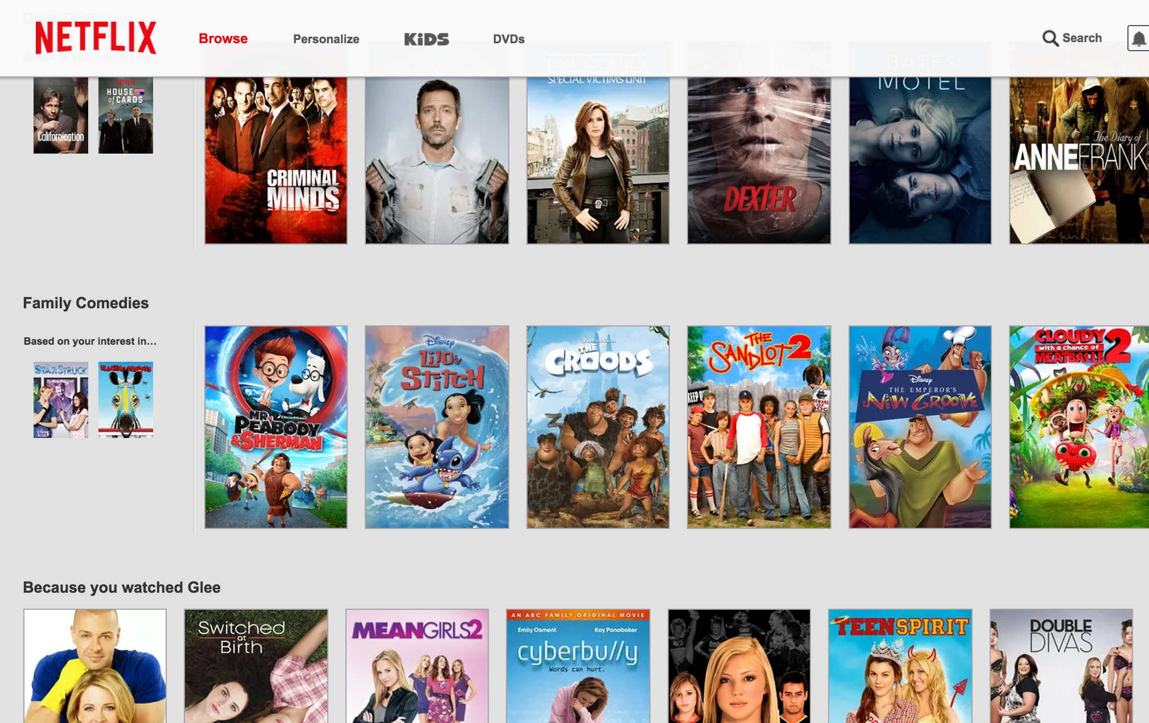

Machine Learning in Our Everyday Lives

Slide 3
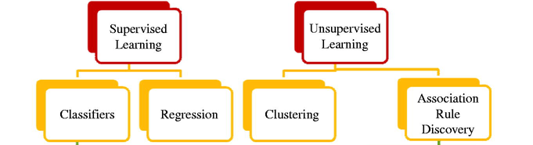
Types of Machine Learning
Regression
Classification

Slide 4

Supervised Learning

Slide 5
Types of Machine Learning
Regression
Classification

Slide 6
Regression
Predict an outcome which is continuous
Housing prices
size (sq ft)
price
input feature
outcome

Slide 7
Regression
price
$1000
600
size (sq ft)

Slide 8
Regression
price
size (sq ft)

Slide 9
Regression
price
size (sq ft)
R squared: sum of squares of difference between prediction and actual value.

Slide 10
Regression
price
size (sq ft)
Can use a metric called R^2 (R squared)

Slide 11
Classification
Predict an outcome which has discrete classes
Does this house have a good view?
Good view
No view
size, price
input features
outcome: 2 classes

Slide 12
Classification
Good view
Good view
price
No view
No view
size (sq ft)

Slide 13
Classification
True positive
Good view
Good view
price
No view
False positive
True negative
False negative
No view
size (sq ft)
Positive outcome: Good view
Negative outcome: No view

Slide 14
Classification
Good view
Good view
price
No view
No view
size (sq ft)
Accuracy: how many points did we get right?
15 right / 18 points = 83%

Slide 15
Classification
Good view
Good view
price
No view
No view
size (sq ft)
Recall (for good view class): of positive outcomes, how many did we get right?
7 right / 9 positives = 77%

Slide 16
Classification
Good view
Good view
price
No view
No view
size (sq ft)
Precision (for good view class): of points we labeled as positive, how many did we get right?
7 right / 8 labeled positive = 87.5%

Slide 17
Many Types of Models
Decision trees
Random Forest
Support Vector Machine
Neural Nets
K Nearest Neighbors
…

Slide 18
Decision Tree
Yes
No
Yes
No
Yes
No
View
No View
View
No View

Slide 19
Decision Tree
Price < 1000
Yes
No
Size < 700
Size > 800
Yes
No
Yes
No
View
No View
View
No View

Slide 20
Random Forest
Construct N (=6) different trees
Average the result of all the individual trees

Slide 21
Linear SVM
SVM = Support Vector Machine
Minimize classification error
Maximize the geometric margin between classes

Slide 22
Overfitting
Good view
Good view
price
No view
No view
size (sq ft)

Slide 23
Split data set
Train
Data
Test
Train model
Evaluate model

Slide 24
Training Set
Good view
Good view
price
No view
No view
size (sq ft)

Slide 25
Test Set
Good view
Good view
price
No view
No view
size (sq ft)
Test error is much greater than train error

Slide 26
Model Selection
How do we pick the best model?
Should we use our test set?
Notes:
We don’t want our test data to leak into the model.

Slide 27
Cross Validation
Randomize and divide data into multiple blocks
Train different models on train data
Score each model on test data
Repeat by choosing different chunks to test (if there is a concern that test data might be biased)
Notes:
We don’t want our test data to leak into the model.

Slide 28
Split data set
Train
Data
Validation
Test
Train model
Evaluate & Select
model
Evaluate final model

Slide 29
Tutorial
Using Python machine learning library called sci-kit learn.
Sci-kit learn has a simple API for training and using models

Slide 30
Feature Engineering
Raw features
Price of the house
Square footage of the house
Per capita crime rate in the neighborhood
Constructed features
Price per square foot

Slide 31
Sci-kit Learn Model API
400 ft
600 ft
1600 ft
800 ft
300 ft
1000 ft
700 ft
$800
$1200
$2600
$1300
$600
$2000
$1100
1
1
0
0
1
1
0
fit( , )
input features
outcomes
train the model

Slide 32
Sci-kit Learn Model API
400 ft
600 ft
1600 ft
800 ft
300 ft
1000 ft
700 ft
$800
$1200
$2600
$1300
$600
$2000
$1100
1
1
0
0
1
1
0
predict( )
input features
outcomes
use the model

Slide 33
Recap
Supervised learning
Regression
Classification
Overfitting
Model selection
Train, test sets
Sci-kit Learn library

Slide 34
Hands-on Examples
Medical Data Classification
TODO: include link
Boston Housing Data Regression
TODO: include link

Slide 35
Hands-on Examples
Medical Data Classification
TODO: include link
Boston Housing Data Regression
TODO: include link

Slide 36
What We Didn’t Teach You
TODO
How a model actually works (The math behind how you train and use a model)
There are lots of different models out there, and they all have flaws.

Slide 37
Want to Learn More?
Go to “Describe the Model Building Process”
By Nathan Howell, Zhixian Yan, Jeffrey Mclellan and Marc Piette
Personalization Track
Grand Canyon 2
1:30pm – 2:15pm

Slide 38
Want to Learn More?
Go to “Describe the Model Building Process”
By Nathan Howell, Zhixian Yan, Jeffrey Mclellan and Marc Piette
Personalization Track
Grand Canyon 2
1:30pm – 2:15pm

