Slide 1
Workshop: Machine Learning Made Ridiculously Simple
Presented by:
Arsen Mamikonyan,
David Kellogg, Lydia Gu
Notes:
Introduce ourselves and what we’ll be talking about!
Arsen and I are engineers on the Locu team. Arsen works on our API and I work on our crowd platform for gathering structured data.
David is a data scientist on the domains team.

Slide 2
Overview
Types of Machine Learning
Supervised Learning
Regression vs Classification
Metrics for evaluating a model
Model selection
Sci-kit Learn library API
How to use ipython notebook for tutorial

Slide 3
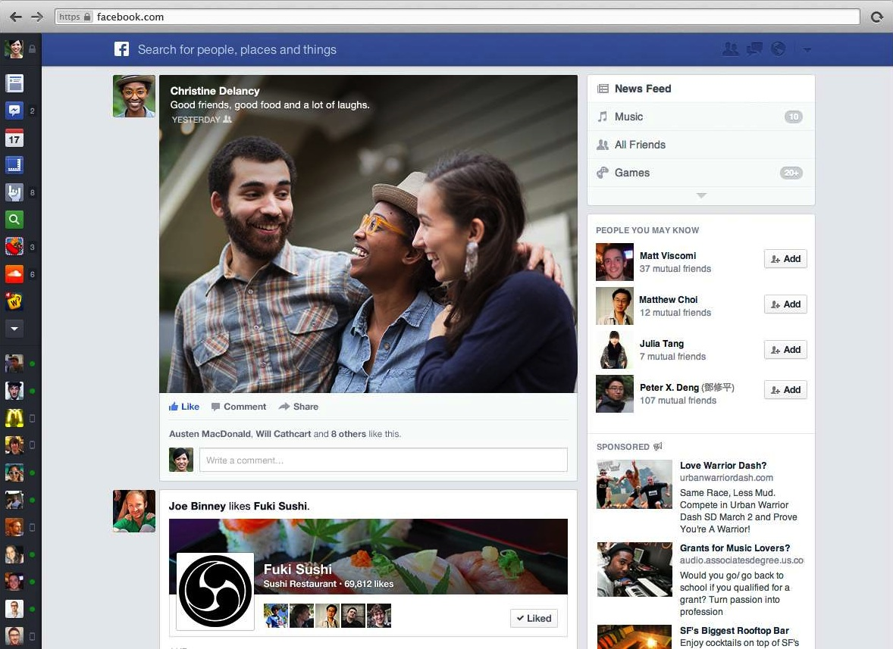
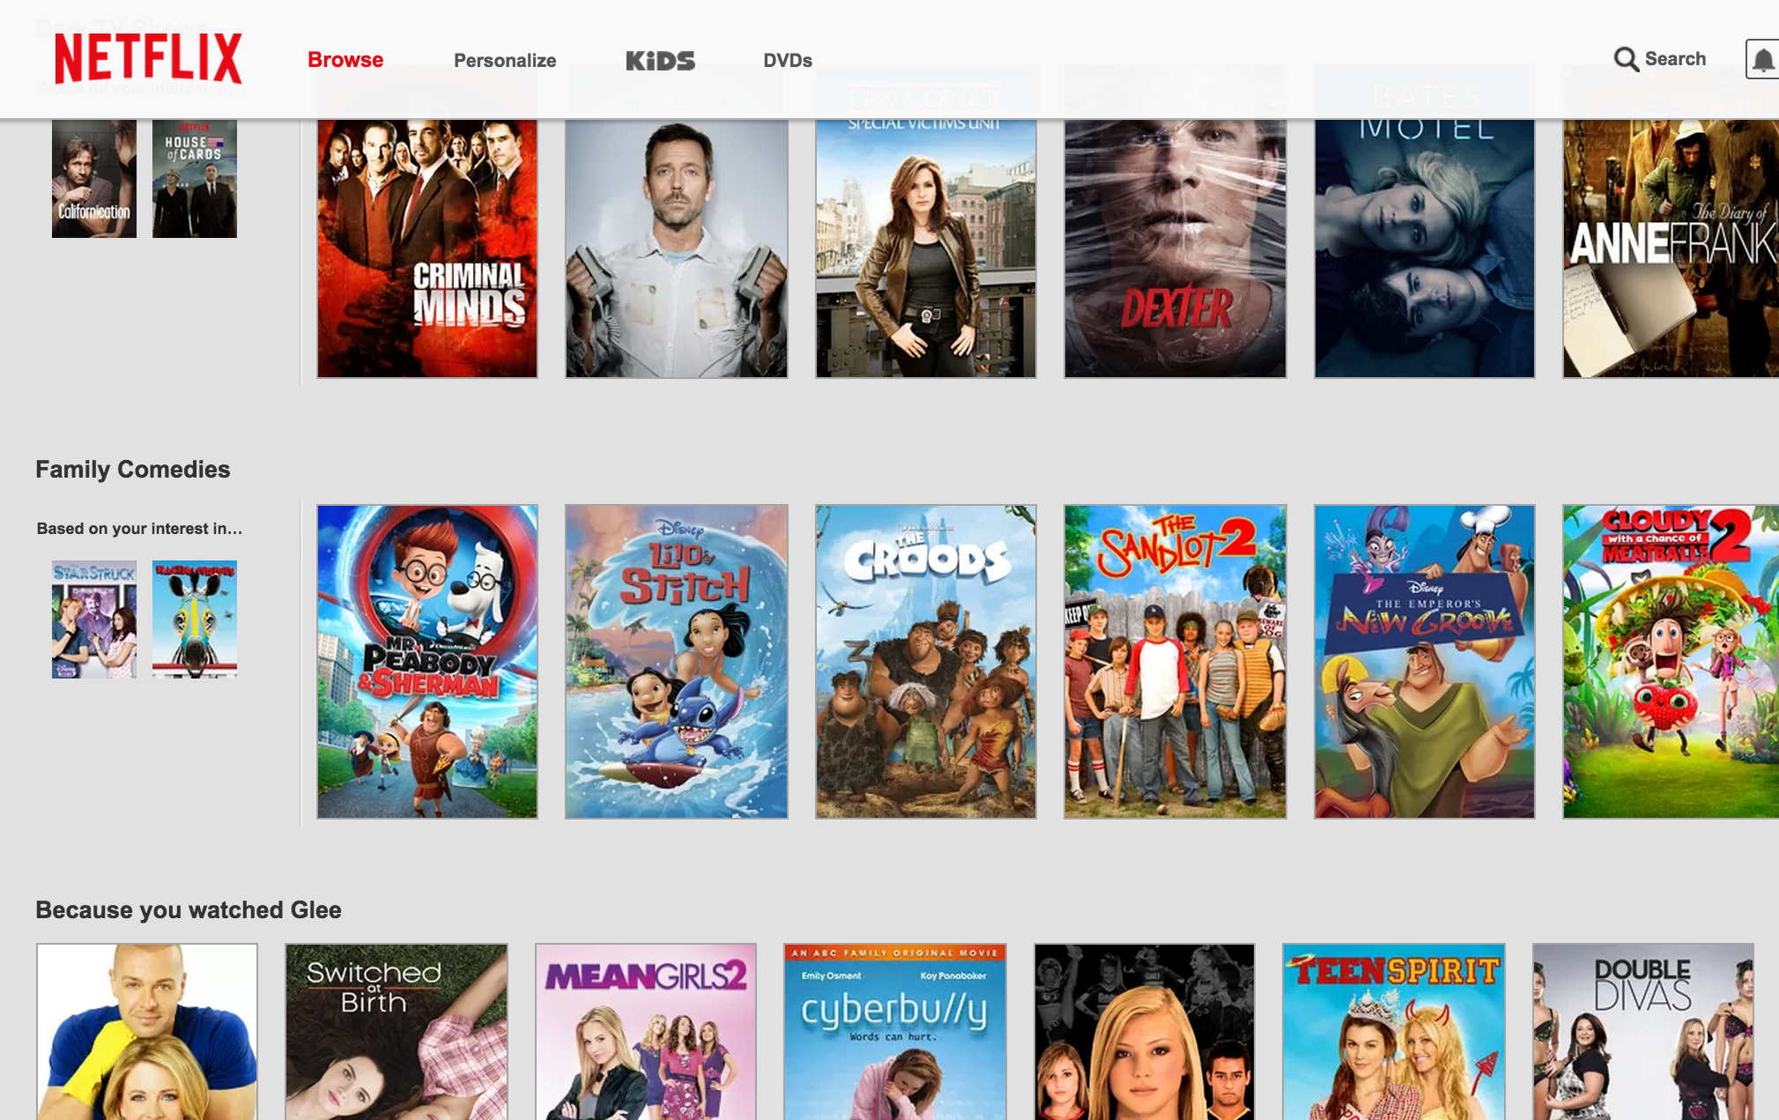

Machine Learning in Our Everyday Lives
Notes:
Machine learning is used to decide what to show in our Facebook news feed
It’s used to recommend movies on Netflix
It’s used in Siri to recognize what we say and answer our questions.

Slide 4
Outline
Machine learning concepts
Scikit-learn: a Python machine learning library
2 hands-on tutorial examples

Slide 5
Outline
Machine learning concepts
Scikit-learn: a Python machine learning library
2 hands-on tutorial examples

Slide 6
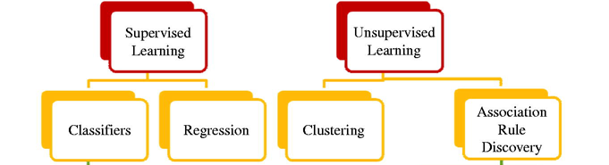
Types of Machine Learning
Regression
Classification
Notes:
Many categories of machine learning. Depends on what the problem is.

Slide 7

Supervised Learning

Slide 8
Types of Machine Learning
Regression
Classification

Slide 9
Regression
Predict an outcome which is continuous
Housing prices
size (sq ft)
price
input feature
outcome

Slide 10
Regression
price
$1000
600
size (sq ft)

Slide 11
Regression
price
size (sq ft)

Slide 12
Regression
price
size (sq ft)
minimize sum of squares of difference between predicted and actual value.

Slide 13
Regression
price
size (sq ft)
Can use a metric called R^2 (R squared)

Slide 14
Types of Machine Learning
Regression
Classification

Slide 15
Classification
Predict an outcome which has discrete classes
Example: Does this house have a view?
View
No View
size, price
input features
labels: 2 classes

Slide 16
Classification
Predicted view
View
price
No View
Predicted no view
size (sq ft)
Does this house have a view?

Slide 17
Classification
True positive
Predicted view
View
price
No View
False positive
True negative
False negative
Predicted no view
size (sq ft)
Positive - View
Negative - No View
Outcome can be:
Notes:
Next slide: How do we measure how “good” a classifier is? There are many metrics, and which one you use often depends on the application.

Slide 18
Classification
Predicted view
View
price
No View
Predicted no view
size (sq ft)
Accuracy: how many points did we get right?
15 correct / 18 total = 83%

Slide 19
Classification
Predicted view
View
price
No View
Predicted no view
size (sq ft)
Recall: What % of houses with views did we predict correctly?
7 correct / 9 positives = 78%
Notes:
If we care more about correctly labeling all the instances of one class, then we use recall. For ex, screening for malignant tumors. TSA bag check

Slide 20
Classification
Predicted view
View
price
No View
Predicted no view
size (sq ft)
Precision: of houses we predicted “View”, how many did we get right?
7 correct / 8 predicted positive = 88%
Notes:
On the other hand, we might care more about how accurate our labels are for one class. Auto-tag people on facebook.

Slide 21
Many Types of Models
Decision trees
Random Forest
Support Vector Machine
Neural Nets
K Nearest Neighbors
…

Slide 22
Decision Tree
Yes
No
Yes
No
Yes
No
View
No View
View
No View

Slide 23
Decision Tree
Price < 1000
Yes
No
Size < 500
Size < 800
Yes
No
Yes
No
View
No View
View
No View

Slide 24
Random Forest
P < 1000
S > 500
S < 200
S < 700
S > 800
P < 700
P > 900
P > 300
P > 900
Construct many different trees
Average the result of all the individual trees

Slide 25
Linear Regression
price
size (sq ft)
Price = a + b * size + epsilon
Algorithms finds a & b, s.t. sum of all epsilons is minimized

Slide 26
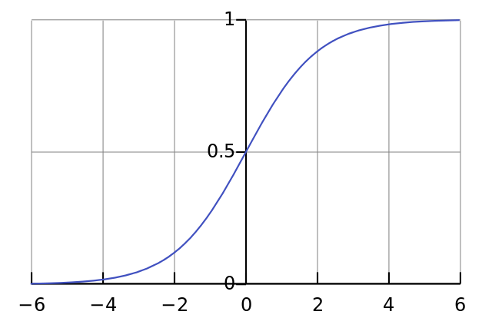
Logistic Regression
price
size (sq ft)
tweak the cost of error, s.t.
We still have an equation for a line
It doesn’t matter much if we are off by 4 or 40

Slide 27
Logistic Regression
SVM = Support Vector Machine
Minimize classification error
Maximize the geometric margin between classes

Slide 28
Split data set
Train
Data
Test
Train model
Evaluate model

Slide 29
Overfitting
Predicted View
View
price
No view
Predicted No view
size (sq ft)

Slide 30
Training Set
Good view
Good view
price
No view
No view
size (sq ft)

Slide 31
Test Set
Predicted View
View
price
No view
Predicted No view
size (sq ft)
Test error is much greater than train error

Slide 32
Model Selection
How do we pick the best model?
Should we use our test set?
Notes:
We don’t want our test data to leak into the model.

Slide 33
Cross Validation
Data
Test
Test
Test
Test
Evaluate model
Evaluate model
Evaluate model
Evaluate model

Slide 34
Cross Validation
Randomize and divide data into multiple blocks
Train different models on train data
Score each model on test data
Repeat by choosing different chunks to test (if there is a concern that test data might be biased)
Notes:
We don’t want our test data to leak into the model.

Slide 35
Split data set
Train
Data
Validation
Test
Train model
Evaluate & Select
model
Evaluate final model

Slide 36
Outline
Machine learning concepts
Scikit-learn: a Python machine learning library
2 hands-on tutorial examples

Slide 37
Tutorial
Using Python machine learning library called sci-kit learn.
Sci-kit learn has a simple API for training and using models

Slide 38
Feature Engineering
Raw features
Price of the house
Square footage of the house
Per capita crime rate in the neighborhood
Constructed features
Price per square foot

Slide 39
Sci-kit Learn Model API
View
1 house features
400 sqft
600 sqft
1600 sqft
800 sqft
300 sqft
1000 sqft
700 sqft
$800
$1200
$2600
$1300
$600
$2000
$1100
1
1
0
0
1
1
0
fit( , )
No View
input features
labels
train the model

Slide 40
Sci-kit Learn Model API
400 sqft
600 sqft
1600 sqft
800 sqft
300 sqft
1000 sqft
700 sqft
$800
$1200
$2600
$1300
$600
$2000
$1100
1
1
0
0
1
1
0
predict( )
input features
predicted labels
use the model

Slide 41
Recap
Supervised learning
Regression
Classification
Overfitting
Model selection
Train, test sets
Sci-kit Learn library

Slide 42
Hands-on Examples
Medical Data Classification
TODO: include link
Boston Housing Data Regression
TODO: include link

Slide 43
Hands-on Examples
Boston Housing Data Regression
TODO: include link
Medical Data Classification
TODO: include link

Slide 44
What We Didn’t Teach You
TODO
How a model actually works (The math behind how you train and use a model)
There are lots of different models out there, and they all have flaws.

Slide 45
Want to Learn More?
Go to “Describe the Model Building Process”
By Nathan Howell, Zhixian Yan, Jeffrey Mclellan and Marc Piette
Personalization Track
Grand Canyon 2
1:30pm – 2:15pm

Slide 46
Want to Learn More?
“Describe the Model Building Process”
Nathan Howell, Jason Ansel, Jeffrey Mclellan and Marc Piette
Personalization Track
Grand Canyon 2
1:30pm – 2:15pm

