Slide 1
Renewable Energy Trading System
By
Alok Sharma

Slide 2
Problem Statement
Overview
The shift toward renewable energy requires smarter decision-making to optimize generation and trading.
Forecasting market trends and grid demand is complex and data-driven.
Manual energy trading is inefficient and often reactive.
Goal: Automate renewable energy trading using real-time weather data and ML forecasts.
This project showcases an AI-powered renewable energy trading platform built with modular microservices. It uses machine learning to forecast energy output, prices, and demand, enabling real-time automated trading decisions. The system includes containerized services for forecasting, trading, scheduling, and visualization, all orchestrated with Docker. A user-friendly dashboard provides insights into trends, actions, and profits, making the platform scalable, efficient, and cloud-ready.

Slide 3
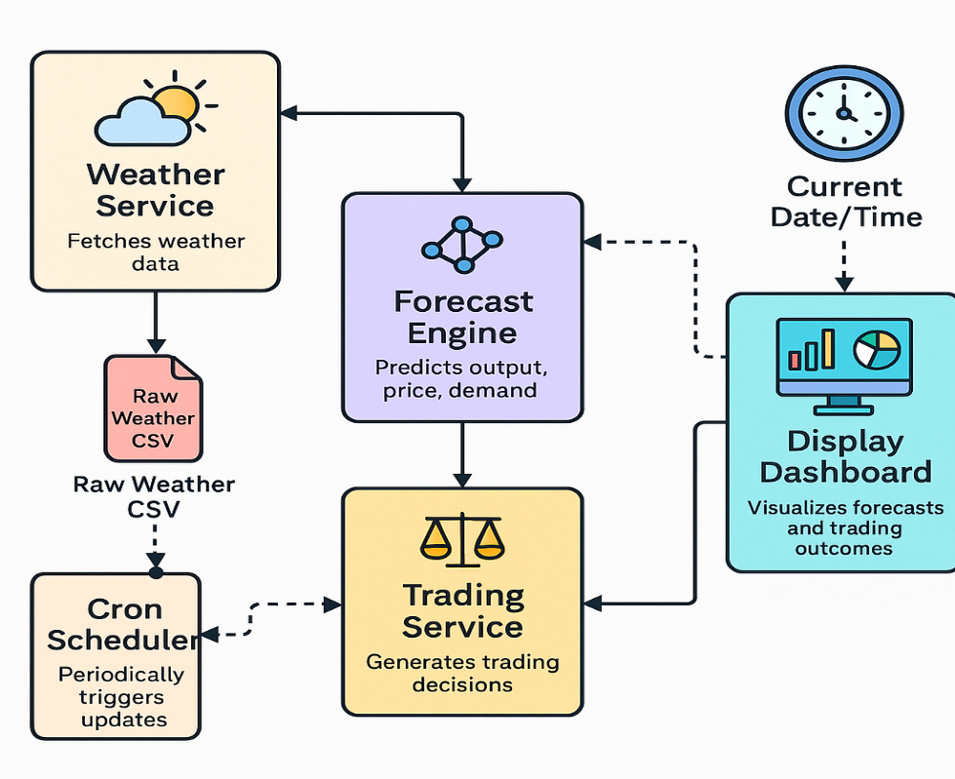
System Architecture (Microservices)
5 core services:
  Weather Service
  Forecast Service (ML)
  Trading Service (Decision Logic)
  Cron Scheduler
  Dashboard (Streamlit)
Services communicate over REST APIs via Docker Compose.
Modular and independently scalable design.

Slide 4
Forecast Service (ML Models)
To generate real-time predictions of energy metrics using machine learning, based on current weather conditions.
Predicts:
  Renewable generation (MW)
  Market electricity price (USD/MWh)
  Grid load demand (MW)
Input: weather data (temp, wind speed, irradiance)
How It Works:
Fetches weather data from the Weather Service (via API).
Parses and preprocesses the data (normalization, feature selection).
Applies pre-trained ML models (e.g., RandomForest, XGBoost using scikit-learn).
Generates a row of predictions for each forecast interval.
Output: forecast_*.csv with timestamped predictions

Slide 5
Trading Service (Decision Logic)
To make real-time trading decisions (Buy, Sell, Hold) based on forecasted energy output, market price, and grid demand.
Inputs:
Predicted energy output (MW)
Predicted market price (USD/MWh)
Interval (e.g., 15 minutes)
How it works:
Receives forecast data row-by-row.
Applies rule-based logic
Calculates:
  Quantity = output × (interval / 60)
  Profit = ± price × quantity
Output:
JSON with decision, reason, quantity, and profit/loss
Results are passed to the dashboard for visualization
Technology:
Implemented with FastAPI, exposed at port 8003
Containerized and orchestrated via Docker Compose

Slide 6
Dashboard (Streamlit)
Visual UI for real-time monitoring
Features:
  Forecast visualization with confidence bands
  Market price trends
  Trading actions and reasons
  Cumulative profit tracking
  Manual refresh button
Connects to trading service via API

Slide 7
Cron Job (Hourly Forecast Updates)
Lightweight cron container using Linux crontab
Executes every 15 minutes:
  Triggers weather_service to fetch current data
  Calls forecast_service to generate predictions
Enables automation with no user intervention

Slide 8
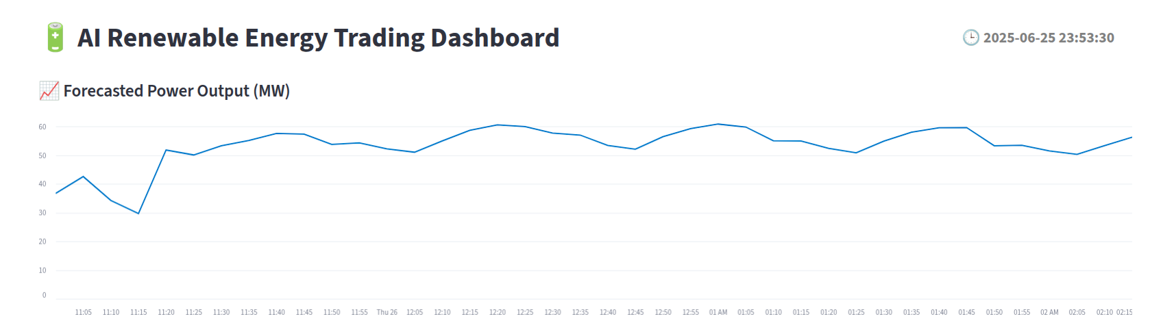
Demo Snapshots
prediction plot

Slide 9
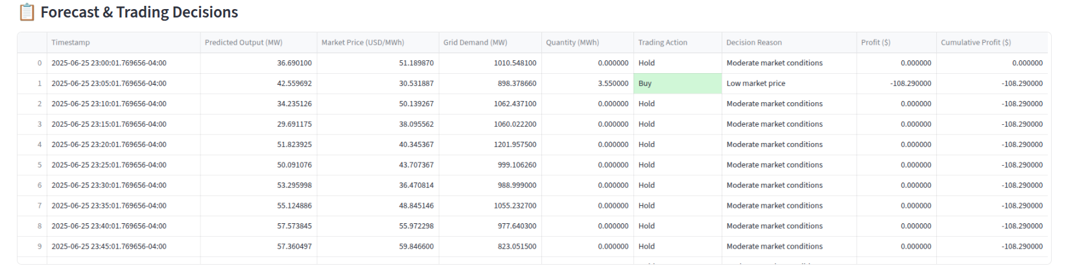
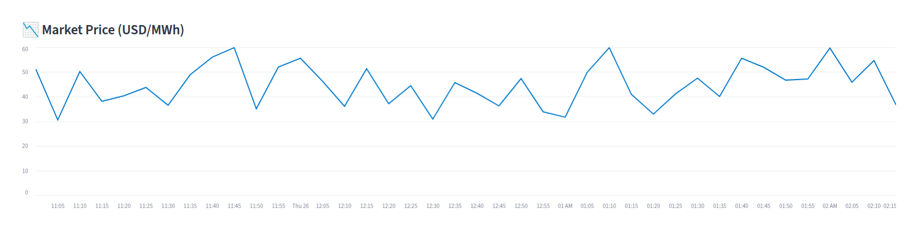
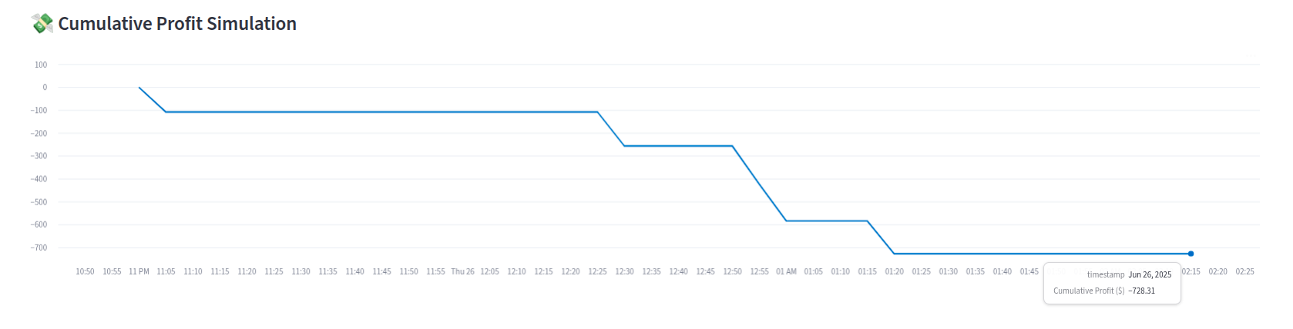
Trading decisions + profit over time

Slide 10
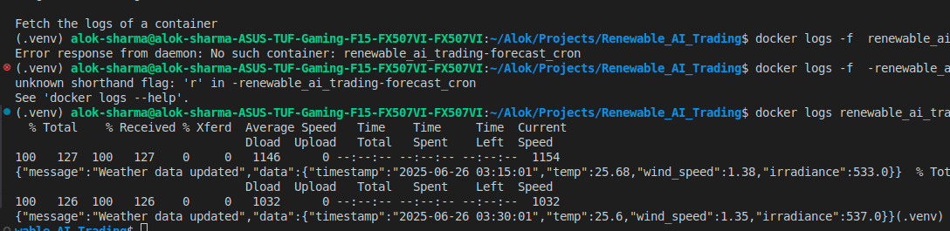
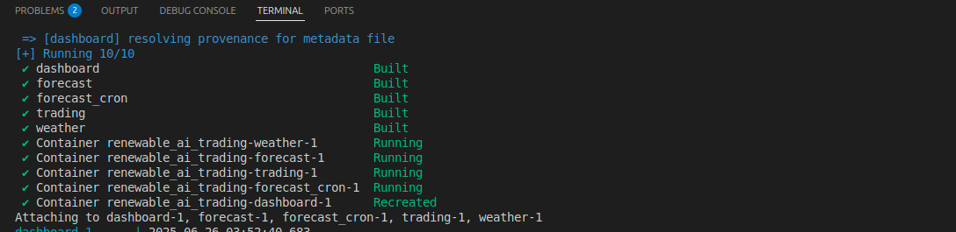
API call from cron log output

Slide 11
Key Features
Automatically makes buy/sell decisions using up-to-date weather and market forecasts.
Real-time prediction-based energy trading
  Automatically makes buy/sell decisions using up-to-date weather and market forecasts.
ML-powered forecast service
  Uses machine learning models trained on weather data to predict generation, price, and demand.
API-driven microservices
  Services communicate via REST APIs, allowing modularity, scalability, and easy integration.
Streamlit visualization with trading insights
  Live dashboard displays forecasts, trading decisions, and profit trends in an intuitive interface
Automated data updates via cron job
  A lightweight cron container triggers forecasting every 15 minutes without manual input

Slide 12
Benefits and Drawbacks
Benefits:
Modular and reusable services
  Each microservice handles a specific task and can be independently updated or replaced
Real-time responsiveness
  The system reacts instantly to new data, ensuring timely and informed trading actions
Portable (Dockerized for cloud/local)
  Easily deployable on local machines or cloud platforms like AWS/GCP using Docker containers.
Drawbacks:
Dependent on accurate weather inputs
  Forecast quality and trading outcomes heavily rely on the precision of external weather data.
Fixed trading logic (not adaptive yet)
  Uses static thresholds for decision-making; does not learn or evolve with new market conditions
Not tested with real-time grid APIs
  The system currently runs in isolation and lacks integration with live grid or market platforms

Slide 13
Challenge | Solution
ML model tuning | Models were trained on simulated real-weather data to mimic real-world conditions and enhance forecast accuracy.
Docker container communication | Services communicate over a shared Docker Compose network bridge, allowing seamless API calls between containers.
Scheduled forecasting | A custom cron container triggers forecasting every 15 minutes, automating weather data collection and prediction updates.
Streamlit update delay | the trading logic is executed only once each time the user refreshes or updates the dashboard—not repeatedly while the dashboard is open.

Slide 14
Conclusion and Future Work
Fully functioning microservice-based energy trading platform
Supports hourly autonomous forecasting and trading logic
Future Enhancements:
  Integrate real grid APIs and market data
  Add adaptive decision-making (RL)
  Deploy to AWS/GCP
  Train models on real-world datasets

Slide 15
Thank You

