Slide 1
Video based Human Action Recognition
CSE-STUDENT
NAME – ALOK KUMAR SINGH

Slide 2
Problem Statement
Previously, we have done audio processing to analyze audio recordings captured during hostage scenario to classify emergency situation.
Now, we will focus on video based human action recognition and group activity recognition to accurately detect and classify emergency situations within the video clips.
By achieving this, the project seeks to help law enforcement and emergency services in hostage scenarios.

Slide 3
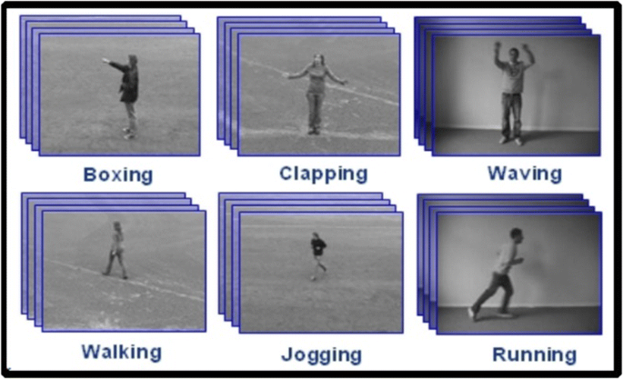
Human Action Recognition
Human action recognition in machine learning refers to the task of automatically identifying and classifying human actions or activities from input data, such as videos or sensor data.

Slide 4
HAR using Deep Learning Approaches (3D ResNet)
3D ResNet adds an extra dimension to the input data. By using 3D convolutions, the network can analyze not just spatial information (like a regular image) but also temporal information (motion across video frames).
It consists of multiple layers, each of which has a series of 3D convolutional layers, followed by batch normalization and a nonlinear activation function (ReLU).

Slide 5
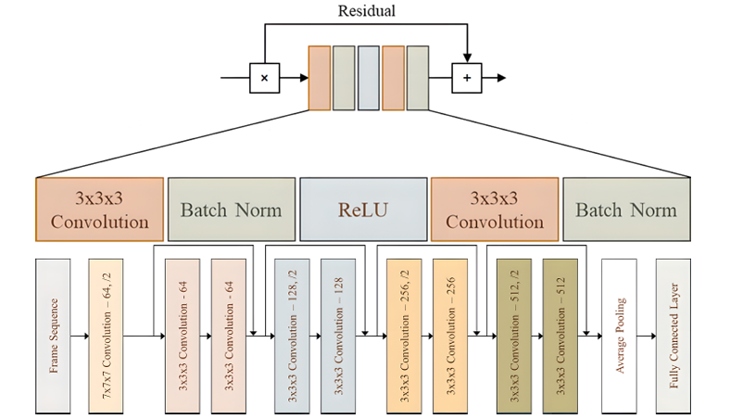
3D ResNet Architecture

Slide 6
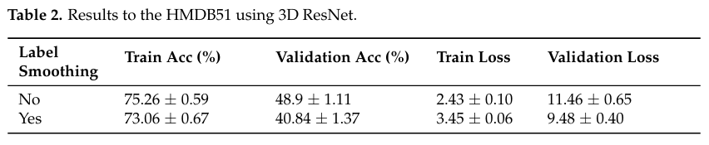
Results for 3D ResNet

Slide 7
Deep Learning Video Based Human Action Recognition on the Edge
Most of the HAR systems rely on the use of deep learning based algorithms which enable them to achieve high performance but usually with a high computational cost, hindering real-time execution.
We will see a HAR system which is optimized for running on the edge and is able to work in real time, in an embedded platform.
We will perform Human Action Recognition (HAR) by using a Long Short-Term Memory (LSTM). The input to the LSTM is an ad-hoc, lightweight feature vector obtained from the bounding box of each detected person in the video surveillance image.

Slide 8
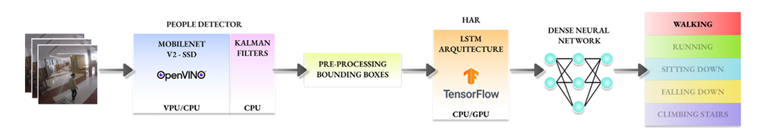
Architecture

Slide 9
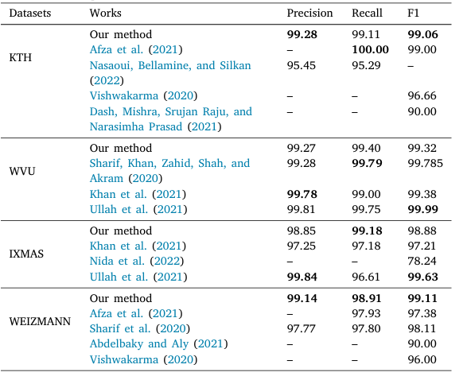
Results

Slide 10
Group Activity Recognition
Group activity recognition is a field of computer vision that focuses on identifying the activities of a group of people in a video. The paper proposes method called Group Former to address the challenges of group activity recognition.
One challenge is how to effectively capture the interactions between individuals and represent the group as a whole. Existing methods either process spatial and temporal information separately or directly combine individual features, which can be inefficient or miss important information.
Group Former addresses this challenge by introducing a Clustered Spatial-Temporal Transformer (CSTT).

Slide 11
Spatial and Temporal Features
Spatial features refer to characteristics or properties of data that are related to their spatial arrangement or distribution in a given space.
Temporal features refers to the changes and interactions that occur over time in a video.

Slide 12
Clustered Spatial-Temporal Transformer (CSTT)
This transformer is designed to:
1. Enhance individual and group representations: It does this by modeling the spatial and temporal context jointly, allowing the model to better understand the relationships between individuals and the group.
2. Model dependencies between individuals: It uses a clustered attention mechanism to dynamically group individuals based on their features. This allows the model to focus on the most relevant relationships between individuals for the specific activity being recognized.

Slide 13
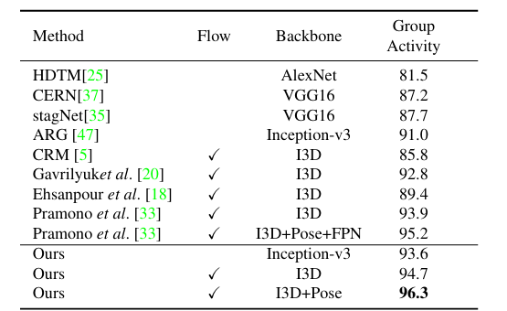
Results

Slide 14
Proposed Hybrid Model
We will modify the original Deep Learning Video Based Human Action Recognition on the Edge architecture and add attention layer with separate weight matrices for intra-group and inter-group attention.
The Action Recognition module utilizes a two-layer LSTM network followed by dense layers for action classification.
We'll modify the HAR module by introducing an attention layer after the first unidirectional LSTM layer. This attention layer will learn to focus on relevant features from different bounding boxes, considering both intra-group and inter-group interactions.

Slide 15
Proposed Hybrid Model
Intra-group Weight Matrix: This matrix captures the relationships between features of people within the same group. It allows the model to focus on how individual actions within a group influence each other.
Inter-group Weight Matrix: This matrix captures the relationships between features of people from different groups. It allows the model to focus on how actions of different groups interact with each other.
The subsequent layers in the architecture can then learn to classify actions considering both the individual features and the contextual information captured by the attention mechanism.
This approach allows the model to differentiate between intra-group and inter-group interactions, leading to a more comprehensive understanding of group activities.

Slide 16
Dataset
We will use the UCF101 dataset. It is a popular benchmark dataset in the field of action recognition in videos
The dataset contains a total of 13,320 videos, covering 101 human action classes. Each action class consists of around 100 video clips, captured from YouTube videos. The videos vary in duration and resolution.

Slide 17
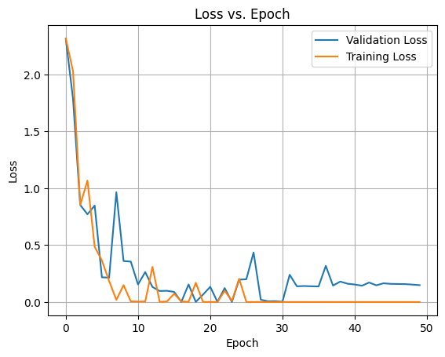
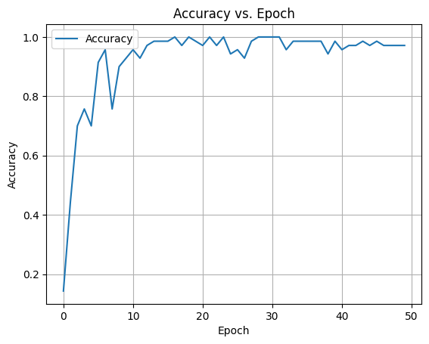
Results
The accuracy of the model was 97.1429%

Slide 18
Conclusion
In this presentation, we have reviewed different methods for human activity recognition and presented a hybrid of Group Former and a lightweight HAR model that uses LSTM for classification.

Slide 19
References
Li, S., Cao, Q., Liu, L., Yang, K., Liu, S., Hou, J., & Yi, S. (2021). GroupFormer: Group Activity Recognition with Clustered Spatial-Temporal Transformer. ArXiv. /abs/2108.12630
Cob-Parro, A. C., Losada-Gutiérrez, C., Marrón-Romera, M., Gardel-Vicente, A., & Bravo-Muñoz, I. (2024). A new framework for deep learning video based Human Action Recognition on the edge. Expert Systems With Applications, 238, 122220. https://doi.org/10.1016/j.eswa.2023.122220
Pham, H. H., Khoudour, L., Crouzil, A., Zegers, P., & Velastin, S. A. (2022). Video-based Human Action Recognition using Deep Learning: A Review. ArXiv. /abs/2208.03775

Slide 20
Thank You

