Slide 1
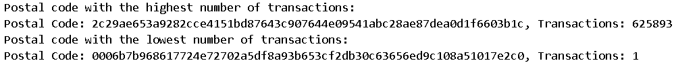
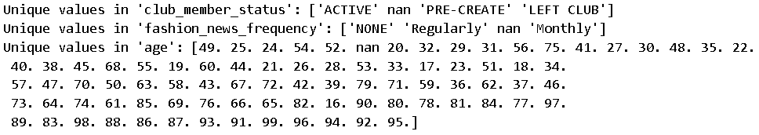
INSIGHTS
We see that the same postal code i.e. location has highest number of customers and also records the highest number of transactions. It could be a posh area, with lots of high networth customers.

Slide 2
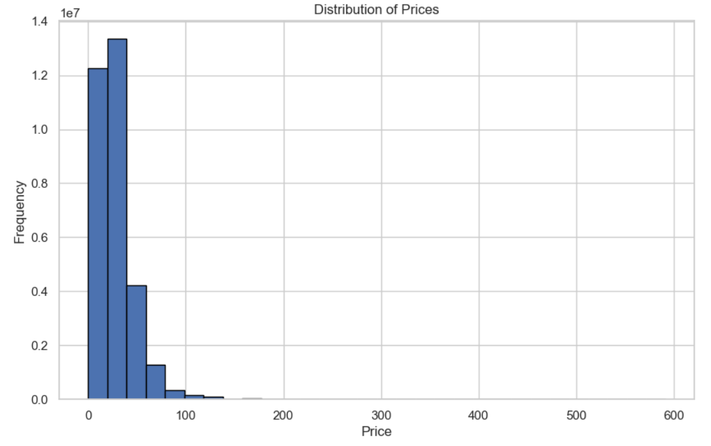
INSIGHTS
Most items are in the price range of 0 to 100 dollars.

Slide 3
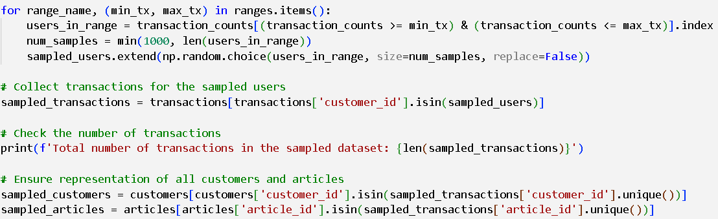
Then, all rows in transactions dataframe with any null values were removed.
Next, we are going to sample the dataset.
For that, we split the users into user segments based on their number of transactions .
We also limited the number of users of each user segment to 1000.
New Users: 0-20 transactions
Medium Users: 21-100 transactions
Frequent Users: 101-200 transactions
Heavy Users: 201-500 transactions
Super Users: More than 500 transactions
New Users: 1000 users
Medium Users: 1000 users
Frequent Users: 1000 users
Heavy Users: 1000 users
Super Users: 474 users
There are only 474 users in the original dataset with number of transactions more than 500.

Slide 4
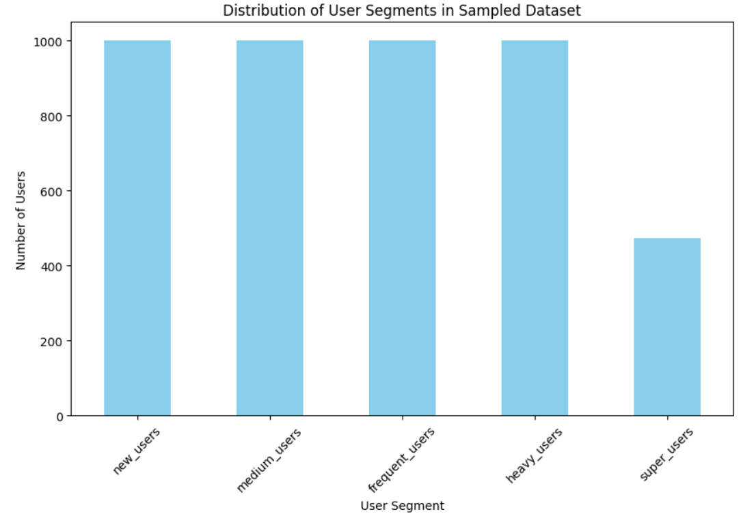

INSIGHTS
In the sampled dataset, we get the following details:-
The criteria for the sampling was to get all transactions of a single user in the sampled data, rather than having many users but not all of their transactions.

Slide 5
INSIGHTS
New Users: Offer discounts or introductory offers to encourage more purchases.
Medium Users: Provide personalized recommendations based on past purchases.
Frequent Users: Offer loyalty rewards or exclusive access to new products.
Heavy Users: Provide premium services or exclusive membership benefits.
Super Users: Offer high-value items or special recognition programs.
For the club membership status, we can:-
Active: Regularly update them with new offers and products.
Pre-create: Encourage them to complete their profiles with special offers.
Left Club: Win-back campaigns with exclusive deals or incentives to rejoin.

Slide 6
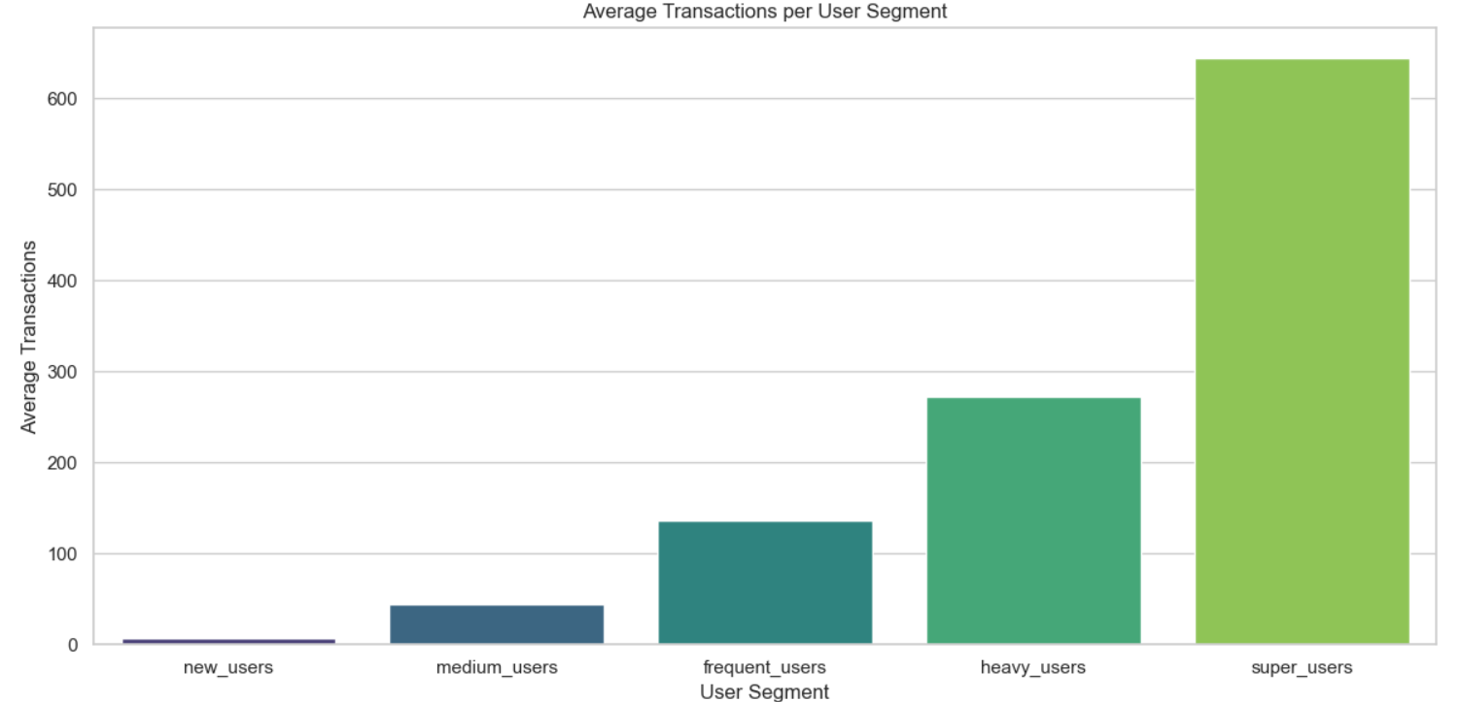
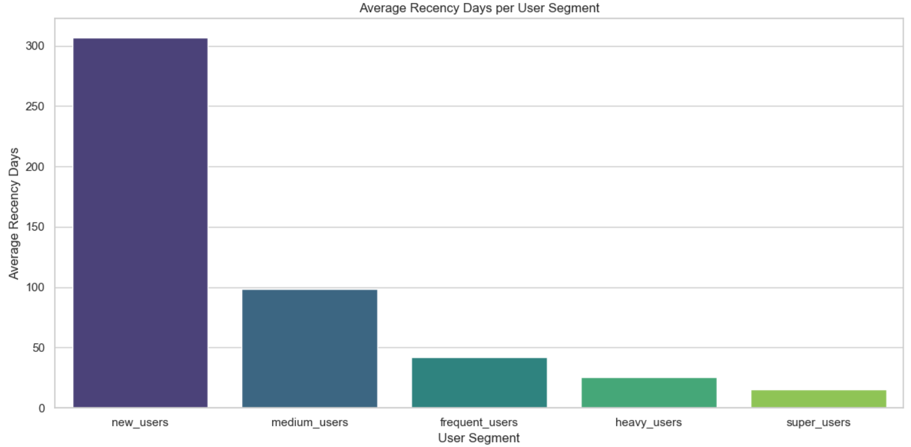

Slide 7
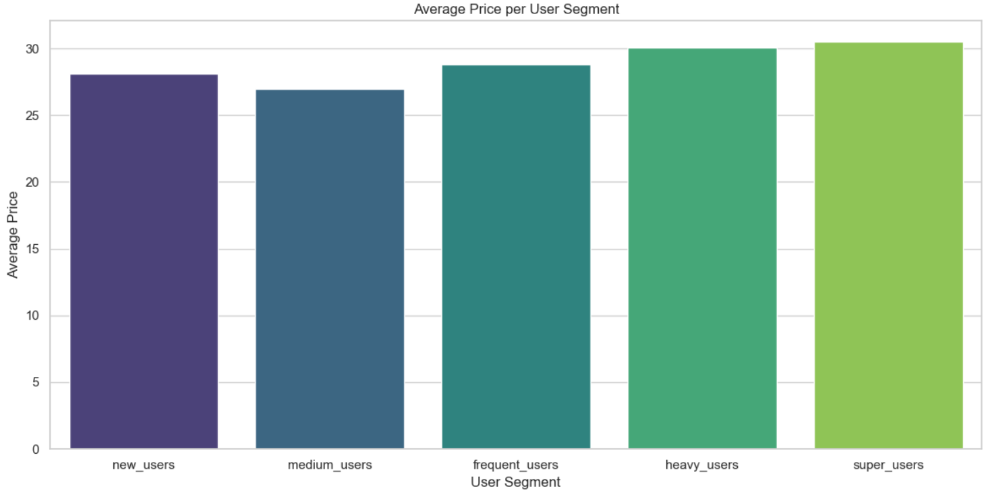
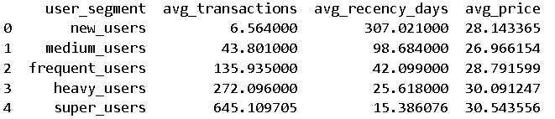

Slide 8
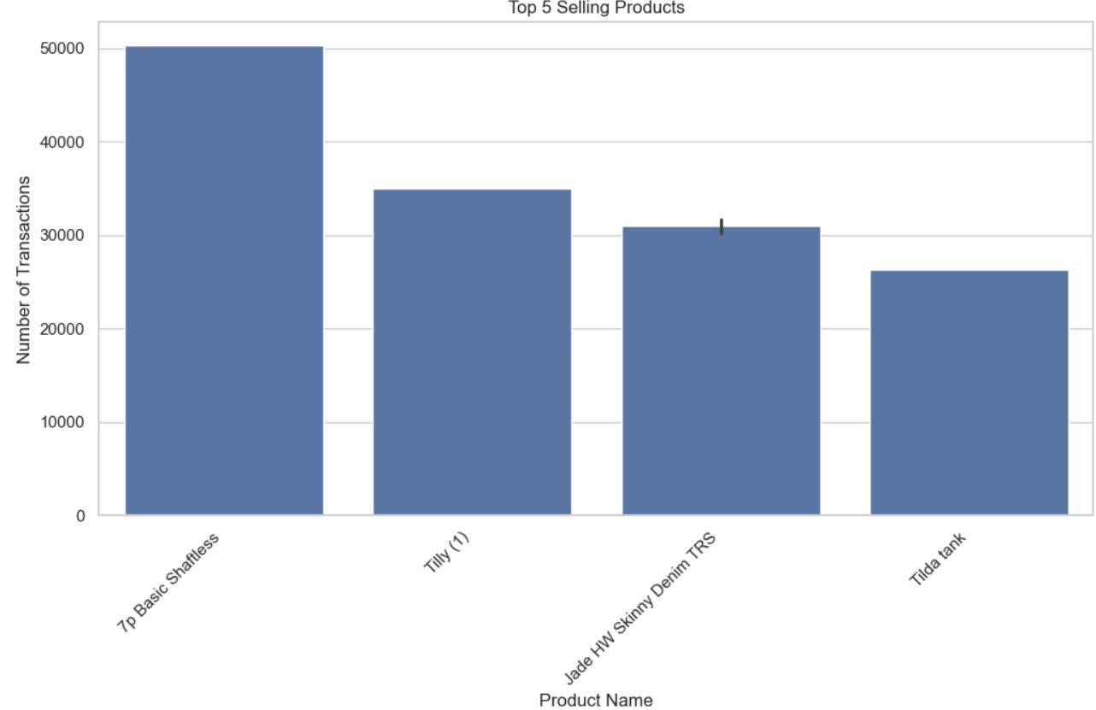
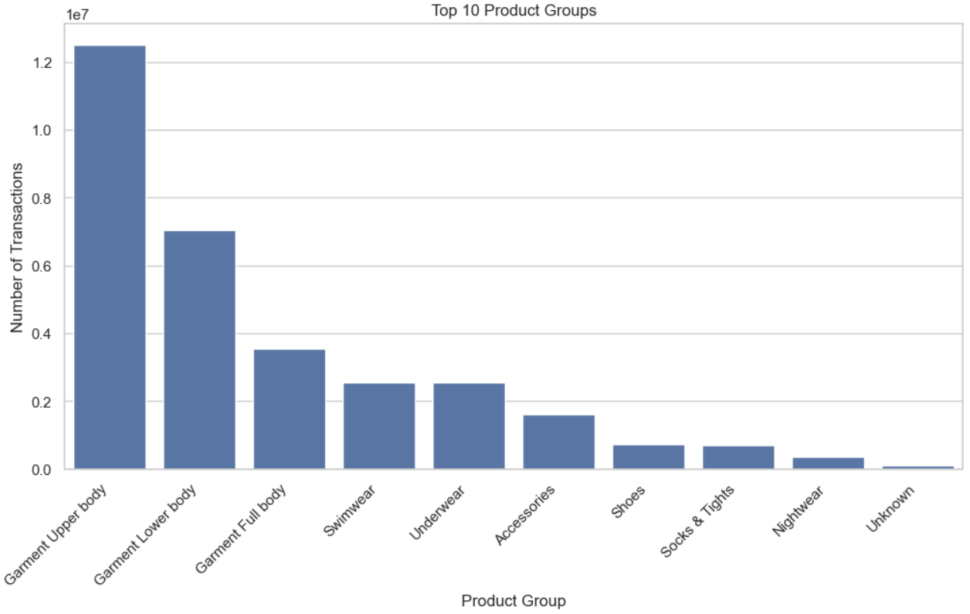
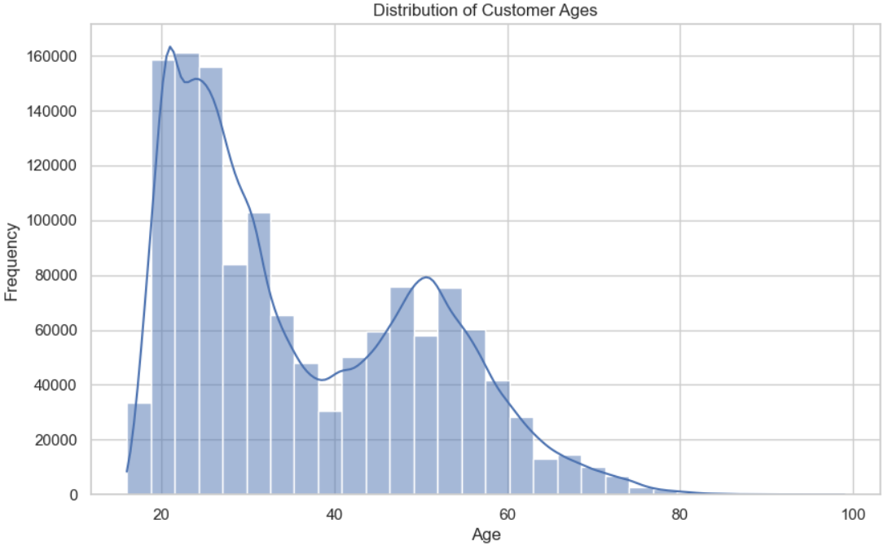
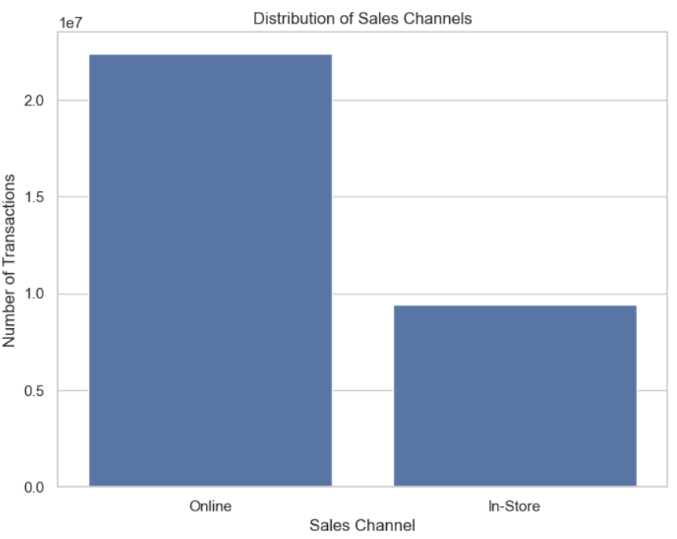
We can recommend shaftless socks, jeggings, greta thong , and products in the first 3 Garment groups for cold start.
Most sales are online sales. Age 18 to 30 bracket is most frequent purchaser.

Slide 9
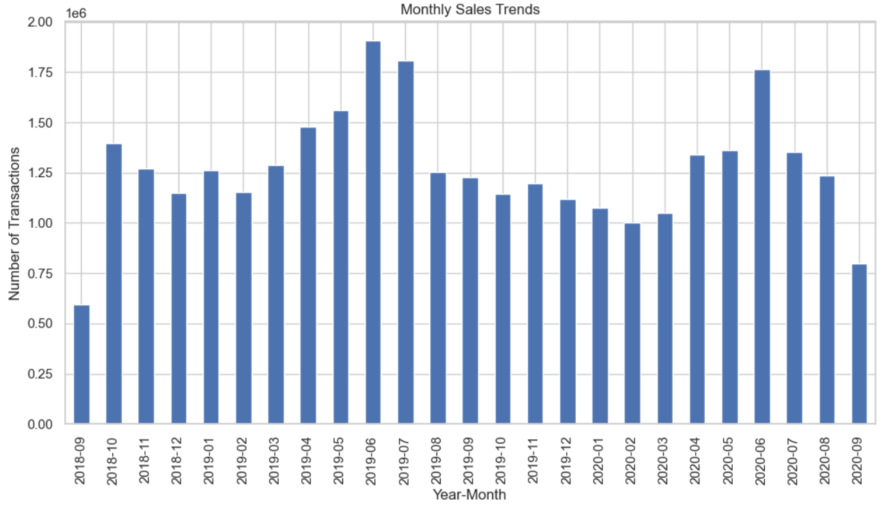
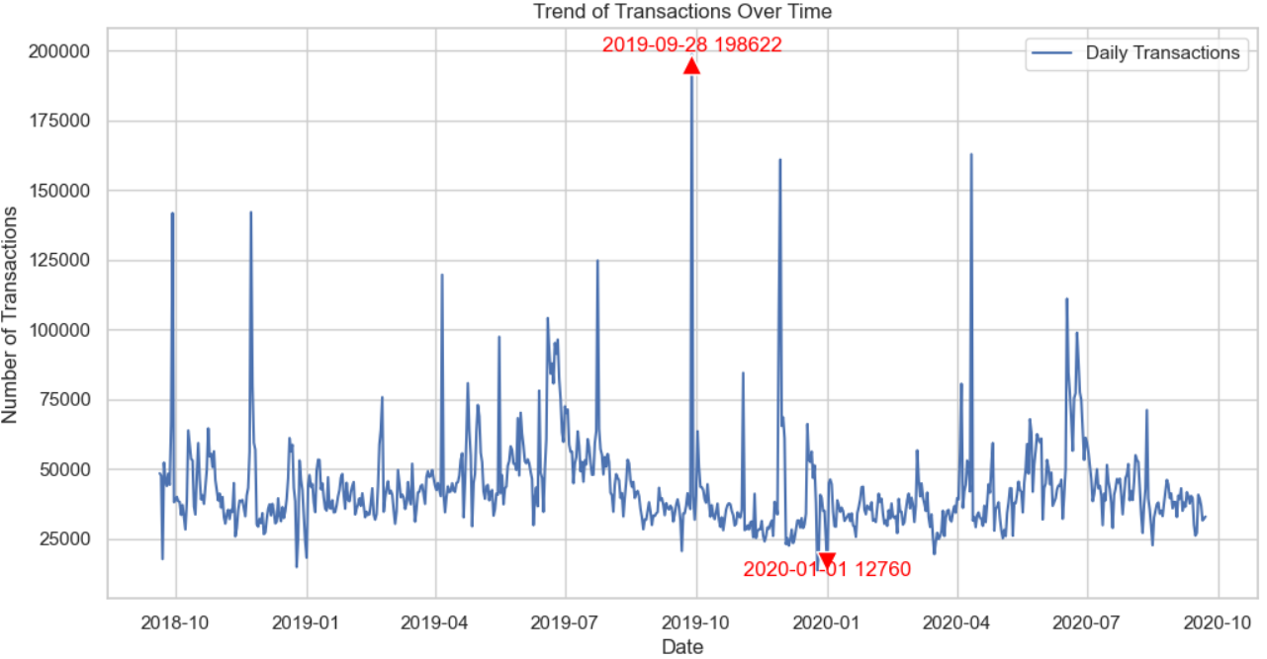
The month with the highest number of transactions is June 2019. I looked at H&M Quarter 2 Report 2019.
There were higher markdowns or discounts given to products to boost sales, which led to more sales.
The day which had the highest number of transactions is 28-09-2019, which was Black Friday Sale day.
The day with lowest number of transactions is 01-01-2020 i.e. New Years Eve, because of post-holiday sales drop, because people had already spent lots during Christmas Holidays, So, people reduce spending and settle their debts etc.

Slide 10
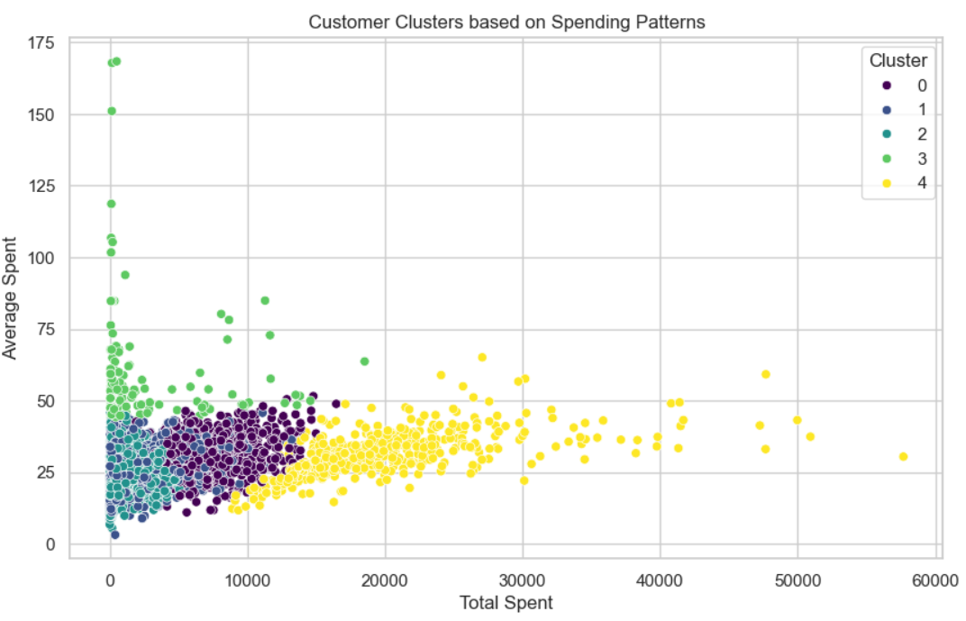
I used K-means clustering with k = 5 to find customer clusters in order to find how much each customer cluster group spents on. The plot is Average Spent per Product versus Total Spent on H&M products.
People are willing to spend usually at most 75 dollars for a product. We can use it to target cheaper items with threshold less than 75 for cold start for new users.

Slide 11
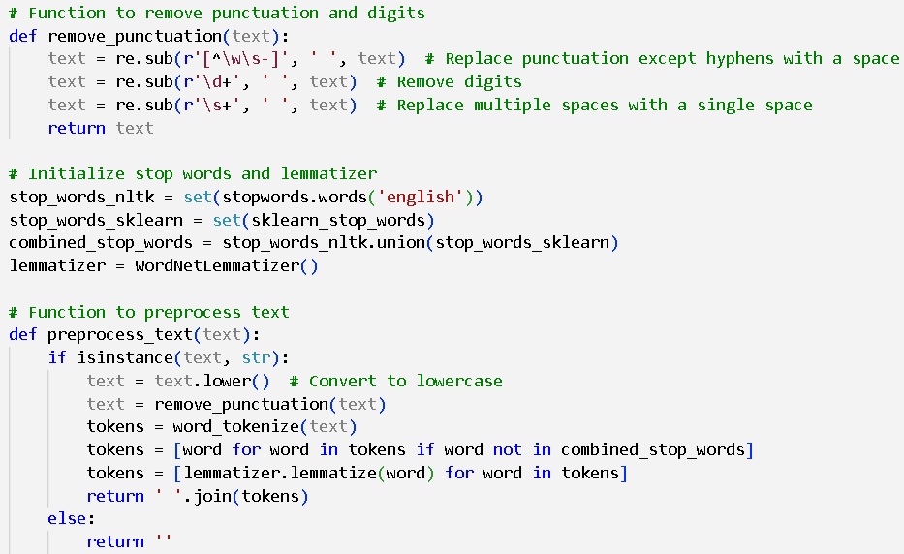
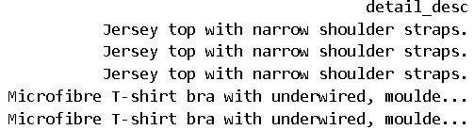
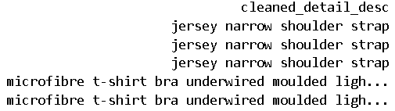
The preprocessing was done on the detail_desc column which is the description of an item.
SPLITTING OF TRANSACTIONS IN SAMPLED DATASET INTO TRAIN SET AND TEST SET USING TIME BASED SPLIT
The method used for Time Based Split is Rolling Window Split.
Rolling window used to ensure representation of all seasons
Rolling Window Split: Ensures that the training set covers different seasons, capturing seasonal patterns.
Seasonal Features: Adding month or season as features to help the model learn these patterns.
Stratified Sampling: Ensures that user segments are proportionally represented in both training and test sets.
{'new_users': 2911, 'medium_users': 36767, 'frequent_users': 124482, 'heavy_users': 253086, 'super_users': 288030} {'new_users': 3653, 'medium_users': 7034, 'frequent_users': 11453, 'heavy_users': 19010, 'super_users': 17752}
Total number of transactions in the sampled dataset: 764178
Number of transactions in train data : 665974
Number of transactions in test data : 98204 Train: 90% size Test: 10% size

Slide 12
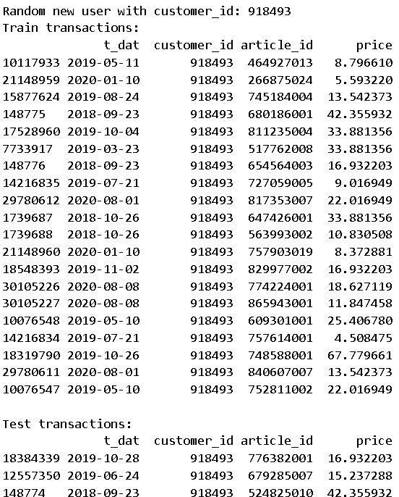
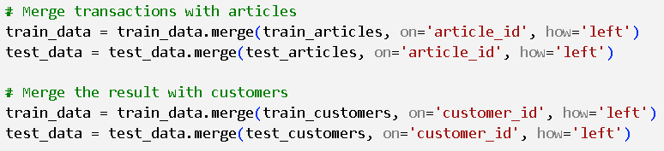


MERGING OF TRANSACTIONS, ARTICLES AND CUSTOMERS
I used left join to do the merging.
So, after merging, since we did a left join, there are customers in test set but not in train set.
So, there are 4437 – 3864 = 573 customers which are present in test set but not in train set.
This scenario can be useful for evaluating how well the model generalizes to new, unseen customers (cold-start problem).
So, we will use these 573 customers for cold-start cases.
We will give fallback recommendations as per most of the insights we learned from the trends and plots we get from analyzing the data.

Slide 13

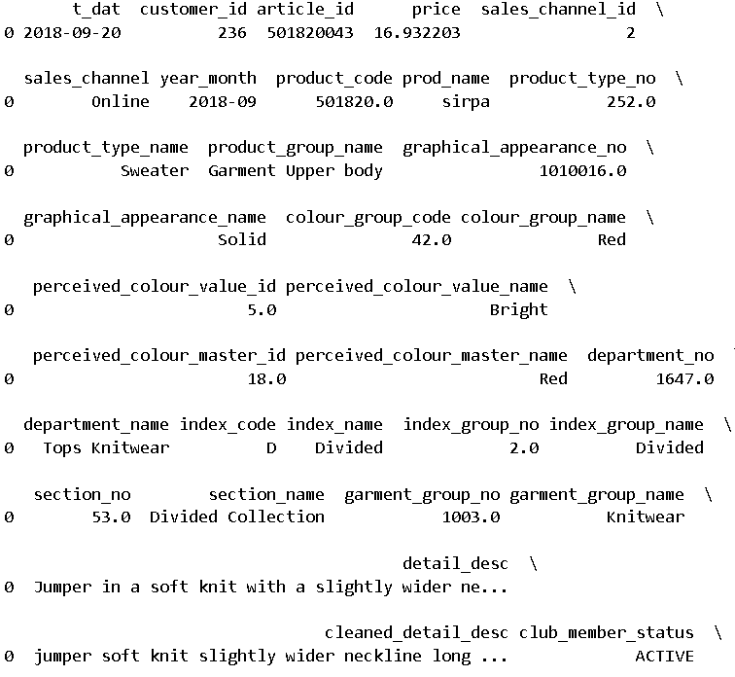
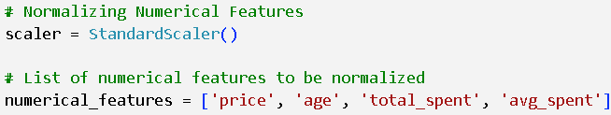

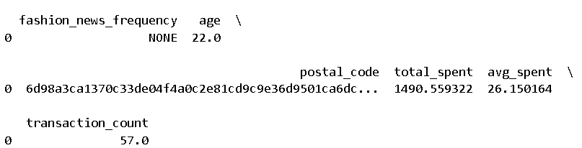



TRAIN DATA
We will do Word2Vec vectorization on detail_desc column.
We will do one hot encoding on all the item features.
The reason I do Vectorization and One Hot Encoding is that I need Numerical data as input for the models I am going to run. I am going to implement 1.) SVD using user-item interaction matrix. 2.) use item profile matrix and user profile matrix.
I will use StandardScaler on four features to ensure normalization.

Slide 14
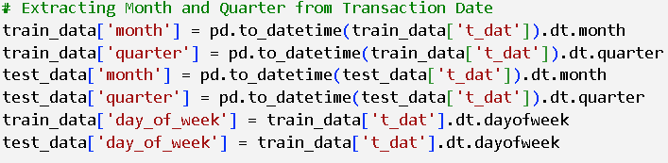
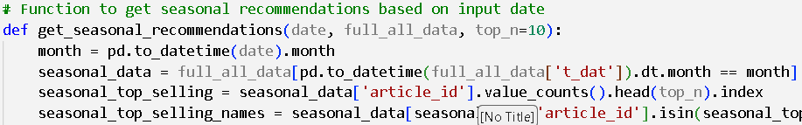

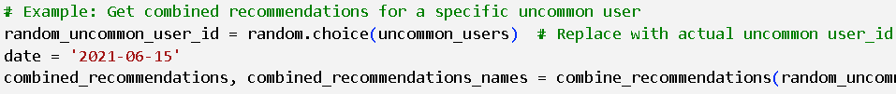
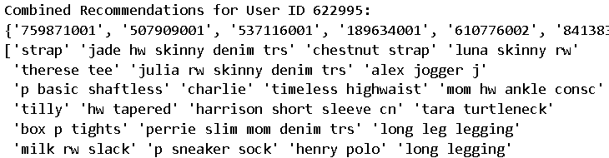
COLD START
Also, we will have a lot of user features like total_spent, average_spent , age, age_bracket, transaction count, user_segment and financial bracket, which we are going to use for cold start.
One-hot encoding transforms categorical features into binary vectors.
For Top N words of Word2Vec, I got
N = 52

Slide 15
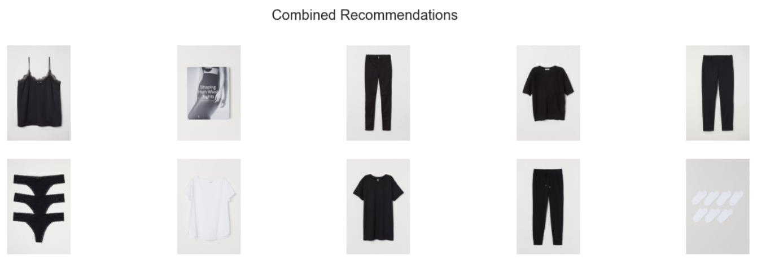
COLD START

Slide 16
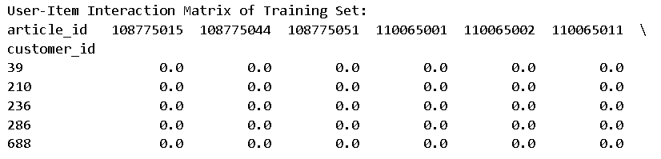
RECOMMENDATION MODEL
I am going to implement two models :-
1.) Collaborative Filtering => SVD using user-item interaction matrix.
2.) Content based Recommendation => use item profile matrix and user profile matrix.
USER ITEM INTERACTION MATRIX
Definition: A user-item interaction matrix is a matrix that records the interactions (e.g., ratings, purchases) between users and items.
Structure: Rows represent users, columns represent items, and the entries in the matrix represent the interaction value (e.g., rating, purchase count). We have used item purchased or not truth i.e. 0 for not purchased and 1 for purchased.
Purpose: It captures user preferences and is used to predict missing interactions for recommendation purposes.

Slide 17
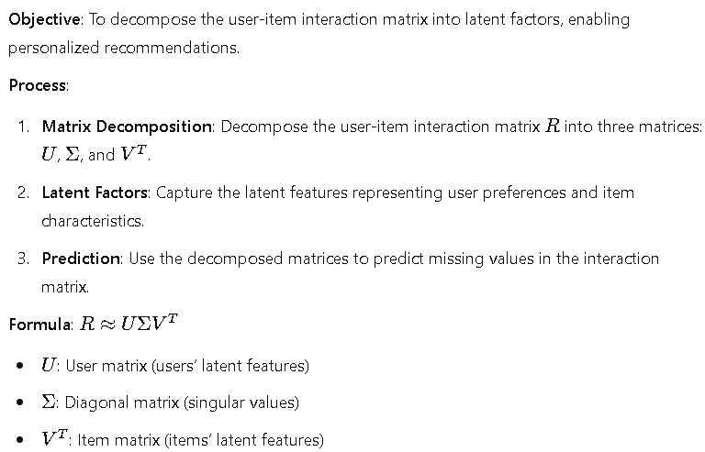
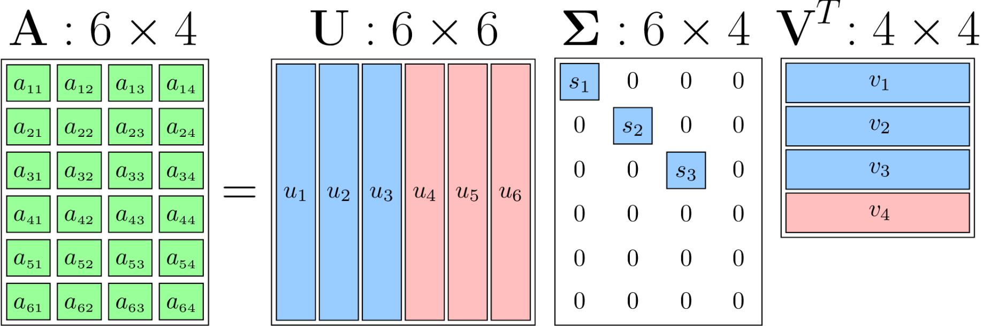
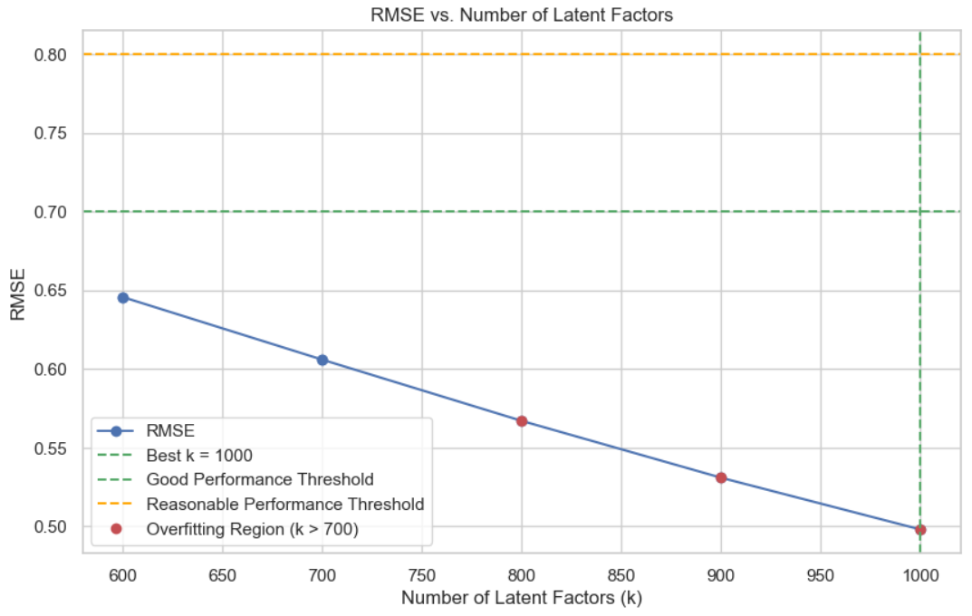
SINGULAR VALUE DECOMPOSITION (SVD)
The reconstructed matrix from decomposition will predict values for items the user has not interacted with.
For e.g. If user A and user B have rated several movies similarly, and user A liked a new movie that user B has not seen, recommend that new movie to user B.
SVD Hyper-Tuning
k = 700 is the sweet spot
K > 700 ... Overfitting and more time-complex.
RMSE for Binary Interactions (0 or 1):-
0.7 to 0.8: Generally considered reasonable.
< 0.7: Indicates good performance.
:> 0.8: May indicate room for improvement.

Slide 18
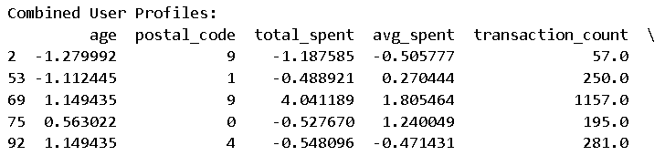
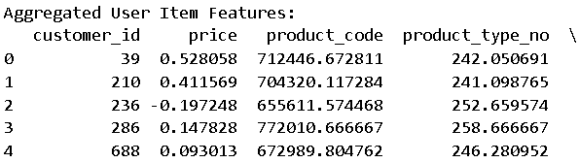
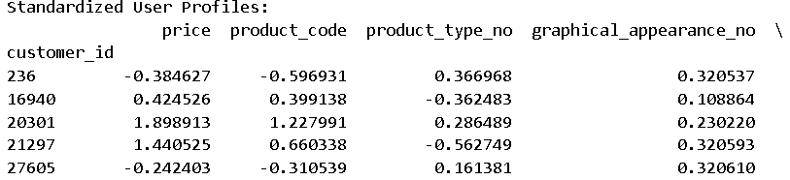
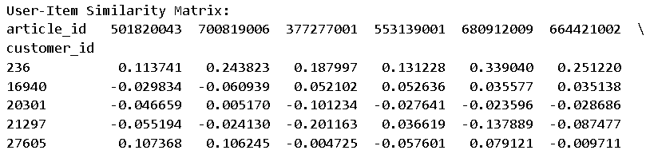
CONTENT BASED USING USER-ITEM FEATURE MATRIX
Summary
User Profile Matrix: Rows represent users, columns represent user features.
Item Profile Matrix: Rows represent items, columns represent item features.
User-Item Feature Matrix: Combined matrix used for computing similarities and recommendations.
Recommendation Process: Top-N items recommended based on highest similarity scores for each user.

Slide 19




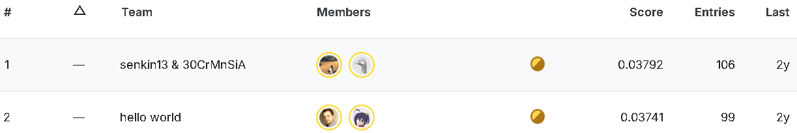
EVALUATION METRICS FOR BOTH RECOMMENDER MODELS
COLLABORATIVE FILTERING USING SVD
CONTENT BASED USING ITEM-USER FEATURE MATRIX
The reason why the evaluation metrics are low is because of the size of the dataset and the number of features.
In the Kaggle competition, the highest score in the leaderboard for MAP@12 evaluation metric is just 0.037.
They have trained on the whole dataset and also used very advanced recommender models not known to public.

Slide 20
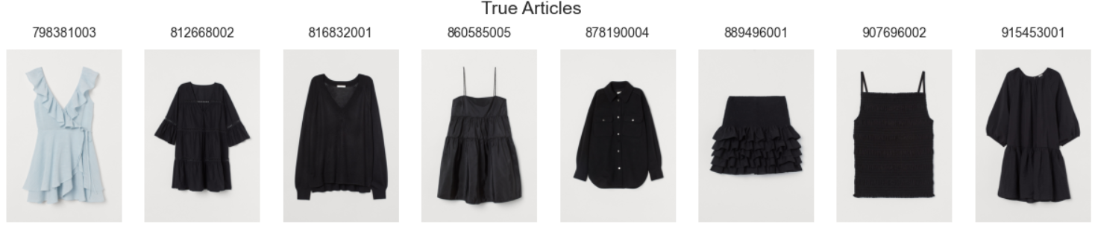
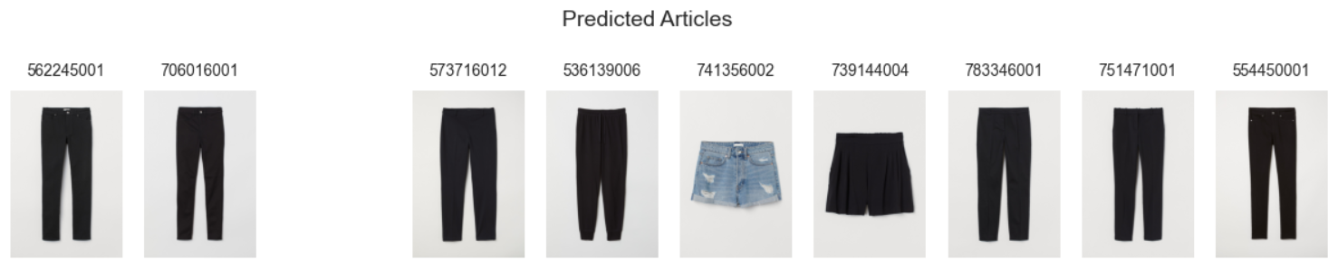
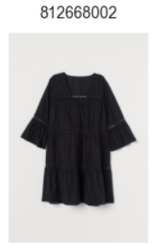
COLLABORATIVE FILTERING USING SVD AND USER-ITEM INTERACTION MATRIX

Slide 21
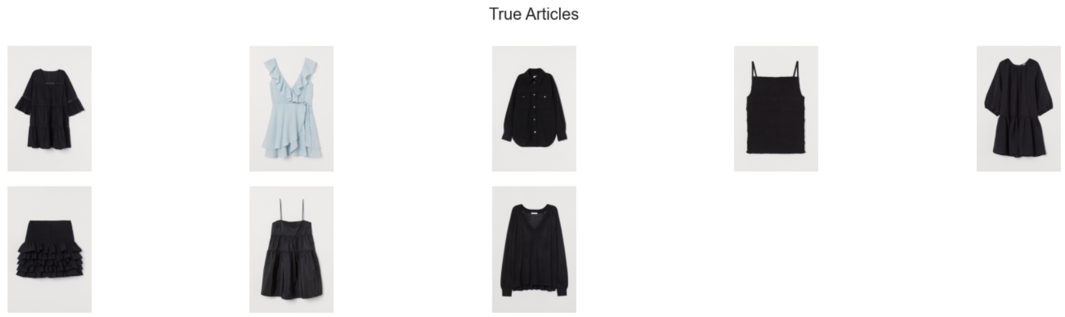
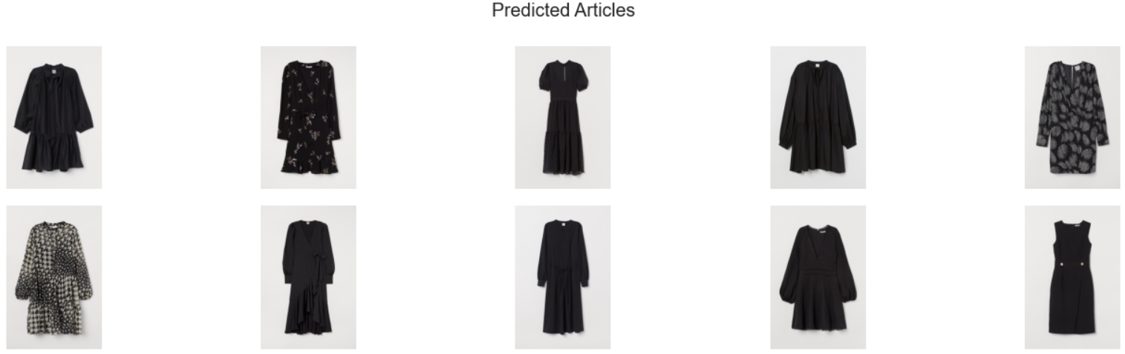
CONTENT BASED USING ITEM-USER FEATURE MATRIX

