Slide 1
SECRET MEDIA ENCRYPTION AND DECRYPTION OVER IMAGE
PRESENTED BY
P SAI SANDEEP
ALOK VISHWAKARMA
SEGGARI KOUSHIK

Slide 2

IN THIS PRESENTATION
INTRODUCTION
STEGANOGRAPHY
TECHNIQUES IN STEGANOGRAPHY
UNDERSTANDING THE IMAGE
IMAGE STEGANOGRAPHY
LSB TECHNIQUE
STEGANALYSIS
ADVANTAGES AND DISADVANTAGES
APPLICATIONS
CONCLUSION

Slide 3
INTRODUCTION TO STEGANOGRAPHY
A form of security through obscurity
The art of hiding data in a file so that only the sender and intended recipient suspect the presence of hidden data
Very easy to accomplish
Harder to detect and decrypt
File formats supported BMP, JPG, HTML/XML, PDF, PNG, GIF, MP3, AVI, DLL, EXE

Slide 4
UNDERSTANDING THE IMAGE
What are images made up of?
Images are made up of lots of little dots called pixels. Each pixel is represented by three bytes- one for red, one for green, one for blue.
11111000 11001001 00000011
248 201 220
Each byte is interpreted as an integer number, which is how much of that colour is used to make the final colour of the pixel.

Slide 5
COLOR PERCEPTION
The difference between two colors that differ by one bit in either one red, green or blue value is impossible to detect for a human eye.
So we can change the least significant(last) bit in a byte, we either add or subtract one or more values from the value it represents.
This means that we can overwrite the last bit in a byte without affecting the color it appears to be.
10000110
10000111

Slide 6
IMAGE STEGANOGRAPHY
Images are used as the message carriers. Images are the most popular cover objects used for steganography.
Image steganography requires the following elements.
Cover medium: it is an image that holds secret message.
The secret message: it is message to be transmitted. It can be plain or encrypted text, images or any other data.
The image compression techniques are extensively used in steganography.
Two types of compression techniques are:
Lossy compression.
Lossless compression.

Slide 7
LEAST SIGNIFICANT BIT TECHNIQUE
The most common and popular method of modern’s day steganography is to make use of LSB of picture’s pixel information.
This technique works best when the file is longer than the message file and if image is grayscale.
When applying LSB techniques to each byte of a 24 bit image, three bits can be encoded into each pixel.
If the LSB of the pixel value of the cover image C(i,j) is equal to the message bit SM of the secret message to be embedded, C(i,j) remain unchanged; if not, set the LSB of C(i,j) to SM.

Slide 8
Example:
We can use images to hide things if we replace the last bit of every color's byte with a bit from the message.
Message A- 01000001
Image with 3 pixels
Pixel 1: 11111000 11001001 00000011
Pixel 2: 11111000 11001001 00000011
Pixel 3: 11111000 11001001 00000011

Slide 9
Now we hide our message in the image.
Message: 010000001
Pixel 1: 11111000 11001001 00000010
Pixel 2: 11111000 11001000 00000010
Pixel 3: 11111000 11001001 00000011

Slide 10
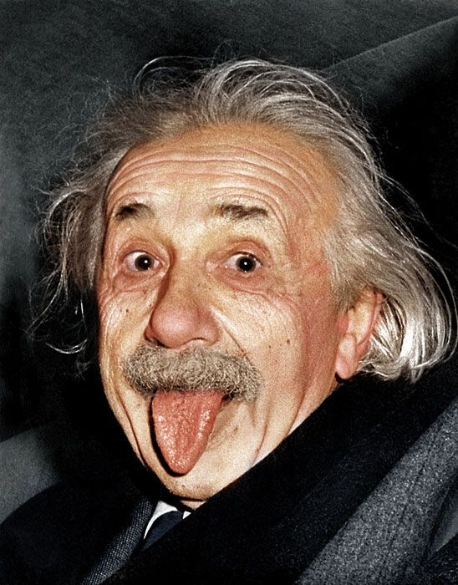
Albert Einstein
Cover image
Setganographic image

Slide 11
Steganalysis
Analyzing images for possible hidden data
Many algorithms perform a statistical analysis to detect anomalies in the cover object
E.g. repetitive patterns could indicate use of a steganography tool or hidden message
Investigating pixel “neighborhoods” to find inconsistencies with ways files are compressed.

Slide 12
Advantages OF IMAGE STEGANOGRAPHY
The advantages of steganography is that messages do not attract attention to themselves. Plainly visible encrypted messages-no matter how unbreakable- will arouse suspicion, and may in themselves be incrimination in countries where encryption is illegal. Therefore steganography can be said to protect both messages and communication parties.
This method featured security, capacity, and robustness, the three needed aspects of steganography that makes it useful in hidden exchange of information thorough text documents and establishing secret communication.
Important files carrying confidential information can be in the server in the encrypted from. No intruder can get any useful information form the original file during transmit.
With the use of steganography corporation government and law enforcement agencies can communicate secretly.

Slide 13
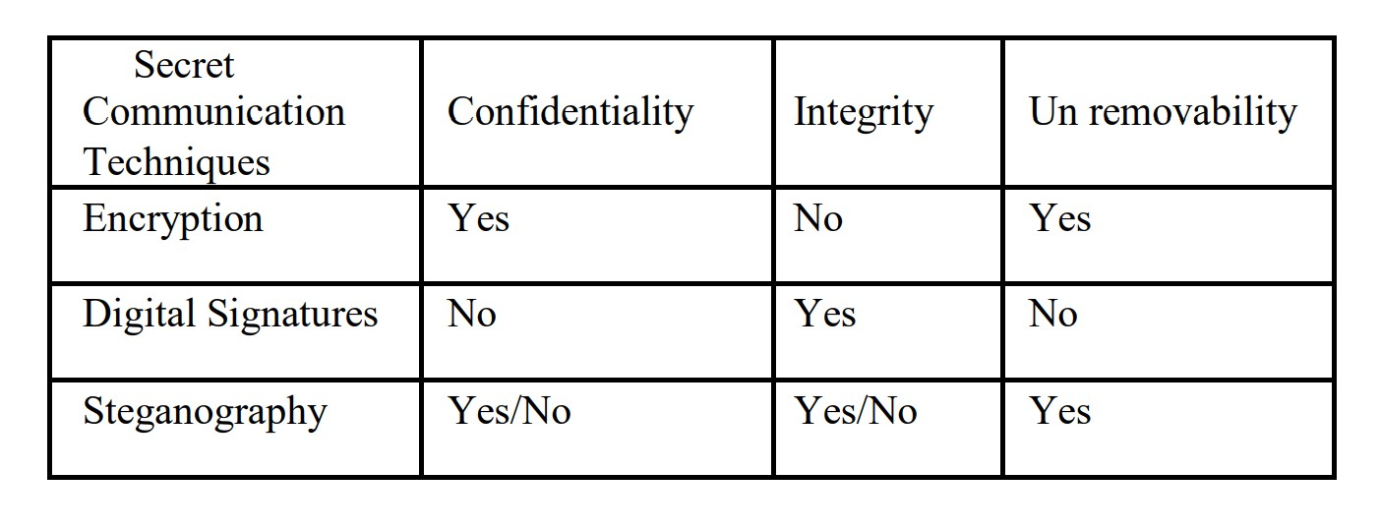
COMPARISON OF SECRET COMMUNICATION TECHNIQUES

Slide 14
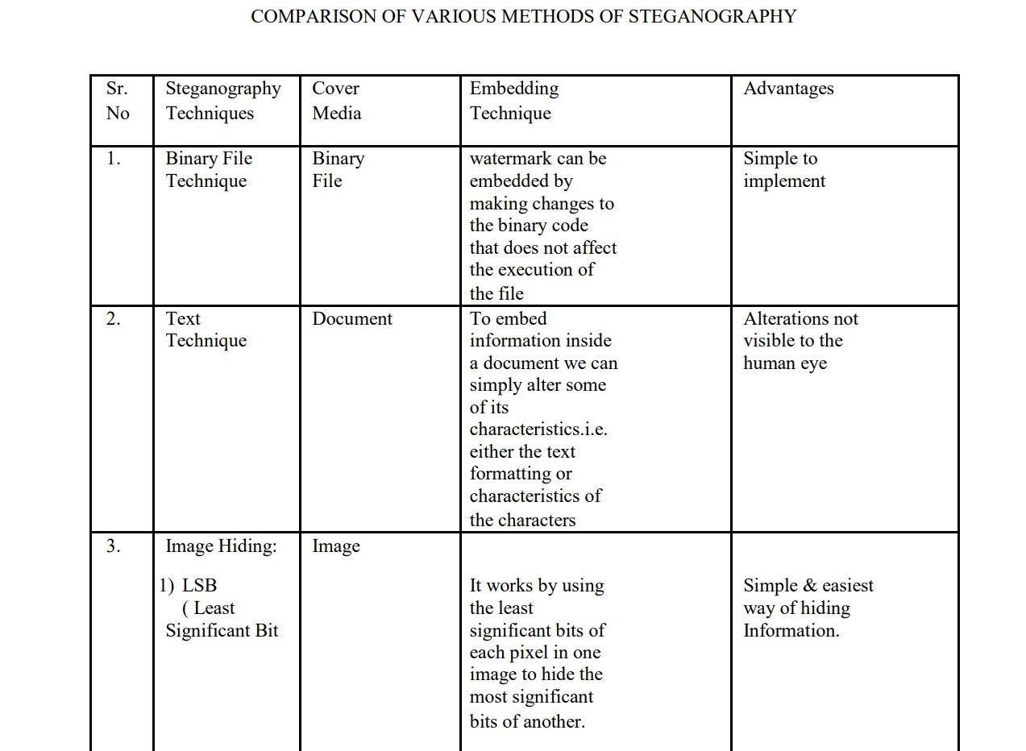
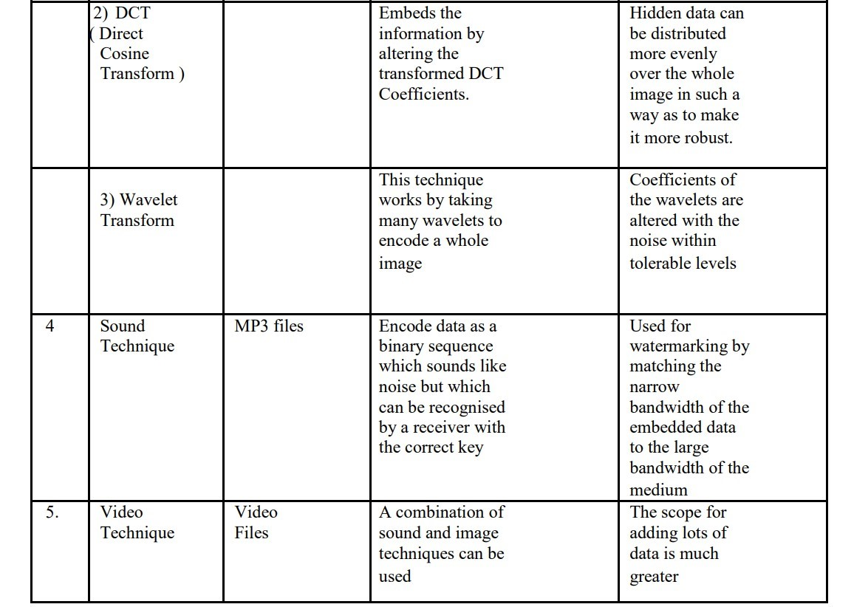
COMPARISON OF VARIOUS METHODS OF STEGANOGRAPHY

Slide 15

CONCLUSION
Hiding a message with steganography method reduces the chance of a message being detected.
Like any tool, steganography is neither inherently good nor evil, it is the manner in which it is used which will determine whether it is a benefit or a detriment to our society.

Slide 16
REFERENCES
W.Gonzalez, “Digital Image Processing”, 2nd ed
Rafael C. Gonzalez, Richard E. Woods, Steve L. Eddins, Digital Image Processing Using MATLAB, 2003
www.geeksforgeeks.org/lsb-based-image-steganography-using-matlab/amp/

Slide 17
THANK YOU FOR YOUR TIME

