Slide 1
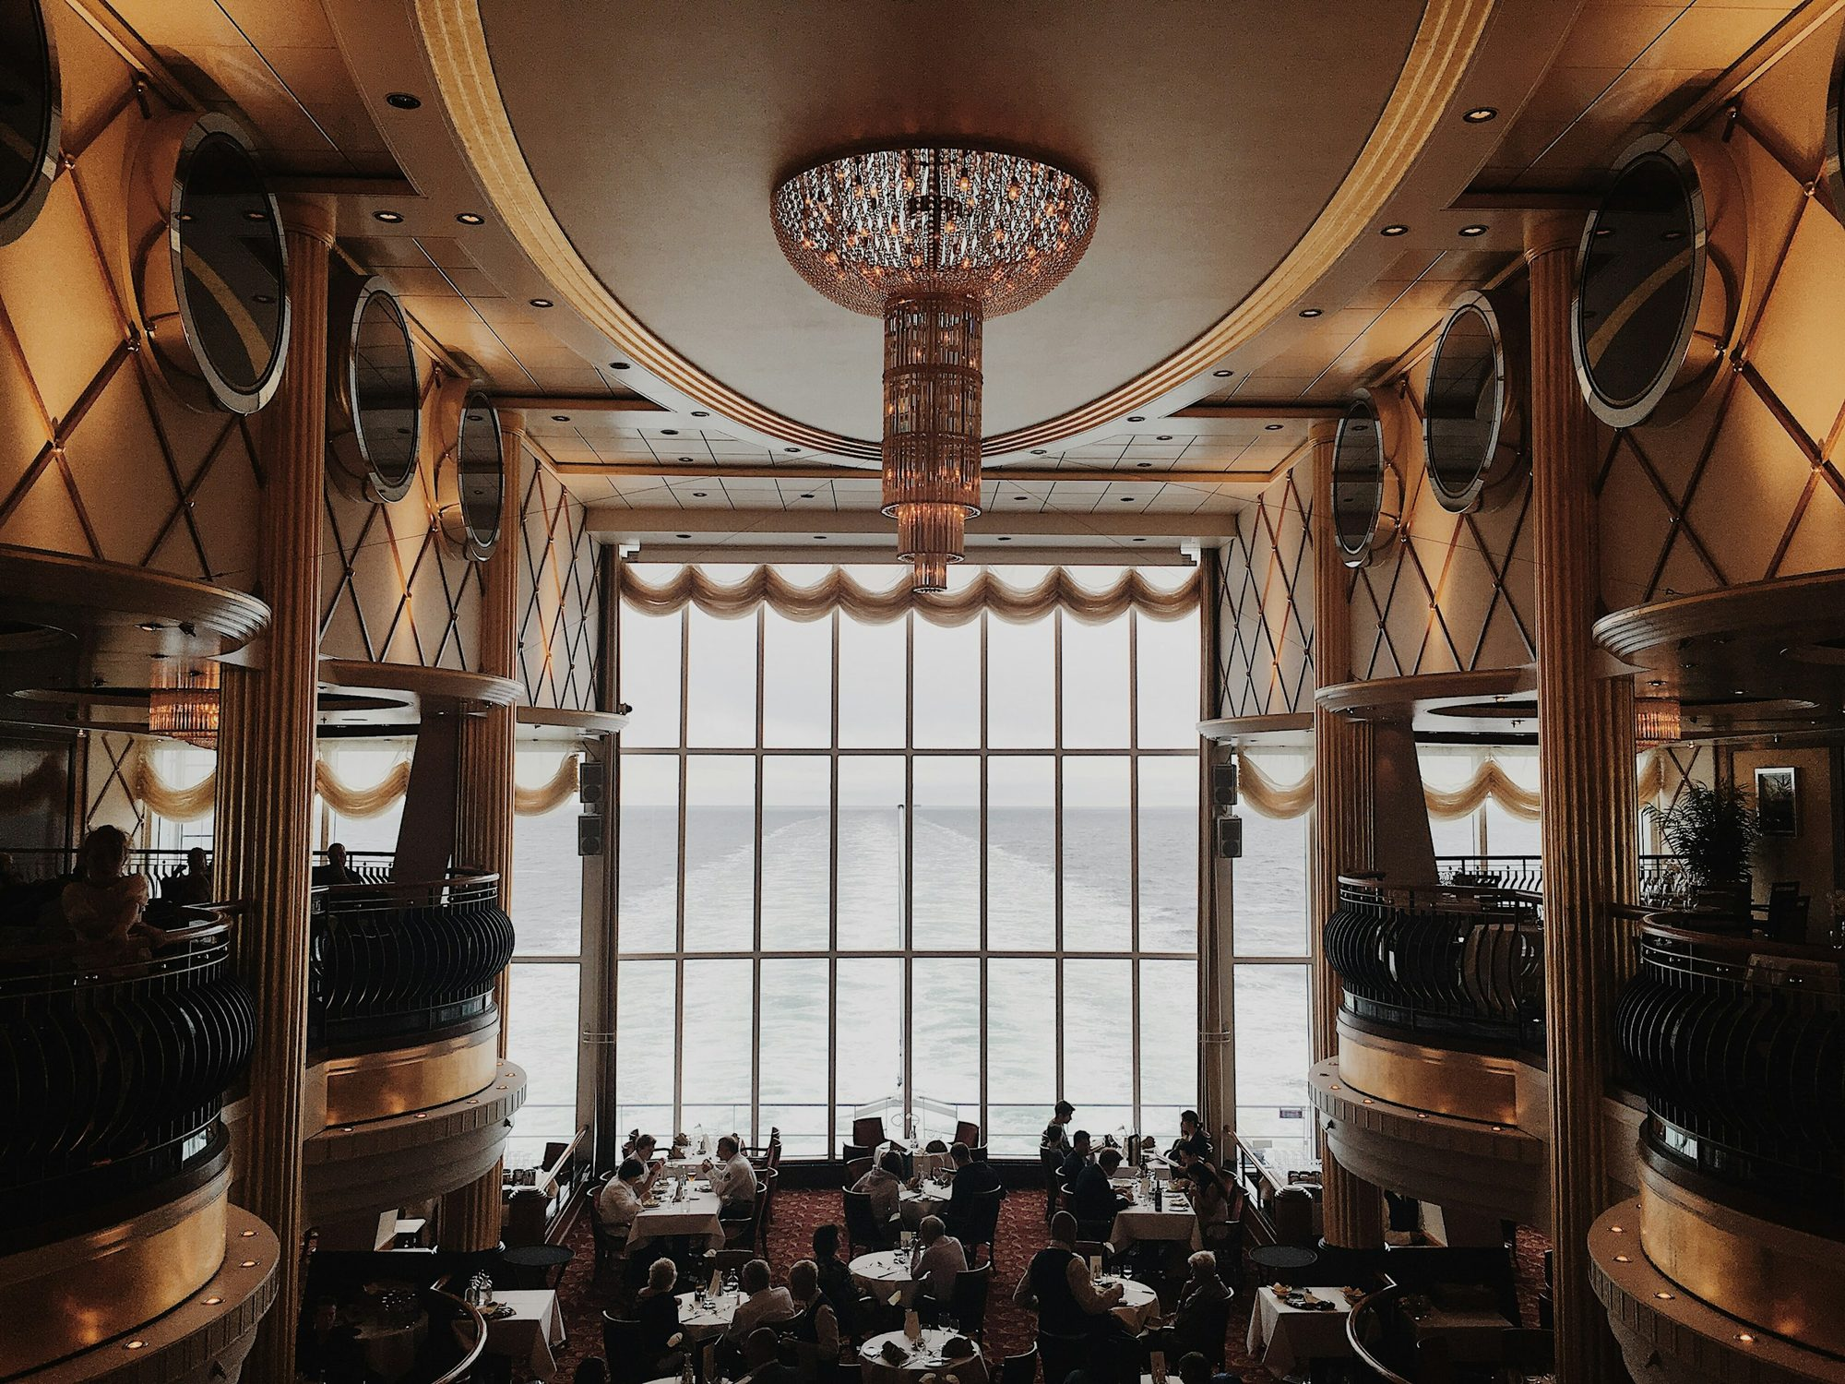

Three kitchens.
One table.
Website, online ordering, reservations and the Interest Account for Lagos’s Nigerian, Polish and Continental restaurant
CLIENT PRESENTATION
Notes:
Welcome and thank everyone for their time. Introduce yourself in one line. Say the purpose: in the next 15 minutes you will show the finished Small Africa platform: the website, ordering and payments, reservations, the Interest Account loyalty programme and the admin panel. Mention that everything they will see is working software, not a mock-up, and that they can try it on their own phones at the end (QR code on slide 17).

Slide 2
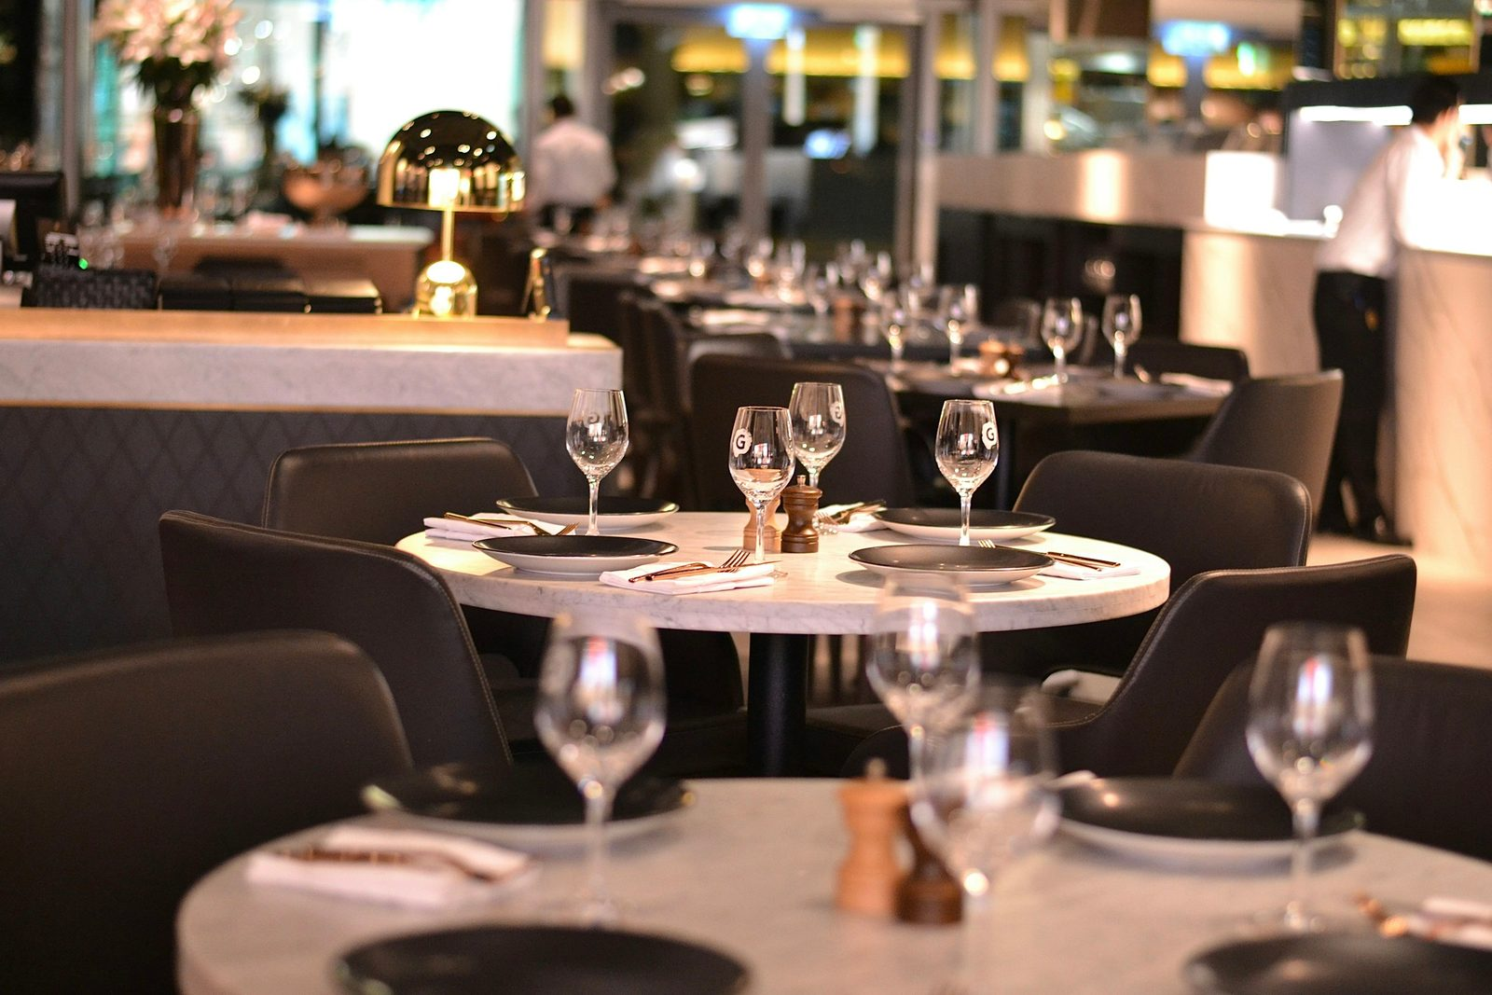
The table Lagos talks about, and the easiest one to book
01 · VISION
Small Africa brings three kitchens together under one roof, cooked properly and served with care. The website has to feel like the restaurant: warm, confident and luxurious. And it has to work hard.
1
Nigerian
Smoky party jollof, suya, egusi
2
Polish
Pierogi, żurek, pączki
3
Continental
Beef Wellington, lobster thermidor
Notes:
The vision in one sentence: the most talked-about table in Lagos, and the easiest one to book. Nobody else in Lagos puts Nigerian, Polish and Continental cooking at this level in one room, which is the story the brand and the website tell. Point to the three kitchens and their colours: they appear everywhere in the site, from the menu filters to the admin charts.

Slide 3
Great food is not enough to fill a room
02 · THE PROBLEM
1
Diners decide on their phone
2
Bookings get lost
They find restaurants on Instagram and Google Maps and leave if the menu is slow, a PDF, or out of date.
Reservations arrive by DM, WhatsApp and phone calls. Nobody sees capacity at a glance, so tables sit empty or get double-booked.
3
Delivery apps own the customer
4
No reason to come back
They take a commission on every order and keep the customer’s details and loyalty.
Without a loyalty programme, a great first visit doesn’t turn into a regular.
Notes:
These are the four problems the platform solves. Ask the client which one costs them most today; usually it is bookings and repeat visits. Keep it short: one sentence per card. The next slide shows the answer.

Slide 4
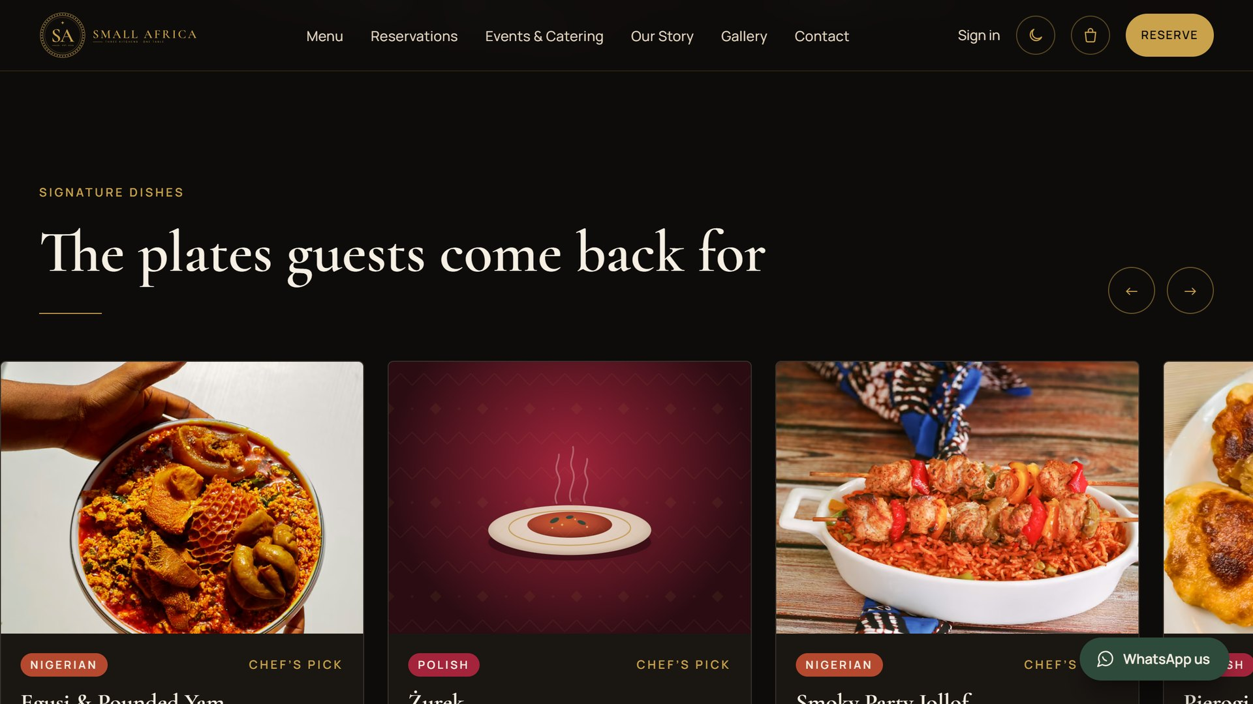
One platform for the guest and the team
03 · THE SOLUTION
A fast, beautiful website
Menu with photos and filters, about, gallery, events, contact, FAQ
Online ordering and payments
Delivery or pickup, scheduling, coupons, Paystack
Reservations
Live availability by area and time, confirmed by the front desk
The Interest Account
Dining credit that earns interest, points, tiers and rewards
The admin panel
Orders, kitchen, bookings, menu, customers, rewards, staff
Notes:
Everything the restaurant needs is in one system that the team controls. No separate booking tool, no separate loyalty app. Each of the five items gets its own slide and a live demo in a moment.

Slide 5
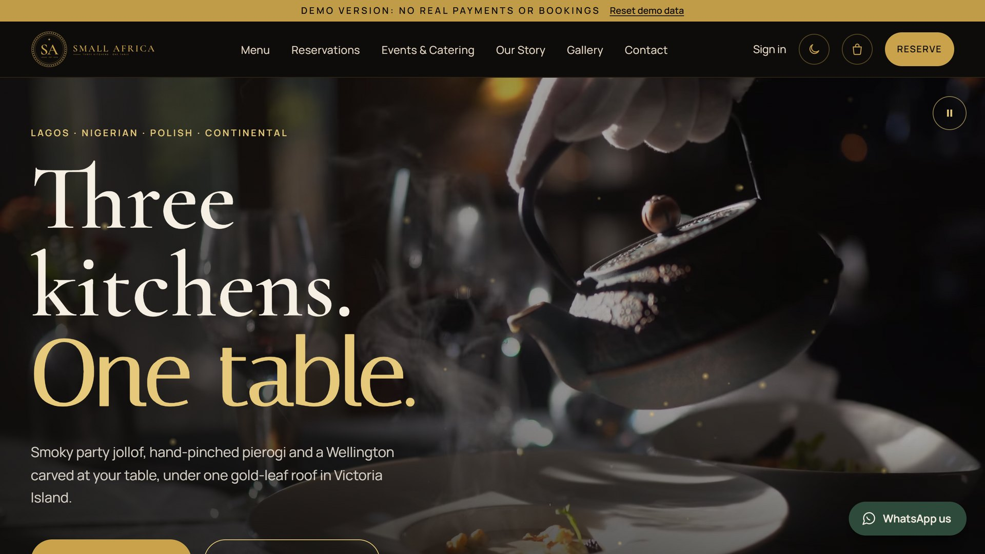
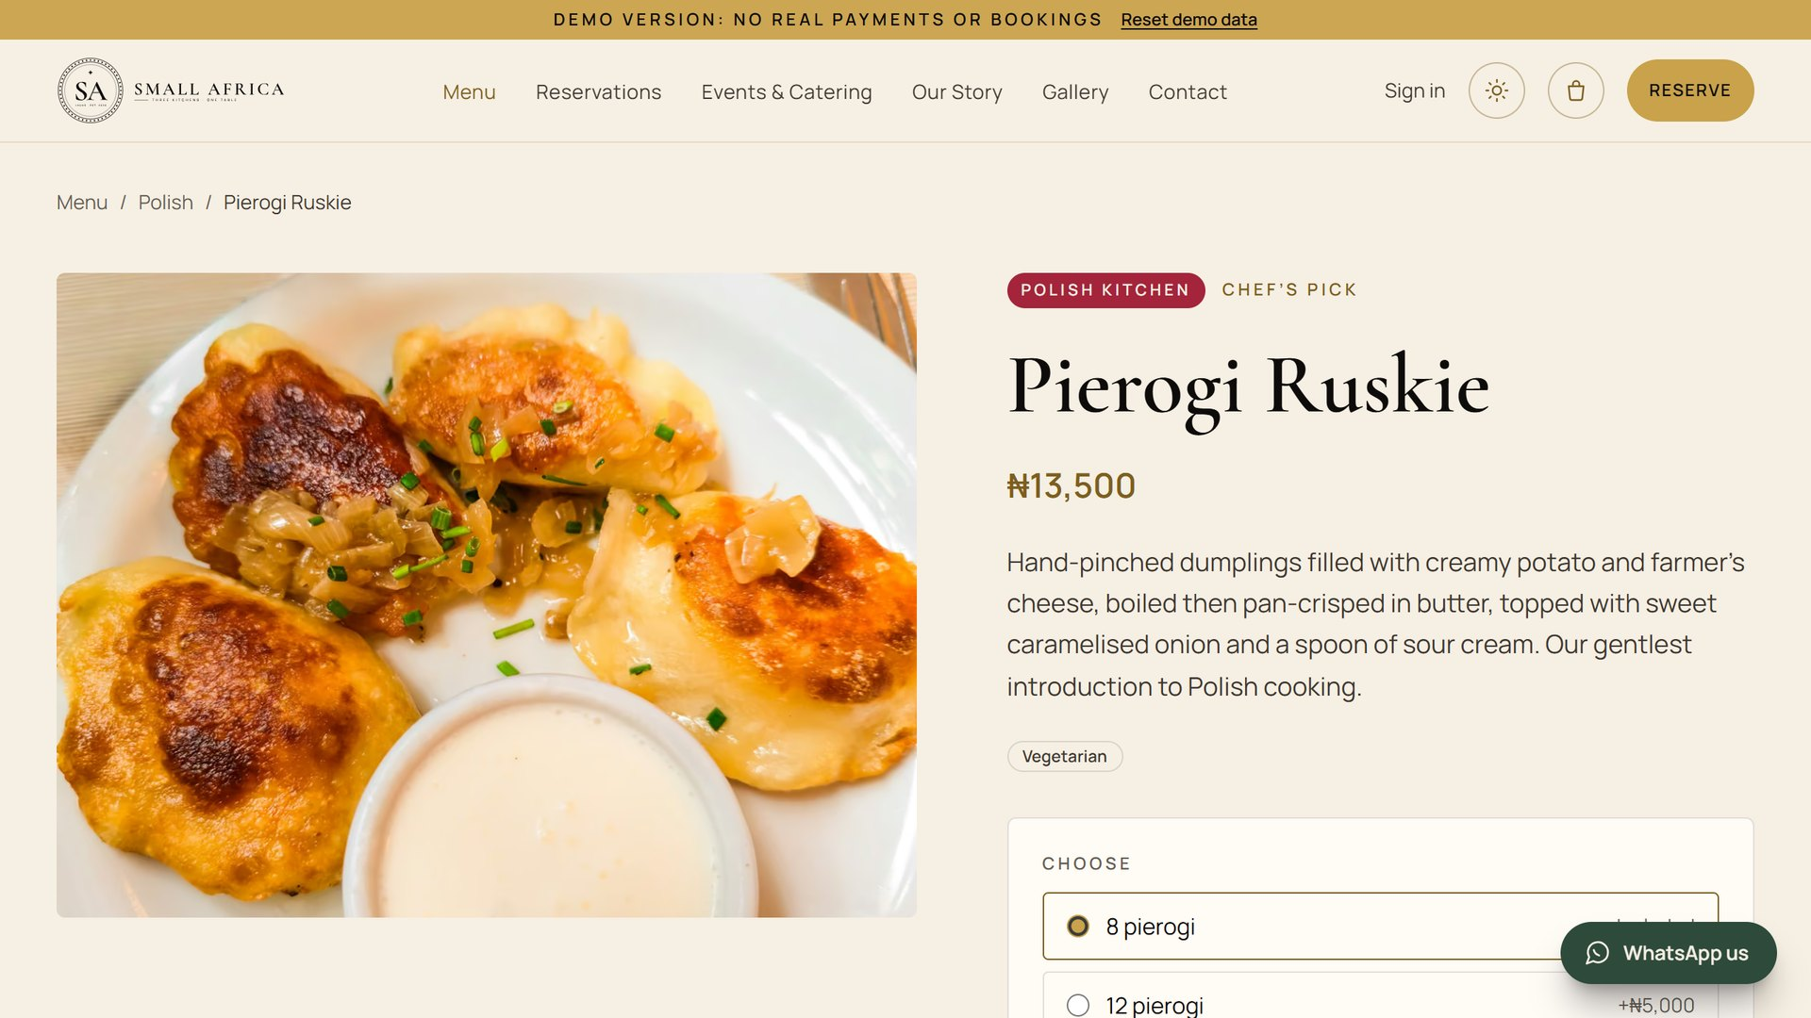
Gold on obsidian, with the warmth of three kitchens
04 · BRAND IDENTITY
Cormorant Garamond
Headings and dish names
Manrope
The SA monogram crest
Text, prices and buttons
One table.
Italiana, for the tagline only
Obsidian
Ebony
Ivory
Sand
Dark by default, with a light theme for daytime. Guests choose, or follow their phone.
Gold
Nigerian
Polish
Continental
Notes:
The brand was designed first, then the website was built from it. Obsidian and gold for luxury; a colour for each kitchen. Three typefaces: Cormorant Garamond for headings, Manrope for everything you read, and Italiana only for the tagline. Show the dark and light themes: the site follows the guest’s phone setting or their choice. The brand guide PDF, Instagram templates and an A4 menu card are in the design folder.

Slide 6
From a post on Instagram to a regular at the table
05 · CUSTOMER JOURNEY
1
2
3
4
5
6
Discover
Browse
Order or book
Pay
Track
Return
Instagram, TikTok, Google Maps or a friend’s referral link
Menu by kitchen, photos, allergens, “No pork” filter
Delivery, pickup or a table in seconds
Paystack: card, bank transfer or USSD
Live order status and booking confirmation
Points, interest on dining credit, birthday rewards
Every step works on a phone, and every step brings the guest back to Small Africa’s own website, not a third-party app.
Notes:
Walk the journey left to right. The important point is the last step: “Return”. The Interest Account and points turn a first visit into a habit. Because orders and bookings happen on the restaurant’s own site, Small Africa keeps the customer relationship and pays no commission.

Slide 7
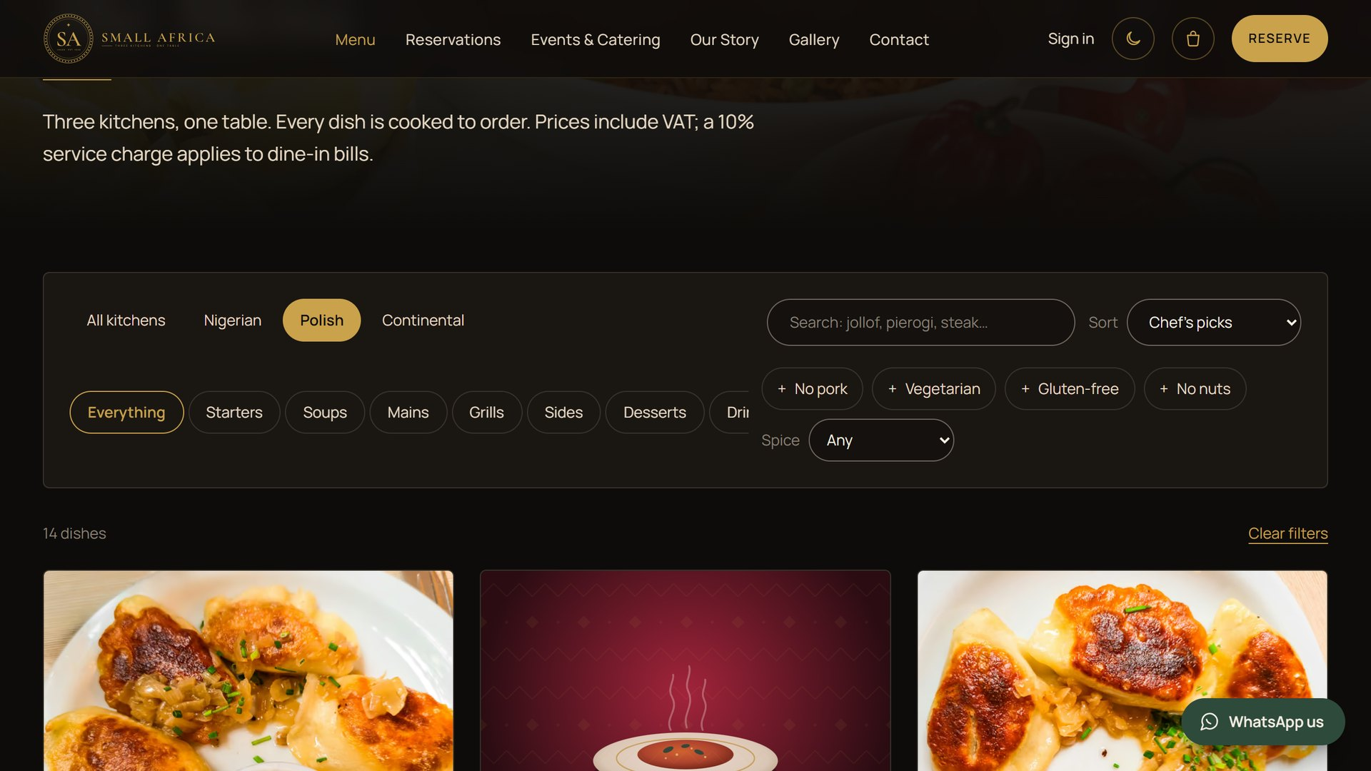
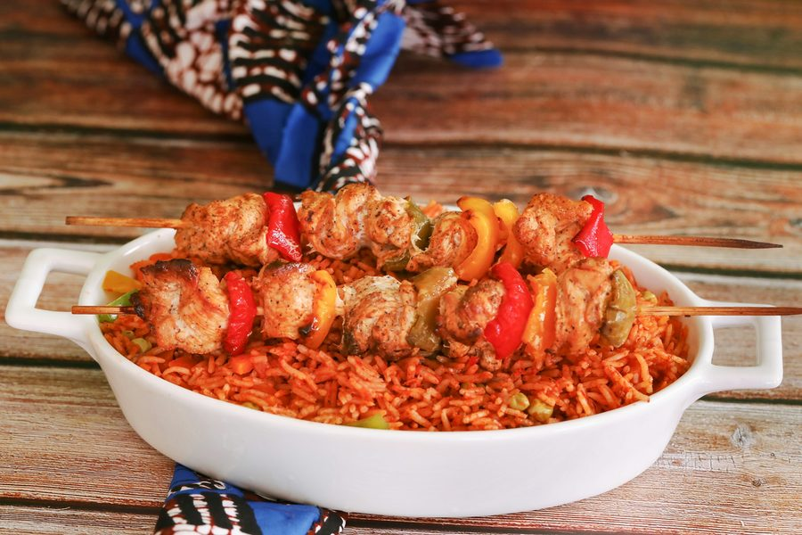
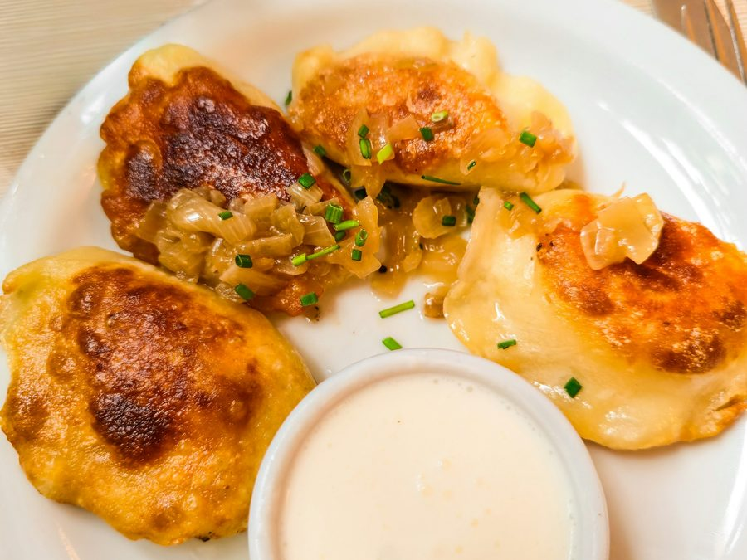
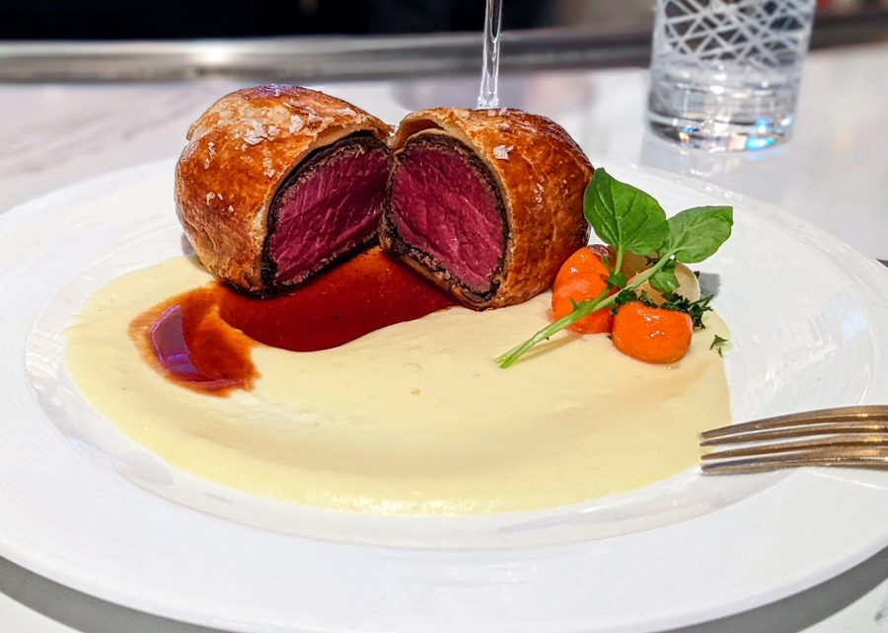
Fifty-four dishes, each with its own page
06 · MENU & THREE KITCHENS
Nigerian
Smoky Party Jollof
Polish
Pierogi Ruskie
Continental
Beef Wellington
Filter by kitchen, dietary needs and “No pork”
Allergens, spice level and photos on every dish
Prices, photos and sold-out changed in the admin
Notes:
Demo: open the menu, filter by Polish, then tick “No pork”: an important filter for many Lagos guests. Open Smoky Party Jollof to show a dish page. Every dish has its own page, so Google can find “pierogi in Lagos” or “party jollof Victoria Island”. The kitchen changes prices and marks dishes sold out from the admin, with no developer needed.

Slide 8
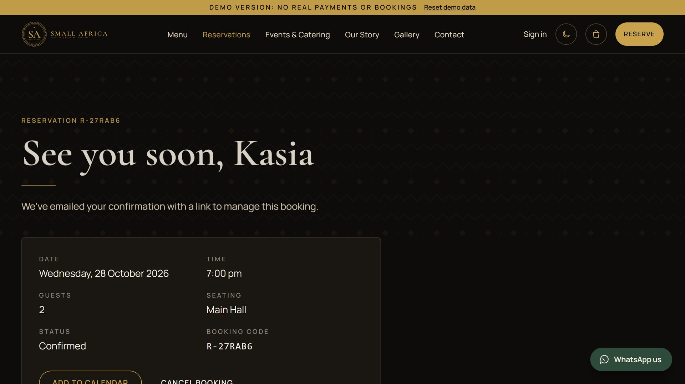
Tables that book themselves
07 · RESERVATIONS
Live availability
Only times with space are offered, per seating area
Four areas
Main Hall, Lounge, Terrace and Private Dining
Up to 12 guests online
Larger groups and events go to an enquiry form
Front desk view
Confirm, seat, move or cancel; capacity at a glance
Notes:
Demo: pick tomorrow, four guests, the Terrace, and a time. The booking appears straight away in the front-desk view in the admin. Capacity is set per area and time slot, so the site never offers a table that isn’t there. Weddings, corporate events and private dining come in through the Events page as enquiries.

Slide 9
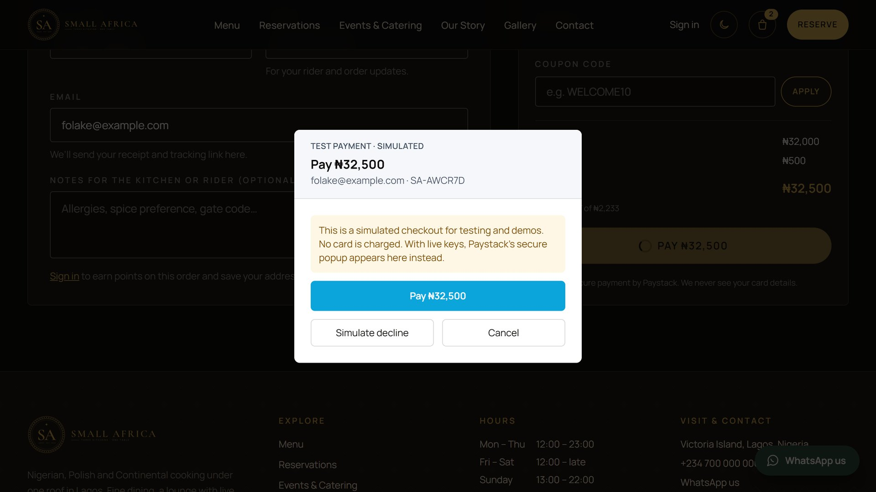
Order in a minute, pay the way Lagos pays
08 · ONLINE ORDERING & PAYMENTS
Delivery or pickup
Seven delivery zones with their own fee and time
Order now or schedule
Up to 7 days ahead, within opening hours
Clear totals
VAT included, packaging fee, coupons such as WELCOME10
Paystack
Cards, bank transfer and USSD; every payment checked with Paystack
Notes:
Demo: add Jollof and Pierogi, check out for pickup later today, apply WELCOME10, and pay in the Paystack window. In the demo the Paystack window is simulated; on the live site it is the real one. Card details never touch our server, and an order is only confirmed after the payment is verified with Paystack.

Slide 10
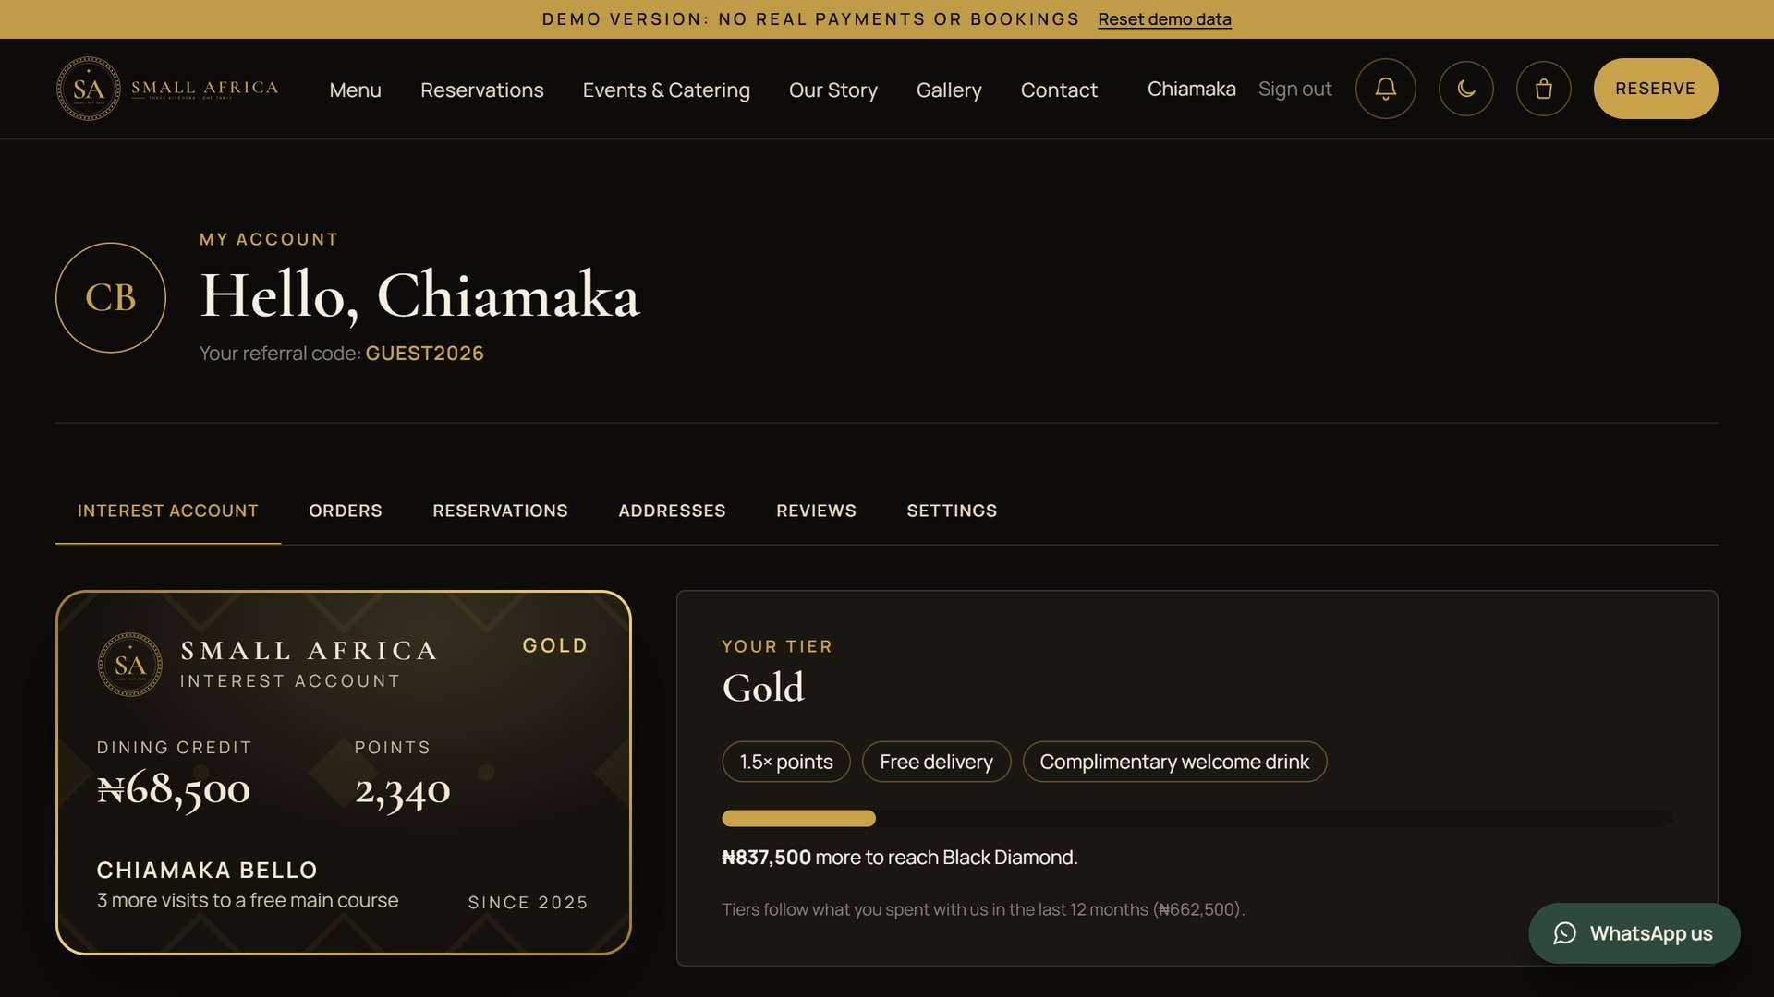
Dining credit that earns interest
09 · ORDER TRACKING & THE INTEREST ACCOUNT
2%
monthly interest on balances of ₦20,000+, up to ₦5,000
10%
bonus credit on top-ups of ₦100,000 (5% from ₦50,000)
4 tiers
Bronze, Silver, Gold and Black Diamond, up to 2× points
Interest is paid as dining credit, which can only be spent at Small Africa. It’s a loyalty programme, not a bank account. Guests also follow every order live, from paid to ready.
Notes:
Demo: sign in as the guest member: Gold tier, ₦68,500 balance, 2,340 points. Top up ₦50,000 and show the bonus. Explain simply: guests put money on their account, get a bonus, and every month balances of ₦20,000 or more earn 2% as extra dining credit, capped at ₦5,000. Money on account brings them back. Be clear it is dining credit, not a savings product; we recommend a lawyer reviews the Rewards Terms before launch. Also mention the live order tracking page.

Slide 11
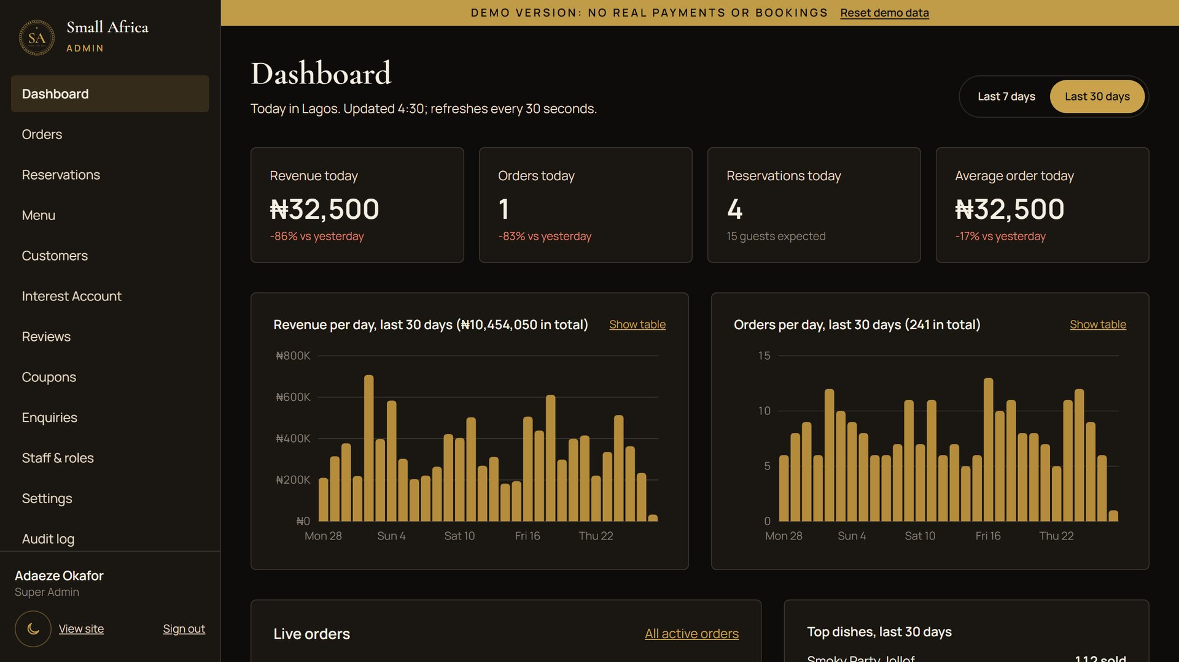
The whole restaurant on one screen
10 · ADMIN DASHBOARD
Dashboard
Revenue, orders by kitchen, busy hours
Orders & kitchen
Tickets move from paid to ready
Menu manager
Dishes, prices, photos, sold out
Rewards manager
Interest, points, tiers, offers
Roles & audit log
Each person sees only their job
Notes:
Switch to the admin window. The dashboard is the manager’s morning screen: revenue, orders per kitchen and busy hours. Open the order you just placed and move it to “Preparing”. Then show the menu manager and the Interest Account manager, including “Simulate month-end interest” (demo only). Roles: Super Admin, Manager, front desk and kitchen. The kitchen can’t see revenue and the front desk can’t change prices. Every change is recorded in the audit log.

Slide 12
Built to protect guests, payments and the business
11 · SECURITY & DATA PROTECTION
Payments
Accounts
Permissions
Card details stay with Paystack. Every payment and webhook is verified.
Strong passwords, two-factor sign-in for staff, sign-out when idle.
Four roles with only the access each job needs; an audit log of every change.
The website
Money on account
Privacy
HTTPS, a strict security policy, protection against common attacks.
Every balance comes from ledgers that are only ever added to, never edited.
Nigeria Data Protection Act 2023: clear policy, consent for marketing.
Notes:
Reassure, don’t lecture. Card details never reach our server. Staff accounts use two-factor sign-in. Each role only sees what it needs, and the audit log records who changed what. Interest Account balances are calculated from ledgers that are never edited, only added to, and a reconcile check confirms every balance matches them. The code is covered by 321 automated tests. The privacy policy follows Nigeria’s Data Protection Act 2023.

Slide 13
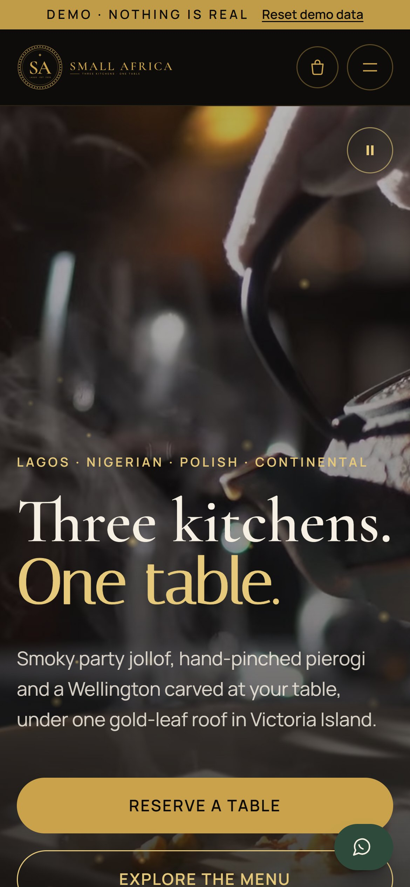
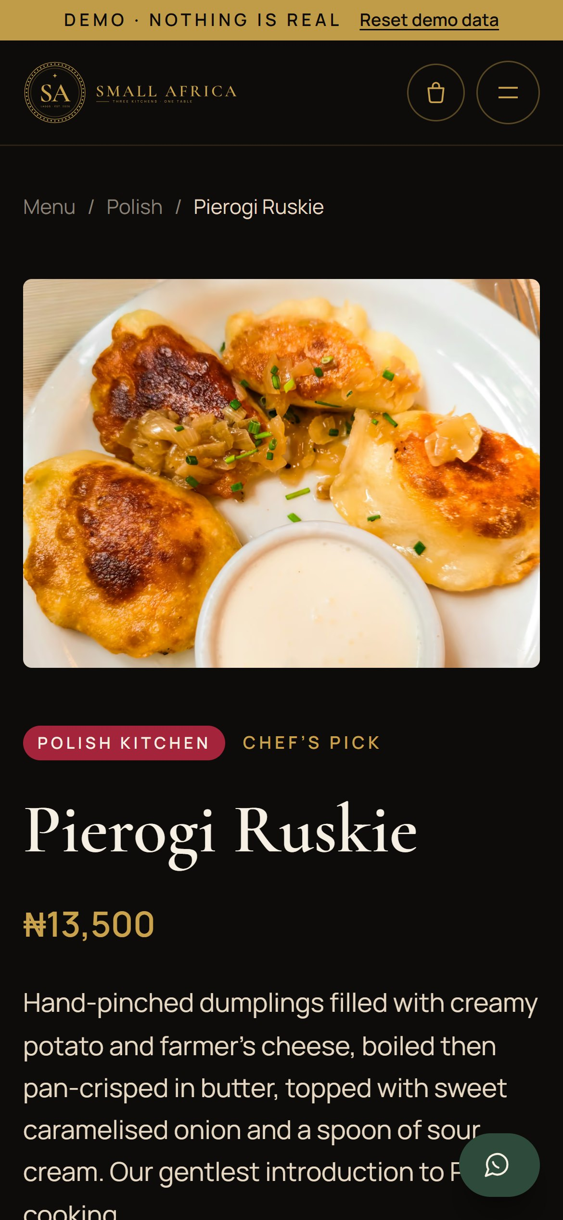
Fast on a phone, even on a weak signal
12 · PERFORMANCE & MOBILE
Google Lighthouse, lowest score across all public pages
Mobile
Desktop
91
100
Performance
100
100
Accessibility
100
100
Best practices
100
100
SEO
Public pages are ready-made HTML, so phones show them straight away. Tested on iPhone, Android and iPad.
Notes:
Lighthouse is Google’s own test for speed, accessibility, good practice and search. These are the lowest scores across every public page, so every page is at least this good. Mobile is the hard one: Lighthouse simulates a mid-range phone on a slow 4G connection. The public pages are pre-built as ready-made pages, so they appear straight away. Hold up your phone and open the live demo now.

Slide 14
Ninety days to a full room and a thousand members
13 · MARKETING PLAN
01
02
03
04
Google profile
30-day social calendar
Influencers
WhatsApp Business
Maps listing with photos, hours, Reserve and Order links
Instagram Reels and TikTok, daily
Lagos food creators, each with a code
Catalogue linked to every dish
05
06
07
08
Chowdeck & Glovo
Polish community
Corporate lunches
Reviews
A delivery menu that travels well
Embassy, groups and Taste of Home nights
Express lunch and client packages
100 Google reviews at 4.5★ in 90 days
Notes:
The full plan is in docs/MARKETING_PLAN.md, with a day-by-day 30-day calendar. Highlights: Google Business Profile first, because that is how Lagos finds restaurants. Influencers each get their own coupon code, so the admin panel shows exactly which creator brought orders. The Polish community is a unique audience nobody else serves. Corporate lunches fill the quiet weekday hours. The goal: 1,000 Interest Account members and 100 Google reviews in 90 days.

Slide 15
From approval to opening night, then growth
14 · ROADMAP
NOW
WEEKS 1–2
WEEK 3
WEEK 4
MONTHS 2–3
Approve
Prepare
Soft launch
Launch
Grow
Feedback on this demo; final content, prices and photos
Domain, hosting, Paystack verification, email, legal review of Rewards Terms
Friends and family, staff training, real test payments
Website live, marketing plan starts, opening night
Gift cards, WhatsApp ordering, delivery-app integration, a menu in Polish
About four weeks from approval to opening night, once the business details and Paystack verification are in.
Notes:
The software is ready. What remains depends mostly on the client: business details, Paystack verification (usually a few days), domain and hosting, and a lawyer’s review of the Rewards Terms. Four weeks to launch is realistic if those come in quickly. The “Grow” items are suggestions for after launch, quoted separately.

Slide 16
Three ways we keep it running
15 · MAINTENANCE & SUPPORT
Essential
Growth
Premium
Peace of mind
Most restaurants choose this
A digital team on call
Hosting and security updates
Daily backups, monthly restore test
Uptime monitoring
Fixes within 2 working days
Everything in Essential
Up to 6 hours of changes a month
Monthly report: orders, bookings, members
Fixes within 1 working day
Everything in Growth
Up to 15 hours a month
Campaign set-up: codes, offers, events
Same-day urgent fixes, 7 days
Prices for each package are in the accompanying proposal. New features are quoted separately.
Notes:
Three packages, from “keep it safe and running” to “a digital team on call”. Recommend Growth for the first six months: launch always brings small changes. Prices are in the written proposal; talk through them there rather than on screen. New features (for example gift cards or delivery-app integration) are quoted separately.

Slide 17
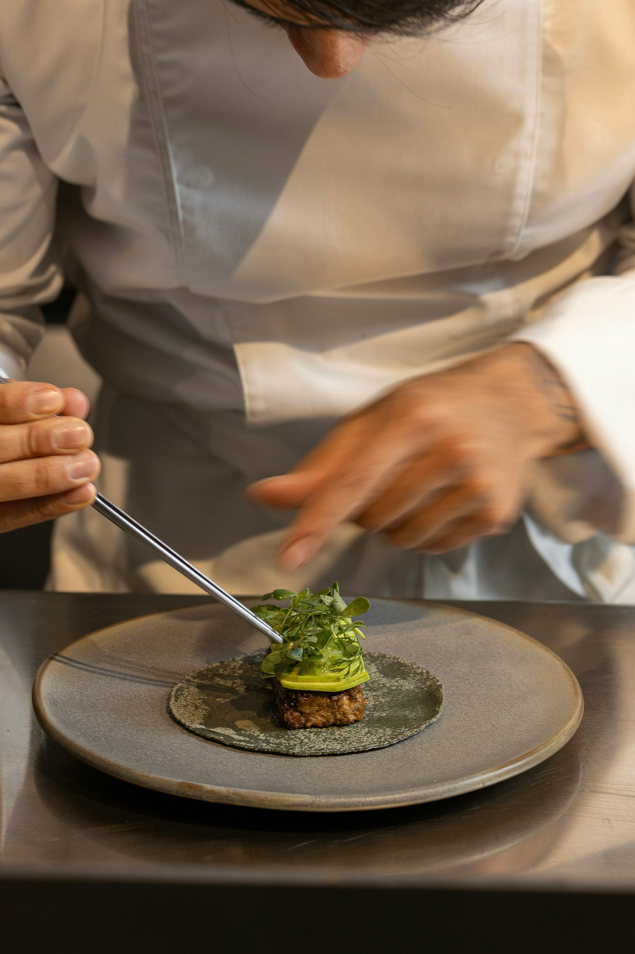

16 · LIVE DEMO
Try it on your phone
Member guest@smallafrica.demo · SmallAfrica@Guest2026
Admin admin@smallafrica.demo · SmallAfrica@Admin2026
alokwemsamuel.github.io/small-africa
Everything works with invented data, and Reset demo data puts it back.
Notes:
Invite everyone to scan the QR code. Nothing they do can break it: it runs on invented data in their own browser, and “Reset demo data” in the ribbon starts it over. The member and admin sign-ins are on screen and on the sign-in page under “Demo credentials”. Give them a minute to explore before moving on.

Slide 18
Thank you
Questions, and the next steps
1
Feedback on the demo and any changes
2
Business details: address, phone, WhatsApp, hours
3
Paystack business verification
4
Choose hosting, domain and a support package
Notes:
Thank them, then open for questions. The presentation guide (docs/PRESENTATION_GUIDE.md) lists the questions clients usually ask, with answers. Close by agreeing the four next steps on screen and who owns each one, and leave the go-live checklist with them.

