Slide 1
TmoTion
IoT Solution
Alom Walters
12/13/2016

Slide 2
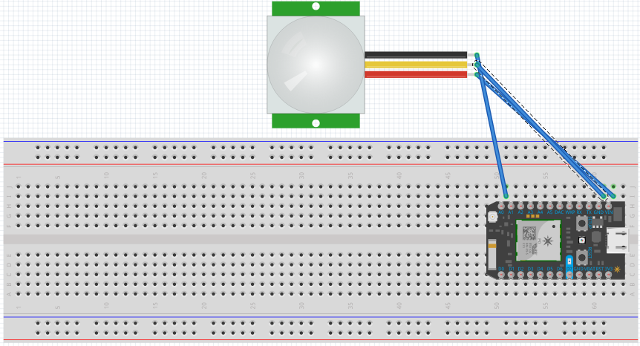
Hardware
sOFTware
Particle
IFTT
Notes:
Breadboard
PIR MOTION SENSOR
Photon
3 Jump Wires
Cellphone- receive texts
Laptop to track data
Uses-
Particle to track when motion happens in my patio- market segment use later on
IT Security class power off and on track

Slide 3
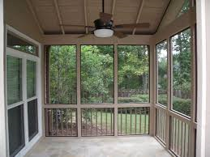
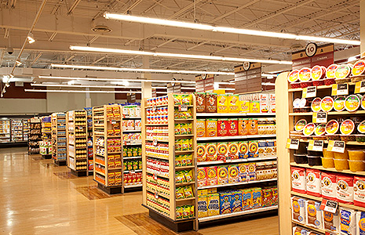

Notes:
Budget for water and TP

Slide 4
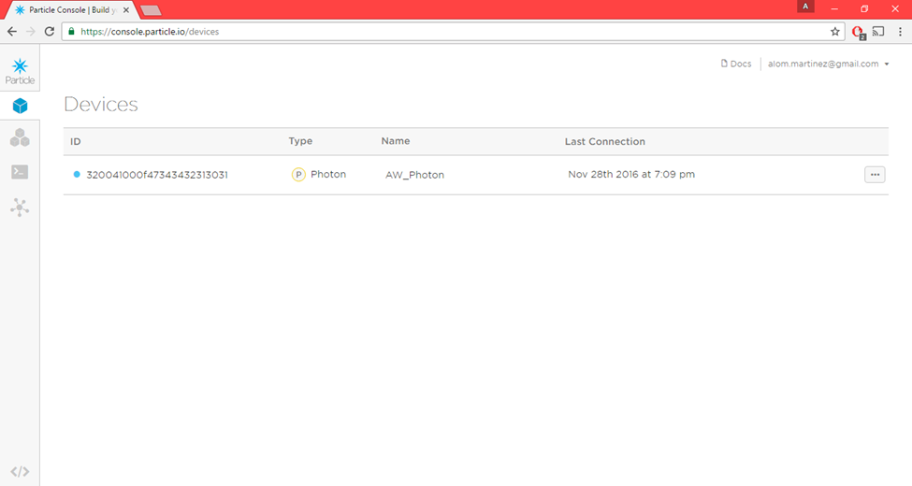

Slide 5
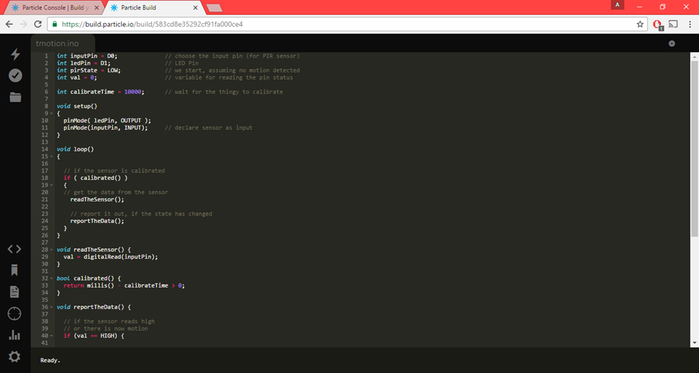

Slide 6
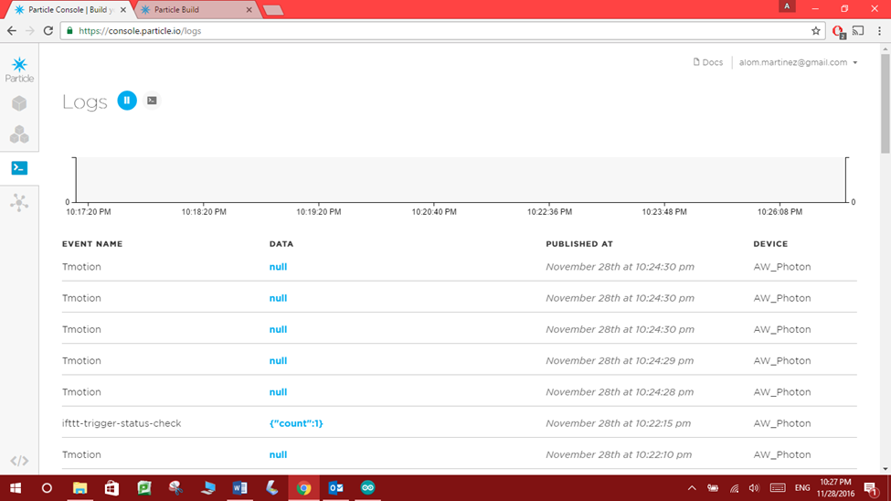
Notes:
Market Segment

Slide 7
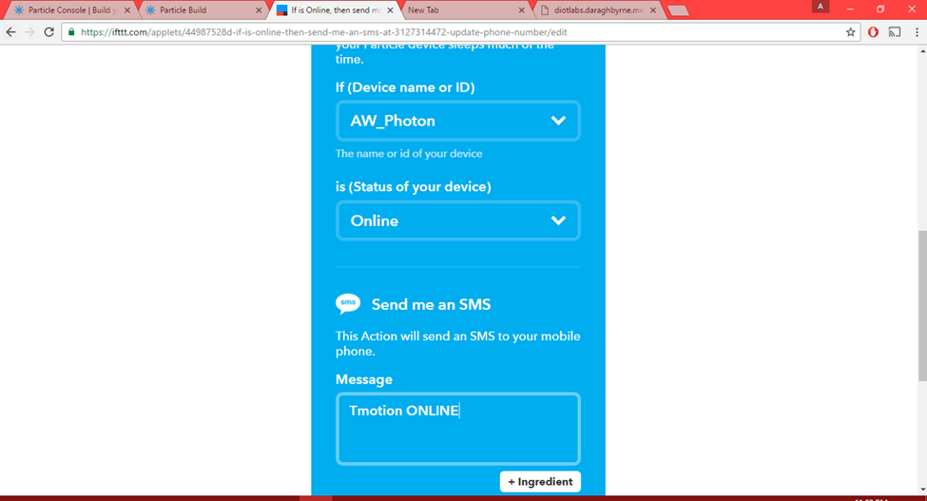

Slide 8
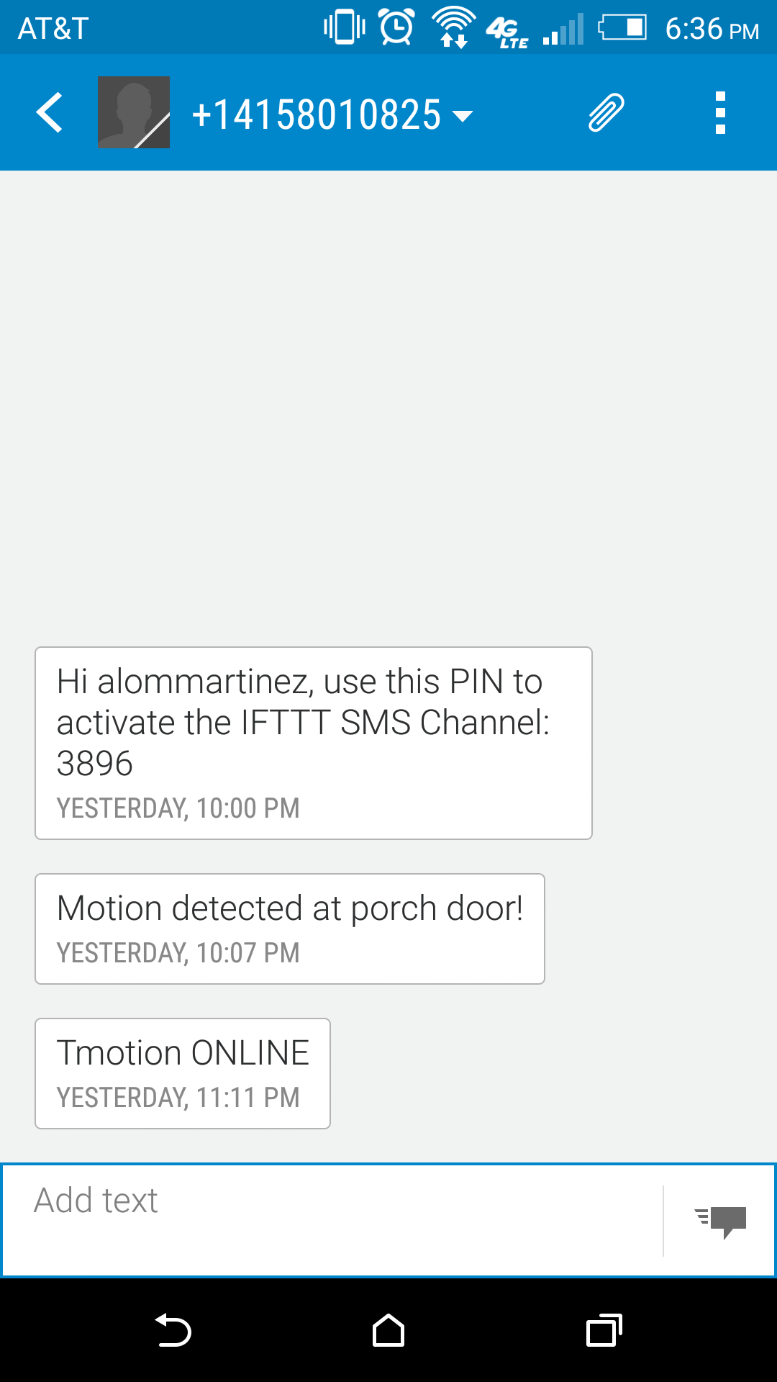
Notes:
Calm Technology

Slide 9
The System
Notes:
Cypress wi-fi chip (one that can be found in Nest Protect, LIFX, and Amazon Dash) alongside a powerful STM32 ARM Cortex M3 microcontroller
Firmware to process the chip data and to Expose a variable through the Cloud so that it can be called with GET /v1/devices/{DEVICE_ID}/{VARIABLE}. Returns a success value - true when the variable was registered.
IFTTT is a free web-based service that allows users to create chains of simple conditional statements, called "applets", which are triggered based on changes to other web services such as Gmail, Facebook, Instagram, and Pinterest
IFTTT will pull directly from the firmware that is currently flashed to your devices. It will only show functions,variables,etc from firmware that is currently flashed to one of your devices. That means that if, for example, you're trying to use the "Monitor a Function" Trigger you'll need to have flashed firmware to your board that includes spark.function().
Scalability and reliability

Slide 10
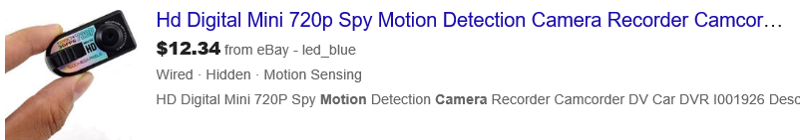
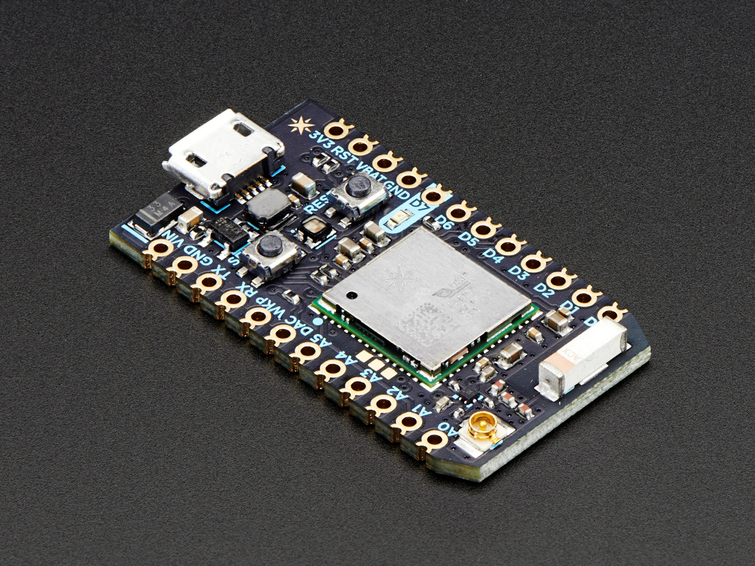
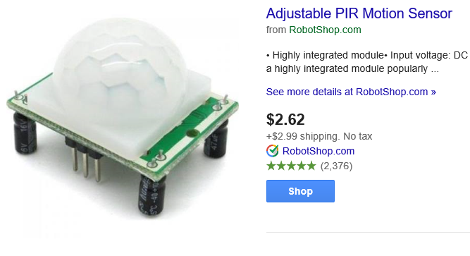
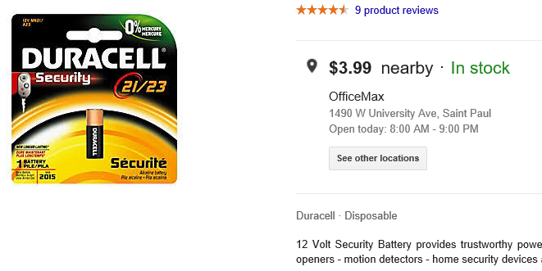
$19

Slide 11
TmoTion

