Slide 1
Progress Mar. 13
Device fingerprinting augmenting authentication

Slide 2
React App Login and Register

Slide 3
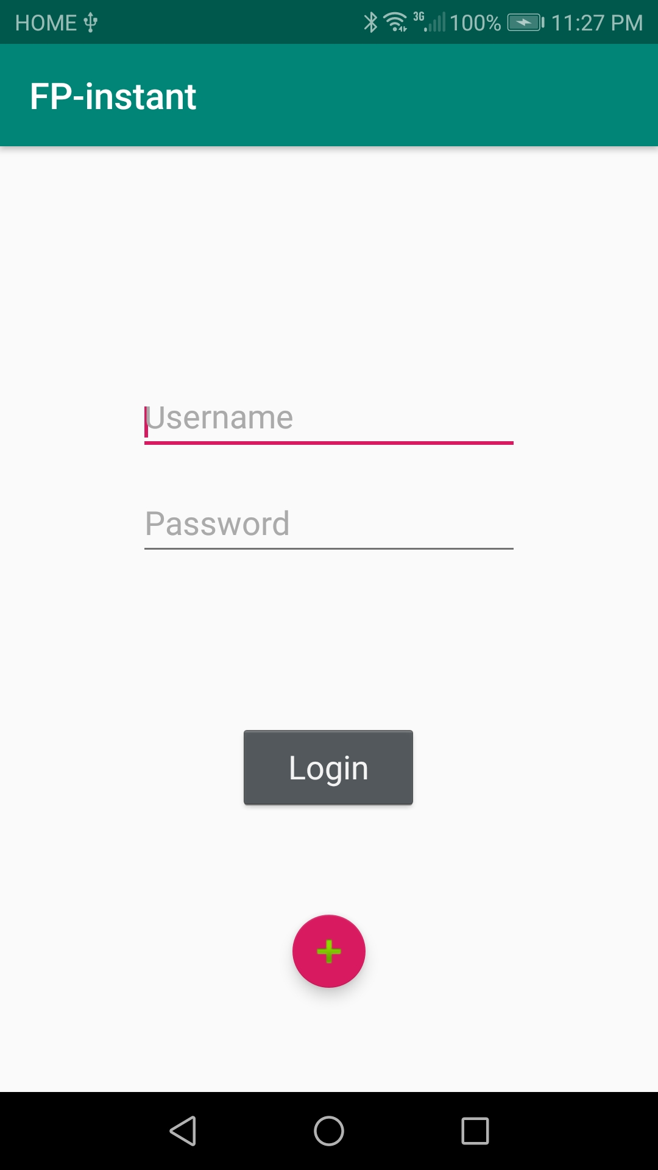
Instant App Fingerprinting

Slide 4
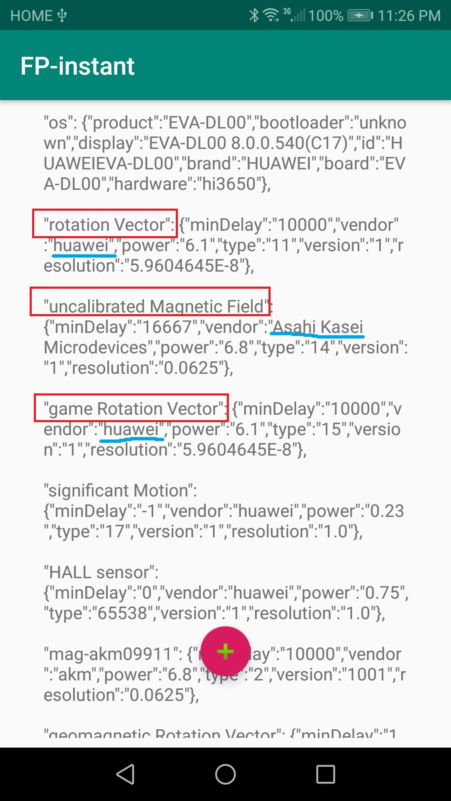
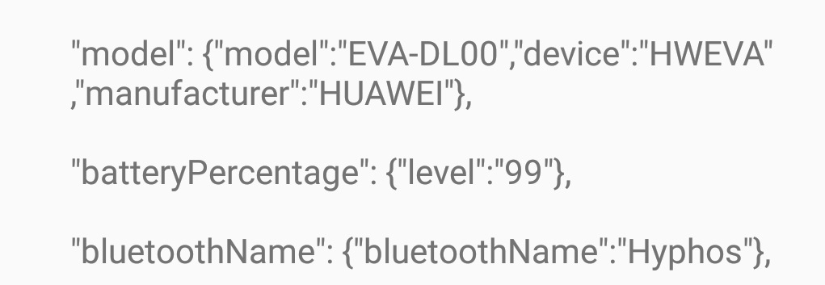
Fingerprints Grabbed

Slide 5
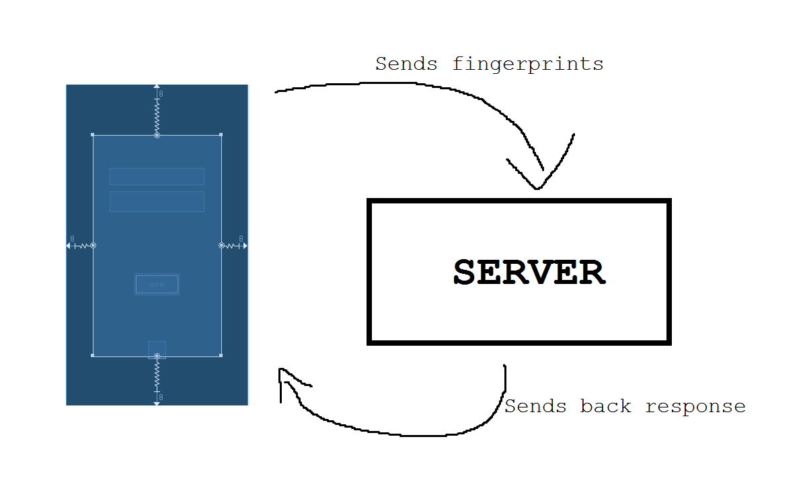
Server Interaction

Slide 6
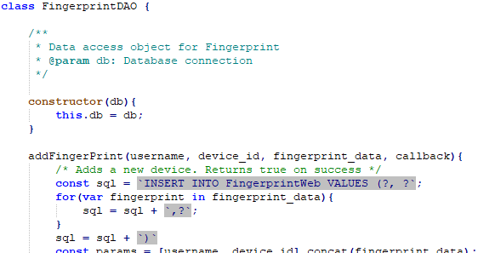
New Database Pattern
We are now using a new pattern for accessing database information called a Database Access Object (DAO)
Helps us work with the database easily with defined functions for doing things we need
One for the user, fingerprints, and the token

Slide 7
Logging in and Registering Server-side
Now our login and register API endpoints now finished
When logging in, we now authenticate the user then check the user’s fingerprints
If the fingerprints don’t match we send a token and can login using the token which then updates or creates a new device for the user

Slide 8
Sending and Receiving Tokens
We can now send tokens through email and also have our way of processing the token for logging in
When receiving the token we have the option of updating an already existing device or creating a new one with the given fingerprints
Update Device
Fingerprints Don’t Match
Send Token
Receive Token
Create new Device

Slide 9

What's in Store for Later
We will look into fingerprinting data sets so we can have an idea for weighing our fingerprints
New fingerprints to take for authentication
Linking up Instant App fingerprinting to our authentication system
Set up our server to act as an implementable API for any website
More research on harder fingerprints for thought

Slide 10
Any Questions?

