Slide 1
Progress Mar. 27
DEVICE FINGERPRINTING AUGMENTING AUTHENTICATION

Slide 2
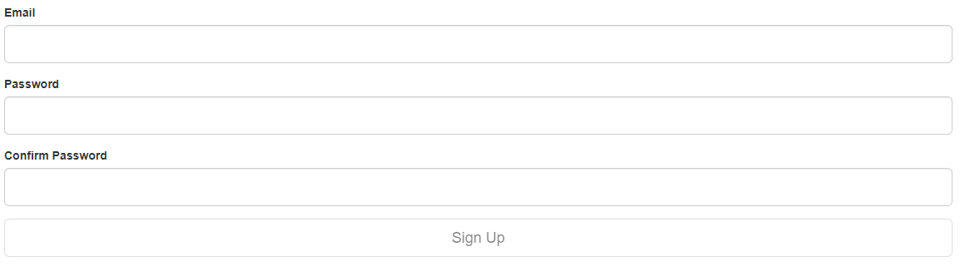
Signup
Endpoints for registering fingerprints and device

Slide 3
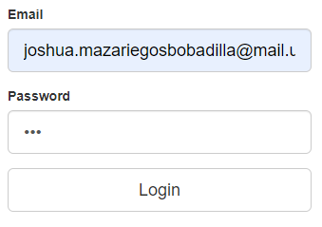
Login and Fingerprint Matcher
Will fingerprint you and try to match you to any devices you have
Has a token slot for logging you in if your fingerprints don’t match
Sends an email if your fingerprints don’t match

Slide 4

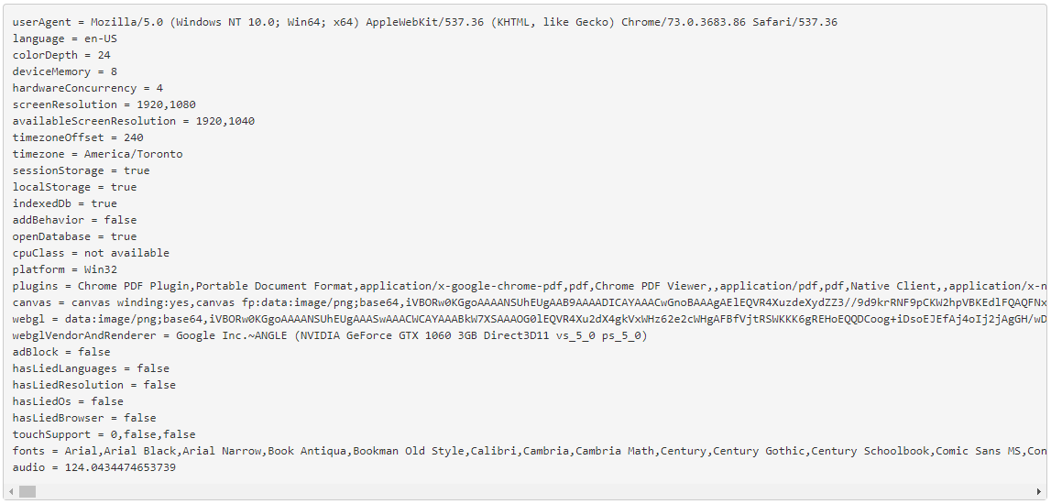
Fingerprints Display

Slide 5
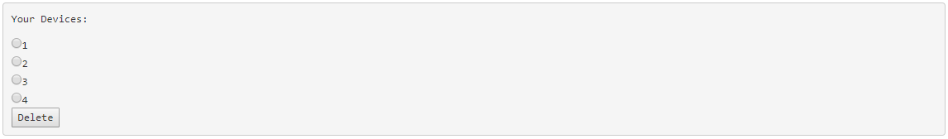
List of Devices and Deleting Them
New endpoint for displaying all devices a user has
New endpoint for deleting a chosen device from the database

Slide 6

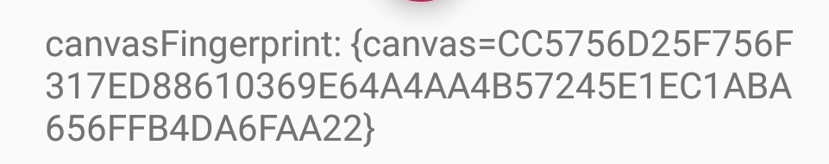
Canvas Fingerprinting
Create a bitmap
Draws shapes/text/font
Encode to a base64 string
Hashes the string
Different devices have different hashes

Slide 7
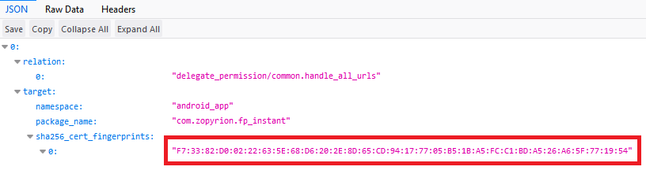
How instant app works?
Digital Assets Link at /.well-known/assetlinks.json to prove domain ownership
Declare intent in Android source code when domain is reached

Slide 8
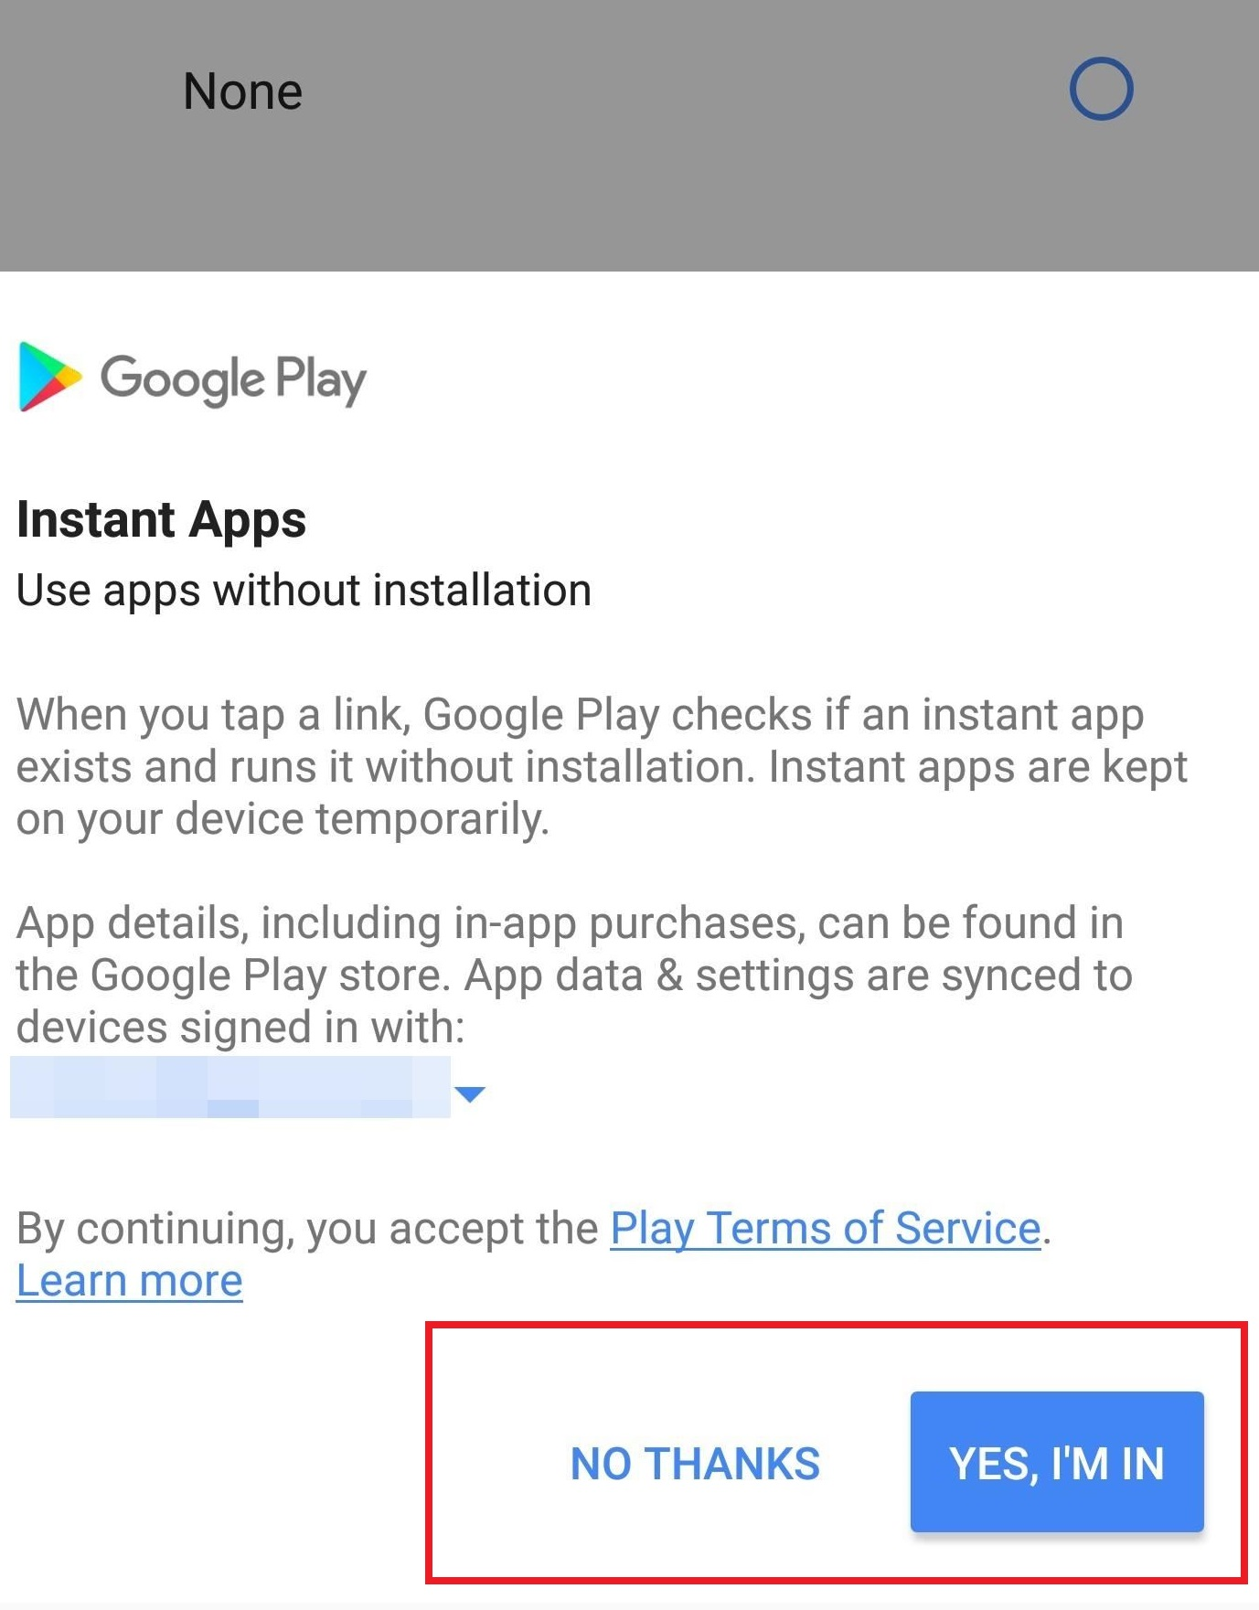

Limitations
User can disable allowing instant apps
Off by default?

Slide 9
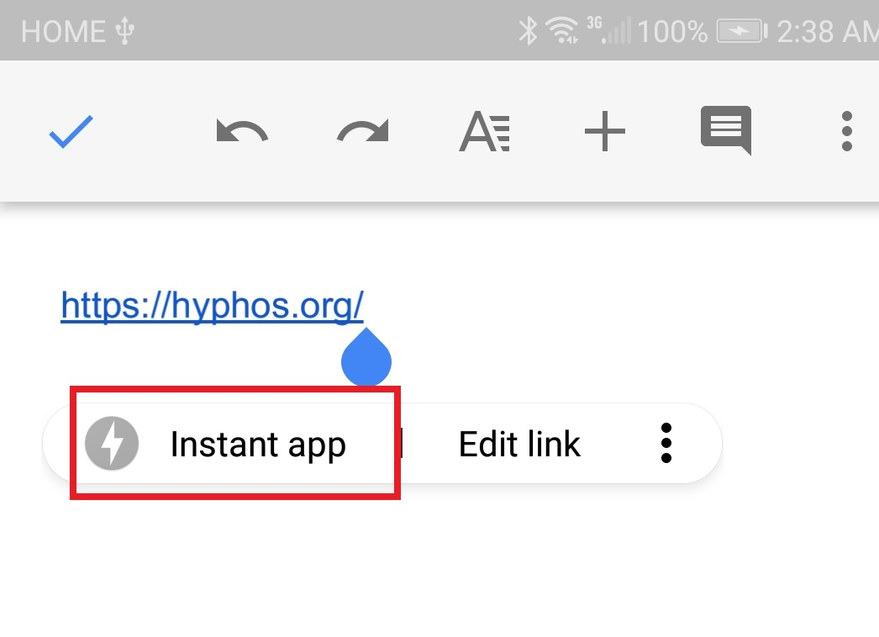
Limitations
Not available directly through the URL
Only accessible through links(text, google docs, search engines)

Slide 10
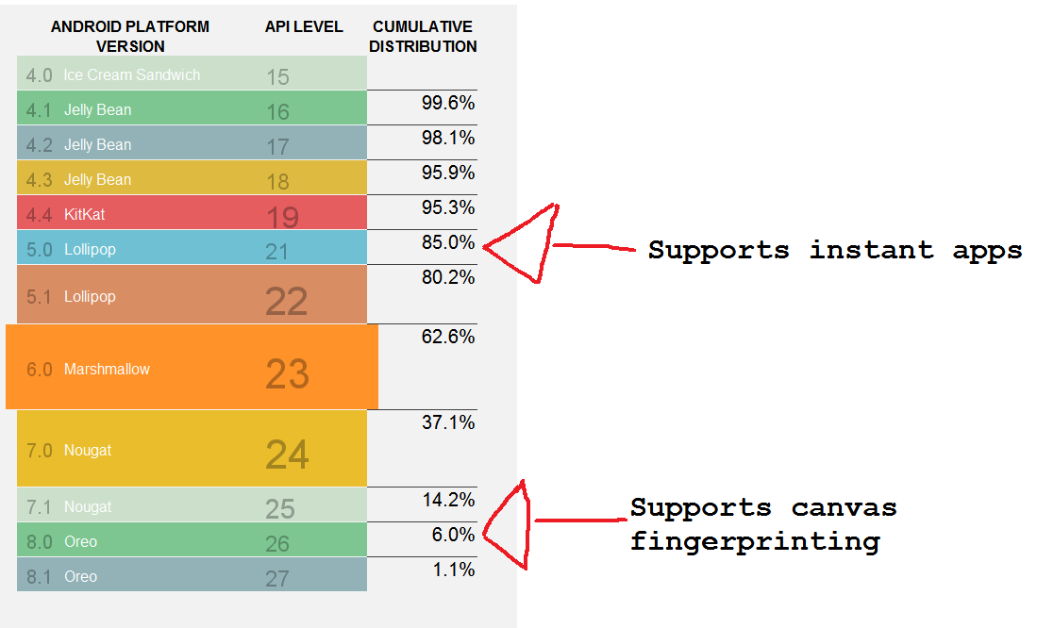
Limitations

Slide 11
Dead in 3, 2 ,1...
Google+
Google URL Shortener
Inbox
Google Glass
…
...
Google Play Instant Apps???
https://killedbygoogle.com/

Slide 12




Demo! (finally!)

Slide 13
What’s in store for now
More testing and bug fixes
Quick thing to have device names

Slide 14
Questions?

